Slide 1

PSYCH402 Social and Developmental Psychology
Person (Internal Factors)
Situation (External Factors)
A Comprehensive Academic Overview
• Personality Traits • Beliefs & Attitudes
• Social Norms • Presence of Others
Level 5 Extended Diploma in Psychology
18 Content Sessions • Social Psychology • Developmental Psychology

Slide 2





Unit Overview and Learning Outcomes
18 Content Sessions + 2 Assignment Workshops
LO3: Gender Development
Understand theories of gender development
LO1: Social Psychology Methods
Understand methodological issues and theorizing in social psychology
LO4: Adolescent Changes
Understand adolescence as a time of physiological and behavioral changes
LO2: Cognitive Development
Understand theoretical views in cognition and development
Integration Focus: Understanding the interplay between individual psychological processes and broader social and environmental influences
Each session builds upon previous concepts, fostering deep understanding and critical thinking skills

Slide 3

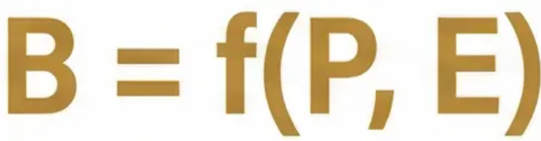


Introduction to Social Psychology: The Person-Situation Debate
Behavior = f(Person, Environment)
Person (Internal Factors)
Situation (External Factors)
• Social psychology focuses on individual psychological processes within social contexts • Our behavior is shaped by both internal factors (personality, beliefs) and external factors (social norms, presence of others) • Situational factors often have more influence than we realize in everyday judgments
Personality Traits
Social Norms Presence of Others
Beliefs & Attitudes
Empirical Methods: Correlational vs. Experimental Research
Foundational concept in social psychology research

Slide 4

Conformity: Types, Explanations, and Asch's Research
Kelman's Three Types (1958)
Psychological Explanations & Asch Study
Compliance
Why Do We Conform? (Deutsch & Gerard, 1955)
• Public change, private disagreement • Superficial and temporary • Example: Agreeing with friends about music you secretly dislike
Normative Social Influence (NSI)
• Definition: Desire to be liked and accepted • Process: Emotional - avoiding rejection • Result: Usually leads to compliance
Identification
Informational Social Influence (ISI)
• Definition: Public and private change, but temporary • Nature: Valuing group membership • Example: Army recruit adopting military values
• Definition: Desire to be right in ambiguous situations • Process: Cognitive - seeking correct information • Result: Often leads to internalization
Internalization
• Definition: Deep, permanent change in beliefs • Nature: Accepting majority view as correct • Example: Becoming vegetarian after living with vegetarians
Asch (1956): Line Judgment Study
• 32% conformed to obviously wrong answers • Demonstrated power of NSI in unambiguous situations • 75% of participants conformed at least once
Conformity occurs even when the majority is clearly wrong - highlighting the power of social pressure

Slide 5
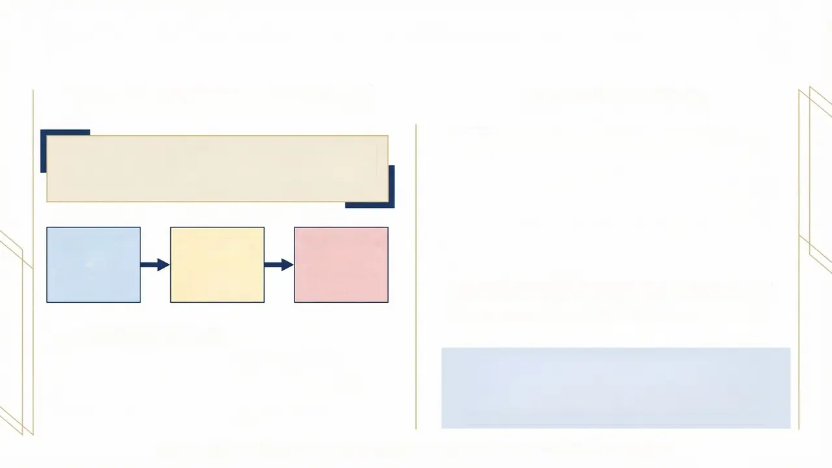
Obedience to Authority: Milgram’s Study and Ethics
Milgram's 1963 Baseline Study
The Ethical Debate
Deception: Participants misled about true purpose and shock reality
65% of participants administered maximum 450V shocks
Right to Withdraw: Authority prompts made leaving difficult
Protection from Harm: Severe psychological distress observed
Informed Consent: Could not be truly informed due to deception
• 40 male volunteers • Rigged “Teacher” role assignment • Escalating shock levels (15V to 450V) • Four standard authority prompts
Does the scientific value of understanding obedience outweigh the ethical costs to participants?
Post-experiment: 84% of participants reported being glad to have participated

Slide 6

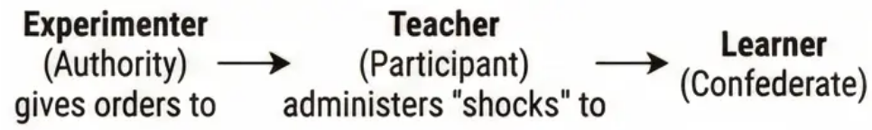
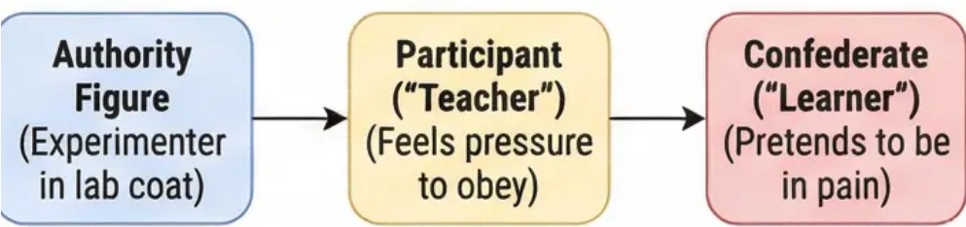
Explanations for Obedience and Resistance
Situational vs Dispositional Factors in Social Influence
What Increases Obedience?
What Enables Resistance?
Situational Variables (Milgram's Variations)
Social Support
• Proximity to victim: Closer = less obedience • Location prestige: Yale vs. office building • Authority uniform: Lab coat vs. civilian clothes
• Presence of disobedient allies • Breaking unanimity reduces pressure
Individual Differences
Theoretical Explanations
• Internal Locus of Control: “I control my fate” • High self-confidence and independence
• Agentic State: Acting as agent of authority • Legitimacy of Authority: Perceived right to command
Situational Factors
Dispositional Factor
• Questioning legitimacy of authority • Moral conviction stronger than pressure
• Authoritarian Personality: Rigid respect for authority
Research shows situation often trumps personality - ordinary people can resist or obey depending on context

Slide 7

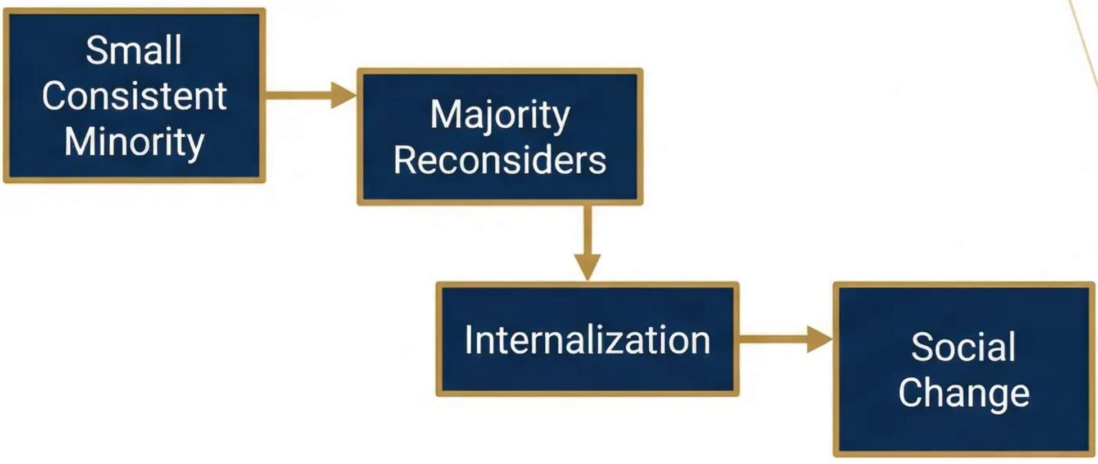



Minority Influence and Social Change
How Small Groups Create Big Changes
CONSISTENCY
Maintaining the same view over time and across group members.
COMMITMENT
Demonstrating dedication through personal sacrifices.
FLEXIBILITY
Adapting approach while maintaining core message.
Unlike conformity (compliance), minority influence creates internalization - lasting attitude change
Moscovici's Blue-Green Study (1969)
Consistent minority called blue slides “green” → 8.4% agreement vs. 1.25% for inconsistent minority

Slide 8

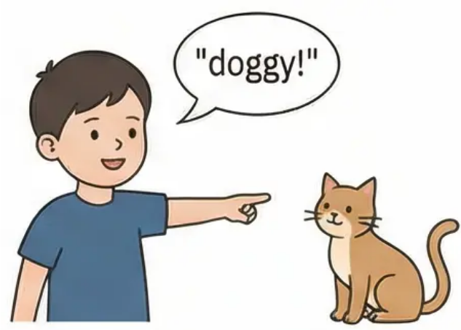
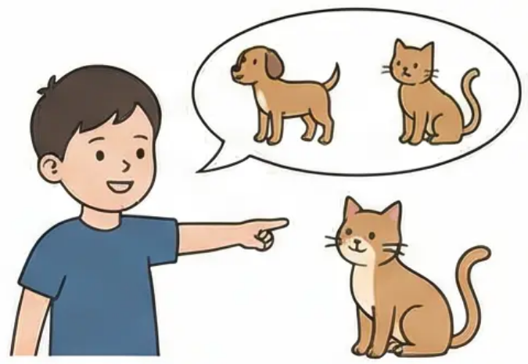
Piaget's Theory of Cognitive Development
The Child as Active Constructor of Knowledge
Fundamental Processes
• Schemas: Mental frameworks for organizing knowledge • Assimilation: Using existing schemas for new experiences • Accommodation: Modifying schemas when they don't fit • Equilibration: Maintaining cognitive balance through adaptation
Initial Developmental Stages
The Adaptation Cycle: New Experience → Disequilibrium → Accommodation → New Equilibrium
• Sensorimotor (0-2 years): Learning through senses and actions
• Preoperational (2-7 years): Symbolic thinking develops, but logical limitations remain

Slide 9

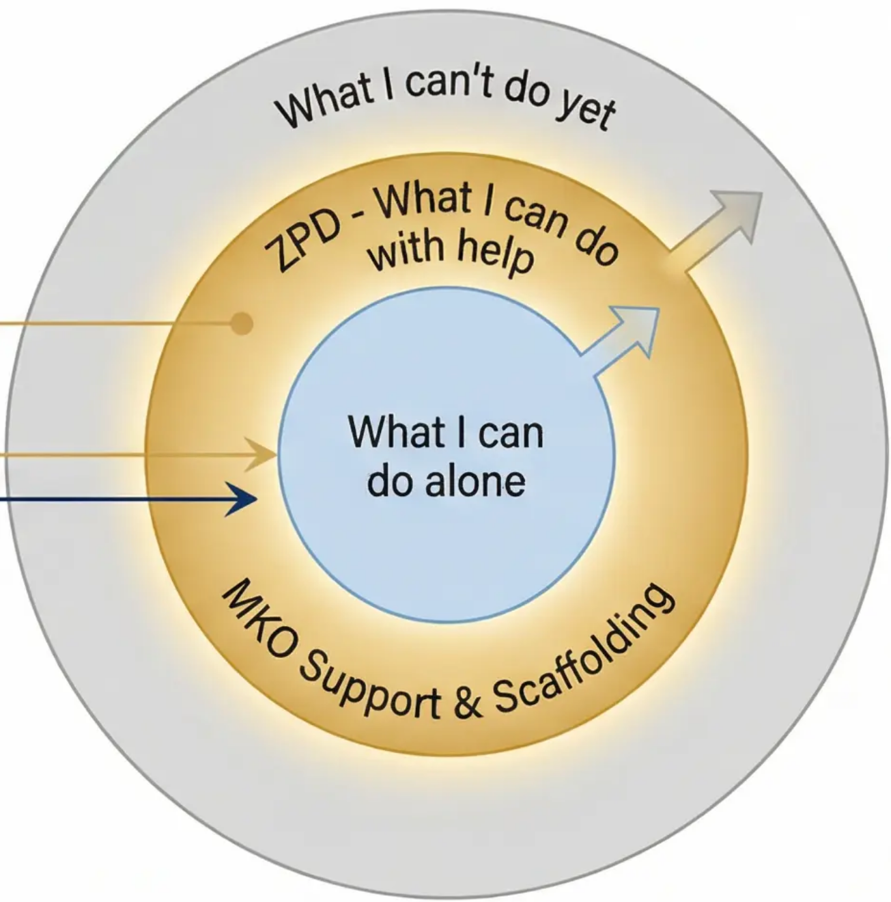
Vygotsky's Sociocultural Theory of Development
Development through Social Interaction
Zone of Proximal Development (ZPD)
The gap between what a child can do alone and what they can achieve with guidance
More Knowledgeable Other (MKO)
Skilled partner who provides support and instruction
Scaffolding
Temporary support structure that is gradually removed as competence grows
Language as a Tool
Private speech becomes internalized thought, guiding cognitive development
In Practice: A teacher provides just enough support to help a student solve a problem, then gradually reduces help as the student gains confidence.

Slide 10

Kohlberg's Stages of Moral Understanding
Three Levels of Moral Reasoning Development
Level 3: Postconventional Morality
Universal Ethical Principles
Abstract reasoning based on universal justice and human rights Example: Heinz should steal because human life transcends property rights
Level 2: Conventional Morality
Social Approval & Law and Order
Conforming to social expectations and maintaining social order Example: Heinz shouldn't steal because laws must be respected for society to function
Level 1: Preconventional Morality
The Heinz Dilemma
Punishment Avoidance & Self-Interest
Focus on personal consequences and immediate rewards Example: Heinz shouldn't steal because he'll go to prison
Should Heinz steal an expensive drug to save his dying wife?
Key Theoretical Points: • Reasoning Process > Final Decision • Universal Sequential Progression
• Universal Sequential Progression • Cognitive Development Drives Moral Growth

