Slide 1

PSYCH403 · Level 5 Extended Diploma in Psychology
Biopsychology
PSYCH403 — Academic Presentation
A comprehensive academic exploration of the biological foundations of behaviour, neural communication, brain structure and function, the endocrine system, and the biopsychological basis of psychological disorders.
20 Sessions · Level 5 Academic Standard
March 2026 | Department of Psychology
Covering all 20 curriculum sessions with comprehensive academic analysis, critical evaluation, and evidence-based content.

Slide 2



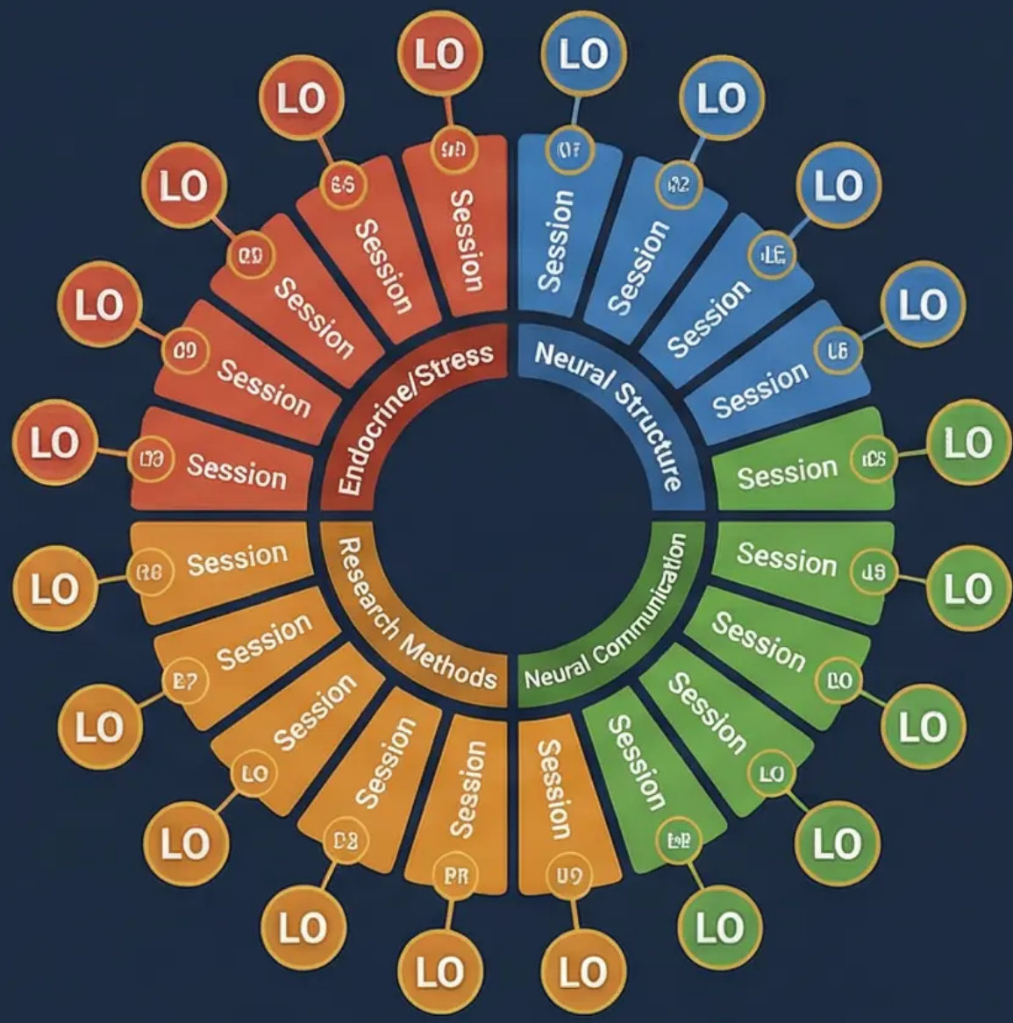

PSYCH403 · Biopsychology
Slide 2 of 20
Learning Outcomes & 20-Session Curriculum Overview
Main Content
Visual Suggestion
LO1 – Neural Structure & Function
Identify and describe major brain structures, their locations and functions; understand sensory, motor and language cortices; analyse cerebral lateralisation and hemispheric specialisation.
LO2 – Neural Communication
Explain the structure and function of sensory, motor and interneurons; describe synaptic transmission, action potentials, and the role of neurotransmitters (excitatory vs. inhibitory); evaluate psychopharmacological interventions.
LO3 – Research Methods in Neuroscience
Critically evaluate clinical, post-mortem, and neuroimaging methods (fMRI, PET, EEG, TMS); assess the strengths and limitations of each approach; apply methodological knowledge to case studies.
LO4 – Endocrine System & Stress Response
Explain the HPA axis and fight-or-flight response; evaluate the effects of chronic stress on brain structure (hippocampal atrophy); apply biopsychological models to mental health conditions.
Discussion Prompt
How do the four learning outcomes of PSYCH403 reflect the interdisciplinary nature of biopsychology? To what extent can biological explanations alone account for the full complexity of human psychological experience?

Slide 3




PSYCH403 · Biopsychology
Slide 3 of 20
Session 1: Foundations of Biopsychology
Main Content
Visual Suggestion
Definition: Biopsychology (also called behavioural neuroscience) is the scientific study of the biological bases of behaviour, cognition, and emotion. It examines how the brain, nervous system, hormones, and genetics influence psychological processes.
Timeline graphic: horizontal arrow from 'Ancient Philosophy (Mind- Body Debate)' (with Greek bust icon) → 'Phineas Gage Case (1848)' → 'Broca's Area Discovery (1861)' → 'EEG Development (1929)' → 'fMRI Era (1990s)' → 'Modern Biopsychology' (with. Each milestone shown with a small icon.
Historical Context: Originated from the mind-body debate (Descartes' dualism, 17th century) → phrenology (Gall, 1800s) → experimental neuroscience (Broca, 1861; Wernicke, 1874) → modern neuroimaging (late 20th century).
Key Case Study — Phineas Gage (1848): A railway worker who survived a tamping iron penetrating his frontal lobe. Post-injury personality changes (impulsivity, poor decision-making) provided early evidence for the biological basis of personality. Damasio (1994) revisited this case using modern neuroimaging to confirm frontal lobe involvement in social cognition.
Key Case Study — Parkinson's Disease: Loss of dopaminergic neurons in the substantia nigra causes motor symptoms (tremor, rigidity, bradykinesia). Demonstrates direct link between neurochemistry and behaviour.
Critical Evaluation: Biopsychology adopts a reductionist approach — explaining complex behaviour through biological mechanisms. Strength: scientific rigour and empirical testability. Limitation: risks ignoring social, cultural, and psychological factors (biopsychosocial model offers a more holistic alternative).
Discussion Prompt To what extent does the case of Phineas Gage support the biological determinism perspective in psychology? Critically evaluate the strengths and limitations of using case studies as evidence in biopsychological research.

Slide 4



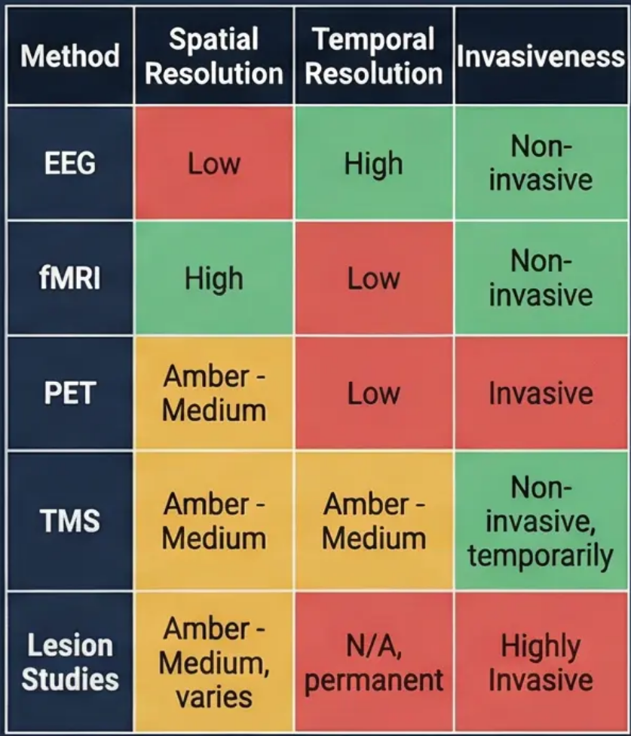

Slide 4 of 20
Session 2: Research Methods in Biopsychology
Main Content
Visual Suggestion
Post-Mortem Studies: Examination of brain tissue after death. Classic example: Broca (1861) – post-mortem analysis of Tan's brain revealed damage to left inferior frontal gyrus (Broca's area), linking it to speech production. Limitation: cannot establish causation; retrospective bias.
Lesion Studies: Deliberate or accidental damage to specific brain regions. Animal studies (e.g., Lashley's maze experiments) and human case studies (Gage, H.M.) provide localisation evidence. Limitation: ethical concerns; individual variability.
EEG (Electroencephalography): Measures electrical activity via scalp electrodes. High temporal resolution; used in sleep research and epilepsy diagnosis. Limitation: poor spatial resolution; cannot identify deep brain structures.
fMRI (Functional MRI): Measures BOLD (Blood Oxygen Level Dependent) signal as proxy for neural activity. High spatial resolution; non-invasive. Limitation: poor temporal resolution; expensive; measures blood flow not direct neural firing.
PET Scans: Radioactive tracer reveals metabolic activity. Used to study neurotransmitter systems. Limitation: invasive (radiation); low temporal resolution.
TMS (Transcranial Magnetic Stimulation): Creates temporary 'virtual lesions' to establish causal relationships. Limitation: limited depth penetration; ethical considerations.
Critical Evaluation: No single method is sufficient. Converging evidence from multiple methods (triangulation) provides the most reliable conclusions. Ethical issues in animal research (3Rs: Replace, Reduce, Refine).
Discussion Prompt
Critically evaluate the use of neuroimaging techniques such as fMRI in biopsychological research. To what extent do these methods provide valid and reliable evidence for the localisation of brain function?

Slide 5




PSYCH403 · Biopsychology
Slide 5 of 20
Session 3: Organisation of the Nervous System
Main Content
Visual Suggestion
Definition & Scope: The nervous system is the body's primary communication network, divided into the Central Nervous System (CNS: brain + spinal cord) and the Peripheral Nervous System (PNS: all nerves outside the CNS).
Hierarchical diagram of the nervous system: CNS (brain + spinal cord) at top, branching to PNS (somatic + autonomic), further branching to sympathetic and parasympathetic. Use colour-coding: blue for CNS, green for somatic, somatic, red for sympathetic, teal for parasympathetic.
CNS Functions: Processes and integrates sensory information; coordinates voluntary and involuntary responses; seat of consciousness, cognition, and emotion.
PNS Divisions: Somatic nervous system (voluntary control of skeletal muscles; afferent/efferent pathways) vs. Autonomic nervous system (involuntary control of internal organs — sympathetic & parasympathetic branches).
Key Study: Damasio (1994) — Phineas Gage case demonstrates how CNS damage (frontal lobe) profoundly alters personality and decision-making, evidencing the biological basis of behaviour.
Critical Evaluation: Reductionist approaches risk oversimplifying complex behaviours to neural pathways alone; holistic perspectives (biopsychosocial model) offer more comprehensive explanations.
Discussion Prompt
To what extent does the division of the nervous system into distinct branches reflect the complexity of human behaviour? Critically evaluate whether a purely biological model of the nervous system is sufficient to explain psychological disorders such as PTSD.

Slide 6



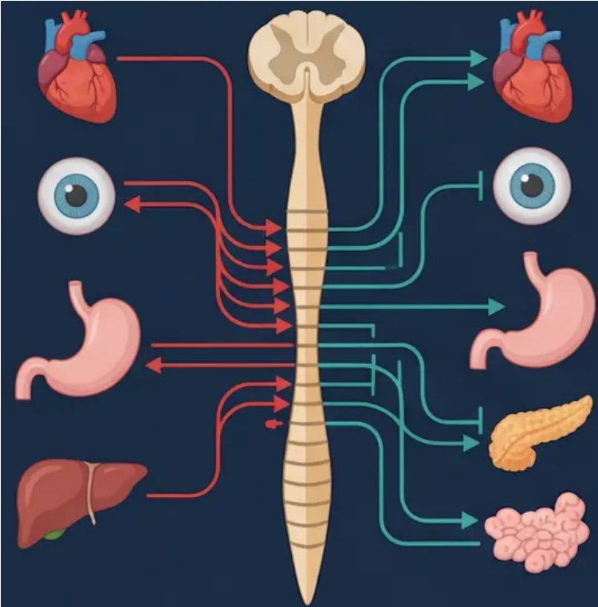
PSYCH403 · Biopsychology
Slide 6 of 20
Session 4: The Autonomic Nervous System
Main Content
Visual Suggestion
• Definition: The ANS is a division of the PNS that regulates involuntary physiological processes (heart rate, digestion, respiration, glandular secretion). It operates largely below conscious awareness.
Split diagram: left side (red) shows sympathetic effects on body organs (heart ↑, pupils dilate, digestion ↓); right side (teal) shows parasympathetic effects (heart ↓, pupils constrict, digestion ↑). Central spinal cord connects both. Arrows show opposing effects.
• Sympathetic Branch — "Fight or Flight": Activated by perceived threat (amygdala → hypothalamus → adrenal medulla → adrenaline/noradrenaline release). Physiological effects: anemosiatriccs: increased heart rate, dilated pupils, bronchodilation, inhibited digestion, glucose release from liver. Evolutionary function: prepares organism for immediate action.
• Parasympathetic Branch — "Rest and Digest": Dominant during calm states. Conserves energy and promotes recovery. Effects: decreased heart rate, constricted pupils, stimulated digestion, increased glandular secretion. Neurotransmitter: acetylcholine (vs. noradrenaline in sympathetic).
• Homeostasis: The two branches work antagonistically to maintain internal equilibrium. Dysregulation is implicated in anxiety disorders, PTSD, and cardiovascular disease.
• Key Study — Cannon (1932): Coined "fight-or-flight" response; demonstrated sympathetic activation in cats exposed to threat. Selye (1956) extended this to the General Adaptation Syndrome (GAS) model.
• Critical Evaluation: The fight-or-flight model is criticised for being androcentric (Taylor et al., 2000 proposed "tend-and-befriend" response more common in females). Cultural and individual differences in ANS reactivity challenge universal biological models.
Discussion Prompt: To what extent does the fight-or-flight response provide a complete explanation of the human stress response? Critically evaluate Taylor et al.'s (2000) "tend-and-befriend" hypothesis as an alternative biological model.

Slide 7




PSYCH403 · Biopsychology
Slide 7 of 20
Session 5: The Spinal Cord & Reflex Arc
Main Content
Visual Suggestion
Spinal Cord Structure: Extends from the brainstem to the lumbar region. Cross-section reveals: • Grey matter (H-shaped core) – contains cell bodies, dendrites, interneurons; site of local processing. • White matter (surrounding) – myelinated axon tracts carrying ascending (sensory) and descending (motor) signals.
Cross-section diagram of spinal cord showing grey matter (H-shape, labelled) and white matter (outer ring). Alongside: reflex arc diagram showing 5 steps (receptor → sensory neuron → interneuron → motor neuron → effector) with numbered arrows. Colour: grey matter in grey, white matter in white/blue.
Ascending Tracts: Carry sensory information (pain, temperature, touch, proprioception) from body to brain. Key tracts: spinothalamic tract (pain/temperature), dorsal column-medial lemniscal pathway (fine touch/proprioception).
Descending Tracts: Carry motor commands from brain to muscles. Key tracts: corticospinal tract (voluntary movement), reticulospinal tract (posture/reflexes).
Reflex Arc Mechanism: A rapid, involuntary neural pathway that bypasses the brain for immediate protective responses. Components: Stimulus → Sensory receptor → Afferent (sensory) neuron → Interneuron (spinal cord) → Efferent (motor) neuron → Effector (muscle/gland). Example: Knee-jerk reflex (monosynaptic); withdrawal reflex (polysynaptic).
Adaptive Significance: Reflexes allow immediate protective responses (e.g., withdrawing from pain) without waiting for cortical processing – reduces reaction time from ~200ms to ~50ms.
Clinical Relevance: Spinal cord injuries disrupt ascending/descending tracts, causing paralysis or sensory loss below the injury level. Spinal shock, spasticity, and autonomic dysreflexia are key clinical consequences.
Discussion Prompt
How does the existence of spinal reflexes challenge the assumption that all behaviour is controlled by the brain? Discuss the implications of spinal cord injury research for our understanding of the relationship between neural structure and voluntary behaviour.

Slide 8




PSYCH403 · Biopsychology
Slide 8 of 20
Session 6: Neurons & Neural Communication
Main Content
Visual Suggestion
Neuron Structure: The neuron is the basic functional unit of the nervous system. Key components: Cell body (soma) – contains nucleus and organelles; Dendrites – receive incoming signals from other neurons; Axon – transmits electrical impulses away from soma; Myelin sheath – fatty insulation (produced by Schwann cells in PNS, oligodendrocytes in CNS) that speeds conduction via saltatory conduction; Axon terminals – release neurotransmitters into synapse.
Detailed neuron diagram labelling: soma, dendrites, axon, myelin sheath, nodes of Ranvier, axon terminals. Below: action potential graph showing voltage (mV) vs time – resting potential (-70mV), threshold (-55mV), depolarisation peak (+40mV), repolarisation, hyperpolarisation.
Types of Neurons: Sensory (afferent) – carry signals from receptors to CNS; Motor (efferent) – carry commands from CNS to muscles/glands; Interneurons – connect neurons within CNS; account for the vast majority.
Resting Potential: Neuron at rest maintains -70mV charge (inside negative relative to outside) due to Na⁺/K⁺ pump and selective permeability. This electrochemical gradient is essential for signal generation.
Action Potential: All-or-nothing electrical impulse. Threshold: -55mV. Depolarisation: Na⁺ rushes in → membrane reaches +40mV. Repolarisation: K⁺ rushes out → returns to resting potential.
Synaptic Transmission: Electrical signal → vesicles release neurotransmitters → diffuse across synaptic cleft → bind to postsynaptic receptors → EPSP (excitatory) or IPSP (inhibitory). Reuptake, enzymatic degradation, or diffusion terminates the signal.
Key Study – Hodgkin & Huxley (1952): Nobel Prize-winning work using squid giant axon to describe the ionic basis of the action potential. Foundational to all subsequent neuroscience.
Discussion Prompt
How does the all-or-nothing principle of the action potential challenge the idea that neural signals can vary in strength? Evaluate the significance of Hodgkin and Huxley's (1952) research for our understanding of neural communication and its implications for psychopharmacology.

Slide 9



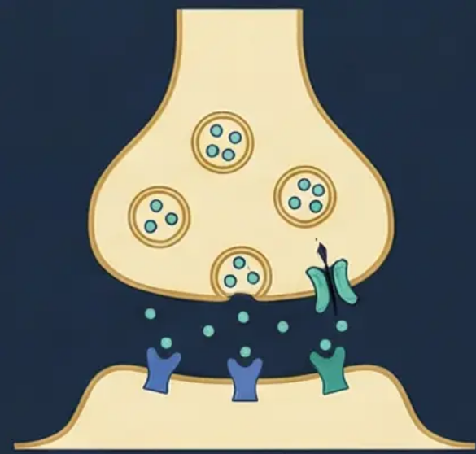
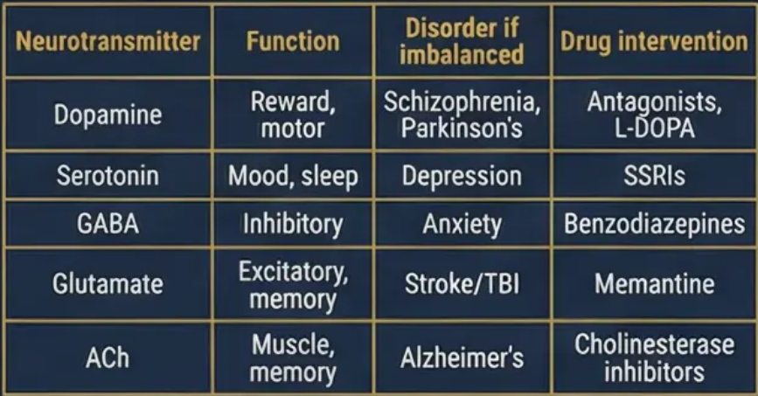

PSYCH403 · Biopsychology
Slide 9 of 20
Session 7: Neurotransmitters & Synaptic Transmission
Main Content
Visual Suggestion
Definition: Neurotransmitters are chemical messengers released from presynaptic terminals that bind to postsynaptic receptors to either excite or inhibit the target neuron. Over 100 neurotransmitters identified.
Key Neurotransmitters: ○ Dopamine: Reward, motivation, motor control. Implicated in schizophrenia (excess) and Parkinson's (deficit). Mesolimbic pathway = reward; nigrostriatal pathway = movement.
○ Serotonin (5-HT): Mood regulation, sleep, appetite. Low levels linked to depression. SSRIs (e.g., fluoxetine) block reuptake to increase availability.
○ GABA (γ-aminobutyric acid): Primary inhibitory neurotransmitter. Reduces neural excitability. Benzodiazepines enhance GABA activity → anxiolytic effect.
○ Glutamate: Primary excitatory neurotransmitter. Essential for learning and memory (LTP). Excess linked to excitotoxicity in stroke/TBI.
○ Acetylcholine (ACh): Muscle contraction, memory, attention. Deficit in Alzheimer's disease. Nicotine mimics ACh at nicotinic receptors.
○ Noradrenaline: Arousal, attention, fight-or-flight. Implicated in PTSD and depression.
Agonists vs. Antagonists: Agonists mimic neurotransmitter action (e.g., morphine = opioid agonist). Antagonists block receptors (e.g., haloperidol = dopamine antagonist used in schizophrenia).
Critical Evaluation: The monoamine hypothesis of depression (low serotonin/noradrenaline) is oversimplified – SSRIs work in weeks despite immediate serotonin increase, suggesting neuroplasticity mechanisms are involved (Cowen, 2008).
Discussion Prompt
To what extent does the dopamine hypothesis provide a satisfactory explanation for schizophrenia? Critically evaluate the evidence for and against the role of neurotransmitter imbalance in the aetiology of mental health disorders.

Slide 10




PSYCH403 · Biopsychology
Slide 10 of 20
Session 8: Brain Divisions & Key Structures
Main Content
Visual Suggestion
Hindbrain (Rhombencephalon): Evolutionarily oldest region. Medulla oblongata – controls vital autonomic functions (breathing, heart rate, blood pressure); damage is fatal. Pons – relay station between cerebellum and cortex; involved in sleep regulation. Cerebellum – coordinates movement, balance, and procedural learning; contains more neurons than rest of brain combined.
Sagittal brain cross-section with colour-coded regions: hindbrain (blue), midbrain (purple), forebrain (gold) (labels pointing to: medulla, pons, cerebellum, thalamus, hypothalamus, amygdala, hippocampus, cerebral cortex. Inset: limbic system highlighted in teal.
Midbrain (Mesencephalon): Small but critical region. Superior/inferior colliculi – process visual and auditory reflexes. Substantia nigra – dopaminergic neurons controlling movement; degeneration causes Parkinson's disease. Reticular activating system (RAS) – regulates arousal and consciousness.
Forebrain (Prosencephalon): Most evolutionarily advanced. Thalamus – sensory relay station ("gateway to cortex"); all sensory information (except olfaction) passes through. Hypothalamus – regulates homeostasis (temperature, hunger, thirst, circadian rhythms); controls pituitary gland (master endocrine gland). Basal ganglia – motor control, habit formation, reward processing. Cerebral cortex – higher cognitive functions (language, reasoning, planning, consciousness).
Limbic System: Amygdala – fear conditioning, emotional memory, threat detection; hyperactivation in PTSD. Hippocampus – spatial navigation and memory consolidation; atrophies under chronic stress (Sapolsky, 1996). Cingulate cortex – emotion regulation, conflict monitoring.
Key Study – H.M. (Henry Molaison): Bilateral hippocampal removal to treat epilepsy resulted in severe anterograde amnesia – unable to form new declarative memories. Demonstrated hippocampus is essential for memory consolidation (Scoville & Milner, 1957).
Discussion Prompt
Using the case of H.M. (Henry Molaison), critically evaluate what the study of brain-damaged patients reveals about the localisation of memory function. What are the methodological and ethical limitations of using such case studies as evidence?

Slide 11



Session 9: The Limbic System — Emotion & Memory
Main Content
Main Content
Main Content
Main Content
Main Content
Main Content
Main Content
Main Content
Main Content
Main Content
Main Content
Main Content
Main Content
Main Content
Main Content
Main Content
Main Content
Main Content
Main Content
Main Content
Main Content
Main Content
Main Content
Main Content
Main Content
Main Content
Main Content
Main Content
Main Content
Main Content
Main Content
Main Content
Main Content
Main Content
Main Content
Main Content
Main Content
Main Content
Main Content
Main Content
Main Content
Main Content
Main Content
Main Content
Main Content
Main Content
Main Content
Main Content
Main Content
Main Content
Main Content
Main Content
Main Content
Main Content
Main Content
Main Content
Main Content
Main Content
Main Content
Main Content
Main Content
Main Content
Main Content
Main Content
Main Content

Slide 12



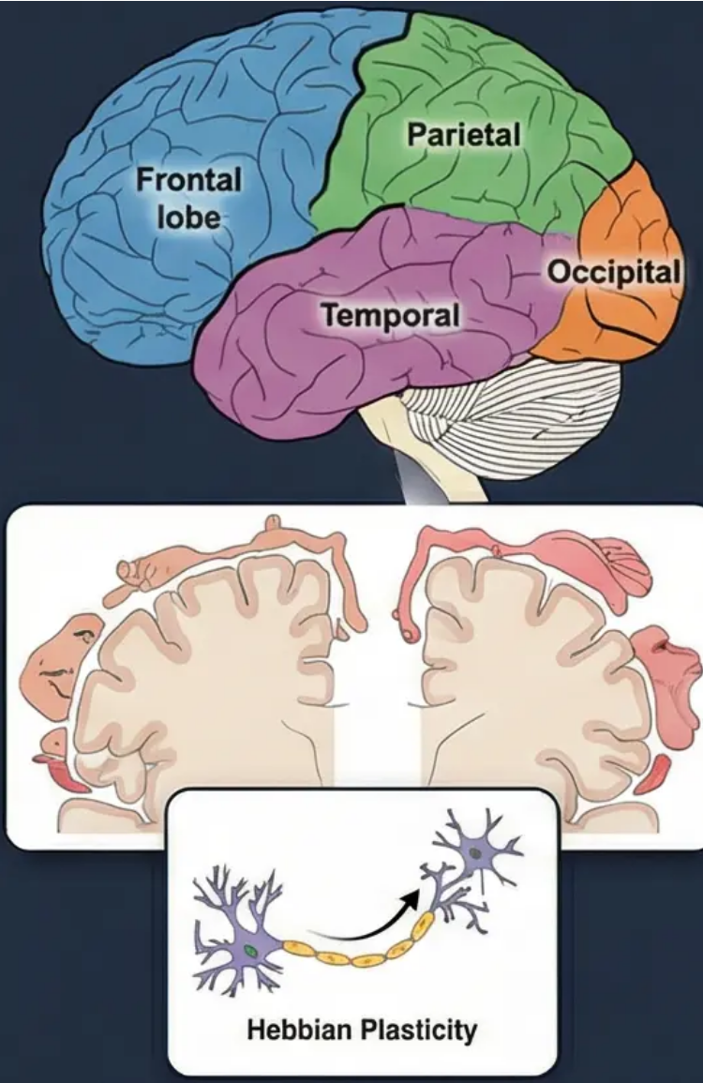
PSYCH403 · Biopsychology
Slide 12 of 20
Session 10: Cortical Localisation & Neuroplasticity
Main Content
Visual Suggestion
• Localisation of Function: The theory that specific brain regions are responsible for specific functions. Evidence: Broca (1861) — speech production in left inferior frontal gyrus; Wernicke (1874) — language comprehension in left superior temporal gyrus; Penfield's cortical mapping (1950s) using electrical stimulation during surgery.
• The Four Lobes: - Frontal lobe: Executive functions (planning, decision-making, impulse control), voluntary motor control (primary motor cortex), Broca's area (speech production), personality. - Parietal lobe: Somatosensory processing (primary somatosensory cortex), spatial awareness, body image. - Temporal lobe: Auditory processing, language comprehension (Wernicke's area), memory (hippocampus), face recognition (fusiform face area). - Occipital lobe: Visual processing (primary visual cortex V1); damage causes cortical blindness.
• The Homunculus: Penfield & Rasmussen (1950) mapped the somatosensory and motor cortices. The cortical representation is disproportionate — areas with greater sensory/motor precision (hands, lips, tongue) have larger cortical representation. Demonstrates functional organisation of cortex.
• Holism vs. Localisation Debate: Lashley (1929) — equipotentiality and mass action principles suggest the cortex functions as a whole. Modern view: distributed processing with specialised hubs (network neuroscience).
• Neuroplasticity: The brain's ability to reorganise synaptic connections in response to experience, learning, or injury. Hebbian learning: “neurons that fire together, wire together.” Examples: London taxi drivers (Maguire et al., 2000) — enlarged posterior hippocampus; phantom limb pain — cortical remapping; stroke recovery — adjacent areas compensate.
Critically evaluate the debate between localisation of function and holism in explaining brain organisation. Using evidence from neuroimaging studies and case studies of brain damage, assess the extent to which the brain operates as a collection of specialised modules or as an integrated whole.

Slide 13


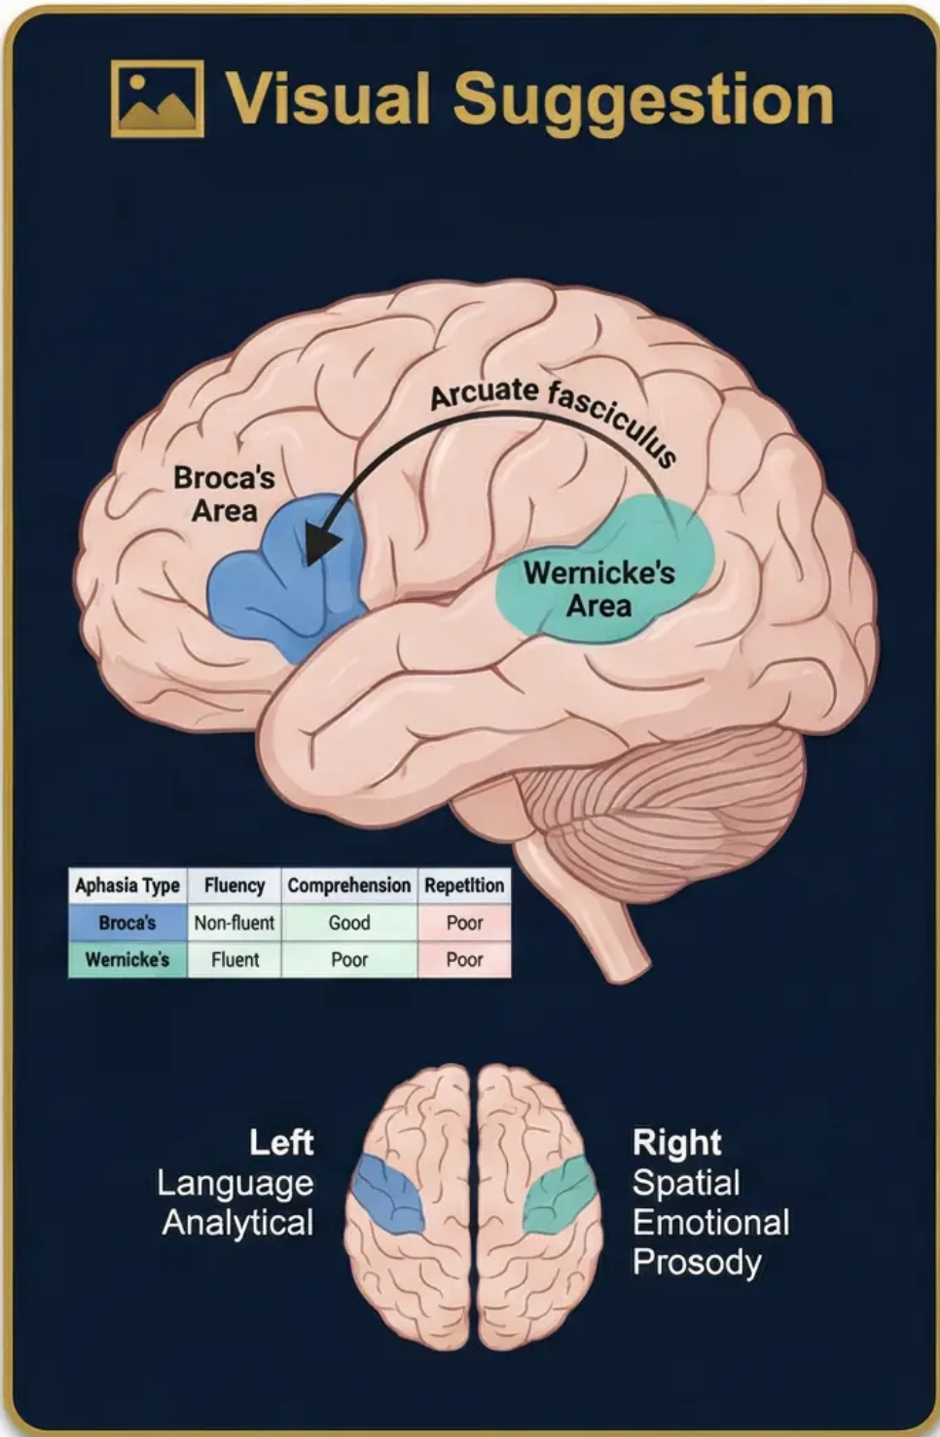
PSYCH403 · Biopsychology
Slide 13 of 20
Session 11: Language & Cerebral Lateralisation
Main Content
• Broca's Area (Left IFG): Paul Broca (1861) — patient "Tan" could only say "tan" despite intact comprehension. Post-mortem revealed damage to left inferior frontal gyrus. Broca's aphasia: non-fluent, effortful speech; telegraphic output; comprehension relatively preserved. Demonstrates production-specific language processing.
• Wernicke's Area (Left STG): Carl Wernicke (1874) — patients produced fluent but meaningless speech ("word salad"). Damage to left superior temporal gyrus. Wernicke's aphasia: fluent but semantically empty speech; poor comprehension. Demonstrates comprehension-specific processing.
• Wernicke-Geschwind Model: Language circuit: Wernicke's area (comprehension) → arcuate fasciculus → Broca's area (production). Conduction aphasia results from arcuate fasciculus damage — intact comprehension and production but impaired repetition.
• Cerebral Lateralisation: Left hemisphere: language, analytical reasoning, sequential processing, right- hand control. Right hemisphere: spatial processing, face recognition, emotional prosody, holistic processing, left-hand control. Established via Wada test (sodium amobarbital injection to anaesthetise one hemisphere).
• Debunking Myths: The "left-brain/right-brain" personality myth is not supported by neuroscience. Nielsen et al. (2013) — fMRI study of 1,000 participants found no evidence of dominant hemisphere for personality traits. Complex tasks require bilateral integration via corpus callosum.
• Individual Differences: ~95% of right-handers are left-hemisphere dominant for language; ~70% of left- handers also show left dominance. Atypical lateralisation associated with dyslexia and schizophrenia.
To what extent does the Wernicke-Geschwind model provide a complete account of language processing in the brain? Critically evaluate the evidence from aphasia research and modern neuroimaging studies, considering the role of both hemispheres in language.

Slide 14



PSYCH403 • Biopsychology
Slide 14 of 20
Session 12: Split-Brain Research — Sperry & Gazzaniga
Main Content
Visual Suggestion
• Background: Corpus callosotomy (surgical severing of the corpus callosum) was performed to treat severe epilepsy. This created "split-brain" patients whose two hemispheres could no longer communicate directly. Sperry & Gazzaniga (1960s) used these patients to investigate hemispheric specialisation.
Diagram of split-brain experiment: patient fixating on central point, 'APPLE' shown to left visual field, 'SPOON' to right. Left hemisphere (speech) says 'spoon'; right hand picks up spoon; left hand (right hemisphere) picks up apple. Corpus callosum shown as severed. Arrows show visual pathways.
• Experimental Procedure: Stimuli presented to one visual field are processed by the contralateral hemisphere. Left visual field → right hemisphere; right visual field → left hemisphere. Patients fixate on a central point; stimuli flashed briefly to prevent eye movement.
• Key Findings:
• Right visual field (left hemisphere): Patient can verbally name the object — confirms left hemisphere language dominance.
• Left visual field (right hemisphere): Patient cannot name the object but can select it with the left hand — confirms right hemisphere spatial processing.
• Chimeric faces: Right hemisphere better at face recognition; left hemisphere better at verbal labelling.
• Emotional stimuli: Right hemisphere processes emotional content; left hemisphere provides verbal rationalisations.
• The Left Hemisphere Interpreter: Gazzaniga (1998) proposed that the left hemisphere constructs post-hoc narratives to explain behaviour, even when the true cause is unknown. This has profound implications for theories of consciousness and free will.
• Implications for Consciousness: Split-brain research suggests consciousness may not be unified — two separate streams of awareness can exist in one skull. Challenges the concept of a single, unified self.
• Critical Evaluation: Small sample sizes (N=11 in original studies); patients had pre-existing epilepsy affecting brain organisation; modern fMRI studies of split-brain patients show some cross-hemispheric communication via subcortical pathways (Volz et al., 2017).
How does split-brain research challenge our understanding of consciousness and the unified self? Critically evaluate the methodological limitations of Sperry and Gazzaniga's studies and consider what their findings reveal about the nature of human consciousness.

Slide 15



PSYCH403 · Biopsychology
Slide 15 of 20
Session 13: The Endocrine System & Hormonal Regulation
Main Content
Visual Suggestion
Definition: The endocrine system is a network of glands that secrete hormones directly into the bloodstream to regulate physiology and behaviour. Unlike the nervous system (fast, electrical), the endocrine system acts slowly but with prolonged effects.
Body diagram showing locations of major endocrine glands (hypothalamus, pituitary, thyroid, adrenal, pancreas, gonads) with hormone names.
Key Glands & Hormones:
- Hypothalamus: Master regulator; releases/inhibits pituitary hormones (CRH, TRH, GnRH).
- Pituitary gland ("master gland"): Anterior pituitary secretes ACTH, TSH, GH, FSH, LH; posterior pituitary releases oxytocin and ADH.
- Adrenal glands: Cortex secretes cortisol (stress response, immune suppression); medulla secretes adrenaline/noradrenaline (fight-or-flight).
Inset: HPA axis flowchart showing stress → CRH → ACTH → cortisol → negative feedback loop.
- Thyroid: Thyroxine regulates metabolism; hypothyroidism linked to depression; hyperthyroidism linked to anxiety.
- Gonads: Oestrogen and testosterone influence sexual behaviour, aggression, and mood.
- Pineal gland: Melatonin regulates circadian rhythms and sleep/wake cycles.
Colour-coded by gland type.
HPA Axis (Hypothalamic-Pituitary-Adrenal): Stress → hypothalamus releases CRH → anterior pituitary releases ACTH → adrenal cortex releases cortisol. Cortisol mobilises energy, suppresses immune function, and provides negative feedback to hypothalamus/pituitary.
- Oxytocin: Released during social bonding, childbirth, breastfeeding. Promotes trust, attachment, and prosocial behaviour. Intranasal oxytocin increases trust in economic games (Kosfeld et al., 2005). Implicated in autism spectrum disorder.
Critical Evaluation: Hormonal effects on behaviour are bidirectional — behaviour also influences hormone levels (e.g., winning a competition raises testosterone). Reductionist to attribute complex social behaviours solely to hormones.
Discussion Prompt: To what extent does the HPA axis provide a complete biological explanation for the stress response? Critically evaluate the role of the endocrine system in psychological disorders such as depression and anxiety, considering both biological and psychosocial factors.

Slide 16



Slide 16 of 20
Session 14: Stress & the Brain — Biological Mechanisms
Main Content
Visual Suggestion
• Acute Stress Response: Perceived threat → amygdala activation → hypothalamus → SAM axis (sympathetic-adrenal-medullary); adrenaline/noradrenaline released within seconds. Simultaneously, HPA axis activated: cortisol released within minutes. Adaptive function: mobilises energy, enhances attention, suppresses non-essential functions.
Selye's GAS model as a graph: x-axis = time, y-axis = resistance to stress. Three phases labelled (alarm, resistance, exhaustion) with normal resistance line. Inset: brain diagram showing hippocampus (shrinking under chronic stress), amygdala (enlarging), and PFC (thinning). Colour: cortisol pathway in red.
• General Adaptation Syndrome (GAS) — Selye (1956): Three stages: (1) Alarm reaction — initial fight-or- flight activation; (2) Resistance — body adapts and maintains elevated arousal; (3) Exhaustion — resources depleted, immune function compromised, disease vulnerability increases. Provides framework for understanding chronic stress effects.
• Chronic Stress & Brain Damage: Prolonged cortisol elevation causes: Hippocampal atrophy — cortisol inhibits neurogenesis and causes dendritic retraction (Sapolsky, 1996; McEwen, 1999); Amygdala hyperactivation — increased fear responses; Prefrontal cortex thinning — impaired executive function and emotional regulation.
• Stress & Mental Health: Chronic stress is a major risk factor for depression (glucocorticoid hypothesis), anxiety disorders, PTSD, and cardiovascular disease. Allostatic load — cumulative wear and tear from chronic stress activation.
• Individual Differences: Perceived control moderates stress response (Seligman's learned helplessness). Social support buffers cortisol response. Early life adversity (ACEs) programmes HPA axis reactivity (epigenetic mechanisms).
• Key Study — Kiecolt-Glaser et al. (1984): Medical students showed reduced NK cell activity during exam periods, demonstrating direct link between psychological stress and immune function (psychoneuroimmunology).
Critically evaluate Selye's General Adaptation Syndrome as a model of the stress response. To what extent does biological research into stress explain the development of psychological disorders such as PTSD and depression? Consider the role of individual differences and social factors.

Slide 17



PSYCH403 · Biopsychology
Slide 17 of 20
Session 15: Sleep & Biological Rhythms
Main Content
Visual Suggestion
Circadian Rhythms: ~24-hour biological cycles regulated by the suprachiasmatic nucleus (SCN) in the hypothalamus — the "master clock." Entrainment by light via retinohypothalamic tract. Melatonin (pineal gland) signals darkness and promotes sleep onset. Disruption (jet lag, shift work) associated with metabolic disorders, depression, and cognitive impairment.
Hypnogram (sleep architecture graph): x- axis = hours of sleep (0- 8), y-axis = sleep stages (Wake, REM, N1, N2, N3).
Sleep Architecture: Measured by EEG. Two main types: NREM (Non-REM) and REM sleep.
NREM stages: Stage 1 (theta waves, hypnagogic hallucinations) → Stage 2 (sleep spindles, K-complexes) → Stage 3 (delta waves, slow-wave sleep — SWS).
Shows 4-5 sleep cycles with REM periods lengthening toward morning.
REM sleep: rapid eye movements, muscle atonia, vivid dreaming, brain activity resembles wakefulness.
Functions of Sleep:
- Memory consolidation: SWS consolidates declarative memories; REM consolidates procedural/emotional memories (Walker, 2017).
Inset: circadian rhythm curve showing melatonin levels (high at night, low during day) and core body temperature (inverse).
- Synaptic homeostasis hypothesis (Tononi & Cirelli, 2006): Sleep downscales synaptic strength built up during waking, preventing saturation.
- Glymphatic system: Brain clears metabolic waste (including amyloid-beta) during sleep — disruption linked to Alzheimer's disease.
Sleep Disorders: Insomnia (difficulty initiating/maintaining sleep); sleep apnoea (airway obstruction, hypoxia); narcolepsy (orexin/hypocretin deficiency — sudden sleep attacks); REM sleep behaviour disorder (acting out dreams — early marker of Parkinson's disease).
Key Study — Dement & Kleitman (1957): Identified REM sleep and its association with dreaming using EEG and eye movement monitoring. Foundational to modern sleep science.
Critically evaluate the evidence for the role of sleep in memory consolidation. To what extent does the synaptic homeostasis hypothesis (Tononi & Cirelli, 2006) provide a satisfactory explanation for why we sleep? Consider alternative theories and the implications of sleep deprivation research.

Slide 18



PSYCH403 · Biopsychology
Slide 18 of 20
Session 16: Psychopharmacology — Drugs & the Brain
Main Content
Visual Suggestion
• Definition: Psychopharmacology is the study of how drugs affect the mind and behaviour through their actions on the nervous system. Drugs alter neurotransmitter systems via agonist or antagonist mechanisms.
• Drug Mechanisms:
– Agonists: Mimic or enhance neurotransmitter action (e.g., morphine = opioid agonist; nicotine = ACh agonist; benzodiazepines = GABA agonist).
– Antagonists: Block receptors (e.g., haloperidol = dopamine D2 antagonist; naloxone = opioid antagonist).
– Reuptake inhibitors: Block transporter proteins (e.g., SSRIs block serotonin reuptake; cocaine blocks dopamine/noradrenaline/serotonin reuptake).
Synapse diagram showing drug action sites: reuptake transporter (SSRI blocks here), receptor (agonist/antagonist), MAO enzyme (MAOI blocks here), vesicle release.
– MAO inhibitors: Prevent enzymatic breakdown of monoamines (e.g., phenelzine for depression).
• Addiction & the Reward Pathway: Mesolimbic dopamine pathway (VTA → nucleus accumbens) is the neural substrate of reward and addiction. All addictive drugs increase dopamine in nucleus accumbens. Tolerance: receptor downregulation requires increasing doses. Withdrawal: rebound effects when drug removed.
• Psychiatric Medications:
Inset: reward pathway diagram showing VTA → nucleus accumbens → prefrontal cortex with dopamine highlighted in gold.
– Antidepressants: SSRIs (fluoxetine), SNRIs, TCAs, MAOIs — all increase monoamine availability.
– Antipsychotics: Typical (haloperidol — D2 antagonist); atypical (clozapine — D2/5-HT2A antagonist). Treat positive symptoms of schizophrenia.
– Anxiolytics: Benzodiazepines (GABA-A agonists); buspirone (5-HT1A partial agonist).
– Mood stabilisers: Lithium (mechanism unclear; affects second messenger systems).
• Critical Evaluation: Pharmacological treatments are effective but not curative. Side effects (tardive dyskinesia, sexual dysfunction, weight gain) affect adherence. Placebo effects account for significant proportion of antidepressant efficacy (Kirsch et al., 2008). Combination with psychotherapy often superior to medication alone.
Discussion Prompt: To what extent does the dopamine hypothesis of addiction provide a complete explanation of addictive behaviour? Critically evaluate the evidence for and against purely biological explanations of addiction, considering psychological and social factors in the development and maintenance of substance use disorders.

Slide 19



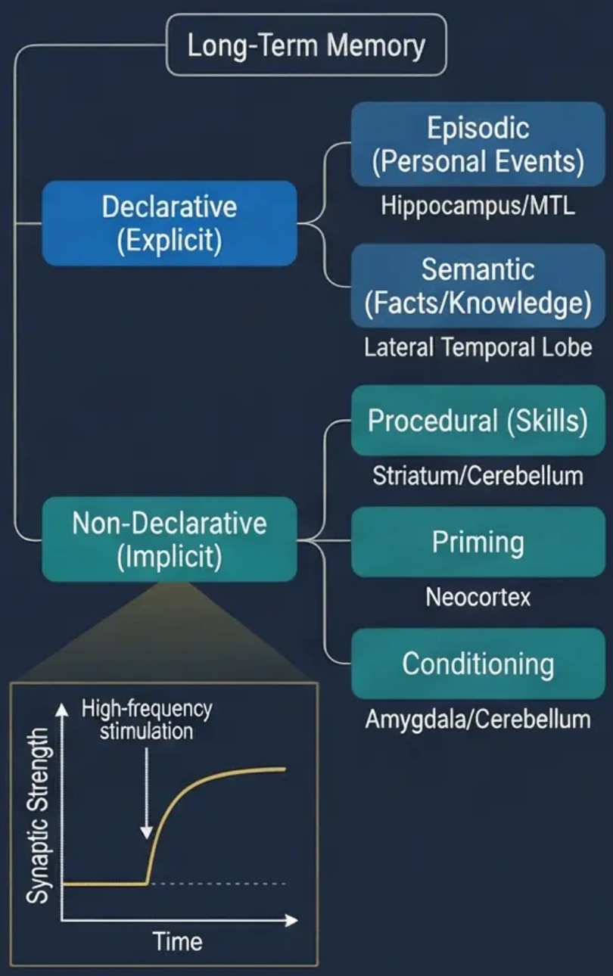
PSYCH403 - Biopsychology
Slide 19 of 20
Sessions 17-18: Emotion, Learning & Memory
Main Content
Visual Suggestion
• Neural Basis of Emotion: James-Lange theory (1884): physiological arousal precedes emotional experience. Cannon-Bard theory: thalamus simultaneously sends signals to cortex (emotion) and body (arousal). Schachter-Singer two-factor theory: arousal + cognitive label = emotion. Modern view: distributed neural networks including amygdala, insula, ACC, vmPFC.
• Emotional Regulation: Prefrontal cortex (especially vmPFC and dIPFC) modulates amygdala activity. Cognitive reappraisal (Gross, 1998) — reinterpreting emotional stimuli reduces amygdala activation (fMRI evidence). Emotion dysregulation in depression, BPD, and PTSD linked to PFC-amygdala connectivity disruption.
• Types of Memory: Declarative (explicit): Episodic (personal events) and semantic (facts).
Hippocampus-dependent. Non-declarative (implicit): Procedural (skills — cerebellum/basal ganglia), priming (neocortex), classical conditioning (amygdala/cerebellum), habituation.
• Long-Term Potentiation (LTP): Hebb's rule: "neurons that fire together, wire together." LTP is the cellular mechanism of learning — repeated stimulation strengthens synaptic connections via AMPA/NMDA receptor upregulation. Bliss & Lomo (1973) first demonstrated LTP in hippocampus.
• Memory Consolidation: Synaptic consolidation (hours): protein synthesis stabilises synaptic changes. Systems consolidation (years): hippocampus gradually transfers memories to neocortex for long-term storage. Sleep-dependent consolidation: SWS for declarative, REM for procedural/emotional memories.
• Key Study — Clive Wearing: Severe anterograde and retrograde amnesia following herpes encephalitis destroying hippocampus and surrounding areas. Could not form new declarative memories but retained procedural memory (piano playing) and emotional memory (recognised wife). Demonstrates multiple memory systems.
Using evidence from case studies (H.M., Clive Wearing) and experimental research (LTP), critically evaluate the claim that memory is not a single unitary system. To what extent does the distinction between declarative and non-declarative memory reflect distinct neural substrates?

Slide 20



PSYCH403 · Biopsychology
Slide 20 of 20
Sessions 19-20: Developmental Biopsychology & Evolutionary Perspectives
Main Content
Visual Suggestion
• Brain Development: Neural tube forms at 3-4 weeks gestation. Neurogenesis peaks prenatally; most neurons present at birth. Synaptic overproduction (synaptogenesis) followed by synaptic pruning — 'use it or lose it' principle. Myelination continues into early adulthood (prefrontal cortex last to mature — explains adolescent risk-taking).
Timeline of brain development from conception to old age: key milestones labelled (neural tube formation, synaptogenesis peak, synaptic pruning, myelination completion, neurodegeneration onset).
• Critical Periods: Windows of heightened neural plasticity during which specific experiences are essential for normal development. Examples: visual cortex (Hubel & Wiesel, 1963 — monocular deprivation in kittens); language acquisition (Lenneberg, 1967 — critical period hypothesis); Genie case study — feral child deprived of language input during critical period showed permanent language deficits.
• Neuroplasticity Across the Lifespan: Infant brain: highly plastic, rapid learning. Adolescence: synaptic pruning, myelination of PFC, heightened reward sensitivity (dopaminergic). Adulthood: reduced plasticity but maintained neurogenesis (hippocampus). Ageing: cognitive reserve, use-dependent plasticity, neurodegeneration (Alzheimer's, Parkinson's).
Inset: evolutionary tree showing brain size increase from early hominids to Homo sapiens. Colour: developmental stages in gradient from teal to gold.
• Evolutionary Perspectives: Evolutionary psychology applies Darwinian principles to explain psychological mechanisms as adaptations. Trivers (1972) — parental investment theory explains sex differences in mate selection. Buss (1989) — cross-cultural study of 37 cultures confirmed evolutionary predictions about mate preferences. Pinker (1997) — language as an evolved instinct.
• Ethical Issues in Biopsychology: Animal research ethics (3Rs: Replace, Reduce, Refine; Animals Act 1986). Neuroimaging privacy concerns. Genetic determinism and its social implications. Neuroethics: deep brain stimulation, cognitive enhancement, brain-computer interfaces. Informed consent in neurological research.
• Future Directions: Optogenetics — light-controlled neural circuits. Brain organoids — 3D neural tissue models. Connectomics — mapping complete neural wiring diagrams. AI-brain interfaces. Personalised psychiatry based on neuroimaging biomarkers.
To what extent does evolutionary psychology provide a valid and scientifically rigorous framework for explaining human behaviour? Critically evaluate the ethical implications of applying biological determinism to explain social inequalities, and consider the future ethical challenges posed by advances in neurotechnology.

