Slide 1

Unit PSYCH404: The
Development of
Psychological Attachments
Qualification: QUALIFI Level 5 Extended Diploma in Psychology
Unit Reference: R/650/5559
Total Qualification Hours: 200 hours (40 guided learning hours)
A comprehensive journey through
theories of psychological attachment
— from Bowlby and Ainsworth to
contemporary research.
Report Created: 2026-03-04

Slide 2


What is Psychological Attachment? Historical Context
Defining Psychological
Attachment
Distinguishing Key Concepts
Historical Shift: From
Cupboard Love to
Comfort Contact
What is Attachment?
Attachment
(Infant→Caregiver)
Bonding
(Caregiver→Infant)
Dependency
• A deep and enduring
emotional bond that
connects one person to
another across time and
space.
Before 1950s: ‘Cupboard
Love Theory’
Reliance on
meeting physical
needs.
Infant's bond to
caregiver.
Caregiver's
feelings towards
the infant.
Infants attach to whoever
feeds them.
• John Bowlby (1969): “A
lasting psychological
connectedness between
human beings.”
A bidirectional
interactive
process.
Food, warmth,
safety.
A unidirectional
process.
After: Harlow's experiments
proved that “contact
comfort” is stronger than
food.
• Influences relationships
and sense of self in later
stages of life.
Begins during
pregnancy and
intensifies after
birth.
A physical, not
emotional,
concept.
Develops during
the first year of
life.
Result: Paved the way for a
new understanding of
attachment.
Think & Discuss: Before this lecture, what was your understanding of why a child
loves their mother?

Slide 3


Caregiver-Infant Interactions:
The Dance of Communication
Reciprocity
Pioneering Research
The reciprocal 'conversational'
interaction between infant and
caregiver.
Each partner responds to the other's
signals and elicits a response.
Brazelton et al. (1975) described it
as a 'dance'.
Forms the foundation for the
development of attachment.
Meltzoff & Moore (1977): Infants
as young as 2 weeks show clear
imitation — linking adult gesture to
infant action — early evidence of
interactional synchrony.
Still Face Experiment (Dr Edward
Tronick): Three phases — normal
interaction → still face → reunion.
Demonstrates infant expectations
of social interaction.
Interactional Synchrony
Temporal coordination of social
behaviour at a micro-level.
Simultaneous mirroring of actions
and emotions.
Referred to as 'mind mirroring'
between caregiver and infant.
Link to attachment quality —
Isabella et al. (1989): High levels
of synchrony are associated with
secure attachment.
Early interaction as a 'dance' —
each partner responds to the
rhythm and signals of the other.

Slide 4

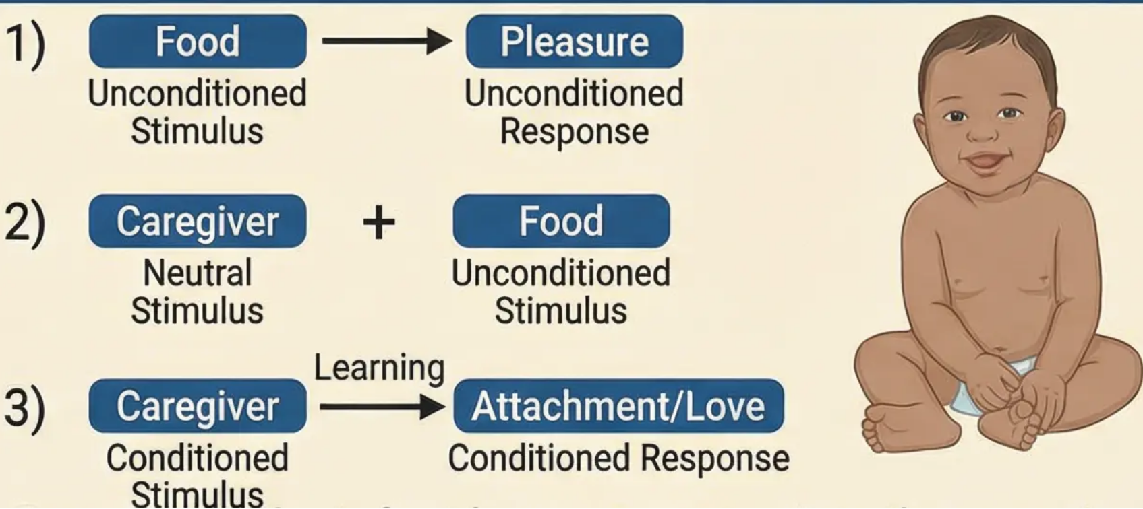
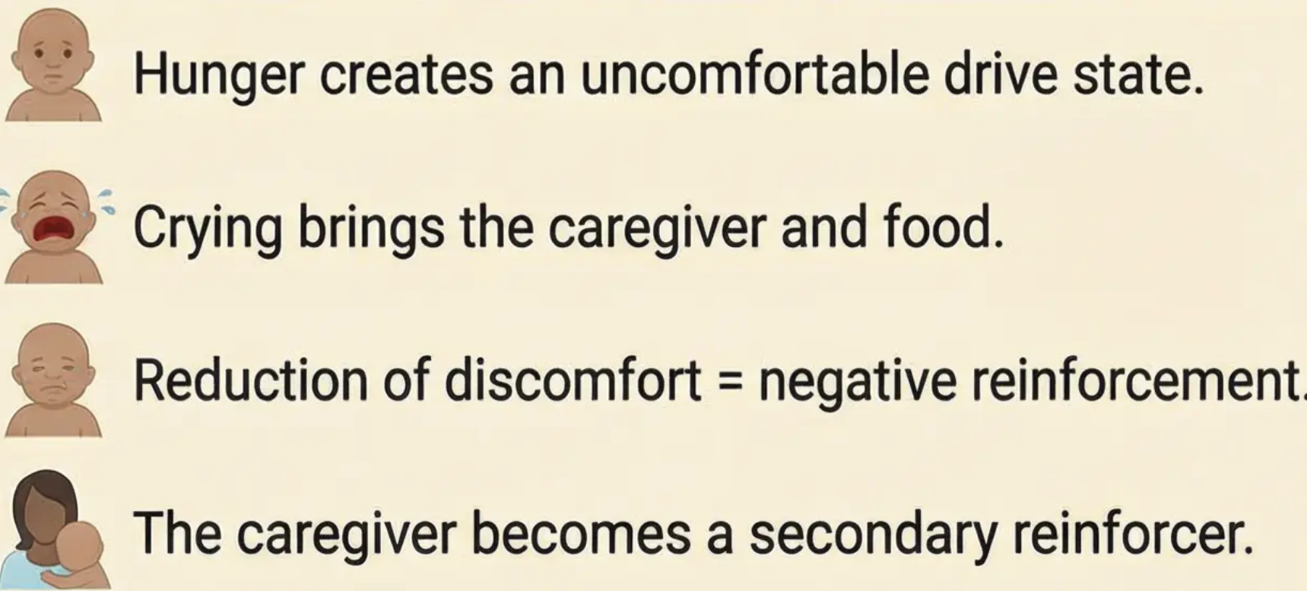
Learning Theory of Attachment (Behavioral Perspective)
Classical Conditioning — Learning
through Association
Operant Conditioning — Learning
through Consequences
Summary: The infant learns to associate the caregiver
with the pleasure derived from food.
Secondary Drive Theory — Dollard & Miller (1950)

Slide 5


Critiquing Learning Theory & Introduction
to the Evolutionary Perspective
Limitations of the Behaviourist Explanation
Bowlby's Adaptive Theory
Over-reductionism
Biological Adaptation
• Reduces a complex emotional bond
to a simple mechanism.
• Attachment is an innate system
that evolved for survival.
• Ignores cognitive and emotional
processes.
• Attached infants = greater
protection from danger.
Contradictory Evidence
Social Releasers
• Schaffer & Emerson: attachment
≠ feeding.
• Innate behaviours that elicit
caring.
• Harlow's experiments: 'contact
comfort' more important than food.
• Large eyes, crying, smiling.
• Lorenz's imprinting: an innate
mechanism.
Sensitive Period
• An optimal time window for
forming attachment.
Failure to Explain
• The first three years are critical.
• Why do infants attach to those
who do not feed them?
Adaptive Value
• How does it explain the need for
comfort and security?
• Proximity to caregiver = survival.
Attachment is not merely a learned response, but
an innate biological system that ensures survival.
• A strong evolutionary basis.

Slide 6






Bowlby's Concepts: Monotropy and Social Releasers
Monotropy
Social Releasers
The innate tendency to form one
primary, intense attachment with
a single individual.
Physical characteristics:
Large eyes and small chin •
This person sits at the top of
the attachment hierarchy.
Typical cute infant features •
Interactive behaviours:
The primary attachment differs
qualitatively from secondary
attachments.
Crying, cooing, and gurgling •
Smiling and clinging •
Responses that elicit protection •
Has a decisive influence on the
child's internal working model.
The Critical Time Window
"The first three years are the optimal time for
forming attachments, though formation is
possible later with greater difficulty."
- Bowlby (1969)
Contemporary Critique:
The concept of monotropy may be oversimplified
in light of modern family structures.

Slide 7

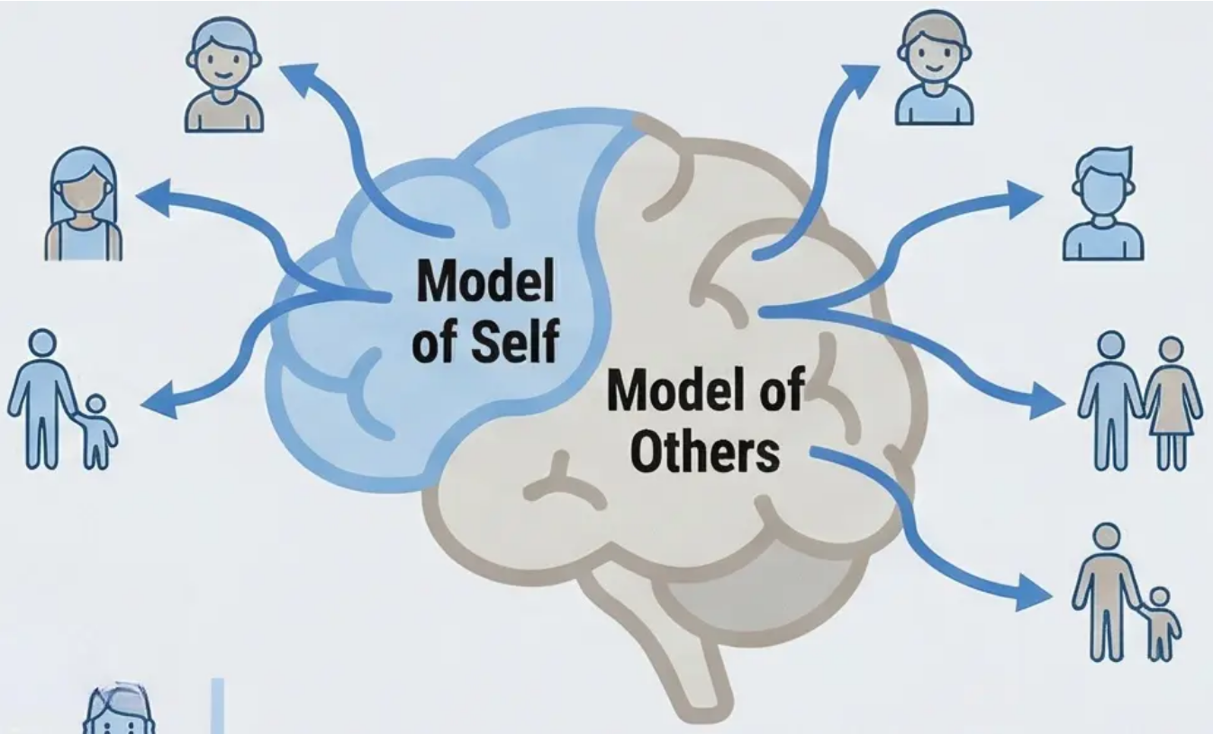




The Internal Working Model & Continuity Hypothesis
(Internal Working Model & Continuity Hypothesis)
Internal Working Model:
The Cognitive Schema for Relationships
The mental representation the child forms of
themselves and others through their first
attachment experience.
Model
of Self
Model of
Others
Two Components of the Internal
Working Model:
The Continuity Hypothesis Across
the Life Cycle
Early Childhood → Social competence
• Model of Self: “Am I lovable and worthy
of care?” – reflects the individual's
self-worth.
Adolescence →
Quality of
friendships
• Model of Others: “Are others
trustworthy and available?” – reflects
expectations of others in relationships.
Evidence from Research
Adulthood →
Romantic
relationships
Hazan & Shaver (1987): Found a
strong correlation between infant
attachment patterns and adult
romantic love styles.
Analytical Question: How can the cycle
of insecure attachment be broken?
Parenthood → Parenting patterns

Slide 8

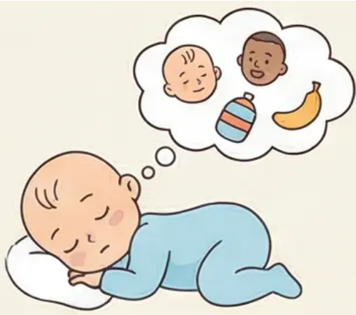

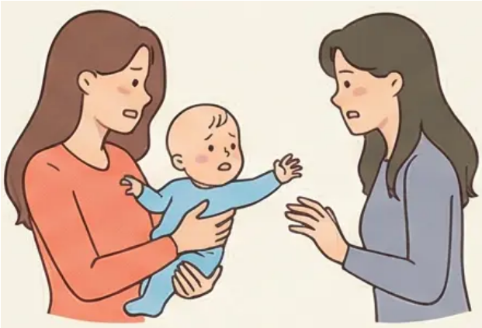
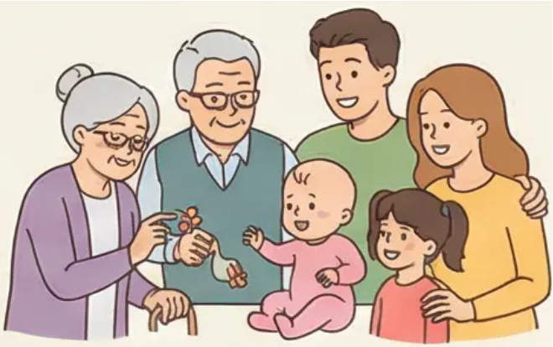
Schaffer & Emerson's Study: Stages of Attachment Development
The Glasgow Longitudinal Study (1964) — 60 infants tracked over 18 months
Asocial Stage
(0-6 weeks)
Indiscriminate Attachment
(6 weeks - 7 months)
Specific Attachment
(7+ months)
Multiple Attachments
(9+ months)
Behaviour is similar
towards people and
objects.
Preference for people;
comfort accepted from
any adult.
Strong attachment to one
particular individual;
stranger and separation
anxiety emerge.
Attachment expands to
include several familiar
individuals.
Key Findings:
Significance of the Study:
• 50% of infants showed separation anxiety between 25-32 weeks.
• 80% had formed a specific attachment by 40 weeks.
• 30% formed multiple attachments quickly.
• The primary attachment was not always with the person who fed the infant.
The first systematic longitudinal
study of attachment development
in a natural environment.

Slide 9

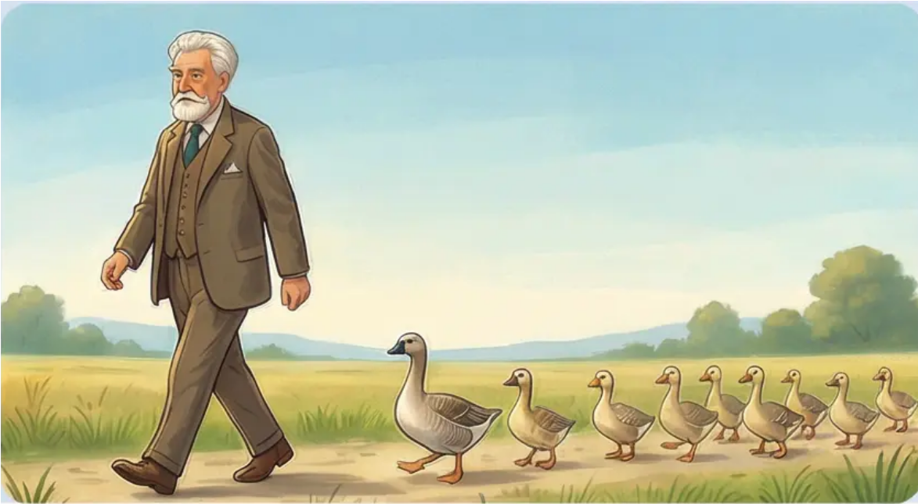

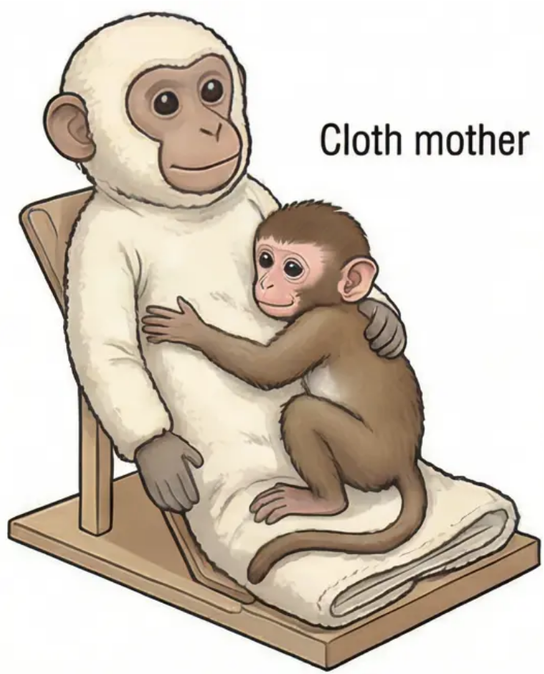



Animal Studies: Lorenz & Harlow
Lorenz's Study (1935): Imprinting in Geese
Harlow's Study (1958): Contact Comfort vs. Feeding
• Procedure: Goose eggs divided — half with natural mother, half with
Lorenz in incubator.
• Key finding: Goslings followed the first moving object they saw (Lorenz!).
• Critical period: 13–16 hours after hatching — a specific time window for
imprinting.
• Sexual imprinting: Birds imprinted on humans later showed courtship
behaviour towards humans.
• Experimental setup: 16 infant monkeys with artificial ‘mothers’ — wire
and cloth.
• Independent variable: Which ‘mother’ provided milk (wire or cloth).
• Remarkable finding: Monkeys preferred the cloth mother for comfort
regardless of food source.
• When frightened: All monkeys fled to the cloth mother for security.
• Conclusion: ‘Contact comfort’ is more important than food in forming
attachment.
Application to Human Attachment
Support for Bowlby's theory:
Limitations of generalisation:
Attachment is an innate, not learned,
mechanism.
Comfort and security are more important
than food.
Sensitive periods for development exist.
Species differences.
Complexity of human attachment.
Ethical considerations in research.

Slide 10

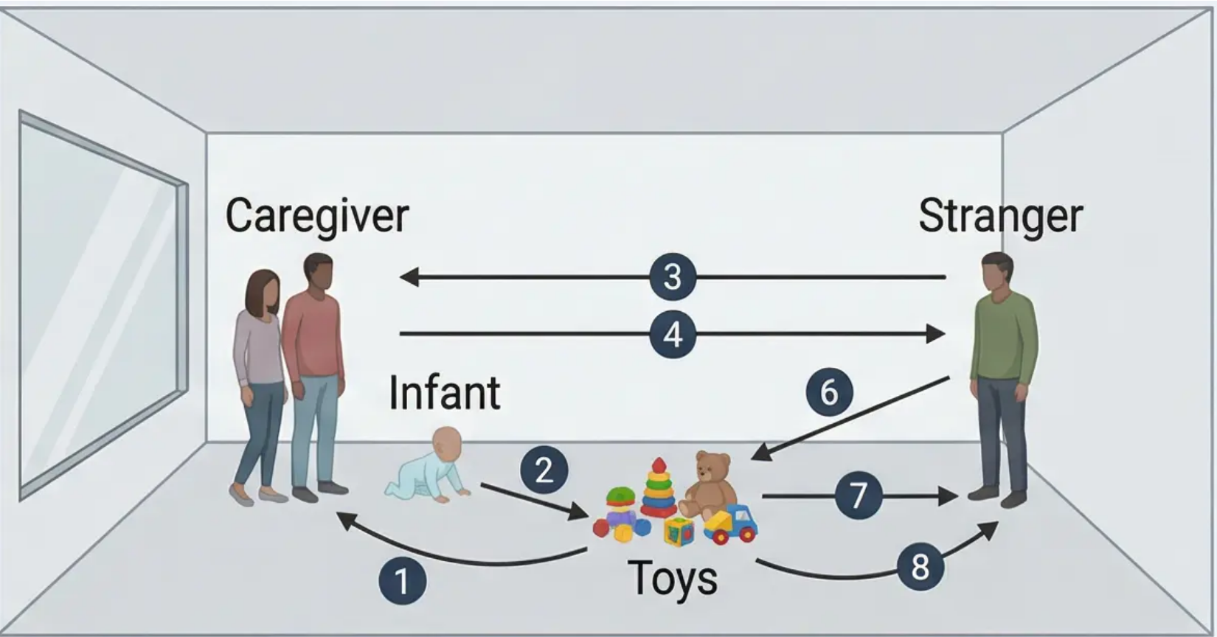





Measuring Attachment: The ‘Strange Situation’ Procedure
Ainsworth's Standardised Methodology
for Assessing Attachment Quality
• Controlled observational method for infants
(9–18 months)
• Structured laboratory environment with toys
• Observation of infant behaviour across different
situations
• Objective assessment of attachment quality
3 minutes per episode
The Eight Episodes of the Procedure
Key Behavioural Indicators
1. Room entry (caregiver + infant)
2. Secure base (toy exploration)
3. Stranger enters (gradual interaction)
4. First separation (stranger + infant)
5. First reunion (caregiver returns)
6. Second separation (infant alone)
7. Stranger returns (attempts to comfort)
8. Final reunion (caregiver returns)
Proximity Seeking - Searching for closeness to caregiver
Exploration & Secure Base - Freedom to play with return to
safety
Stranger Anxiety - Reaction to unfamiliar persons
Separation Anxiety - Distress when caregiver leaves
Reunion Behaviour - Response when caregiver returns
Proximity Seeking - Searching for closeness to caregiver
Exploration & Secure Base - Freedom to play with return to
safety
Stranger Anxiety - Reaction to unfamiliar persons
Separation Anxiety - Distress when caregiver leaves
Reunion Behaviour - Response when caregiver returns

Slide 11


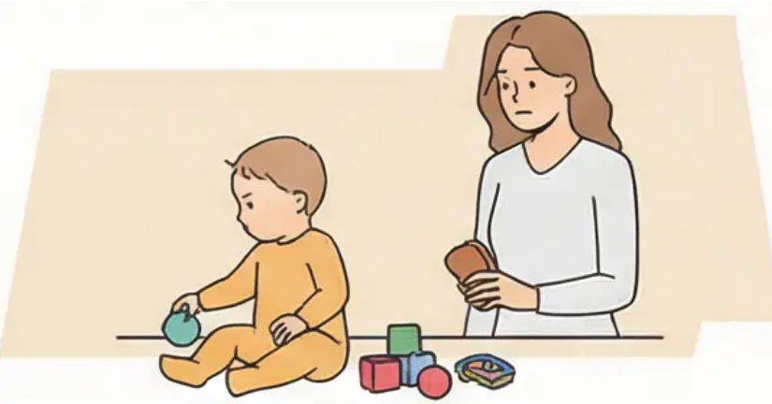

Ainsworth's Three Attachment Types
(Ainsworth's Three Attachment Types)
Distinguish secure attachment characteristics (Type B), insecure avoidant (Type A), and insecure resistant (Type C)
Type B – Secure Attachment
(Secure Attachment)
Type A – Insecure Avoidant
(Insecure Avoidant)
Type C – Insecure Resistant
(Insecure Resistant)
• Explores the environment with
confidence
• Seeks comfort upon caregiver's return
• Shows moderate separation distress
• Accepts comfort easily
• Avoids eye contact
• Does not seek proximity upon
caregiver's return
• Shows excessive independence
• Resists comfort
• Shows ambivalent behaviour
• Extreme distress upon separation
• Difficulty being soothed
• Resists comfort while
simultaneously seeking it
Approx. 60-75% of infants
Approx. 20-25% of infants
Approx. 3% of infants
Reunion behaviour is the strongest indicator of attachment type
(Reunion behavior is the strongest indicator of attachment type)

Slide 12

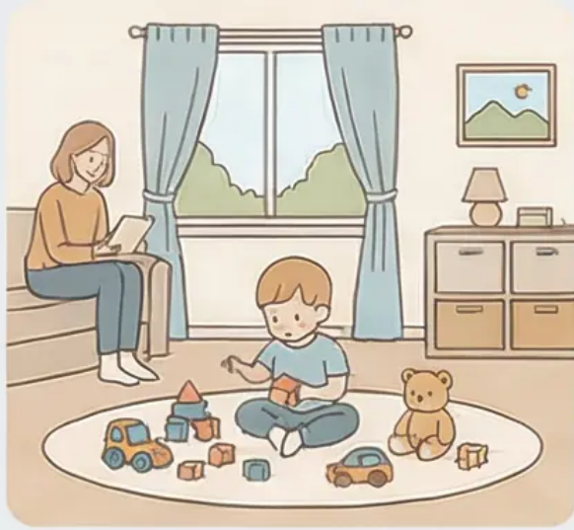


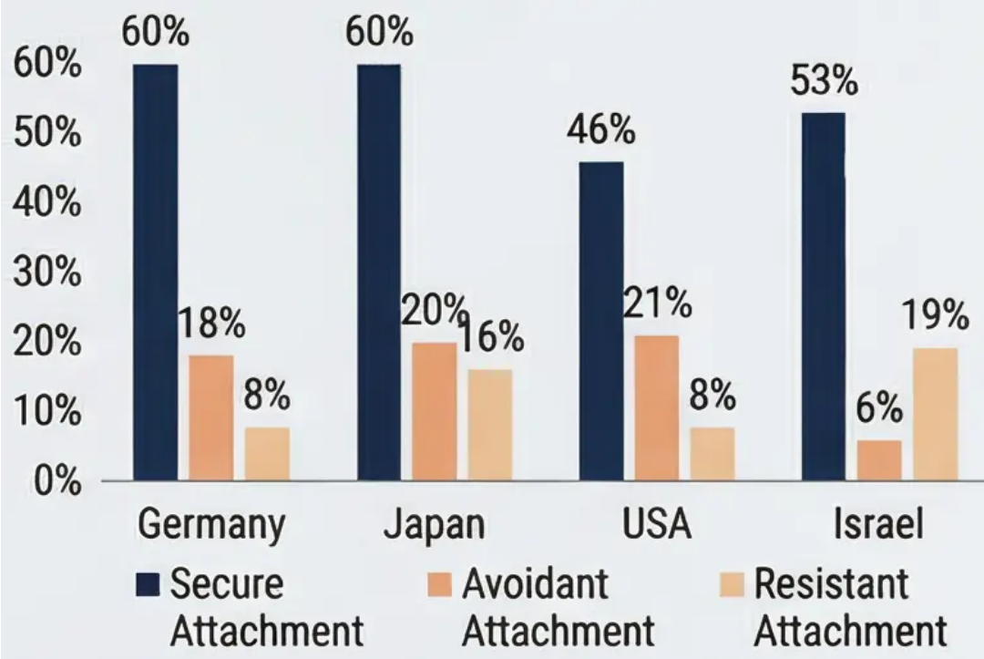
Cultural Variations in Psychological Attachment
Is attachment a universal phenomenon or culturally specific?
Van IJzendoorn & Kroonenberg (1988)
• Meta-analysis covering 32 studies across 8
countries.
• Secure attachment was the most common
across all cultures.
• Variation within countries was greater than
variation between countries.
Germany
Japan
Israel
• Germany: high proportion of avoidant type.
• Japan: high proportion of resistant type.
The Problem of 'Imposed Etic'
Cultural Interpretation
Applying standards and theories
developed in one culture to other
cultures without accounting for
cultural differences in child-rearing
values and practices.
• Germany: valuing independence and self-
reliance.
• Japan: tradition of non-separation between
mother and child.
How can attachment measurement
tools be developed that are more
culturally sensitive?
• Israel: kibbutz system and collective care.

Slide 13

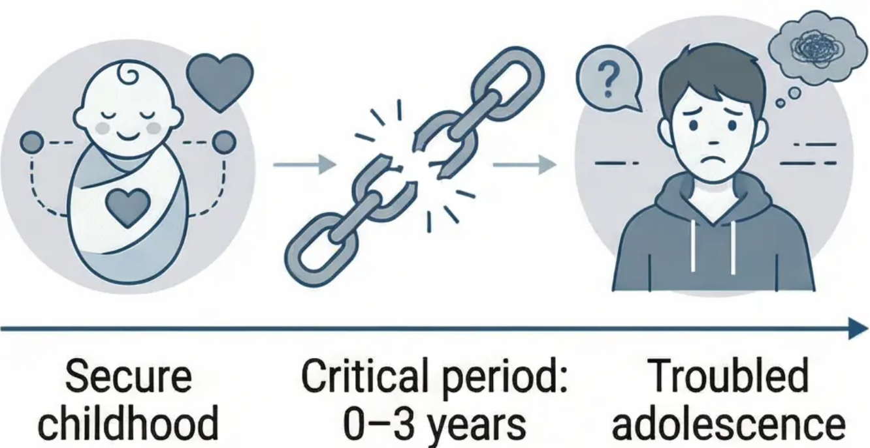



Bowlby's Maternal Deprivation Hypothesis
Maternal Deprivation: The loss of
continuous emotional care from the
mother or mother-substitute during
the critical early years of life.
1. Core Components of the Hypothesis:
Critical Analysis:
The Critical Period: the first three years of life. •
Distinction between separation and
emotional deprivation. •
Long-term effects on intellectual and
emotional development. •
First study to link
early deprivation to
behavioural problems.
Methodological flaws:
Bowlby conducted
the
assessments himself.
2. The '44 Juvenile Thieves' Study (1944):
Sample: 44 adolescent delinquents •
charged with theft. •
Methodology: Interviews with the thieves •
and their families. •
Correlational, not
causal.
Key findings: 14 of 44 showed affectionless
psychopathy. •
Correlation: 12 of 14 had experienced
prolonged early separation. •
Failed to replicate
(Lewis, 1954 study).
Specific Effects of Maternal Deprivation:
Emotional development:
Affectionless psychopathy.
Intellectual development:
Reduced IQ.

Slide 14

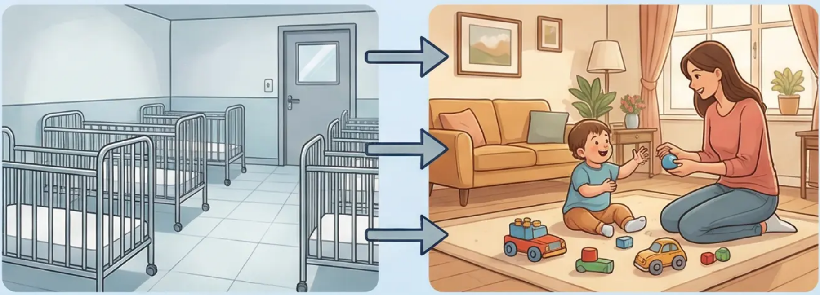
Effects of Institutionalisation and Complete Privation
Rutter's Romanian Orphan Studies
The ERA Longitudinal Study (Rutter, 2011)
Rutter's Critical Distinction
• 165 Romanian orphans adopted in Britain.
• Followed up at ages 4, 6, 11, and 15 years.
• Key variable: age at adoption.
• Deprivation: Loss of an attachment bond after
it has been formed.
• Privation: Complete failure to form any
primary attachment bond at all.
Key Findings
Initial Condition:
Catch-up Growth:
• More than half the orphans showed intellectual
developmental delay and severe malnutrition.
• By age 11, children showed varying recovery
rates based on age at adoption.
Disinhibited Attachment:
• Children were equally friendly and
affectionate towards familiar people and
strangers.
Long-term Effects:
• Persistent cognitive impairment in some cases.
• Difficulties in emotional regulation.
• Problems in social relationships.
The Critical Age: Children adopted before 6 months showed near-complete recovery, while
those adopted after age 2 faced ongoing challenges.

Slide 15




Workshop Objectives:
Morkshop Objective
- Consolidate knowledge of core attachment
theories.
- Develop academic essay planning skills.
- Compare human and animal attachment.
- Critically analyse research evidence.
Mid-Course Review & Formative Assessment
Core Theories Under Review:
Formative Assessment Focus:
• 600–700 word essay on stages of attachment.
• Link learning theory to developmental stages.
• Compare findings from human and animal studies.
Academic Essay Planning Framework:
1. Introduction and clear thesis.
2. Comparison of human and animal studies.
3. Critical analysis of evidence.
4. Conclusion and synthesis.
Interactive Activity: “Concept Speed Dating”
Exchange key concepts with peers to consolidate understanding.

Slide 16
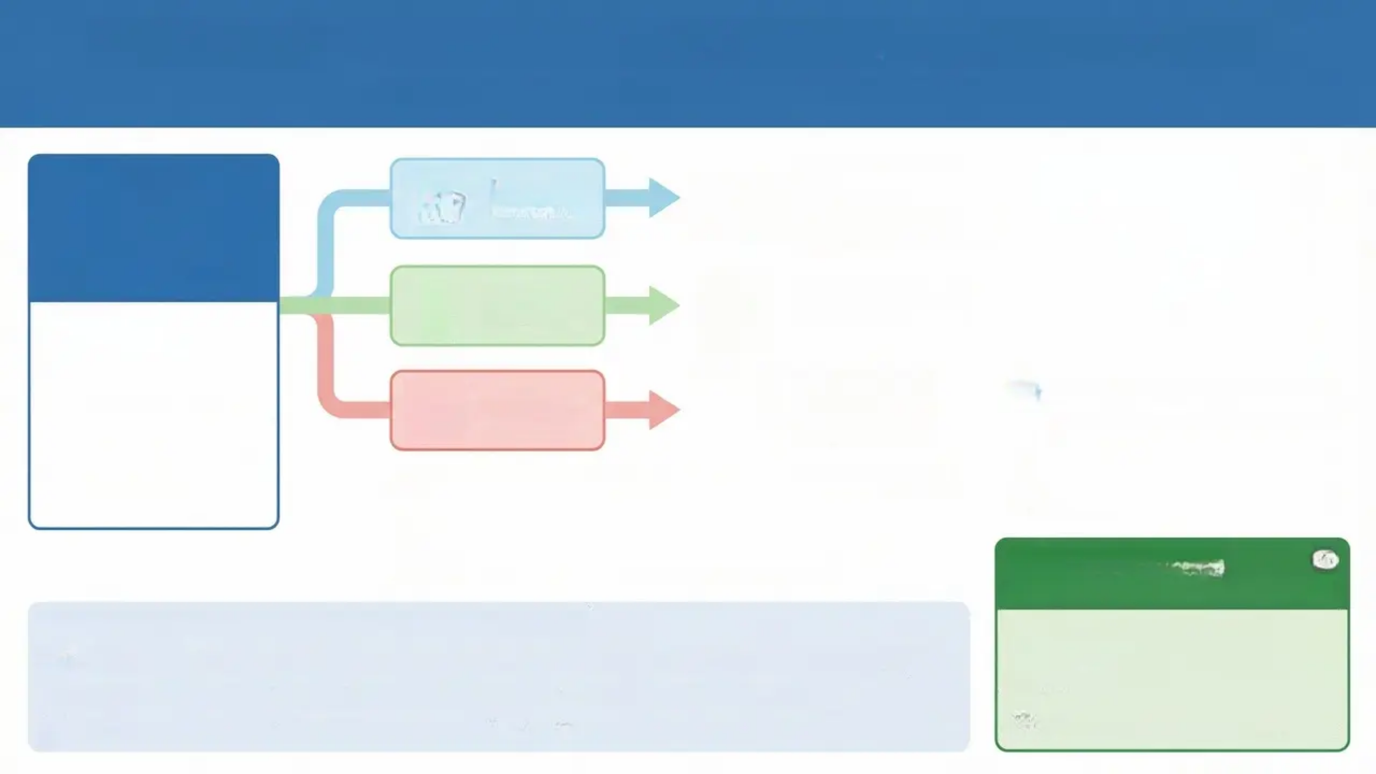


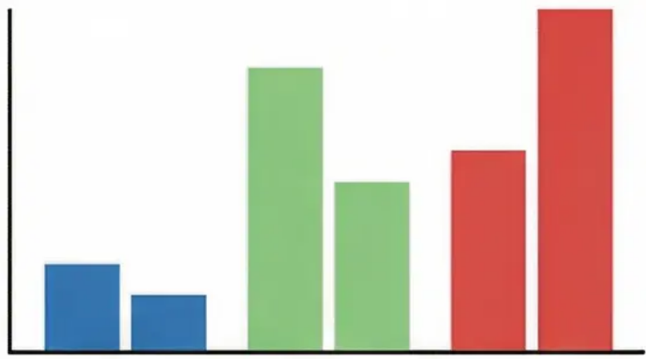



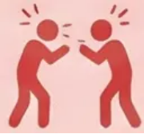












The Impact of Early Attachment on Childhood and Bullying
(Impact of Early Attachment on Childhood and Bullying)
Cooperative play and
healthy relationships
Positive and prosocial
behaviour.
Secure
Attachment
Early Bond
Insecure
Avoidant
Social isolation and
avoidance.
Internal Working
Model in the Playground
Proportions of Attachment
Patterns in Bullying Behaviour
The cognitive schema
formed in infancy that
determines our
expectations of future
relationships.
Insecure
Resistant
Confrontational
behaviour and
clinginess.
Secure: 15% victims, 10% bullies
Insecure Avoidant: 50% victims,
30% bullies
Insecure Resistant: 35% victims,
60% bullies
Myron, Wilson & Smith (1998): "Securely attached children
rarely participate in bullying."
"Insecure Avoidant: More likely to be victims of bullying."
Practical Application:
Designing a School Intervention
"Insecure Resistant: More likely to be bullies."
Section 1: Peer Relationship Patterns and Attachment
How can understanding attachment
patterns help develop anti-bullying
programmes?
Secure Attachment: Enter social situations with confidence and form healthy friendships.
Insecure Avoidant: May avoid close friendships and appear socially withdrawn.
Insecure Resistant: May be clingy or controlling in friendships.
Class discussion and suggestions.

Slide 17



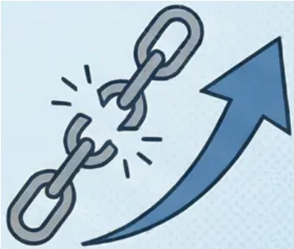
Attachment in Adulthood: The ‘Love Quiz’
(Adult Attachment: The ‘Love Quiz’)
3. ‘Earned Security’
Definition: Developing a secure attachment pattern
in adulthood despite early insecure experiences.
Attachment is not a fixed destiny
— it can be changed through
positive experiences.
1. Hazan & Shaver (1987)
• Aim: To link early attachment patterns to romantic relationships.
• Methodology: 'Love Quiz' questionnaire in a local newspaper.
• Key findings:
• Secure individuals: Stable relationships and trust in partner.
• Avoidant individuals: Discomfort with emotional closeness.
• Anxious individuals: Intense desire for relationship combined
with fear of abandonment.
Ways to achieve earned security:
• Corrective relationships: a securely attached partner
providing a secure base.
• Psychotherapy: a supportive and stable therapeutic
environment.
• Self-reflection: understanding personal attachment
patterns and making conscious choices to change.
2. Critical Evaluation
Intergenerational continuity:
Secure parent → secure child (usually).
Breaking the cycle is possible through
earned security.
• Data is correlational, not causal.
• Sample of volunteers may not represent the population.
• Oversimplification of complex human relationships.

Slide 18




Attachment Disorders & Atypical Development
When the Attachment System Breaks Down: RAD & DSED
RAD – Reactive
Attachment Disorder
DSED – Disinhibited Social
Engagement Disorder
• Inhibited and emotionally
withdrawn behaviour.
• Rarely seeks comfort when
distressed.
• Very limited social
responsiveness.
• Unexplained episodes of
irritability and fear.
• Overly familiar behaviour
with strangers.
• Absence of normal
caution.
• Willingness to go with any
adult.
• Failure to check back with
primary caregiver.
Shared Causes: Severe Neglect and Institutional Deprivation
Both disorders stem from a chronic lack of emotional care and
responsiveness, often associated with institutional
environments or repeated changes in primary caregivers.
Romanian Orphan
Study: demonstrated
long-term effects of
institutional deprivation.

Slide 19


Research Methods & Ethical Considerations
Critical Evaluation of Methodologies and Protection of Young Participants
Ethical Challenges
Key Methodologies
Informed Consent
Controlled Observation
Challenge: Infants cannot give consent.
Solution: Parental consent + continuous monitoring.
*Ainsworth's Strange Situation.
Strengths: High control, internal validity.✔️
Limitations: May lack ecological validity.❌
Protection from Harm
Psychological: Avoid excessive distress in infants.
Physical: Safe environments and medical
supervision.
Naturalistic Observation
*Schaffer & Emerson's Glasgow Study.
Strengths: High ecological validity.✔️
authentic behaviour.
Limitations: Difficulty establishing cause❌
and effect.
Confidentiality & Anonymity
Protect family identities.
Secure sensitive data.
Interviews & Questionnaires
Deception & Transparency
*Hazan & Shaver's Love Quiz.
Strengths: Rich, in-depth data.✔️
Limitations: Bias, memory problems.❌
Avoid deception with infants.
Clear explanation to parents.
Methodological Triangulation
Using multiple methods strengthens findings and reduces the limitations of any single methodology.

Slide 20

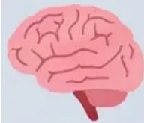

Future Directions & Final Summative Assessment
New Horizons in Attachment Research
Final Summative Assessment
Neuroscience of Attachment
Attachment problems and issues across
early stages of human development.
• Neuroimaging techniques to study mother-
infant interactions
• Understanding the biological basis of
emotional bonds
Essay requirements:
• Word count: 2,000–3,000 words
• Requires analysis of two peer-reviewed studies
• Discuss the effects of attachment on:
○ early childhood
○ adolescence and peer relationships
○ adult romantic relationships
○ parenthood
Epigenetics & Attachment
• How the environment influences gene
expression
• Long-term effects of early experiences
Assessment criteria:
• Depth of critical analysis
• Integration of multiple theories
• Quality of evidence used
• Clarity of argument and organisation
Technology & Modern Relationships
• Impact of social media
• Attachment in the digital age
A Journey of Exploring Psychological Attachment: From Classical Theories to Contemporary Research

