Slide 1

PSYCH405:
HUMAN MEMORY
PROCESSES
Introduction to Cognitive Psychology
Level 5 Extended Diploma in Psychology
Core Unit in Cognitive Sciences & Human Memory
Lecturer: [Name]
Date: [Date]
Institution: [Name]

Slide 2





Unit Overview
This unit aims to provide learners with a comprehensive and in-depth understanding of human memory processes as
dynamic and complex systems, with a focus on practical applications in cognitive, forensic, and educational psychology.
Dynamics of Encoding, Storage & Retrieval
Memory Models & Cognitive Representation
We move beyond traditional conceptions of discrete
memory stages to understand how encoding, storage, and
retrieval interact in complex ways. Memory is not a passive
recording system but an active reconstructive process
influenced by context, state, and expectations.
We explore the historical evolution of memory understanding
understanding — from simple linear models such as the
Multi-Store Model (MSM) to more complex frameworks like the
Working Memory Model (WMM). We analyse how information
is represented across different cognitive systems and how
these systems interact to produce unified human experience.
Theories of Forgetting & Cognitive Loss
Applications in Criminal Justice
We analyse various theories of forgetting — from
interference to retrieval failure — focusing on how these
concepts apply in educational and therapeutic contexts. We
discuss how forgetting may serve as an adaptive mechanism
rather than a mere system failure.
We examine in depth the reliability of eyewitness testimony
from a psychological perspective, exploring how factors such
as misleading information, anxiety, and leading questions
affect memory accuracy. This analysis highlights the vital
importance of psychology within the justice system.
Academic Integration
This unit bridges theory and application, providing a strong foundation for advanced modules in cognitive, neuropsychological, and applied
psychology. It develops critical thinking about the nature of human cognition and its application across diverse professional fields.

Slide 3






Learning Outcomes
Session
Upon successful completion of this unit, learners will be able to achieve the following academic outcomes at Level 5 of the
Extended Diploma:
01
02
03
04
Understanding the Multi-
Store Model of Memory:
Mastering the Working
Memory Model:
Classifying Types of Long-
Term Memory:
Explaining Mechanisms of
Forgetting Scientifically:
• Analyse the three main
components: sensory register,
short-term memory, and long-
term memory
• Explain the functions of the
central executive as an
attentional control system
• Distinguish between explicit
memory (episodic and semantic)
and implicit
(procedural) memory
• Compare different theories:
interference, retrieval failure,
and trace decay
• Analyse the subsidiary
systems: phonological loop,
visuospatial sketchpad, and
episodic buffer
• Analyse factors affecting
eyewitness testimony accuracy
from a cognitive psychology
perspective
• Evaluate the distinctive
characteristics of each store in
terms of capacity, duration,
and encoding
• Analyse functional dissociation
between systems using
neuropsychological evidence
• Examine experimental
evidence supporting and
critically evaluating the model
• Apply model concepts to
understand complex cognitive
processes
• Understand the interaction
between different memory
types in cognitive processing
• Evaluate the impact of anxiety
and misleading information on
memory retrieval
• Relate the model to cognitive
phenomena such as the serial
position effect
• Evaluate evidence from dual-
task studies and
neuropsychological cases
• Apply these concepts in clinical
and educational contexts
• Apply theoretical principles to
practical problems in law and
education
These outcomes integrate with academic assessment standards to achieve the required levels of understanding, application, analysis, and evaluation at Level 5.

Slide 4


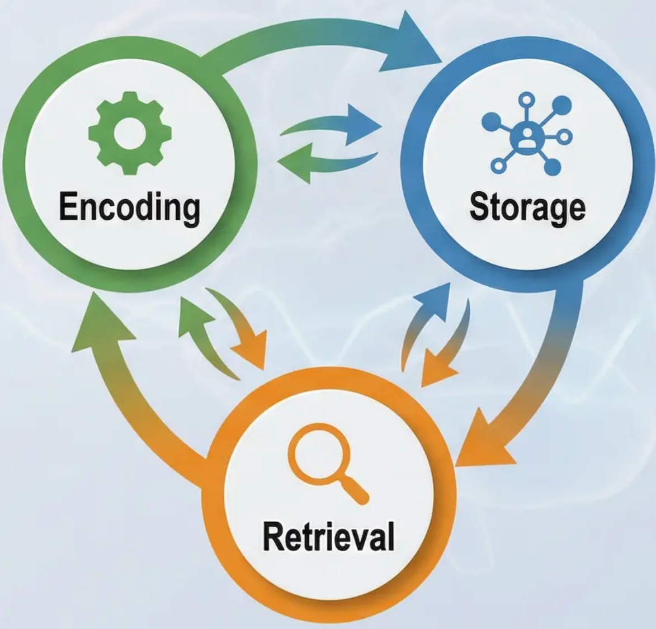

Encoding, Storage & Retrieval: The Three Core Stages of Memory
Session 1
Session 1: Foundational Concepts of Memory Processes
Human memory is a complex and dynamic cognitive system — not a passive recorder of events. Information passes through three
fundamental, interacting stages that form the core of memory operations within the human cognitive system.
1. Encoding – Active Transformation
2. Storage – Mechanisms of Retention &
Organisation
The initial process by which diverse sensory
inputs are converted into neural representations
that can be processed and stored. This involves
active interpretation and cognitive organisation
of incoming information.
The process of retaining encoded information
across varying time periods, organising it within
interconnected networks of cognitive represen-
tations. Storage characteristics differ in terms of
capacity, duration, and structural organisation.
Types of Encoding:
✔ Structural encoding: processing the
physical features of stimuli
✔ Acoustic encoding: processing auditory
and phonological properties
✔ Semantic encoding: processing meaning
and conceptual context
3. Retrieval – Accessing Stored Information
The complex process of accessing stored
information and returning it to active
consciousness. Retrieval can be conscious and
deliberate, or automatic and unconscious, and
depends on the effectiveness of contextual cues
and conceptual associations.
Dynamic Interaction note: These three stages are not separate or linear — they interact continuously and in complex ways. The quality of encoding
affects storage effectiveness, and retrieval can reshape the stored memory trace through the process of reconsolidation.
Discussion question: How can failure at any of these three stages lead to different patterns of memory problems? What distinguishes
encoding failure from retrieval failure?

Slide 5

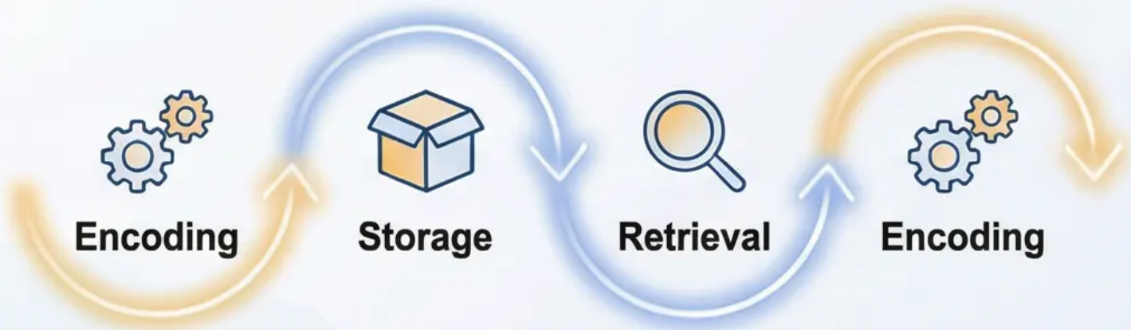
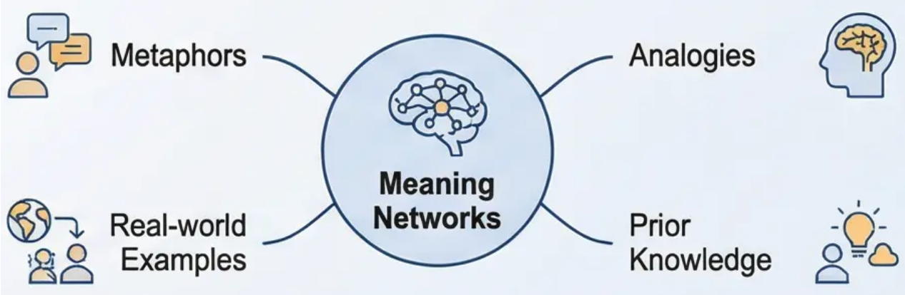
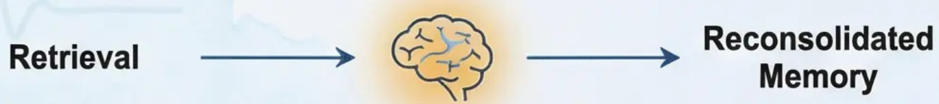

Advanced Analysis: Interactive Stages of Memory & Their Applications
Advanced Theoretical Critique
Advanced Practical Applications
The Non-Linear Relationship Between Memory Stages
Active Learning Strategies
Deep semantic encoding requires actively linking new information to existing
knowledge. Rather than rote memorisation, learners should construct rich
meaning networks through analogies, metaphors, and real-world examples. This
approach not only enhances retention but develops a deeper and more flexible
understanding of concepts.
The Concept of Reconsolidation
Applications in Psychotherapy
The revolutionary discovery that the act of retrieval itself can modify the stored
memory trace challenges traditional assumptions about the stability of
consolidated memories. When a traumatic memory is activated in a safe
therapeutic environment, it becomes modifiable — allowing therapists to 'rewrite'
the painful aspects of the memory and reduce its negative emotional impact.
The concept of reconsolidation has revolutionary implications for treating trauma-
related memory disorders. When a traumatic memory is activated in a safe
therapeutic environment, it becomes modifiable — allowing therapists to 'rewrite'
the painful aspects of the memory and reduce its negative emotional impact.
Discussion question: How can the concept of 'reconsolidation'
change our understanding of memory plasticity, particularly in the
context of trauma therapy? What are the potential ethical
challenges of manipulating memories?

Slide 6





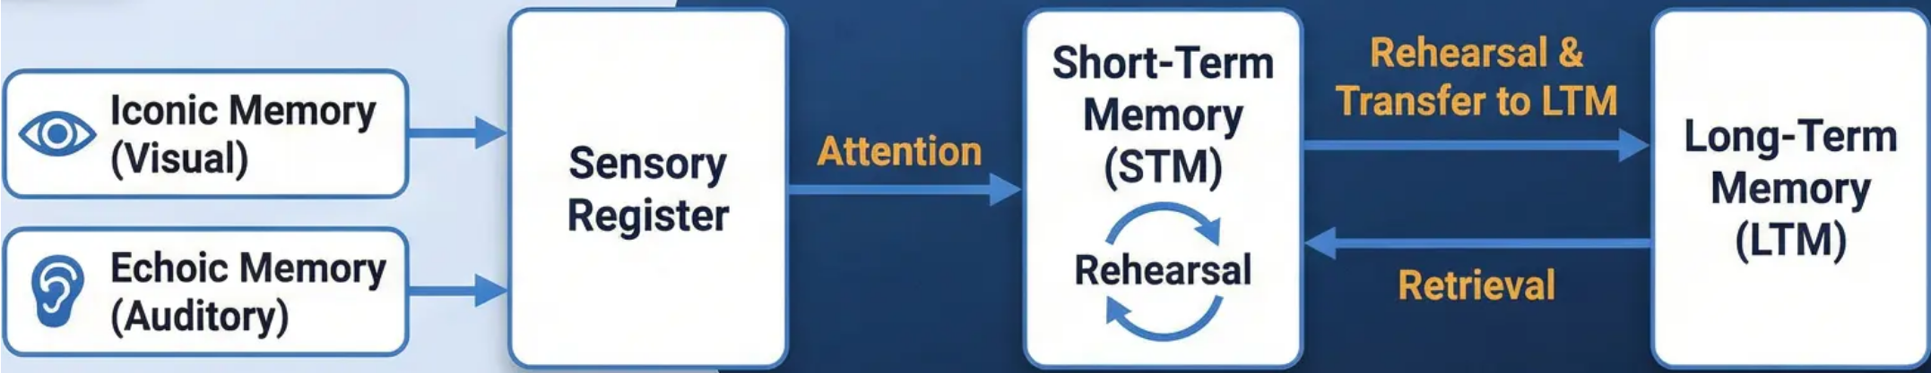
Session 2
The Multi-Store Model of Memory (MSM) & the Sensory Register
Atkinson & Shiffrin (1968): The Multi-Store Model of Memory
The Multi-Store Model represents the first systematic attempt to map a comprehensive structural framework of human memory. This
pioneering model emerged during the 'cognitive revolution' of the 1960s, using computational metaphors to understand the mind as
a linear, organised information-processing system.
The Sensory Register — The First Gateway
Attention as a Critical Cognitive Filter
Iconic Memory (Visual)
Attention operates as a selective mechanism that determines which
information merits further processing. This cognitive filter is essential to
prevent the system from being overwhelmed by an endless stream of sensory
data, allowing the mind to focus on relevant and important information.
• High-capacity storage system for raw visual information
• Very brief duration: less than 500 milliseconds
• Retains a temporary mental image of what was just seen
Echoic Memory (Auditory)
How might individual differences in attentional capacity affect the
efficiency of the sensory register in processing complex
environmental information?
• Processes unfiltered auditory information
• Relatively longer duration: 2–4 seconds
• Allows mental 'replay' of recently heard sounds

Slide 7





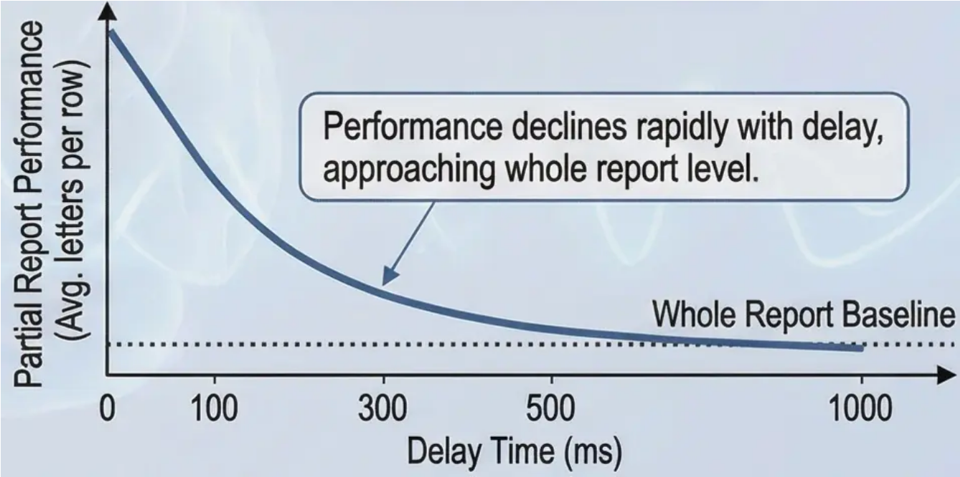
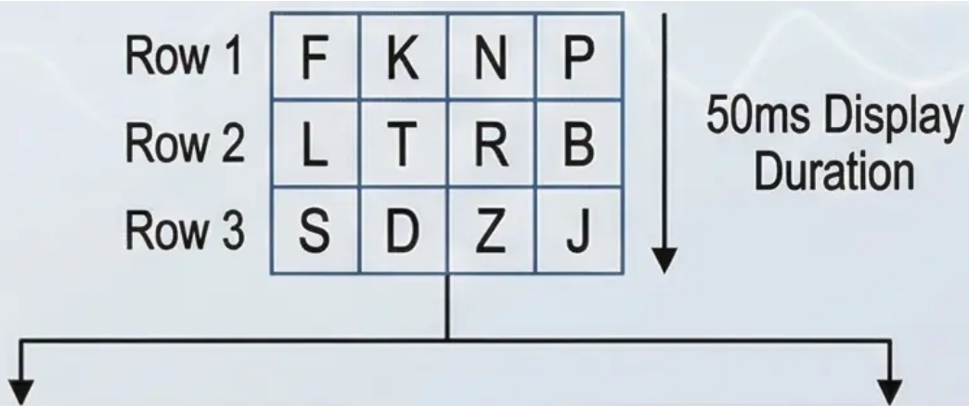

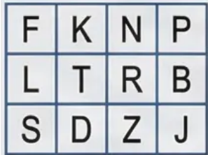
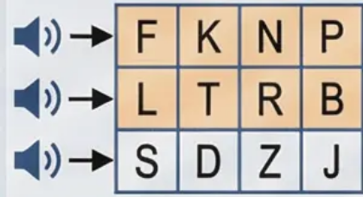

Experimental Evidence for the Sensory Register:
Sperling's (1960) Study
Session 2: Sensory Register
& Iconic Memory
Analysis of Whole and Partial Report Experiments as Decisive Evidence for Iconic Memory
Sperling's 1960 study is considered one of the most important studies in the
history of cognitive psychology, providing the first conclusive experimental
evidence for the existence of iconic memory. Sperling used an innovative
methodology comparing two types of recall to test his hypothesis about the
vast capacity and brief duration of the visual sensory register.
Revolutionary Results & Analysis
Scientific Interpretation of the Paradox: The fundamental difference between
results reveals the dual nature of iconic memory:
• High Capacity: The entire grid is temporarily available in iconic memory
• Rapid Decay: Information fades before participants can transfer it all to STM
Innovative Experimental Design
Basic Procedure: Sperling presented participants with a grid of three rows,
each containing four letters, for only 50 milliseconds — a period too brief to
allow eye movements or deliberate conscious processing.
Performance declines rapidly with delay,
approaching whole report level.
Deep Theoretical Implications
Participants asked to
recall all letters.
Result: Only 4-5
letters recalled out of
12.
An auditory tone cued
participants to recall one
specific row.
This study provides conclusive evidence that the sensory register is a separate
system from STM, with entirely distinct characteristics in terms of capacity and
duration.
Estimated total accessible:
~9 out of 12 letters (12 × 75%).
Discussion question: How do you explain the discrepancy between participants'
ability to recall 9 letters in partial report vs. only 4-5 in whole report? What does
this reveal about the nature of processing in the sensory register?

Slide 8

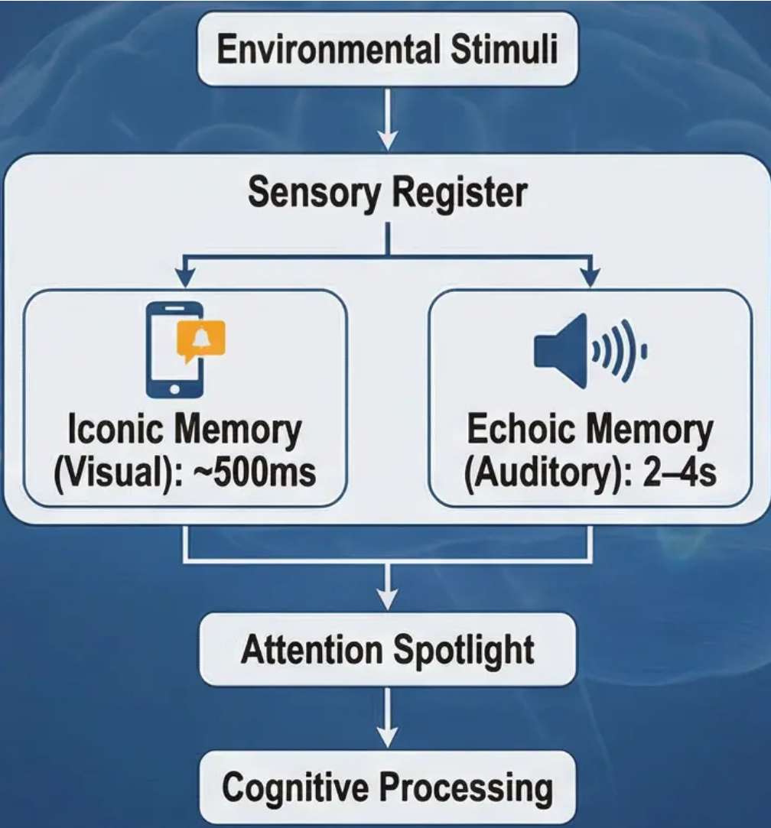


Critical Evaluation of the Sensory Register & User Interface Applications
From Theory to Practical Application in Digital Experience Design
Critical Analysis
UI Applications — Design Principles
from the Sensory Register
Information Flow through Sensory Register
Academic Excellence Framework
To achieve excellence in sensory register analysis, one
must move beyond simple description to critical
evaluation of empirical evidence. Sperling's 1960 study
not only revealed the existence of iconic memory but also
highlighted the interaction mechanism between high
capacity and short duration.
Applications of Iconic Memory
• Flash Notifications: Visually designed notifications
lasting 300-500ms to attract attention without
overwhelming the user
• Visual Feedback: Using rapid visual changes to
confirm user actions
• Loading Animations: Applying visual continuity
principles to enhance the waiting experience
Methodological Strengths
• Precise experimental control over display time (50ms)
• Inventive distinction between whole and partial reports
• Ability to measure effective capacity vs. reported
capacity
Applications of Echoic Memory
Critical Limitations
• Audio Cues: Designing audio signals lasting 2-4
seconds to ensure effective processing
• Voice Interface: Improving speech recognition
systems using echoic memory characteristics
• Alert Systems: Developing multi-modal alerts that
consider attentional limitations
• Reliance on artificial stimuli (random letters)
• Lack of consideration for contextual and semantic
influences
• Inadequacy in explaining individual differences in
performance
Evidence-Based UX Design
Discussion Question
Understanding sensory register characteristics allows UX designers to
create interfaces that align with users' natural cognitive abilities,
reducing cognitive load and enhancing usability.
How can our understanding of sensory register limitations guide the
design of more effective digital learning environments that account
for students' cognitive capacities?

Slide 9

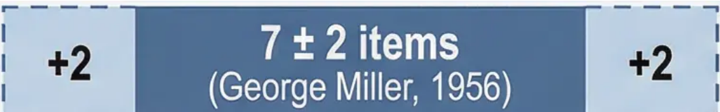
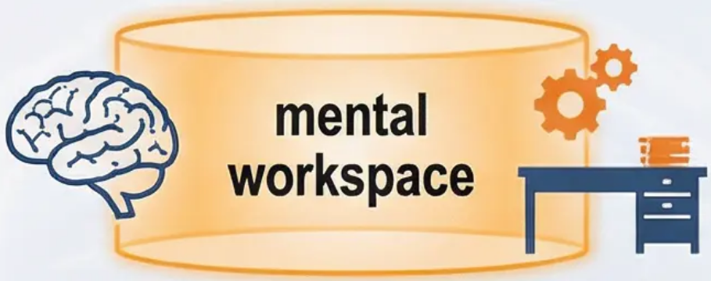




Session 3: Short-Term Memory (STM): Characteristics & Limitations
STM as the ‘Mental Workspace’ of Conscious Awareness
1. Capacity (Limited)
2. Duration (Short)
3. Acoustic Coding (Sound-based)
7 ± 2 items
The Magical Number Seven,
Plus or Minus Two
Without active effort,
information fades and is lost
(Peterson & Peterson, 1959)
Information is primarily encoded
acoustically (Conrad, 1964)
Chunking Strategy
B, C, D, E, G, P, T
EXF B✔V
Active maintenance
information excesses to
prevents decay in decay.
STM capacity is approximately 5-9 items.
This limited capacity can be overcome by
grouping individual items into larger,
meaningful units — a strategy known as
Participants are more prone to confusing
acoustically similar letters — information is
encoded by its sound, not its visual
appearance.
Information fades within approximately
15-30 seconds without active rehearsal.
Cognitive Implications
These limitations explain why we cannot follow a complex
conversation while simultaneously solving a mathematical problem —
both compete for limited STM resources.
Discussion Question: If STM duration is so brief, how are we able
to follow a conversation or read a complex sentence? What does
this suggest about the processes occurring within STM?

Slide 10






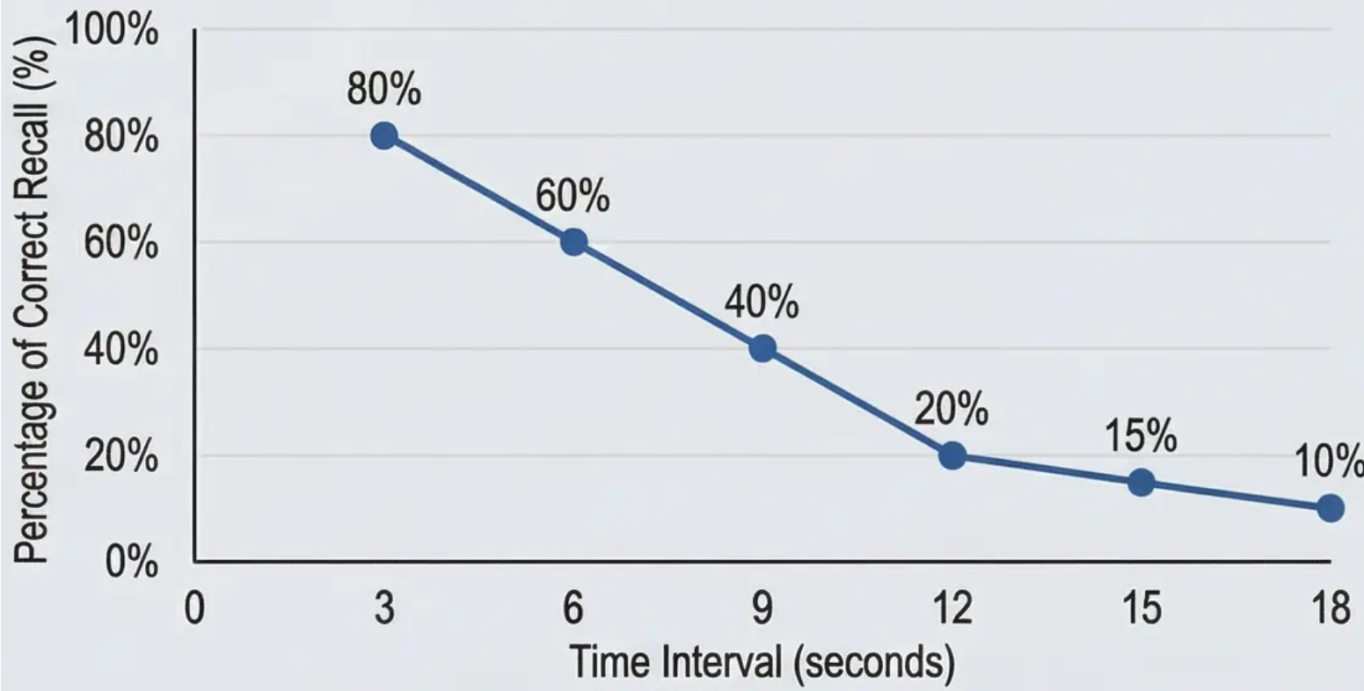

Studies on Capacity, Duration & Encoding in Short-Term Memory
Session 5: STM
Characteristics & Evidence
Critical Experimental Evidence for STM Characteristics
Conrad's Study (1964) — Acoustic Encoding
Peterson & Peterson's Study (1959) — Information Decay
Conrad presented participants with visual sequences of 6 letters, then
analysed error patterns in immediate recall.
Participants memorised sets of three letters (e.g., TRG), then counted
backwards from a given number to prevent rehearsal. Recall was
tested at increasing intervals: 3, 6, 9, 12, 15, 18 seconds.
Chunking Mechanism — Overcoming Capacity Limitations
Chunking allows grouping individual elements into meaningful units,
increasing the functional efficiency of STM without changing its
underlying capacity.
Example 1 (Difficult): C-I-A-F-B-I-K-G-B (9 separate letters) ❌
Example 2 (Easy): CIA – FBI – KGB (3 meaningful units) ✅
Chunking utilises knowledge stored in LTM to reorganise information in
STM, illustrating the dynamic interaction between memory systems.
Discussion Question: How does the fact that chunking improves STM
performance without increasing its underlying capacity reveal about the
relationship between STM and LTM?

Slide 11



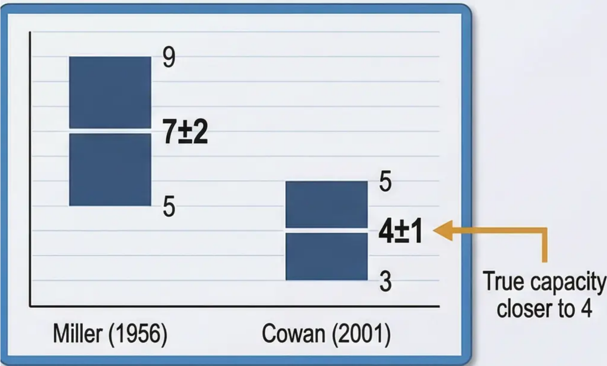
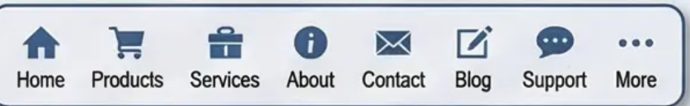
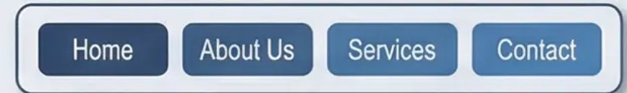

Critical Evaluation of STM Capacity & Educational Applications
Theoretical Analysis & Critical Evaluation
Practical Applications
Reconsidering the “Magical Number”
Educational Implications of Limited Capacity
Theoretical Evolution: From Miller to Cowan
To achieve academic distinction, one must move beyond accepting “7±2”
as absolute truth. Contemporary research by
suggests that the true capacity of STM is closer to 4 chunks, not the 7
originally proposed by Miller.
Cognitive Load Theory in Instructional Design (Sweller):
STM's limited capacity is a central factor in
Instructional designers must segment information into “chunks” that do not
exceed cognitive processing limits.
Practical Application Strategies:
Why was Miller’s estimate inflated?
Hierarchical Progression: Present information in layers, starting from
core concepts
This discrepancy arises because participants in traditional experiments used
subtle rehearsal strategies even in laboratory settings — when these are
controlled for, the true capacity emerges.
Intelligent Chunking: Link new information to existing knowledge to form
meaningful units
Temporal Distribution: Avoid overload by distributing information across
multiple sessions
Applications in User Interface Design:
Understanding STM limits is crucial for effective digital interfaces — menus,
buttons, and options should respect the 4±1 limit to avoid cognitive overload.
UI Design Example:
Ineffective design (cluttered)
Effective design (respects capacity)
Discussion question: How can teachers use understanding of the true STM
capacity (4 chunks) to redesign traditional teaching strategies that may rely
on inflated assumptions about students' information-processing abilities?

Slide 12





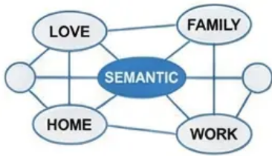





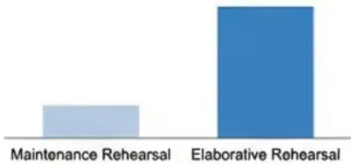

Session 4: Long-Term Memory (LTM): Capacity & Encoding
LTM as the Unlimited Reservoir of Human Knowledge
1. Unlimited Capacity & Duration
2. Semantic Encoding
Long-term memory is not
merely a storage unit for
information, but a dynamic
system that constantly
reorganises itself — every
new piece of information
alters the overall structure of
the cognitive network.
The capacity of LTM is practically unlimited — there is
no known limit to the amount of information that can be
stored over a lifetime. Its duration is potentially
permanent; evidence suggests that correctly stored
information can be retained for decades. Forgetting is
often a retrieval problem, not a storage loss.
The fundamental difference from STM is LTM's reliance
on semantic encoding — meaning and conceptual links.
Information is organised into complex semantic
networks connecting related concepts, creating a more
efficient and richer storage and retrieval system than
simple phonological encoding.
3. Memory Consolidation Process
4. Elaborative vs. Maintenance Rehearsal
Introduction:
Consolidation is the neurobiological process that
strengthens the initial memory trace after acquisition. It
involves structural and chemical changes in the brain,
including the strengthening of synaptic connections.
This process takes time and is affected by the type and
level of rehearsal used.
While the MSM focuses on simple repetition, research
emphasises the effectiveness of elaborative rehearsal
— actively thinking about the meaning of information
and making connections with existing knowledge. This
is far more effective than maintenance rehearsal for
creating strong, lasting LTM traces.
Long-term memory represents the
ultimate destination for information in the
Multi-Store Model. It is the vast and
permanent reservoir of our knowledge,
skills, and personal experiences.
Unlike the strict limitations of previous
stores, LTM possesses exceptional
characteristics that make it the true
foundation of human cognitive identity.
Challenge question: If LTM capacity is unlimited, why do we feel as if we 'run out of space' when
studying for exams? Does this contradict the theory, or can it be explained by other factors?

Slide 13

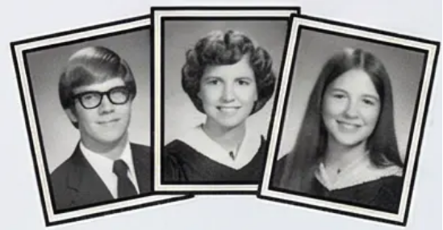
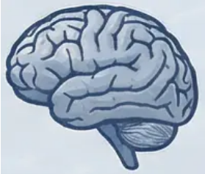
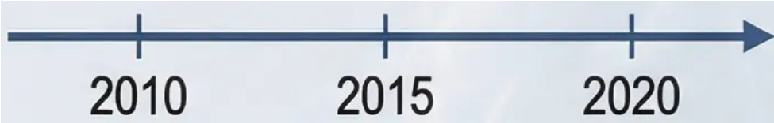
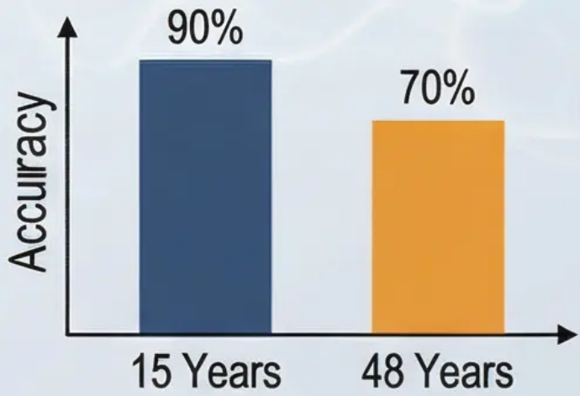
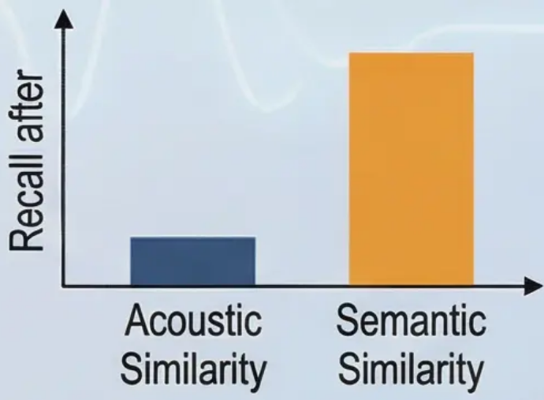

Supporting Evidence for LTM: Bahrick et al. & Baddeley's Studies
Experimental Evidence for the Distinctive Characteristics of Long-Term Memory
Bahrick et al. (1975) — Memory Retention Across Decades
Baddeley (1966) — Semantic Encoding in LTM
Acoustic:
(Man, Can, Cap,
Map, Mad)
Semantic:
(Big, Large, Huge,
Great, Wide)
392 graduates (aged 17–74) were
tested on four tasks: face recognition,
name matching, and free recall.
Compared the effects of acoustic
and semantic similarity on recall after
20 minutes.
Recall after 20 Minutes
Groups:
Experimental Design:
Yearbook photos used as stimuli;
Timeline spanning decades of
retention.
1. Acoustically similar words;
2. Semantically similar words;
3. Control (unrelated words).
Results:
Acoustically similar words: Poor recall (interference).
Semantically similar words: Good recall.
Remarkable results:
After 15 years: 90% accuracy in face recognition.
After 48 years: 70% accuracy in face recognition, 30% in name recall.
Scientific Conclusion
These findings demonstrate that LTM can retain information with
remarkable accuracy over extraordinarily long periods —
challenging the notion that forgetting is inevitable.
These findings confirm that LTM relies primarily on semantic
encoding (meaning) rather than acoustic encoding —
clearly distinguishing it from STM.

Slide 14

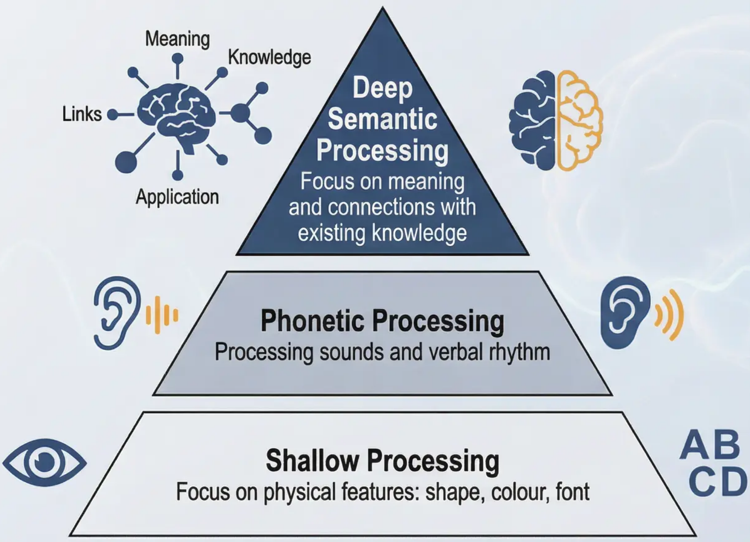




Levels of Processing & Distinction in Understanding Long-Term Memory
Craik & Lockhart (1972) Framework & Critique of Rehearsal in the MSM
Levels of Processing Framework
Elaborative vs. Maintenance Rehearsal
Maintenance Rehearsal
• Literal, rote repetition of information
• Maintains information in STM but does not guarantee effective
transfer to LTM
• Example: Repeating a phone number without connecting it to any meaning
Elaborative Rehearsal
• Active processing that links new information to existing knowledge
• Creates rich, interconnected semantic networks
• Uses analogies, examples, and personal applications
• Example: Linking a historical date to a personally significant event
Critical Evaluation of Rehearsal in the MSM
The Levels of Processing framework reveals a fundamental shortcoming
in the MSM. The original model assumes that repeated rehearsal inevitably
leads to transfer to LTM, but experimental evidence indicates:
→ Information processed semantically (even once) is retained better
than information rehearsed superficially hundreds of times
→ Quality of encoding matters more than quantity of exposure
→ LTM organises itself around meaning, not mechanical repetition
Levels of Processing Framework
The Levels of Processing framework by Craik & Lockhart (1972) presents
a fundamental challenge to the MSM's assumptions about rehearsal. Rather
than focusing on the quantity of repetition, this framework emphasises the
quality and depth of cognitive processing as the primary determinant of
LTM strength.
How can principles of deep processing be integrated into curriculum
design to enhance long-term retention rather than temporary exam
memorisation? What practical strategies can students use to
transform information from shallow to deep semantic processing?

Slide 15



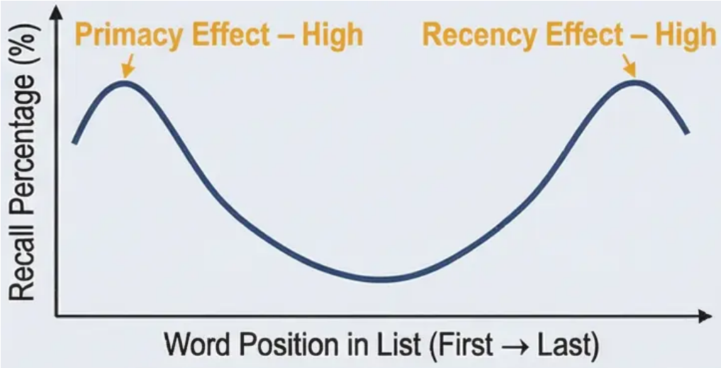


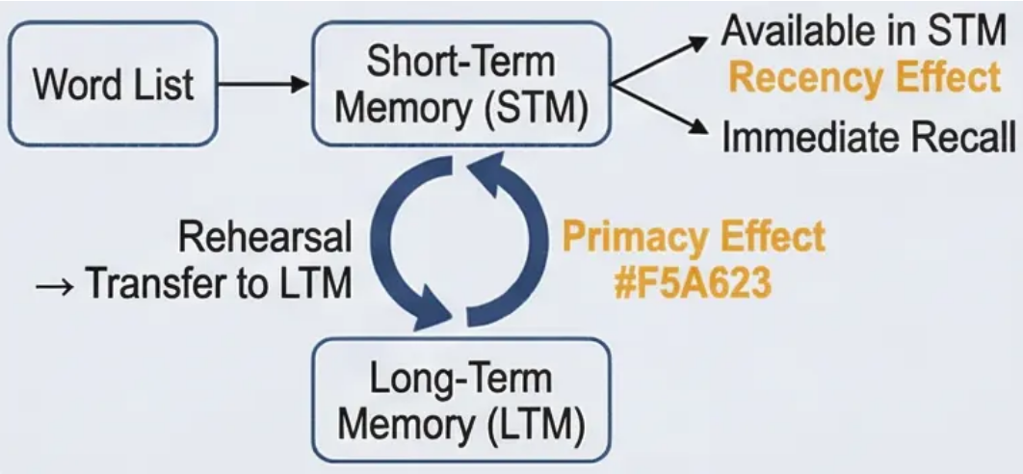

Evaluating the Contributions and Explanatory Power of
the Multi-Store Model of Memory
Session 5: MSM Evaluation
& Serial Position Effect
Leading Model & Scientific Impact
The MSM was the first cognitive model to provide a comprehensive, empirically testable framework for
memory, shifting psychology away from purely behaviourist explanations. Its conceptual clarity and simplicity
served as a powerful catalyst for advanced scientific research in subsequent decades.
Structural Differentiation Between Stores
Its greatest contribution is the clear, systematic distinction between the Sensory Register, Short-Term
Memory (STM), and Long-Term Memory (LTM). This tripartite sequential division stimulated decades of specialised
research into the unique characteristics of each store in terms of capacity, duration, and encoding mechanisms.
Serial Position Effect
The model provides an elegant and coherent explanation for the Serial Position Effect — the empirical
finding that individuals recall items from the beginning and end of a list significantly better than items
from the middle.
→ Primacy Effect
Superior recall of early items is explained by their additional rehearsal and transfer to LTM. Early
items receive longer processing time and more rehearsal cycles before subsequent items arrive,
consolidating them in long-term storage.
→ Recency Effect
Good recall of the final items is explained by their continued presence in STM at the time of testing,
making them immediately available for retrieval without requiring access to LTM.
Critical Analysis
This explanation supports the concept of separate and distinct memory stores, as
each effect reflects the unique characteristics of a different store — providing
strong empirical support for the MSM's structural assumptions.
Can the Serial Position Effect be used to argue against the MSM as
well as support it? Consider how naturalistic memory (e.g., recalling
a story) does not always show a strong recency effect. What does
this imply for the model's ecological validity?

Slide 16


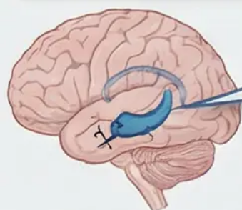
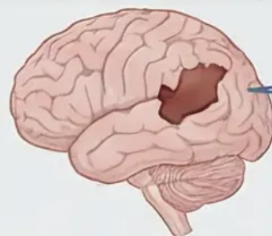
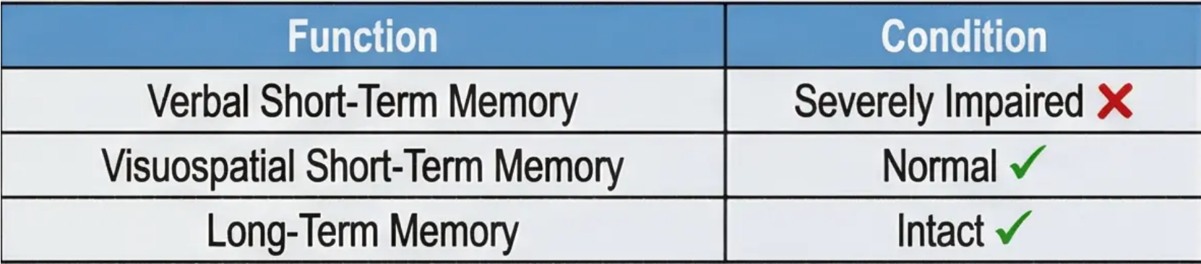




Structural Deficiencies of the MSM:
Neuropsychological Case Studies
Session 5: MSM Evaluation
Analytical Introduction:
Patient HM (Henry Molaison)
Patient KF
Removal of Hippocampus and Amygdala
(Bilateral Temporal Lobectomy) (1953)
- To treat epilepsy
Damage from motorcycle
accident
Medical Context: HM underwent bilateral temporal lobectomy (removal of
hippocampus and amygdala, 1953) to treat severe epilepsy, resulting in
profound anterograde amnesia — an inability to form new long-term
memories.
Injury & Symptoms: Severe impairment in verbal short-term memory following
a motorcycle accident, while visuospatial short-term memory remained intact.
Challenge to the Unitary Assumption
This case refutes the MSM's assumption of a single, unified short-term
memory store.
Challenge to the MSM — Theoretical Implications
Long-term memory is NOT a unified block:
🧠 Declarative memory: Severely impaired — unable to recall new
events or facts
🧠 Procedural memory: Completely intact — able to learn new motor
skills (e.g., mirror drawing)
🧠 Short-term memory: Functions normally
Advanced Critical Analysis
Case Study Methodology
• Strengths: Natural evidence that cannot be ethically replicated; reveals
true functional dissociations; supports multi-system theories
• Limitations: Difficulty in generalisation; variability in injuries; potential
compensatory brain effects
Broader Theoretical Implications
These cases paved the way for more complex models, such as the Working
Memory Model and multi-system theories of LTM.
How can individual case studies refute an entire scientific theory?
What criteria must a case study meet to be scientifically convincing?

Slide 17


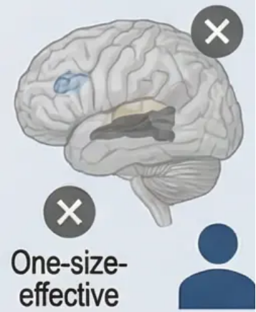
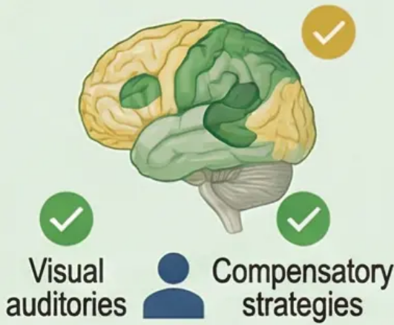
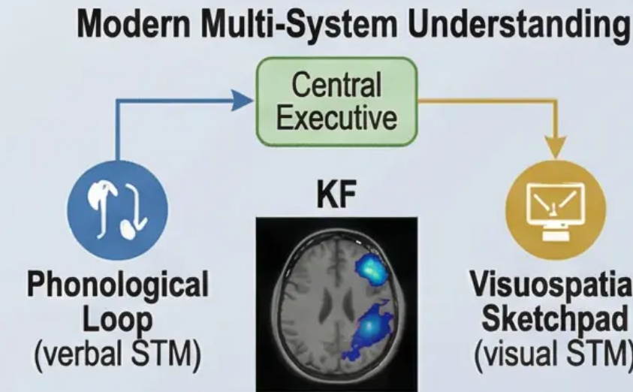
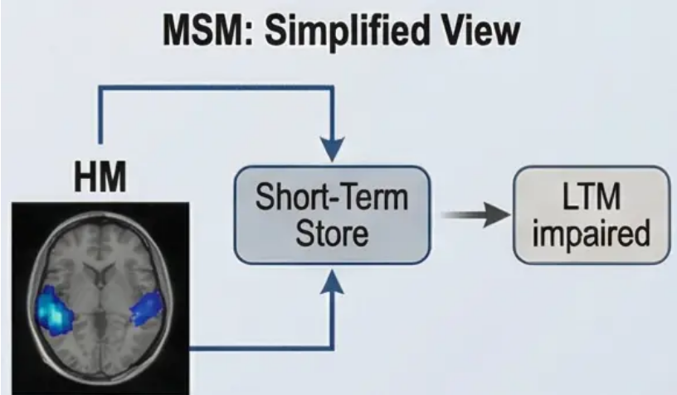
Critical Synthesis of the MSM & Neurorehabilitation Applications
From Theoretical Shortcomings to Therapeutic Innovation
Core Academic Analysis:
Applications in Neurorehabilitation:
The transition from simplified models to a multi-system
understanding of memory is no longer merely a theoretical
development — it is a clinical necessity for improving patients' lives.
Advanced Differential Diagnosis:
Understanding the multi-system complexity of memory enables
rehabilitation specialists to design more precise assessments. Rather than
testing memory as a single unit, each subsystem can be evaluated
separately — precisely identifying damaged and intact areas.
The Logical Argument for Model Development:
Advanced academic evaluation of the MSM requires constructing a coherent
logical argument that moves from empirical evidence to theoretical conclusions.
The functional dissociations in cases HM and KF are not mere individual exceptions
— they reveal fundamental shortcomings in the core assumptions of the MSM.
Targeted Compensation Strategies:
When verbal memory is impaired but visual memory is intact, therapeutic
programmes can be developed to exploit visual strengths to compensate
for verbal weaknesses. This principle, derived from understanding the neural
complexity of memory, significantly improves rehabilitation outcomes.
Scientific Logic:
If the MSM were correct in assuming a single unified STM store, any damage
to this store should affect all types of short-term processing equally.
However, patient KF shows a clear dissociation: impaired verbal processing
with intact visuospatial processing. This pattern of selective deficit logically
refutes the concept of a unified store.
Comparison:
Comparison Diagram:
Discussion Prompt: How can an advanced understanding of multiple
memory systems radically change rehabilitation approaches for patients
with different types of brain injury? What are the ethical and practical
challenges in applying this understanding?

Slide 18


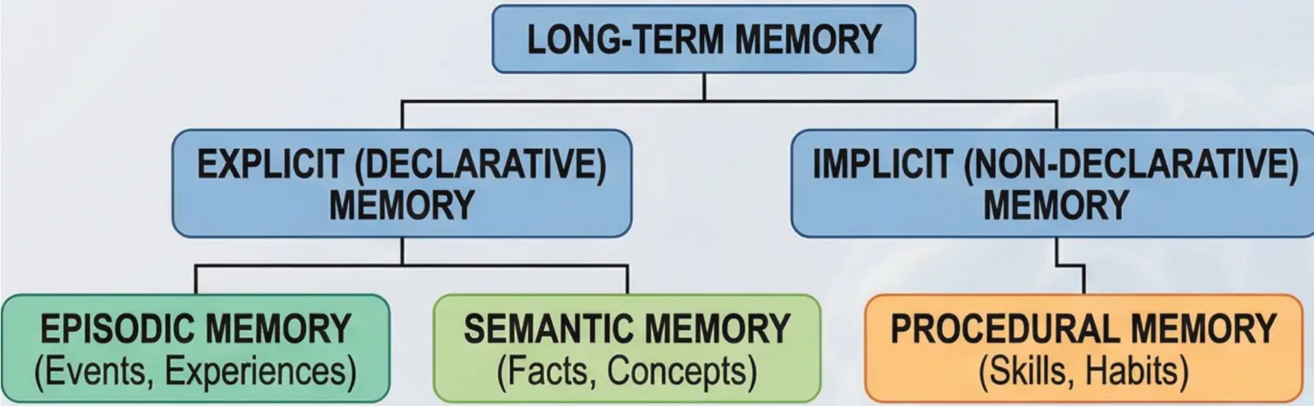
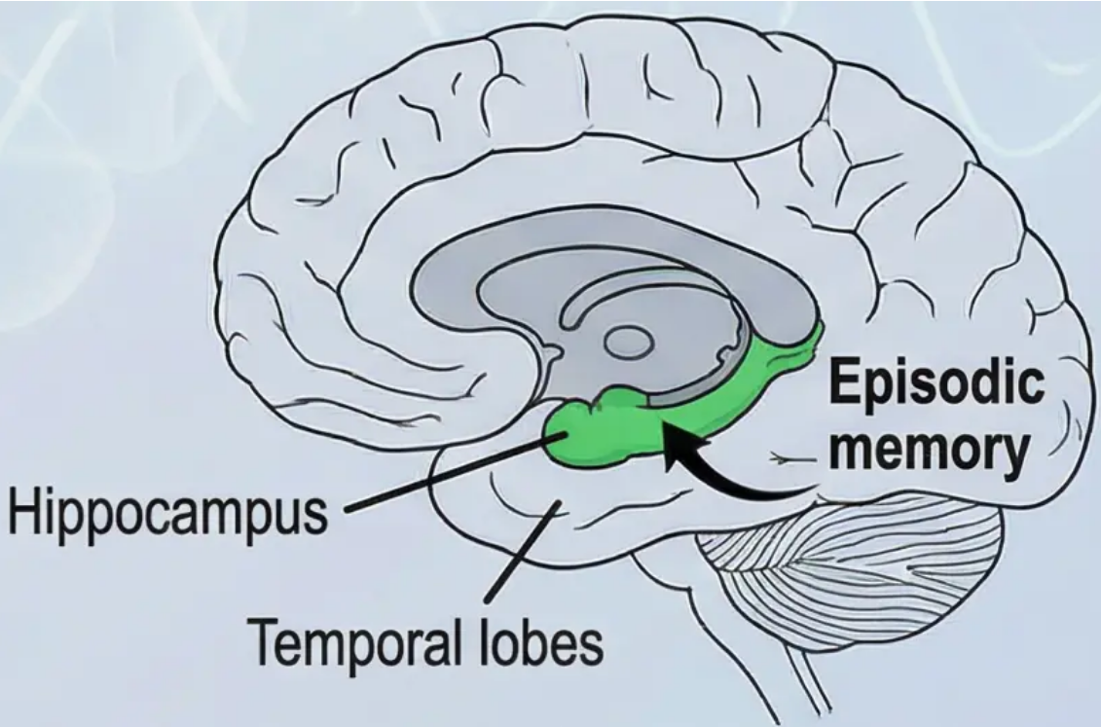



Explicit Memory: Episodic & Semantic Memory
Session 6
Theoretical Context:
Tulving's (1972) Classification of Long-Term Memory
The clear limitations of the Multi-Store Model, particularly evidence
from neuropsychological case studies such as patient HM, led
to the recognition that LTM is not a single unified store. This
prompted psychologist Endel Tulving (1972) to propose a
revolutionary distinction within LTM, arguing that it comprises
specialised, functionally distinct systems.
Explicit Memory
Explicit memory refers to memories that can be consciously recalled
and verbally declared — our 'declarable' knowledge. It divides into
two specialised systems:
Episodic Memory
• Definition: Our personal and autobiographical memory store
• Characteristics: Time-stamped, tied to specific context
• Nature: Subjective experience of 'mental time travel'
• Content: Personal events, experiences, memorable moments
• Example: 'I remember when I graduated on a rainy day...'
Semantic Memory
• Definition: Network of general knowledge and organised facts
• Characteristics: Detached from temporal and spatial context
• Nature: Objective, culturally shared information
• Content: Facts, concepts, language, rules
• Example: 'I know that Paris is the capital of France' (without
remembering when this was learned)
Can you have episodic memory without semantic memory?
Can the reverse occur? Consider your memory of
'graduation day' — what belongs to each system?

Slide 19

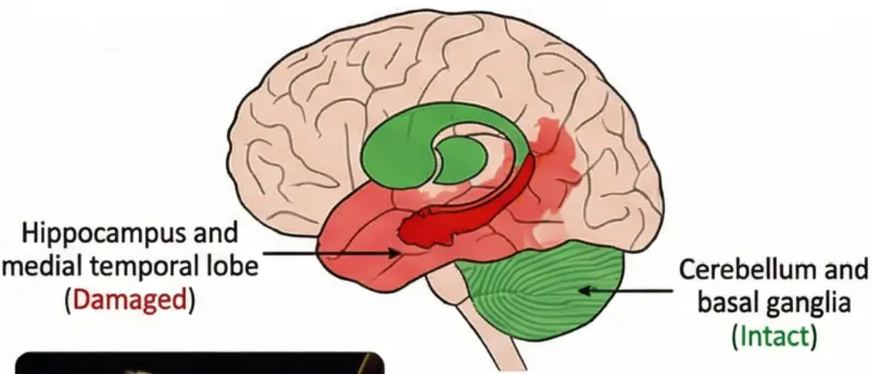
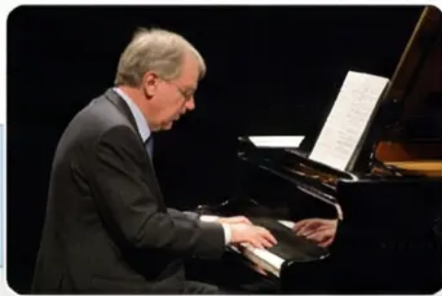
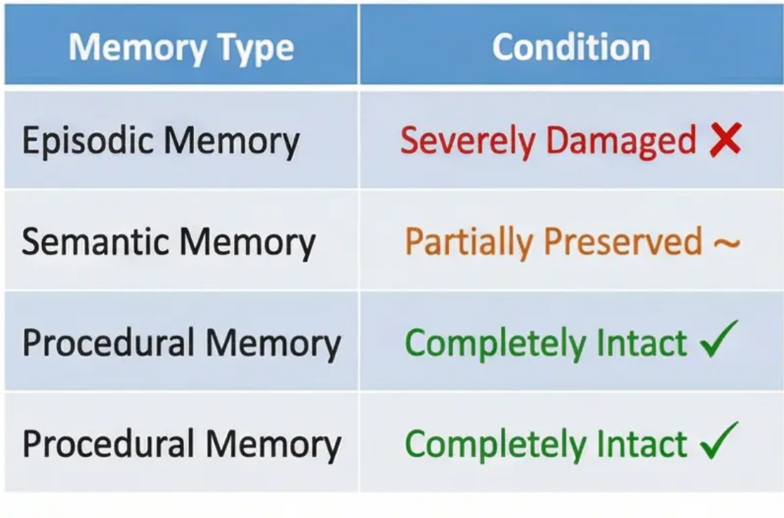

Functional Dissociation in LTM: The Case of Clive Wearing
Crucial Neuropsychological Evidence for Distinct Memory Systems
Case Background
Crucial Theoretical Significance
Clive Wearing, a distinguished British musician,
suffered from encephalitis caused by the herpes
simplex virus in 1985. This viral infection
destroyed crucial parts of his brain, particularly
the hippocampus and surrounding regions in the
medial temporal lobe. The result was one of the
most severe cases of amnesia documented in
neuropsychological literature.
Wearing's case provides strong evidence against the
MSM's assumption of a single LTM store. The clear
dissociation between the three types of memory
proves they are independent systems relying on
separate neural networks.
Neurological Evidence for Functional Dissociation
1. Severely Damaged Episodic Memory: Wearing lost the
ability to form new episodic memories (severe
anterograde amnesia). He cannot recall events that
occurred just minutes ago and lives in a state of
“perpetual awakening,” feeling as if he has just woken
from a prolonged coma.
Memory State Comparison Table
2. Partially Preserved Semantic Memory: Despite severe
damage, Wearing retained basic world knowledge. He
knows who his wife Deborah is, remembers basic
musical facts, and recognises familiar people — but
cannot recall when or where he acquired this knowledge.
Neuroanatomical Interpretation
• The hippocampus is essential for episodic memory as
it links different pieces of information (time, place,
context) into a coherent ‘event.’ Damage prevents this
linking. In contrast, procedural memory relies on the
cerebellum and basal ganglia — which remained
intact in Wearing’s case.
3. Completely Intact Procedural Memory: The most
remarkable aspect is his complete preservation of
complex musical skills. He can play the piano, conduct
orchestras, and read musical scores with the
same proficiency as before — without any conscious
awareness that he is performing these skills.
How does Clive Wearing's case challenge the traditional concept of memory as a single system?
What are the implications for our understanding of personal identity when episodic memory is lost?

Slide 20


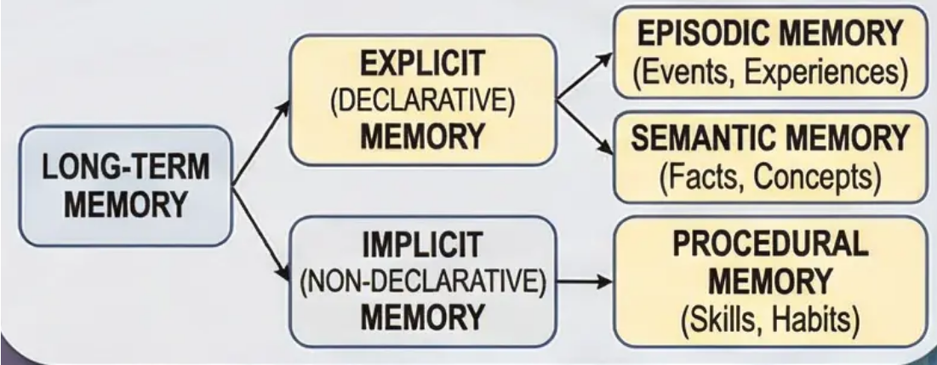



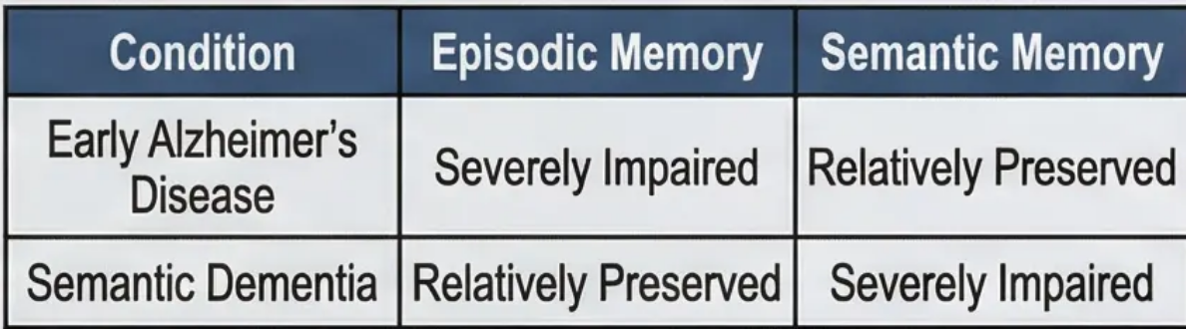

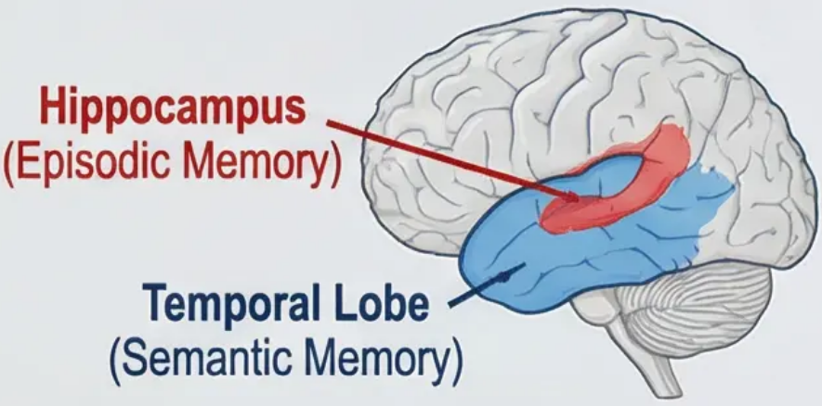

Interaction Between Explicit Systems
& Clinical Diagnostic Applications
Advanced Theoretical Analysis
Specialised Clinical Applications
Interactive Relationship Between Systems
Differential Diagnosis in Neuropsychology
To achieve academic excellence, one must move beyond
the simplistic view that treats episodic and semantic
memory as entirely separate entities. The scientific reality is
more complex and rich — these two systems are deeply
interconnected in a complex network of mutual interactions.
This theoretical distinction is crucial in clinical practice
for accurately diagnosing memory disorders. A
patient may have relatively intact semantic memory
(knowing who the current prime minister is,
remembering general concepts) while suffering from
severe episodic memory loss (not remembering
what they did this morning, or a doctor's visit last
week).
Therapeutic Implications
Mechanisms of Mutual Influence
Designing Cognitive Rehabilitation
Programmes
Understanding this interaction guides the
development of therapeutic strategies. For
patients with episodic memory impairment but
preserved semantic memory, preserved semantic
knowledge can be used as a foundation for
building compensatory strategies to improve daily
functioning.
Our semantic knowledge of 'dogs' as a general concept is
gradually built through multiple episodic encounters with
specific dogs at different times and places. Each personal
experience with a specific dog contributes to enriching and
refining our general semantic concept.
Conversely, our ability to understand and encode a new
episodic event depends on our pre-existing semantic
knowledge.
Compensatory
Strategies
Preserved
Semantic
Knowledge
How can an advanced understanding of this
interaction affect how we design rehabilitation
programmes for patients with specific types of
memory loss? What are the ethical
considerations in utilising preserved systems?

Slide 21




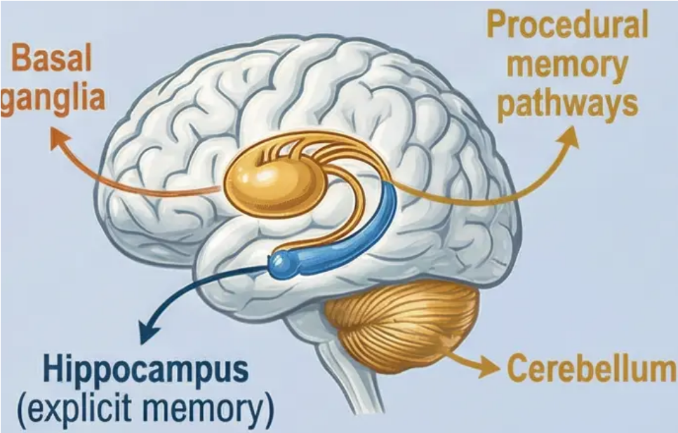
Implicit & Procedural Memory
Session 7
Non-Declarative Memory Systems
Implicit Memory
Characteristics of Automaticity
Implicit memory refers to the memory system that operates without direct
conscious awareness, where past experiences influence behaviour
and performance without the individual being aware of this influence. It
is also known as non-declarative memory because it does not require
conscious recall or the ability to verbally express its contents.
Automaticity Properties:
Unconscious Execution: Procedural skills are
performed without conscious thought about their steps
Resistance to Interference: Difficulty disrupting
performance once learning is complete
Speed & Efficiency: Rapid and accurate execution with
minimal cognitive effort
Procedural Memory
Distinction from Explicit Memory:
The most prominent type of implicit memory,
specialising in storing motor skills, habits, and
automatic procedures. It encompasses “know-how”
knowledge — such as riding a bicycle, playing a
musical instrument, or typing on a keyboard.
While explicit memory (episodic and semantic) requires
conscious effort for recall and the ability for verbal description,
procedural memory operates automatically and resists
conscious attempts to control it.
Neural Bases
Procedural memory relies on a different neural network from explicit memory, involving the Basal
Ganglia and Cerebellum rather than the Hippocampus (which supports explicit memory).
Why might it be evolutionarily advantageous for complex skills to become automatic?
Consider the potential advantages and disadvantages of this automaticity in everyday life.

Slide 22

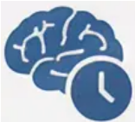

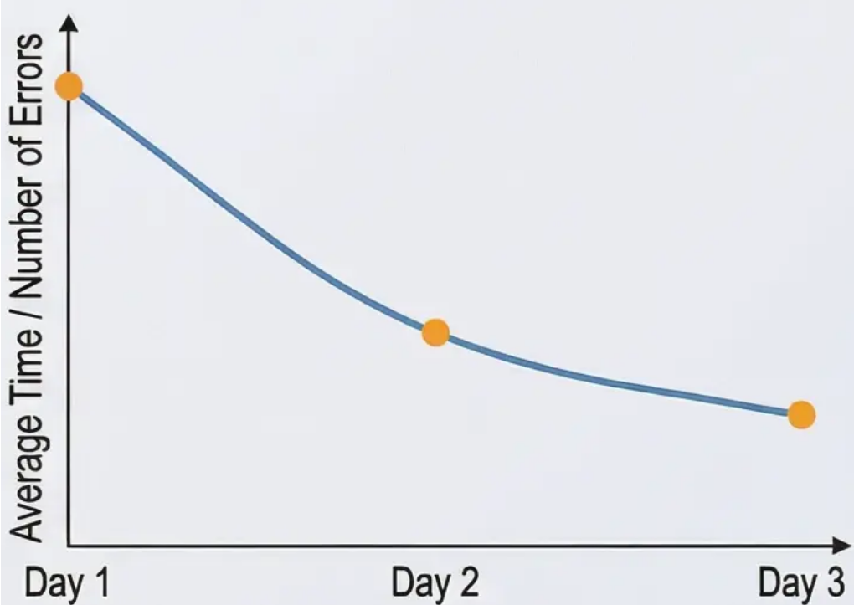

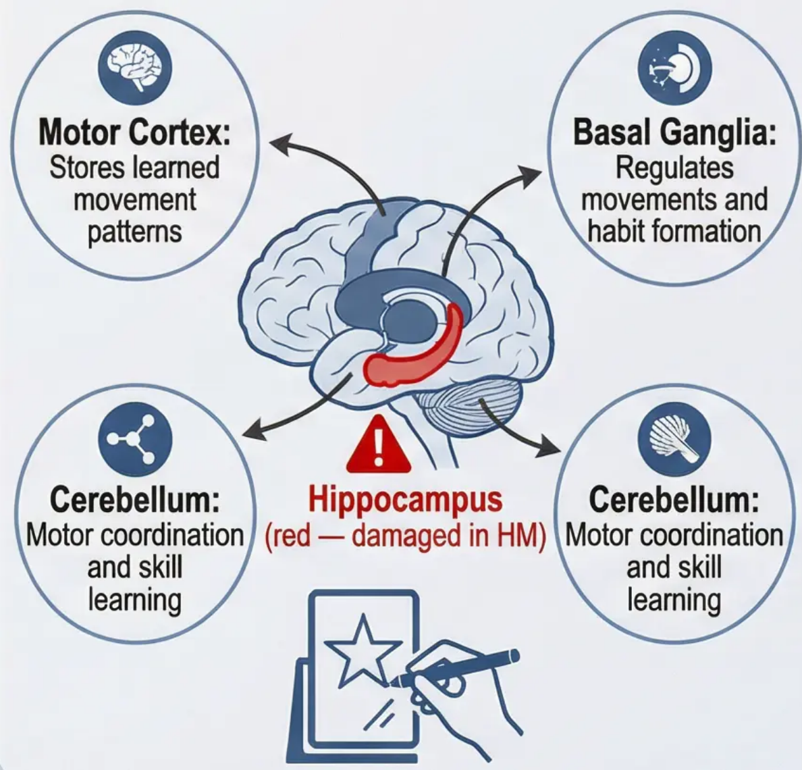


Experimental Evidence for Procedural Memory: The Mirror-Drawing Task
Neuropsychological Case Studies & Analysis
Patient HM — Functional
Dissociation
Neuropsychological Interpretation
& Theoretical Implications
HM's Learning Curve —
Mirror-Drawing Task
After surgical removal of the hippocampus to treat
epilepsy, HM suffered from severe anterograde
amnesia, unable to form new explicit memories.
However, his motor skill learning provided strong
evidence for a separate procedural memory system.
Dramatic Dissociation: Procedural memory relies
on different neural circuits from explicit memory
(which was damaged in HM). This demonstrates
learning in the “know-how” domain, entirely
independent of declarative memory.
The Mirror-Drawing Task —
Detailed Analysis
HM was asked to trace a five-pointed star while
viewing his hand through a mirror reflection, which
reverses natural movement directions. This task
requires new motor coordination and reprogramming
of automatic responses.
Crucial Results
Improved performance across sessions despite
no conscious memory of the task.
✔ Consistent and measurable improvement
in performance across sessions
✔ Decrease in number of errors and
completion time at a normal learning rate
✔ Retention of the acquired skill even after
long rest periods
✔ He insisted in each session that he had
never performed the task before
Discussion Question
How can this dissociation between ‘knowing
how’ and ‘knowing what’ explain everyday
phenomena — such as our ability to ride a
bicycle years after not practising, despite
not remembering the details of learning it?

Slide 23



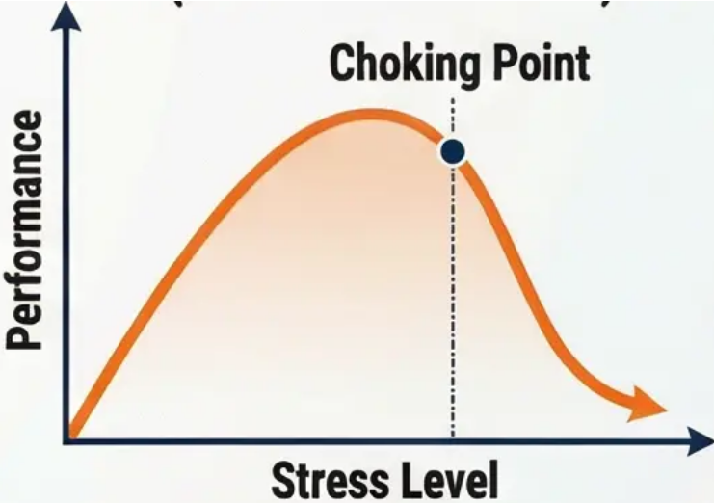

Academic Distinction Between LTM Types
& Sports Performance Applications
Comparative Analysis of Explicit vs. Implicit Memory Systems
Neuroanatomical Basis
Explicit Memory:
Relies on hippocampus
and medial temporal
lobe – vulnerable to
damage and amnesia
Implicit Memory:
Relies on cerebellum
and basal ganglia –
explaining its
persistence even with
hippocampal damage
Performance Curve
(Yerkes-Dodson Law)
Applications in Sports Psychology: The 'Choking Under Pressure' Phenomenon
Psychological Mechanism:
Applied Strategies:
1. Automated skill operates efficiently through procedural memory
2. Pressure stimulates the desire for conscious control
3. Conscious interference disrupts the automatic mechanism
4. Result: Performance decline despite high experience
Training Under Pressure: Building resistance to conscious interference
External Focus Techniques: Directing attention to outcomes, not the
process
Varied Practice: Strengthening multiple procedural pathways
Discussions: How can sports coaches use their understanding of procedural memory to design training programmes that reduce
the likelihood of 'choking under pressure'? What strategies can enhance automatic performance in high-pressure situations?

Slide 24



Session 8:
MSM Evaluation &
Serial Position Effect
The Working Memory Model (WMM): Core Components
Baddeley & Hitch (1974): From Passive Memory to Active Processor
Theoretical Development
& Motivation
Components of the WMM
WMM Diagrams
1. Central Executive
The development of the Working Memory
Model by Alan Baddeley and Graham Hitch
in 1974 was a direct response
to shortcomings in the MSM. Instead of
viewing STM as a single, passive store, they
proposed a dynamic multi-component
system that actively participates in complex
cognitive processing.
The main supervisory component that does not
store information itself, but coordinates the
activities of its subsidiary systems.
Basic Functions:
• Focusing, dividing, and switching attention
• Monitoring and processing incoming information
• Retrieving information from long-term memory
• Controlling cognitive processing strategies
• Working memory is an active attentional
control system
• It consists of specialised and partially
independent components
• It supports higher cognitive tasks such
as thinking and problem-solving
• It has limited processing capacity,
requiring resource management
2. Phonological Loop
A specialised subsidiary system for processing
auditory and verbal information.
a) Phonological Store (Passive):
• Retains auditory information
• Very short duration (1-2 seconds)
• Known as the 'inner ear'
b) Articulatory Process (Active):
• Rehearsal and maintenance component
• Converts written material into phonological code
• Known as the 'inner voice'

Slide 25





Phonological Loop Studies & the Word Length Effect
Experimental Evidence for the Articulatory Rehearsal Mechanism
Articulatory Suppression
The Word Length Effect
Articulatory suppression provides direct evidence
for the role of the articulatory process in the
phonological loop.
When participants are asked to repeat a
meaningless word (e.g., 'the, the, the') aloud while
attempting to remember a list of words, their
performance deteriorates significantly.
The word length effect is considered one of the strongest experimental pieces of evidence for the
existence of a time-limited articulatory rehearsal mechanism in the phonological loop.
Multiple studies have shown that individuals recall short words (e.g., 'pen, house, fire') significantly
better than long words (e.g., 'university, hospital, television') in STM tasks.
Psychological Mechanism
The capacity of the phonological loop is not determined by a fixed number of items, but by the time
required for inner articulation — approximately 2 seconds. Short words require less articulation time,
allowing more repetitions within this limited window.
Long words consume more time, reducing rehearsal frequency
and causing faster decay of the phonological trace.
Scientific Explanation
This deterioration occurs because external
repetition blocks the 'inner voice' (articulatory
process), preventing maintenance rehearsal of
information in the phonological store.
The result is rapid decay of information within 1–2
seconds — proving that articulatory rehearsal is
essential for maintaining information in the
phonological loop.
Theoretical Significance
• Proving Functional Specialisation: The
phonological loop handles verbal and auditory
information exclusively.
• Confirming Temporal Limits: Capacity is limited by
time, not number of items.
• Proving Active Rehearsal: The articulatory process
is essential for information maintenance.
How can our understanding of the word length effect
be used to develop more effective teaching strategies
for children learning to read, particularly those with
difficulties in verbal information processing?

Slide 26



WMM Applications in Diagnosing & Treating Learning Disabilities
Phonological Loop Deficits & Multi-Sensory Intervention Strategies
WMM & Learning Disabilities Connection
Mechanism of Phonological Loop Deficit in Dyslexia
The Working Memory Model has brought a real revolution in our understanding of
learning disabilities, especially dyslexia. Research indicates that many children with
reading difficulties have a specific deficit in the phonological loop — the component
responsible for processing and temporarily retaining verbal sounds.
When a child with dyslexia tries to read a new word, their ability to retain letter
sounds in the phonological loop is weak. This makes it difficult to link sounds
together to form a complete word — they may forget the first sound by the time
they reach the last.
Clinical & Diagnostic Applications
Multi-Sensory Intervention Strategies
• Visual-Motor Method (✋): Using different colours for letters with hand
movements to strengthen visual and motor encoding, reducing reliance on
the phonological loop alone.
• Phonological Loop Tests: Digit span, word recall
• Visuospatial Sketchpad Tests: Visual arrays
• Rhythmic Repetition (🎶): Using rhythm and music to support retention of
auditory information — rhythm helps strengthen the phonological store.
• Central Executive Tests: Dual tasks
This specialised assessment helps develop customised intervention plans for each
child based on their strengths and weaknesses in working memory.
• Semantic Chunking (📚): Teaching children to associate words with pictures
or stories, activating the visuospatial sketchpad and providing alternative
pathways for recall.
Discussion Prompt: “How can teachers in regular classrooms apply working memory principles to support all students — not just those diagnosed with learning disabilities?”

Slide 27
The Visuospatial Sketchpad & the Episodic Buffer
Session 9:
The Visuospatial Sketchpad
& the Episodic Buffer
Components of the Working Memory Model
Part 1: Visuospatial Sketchpad (VSS)
Part 2: Episodic Buffer
The Visuospatial Sketchpad is the second subsidiary system within the
Working Memory Model. It acts as the 'inner eye' of the model, responsible for
the temporary storage and active processing of visual and spatial information.
Baddeley added this component in 2000 to address structural deficiencies
in the original model. The episodic buffer is a temporary, limited-capacity
store that performs a crucial integrative function in working memory.
Subdivision (Logie, 1995):
Key Functions:
Visual Cache (passive): Retains information about visual characteristics
of objects: shape, colour, visual texture;
• Functions as a temporary repository for static mental images.
• Multimodal Integration: Integrates information from the phonological
loop and visuospatial sketchpad into a unified, coherent
representation
Inner Scribe (active):
• Deals with spatial and movement information;
• Rehearses information in visual memory;
• Allows processing and manipulation of mental images (e.g., rotating
3D shapes, tracking spatial paths).
• Interface with LTM: Connects working memory with long-term
memory, allowing new information to integrate with existing knowledge
• Construction of Temporary Episodes: Creates temporary 'episodes'
combining visual, verbal, and cognitive elements within a specific
temporal context.
Advanced Application Example:
When watching a film, your phonological loop processes dialogue and sound
effects, while your visuospatial sketchpad processes visual scenes and
camera movements. The episodic buffer integrates these separate streams
with your prior knowledge from LTM, producing a unified and coherent
understanding of the story.
How can the episodic buffer explain our ability to understand complex
narratives or follow events in multi-plot films? What are the implications
for designing multimedia educational content?

Slide 28
The Logic of Dual-Task Studies
Proving the Independence of Subsidiary Systems in the Working Memory Model
Core Principle of Selective Interference
Expected Result Patterns:
Dual-task studies are based on a fundamental
principle: if two tasks use the same cognitive
system, they will compete for that system's limited
resources, causing performance to deteriorate.
Conversely, if two tasks use different, independent
systems, they can be performed simultaneously with
minimal interference.
Scenario 1 — System Competition
(Same Subsidiary System)
Scenario 2 — System Independence
(Different Systems)
When one task uses the phonological loop (e.g., word
repetition) and the other uses the visuospatial sketchpad
(e.g., visual path tracking), interference is minimal
or absent. Both tasks can be performed efficiently as
each uses an independent system.
The
text
describes
the
expected
results.
Experimental Design:
• Phase 1 — Single Task Baseline: Participants
perform each task separately to establish baseline
performance. For example: a digit span task (uses
phonological loop) and a moving dot tracking task
(uses visuospatial sketchpad).
The text describes the expected results of the
experiment. It explains that when two tasks use the
same subsidiary system, such as the phonological
loop, performance decreases significantly. This
is indicated by the 'Conflict' symbol, a red
lightning bolt, and the 'Performance Decrease'
arrow, a red downward arrow.
• Phase 2 — Dual Task: Participants perform both
tasks simultaneously. The degree of performance
decline compared to single-task baseline is
measured.
Performance Comparison Table:
Theoretical Significance:
This pattern of results provides strong evidence that
the WMM is correct in assuming separate, independent
subsidiary systems — rather than a single unified store
as proposed by the MSM.
Discussion Questions? How can the logic of dual-task studies be used to test whether
a new cognitive task uses the phonological loop or the visuospatial sketchpad? Design
a simple experiment to test this.

Slide 29
WMM Applications in STEM Fields & Game Design
Utilising the Visuospatial Sketchpad in Advanced Interactive & Professional Environments
Applications in STEM Fields
Game & Virtual Reality Design
Architectural Engineering & Design
Considering Working Memory Limits
Architects and engineers use the VSS extensively for
mentally rotating 3D models, visualising designs from
multiple angles, processing complex spatial
relationships, and analysing structural designs to
identify potential problems before construction.
Game and VR designers must understand working
memory limitations to create experiences that don't
overload the player's cognitive system — providing
enough information for immersion without causing
cognitive strain.
Surgery & Medicine
Designing Interactive Interfaces
Surgeons rely heavily on the VSS to navigate complex
anatomical structures during operations. The ability to
maintain and constantly update a 3D mental map of
internal organs is vital for successful procedures and
patient safety.
Understanding VSS capacity helps in designing effective
visual user interfaces. The number of elements displayed
simultaneously, complexity of spatial layouts, and speed
of visual changes must align with human VSS
capabilities.
Molecular Chemistry
Immersive Environments
Chemists use the VSS to visualise complex molecular
structures and understand 3D chemical reactions —
essential for drug design and comprehending molecular
interaction mechanisms.
When designing VR environments, it is important to
consider how the VSS processes spatial information to
create a realistic sense of presence and spatial
orientation without causing cognitive fatigue or motion
sickness.
Applied Considerations
Individual Differences in VSS Abilities
Training & Developing Abilities
VSS abilities vary significantly among individuals, requiring designers and
educators to develop diverse strategies accommodating different skill levels.
Research indicates that VSS abilities can be improved through targeted training,
opening new avenues for specialised training programmes in STEM fields and design.
Discussion questions: How can game developers use their understanding of VSS limitations to create more immersive and less cognitively demanding experiences?
What are the potential ethical challenges in using knowledge of working memory to influence player behaviour?

Slide 30
Critical Evaluation of the Working Memory Model
Strengths, Explanatory Power & Applications
Session 10
Basic Strengths
Explanatory Power & Applications
The Model as an Active & Dynamic Processor
Understanding Individual Differences in Cognitive Abilities
Working memory demonstrates the ability to actively process
and manipulate information, making it fundamental for higher
cognitive processes such as thinking, problem-solving, and
comprehension.
WMM
(Passive Storage)
Strong Neuropsychological Evidence
The model receives exceptional support from neurological case
studies, notably patient KF. KF suffered brain damage affecting his
verbal short-term memory while maintaining visuospatial abilities.
This functional dissociation provides conclusive evidence for
independent sub-systems — directly contradicting the MSM's
unified store assumption.
Applications in Learning Difficulties
The model has shown exceptional value in diagnosing and treating
learning difficulties:
• Children with phonological loop weaknesses → reading difficulties
• Children with visuospatial sketchpad problems → difficulties in
mathematics and engineering
How can individual
difference in working memory
components affect students'
academic specialisation
choices? What are the
implications for designing
educational curricula?

Slide 31
Critiquing the “Central Executive” & Perceptual Deficiencies in the WMM
Key Weaknesses in the Working Memory Model
The Working Memory Model faces fundamental criticisms centred on three core
scientific issues that limit its explanatory power and experimental testability.
Weakness 2: Deficiency in Sensory Specialisation
Weakness 1: The “Homunculus Problem” in the Central Executive
The central executive is the most controversial
component of the model. Critics argue that its
description as an “attentional control system”
effectively conceals a fundamental problem in
scientific explanation. Rather than explaining how
cognitive control occurs, the model attributes
these functions to a vague entity lacking specific
mechanisms.
The WMM focuses almost exclusively on visual and auditory information,
largely neglecting other senses. There is no clear component for
processing tactile, olfactory, or gustatory information in working memory.
This neglect raises questions about the model's comprehensiveness as an
explanation for human cognitive processing, especially given increasing
evidence for the importance of these senses in learning and memory.
This criticism — known as the “Homunculus
Problem” — suggests that the central executive
resembles a “little person in the head” making
decisions without explaining how those decisions
are made. Baddeley himself acknowledged this
deficiency, describing the central executive as the
“remaining region of ignorance” in his theory.
Weakness 3: Over-Simplification of Complex Interactions
While the model depicts subsidiary systems as separate and independent
units, recent research indicates more complex interactions between these
components. This simplification may obscure the true dynamic nature of
cognitive processing.
Important Note
Discussion Question: If the central executive is considered a “region
of remaining ignorance,” how can researchers develop more specific
models for cognitive control mechanisms? What experimental methods
could test these mechanisms independently?

Slide 32
Cognitive Ageing & Future Research in Working Memory
The Impact of Ageing on the & New Research Horizons
Cognitive Effects of Ageing
Future Research Horizons
Neuropsychological research shows that ageing unequally
affects working memory components. While subsidiary
systems (phonological loop and visuospatial sketchpad)
remain relatively strong in older adults, the functions of the
central executive significantly decline. This selective
decline explains the specific difficulties faced by older adults.
Connecting Working Memory to This
represents one of the most exciting frontiers in contemporary
cognitive psychology. The central question: Is the central
executive the neural mechanism of itself?
New Hypotheses
Global Workspace Theory: Proposes that consciousness
arises from the integration of information across multiple
brain networks
Affected Functions
→ Task Switching: Decreased ability to flexibly switch
between different tasks
→ Inhibition: Difficulty filtering out irrelevant information from
the environment
→ Updating: Challenges in renewing the contents of working
memory
→ Divided Attention: Impairment in managing multiple
sources of attention
Integrated Information Theory: Links consciousness to the
level of information integration within the nervous system
Attention as the Gateway to Consciousness: The role of
the central executive in determining what enters conscious
awareness
Emerging Research Techniques
Advanced Neuroimaging: Using fMRI and EEG to map
central executive activity in real-time
Neural Mechanisms
Computational Modelling: Simulating working memory
using artificial neural networks
This decline is linked to changes in the —
the brain region responsible for executive functions. A
decrease in neurotransmitters such as dopamine
contributes to impaired cognitive control.
Virtual Reality Studies: Testing working memory in
complex and realistic environments
Baddeley's
Original Model
Early
Neurophysiological
Studies
Modern Theories
of Consciousness
Future
Horizons
If the central executive is linked to consciousness, how can we explain
situations where we perform complex tasks without full conscious
awareness — such as automatic driving or playing a musical instrument?

Slide 33
The Psychology of Forgetting: Availability vs. Accessibility
Introduction to Forgetting Theories
Session 11
Introduction: Forgetting is not merely a failure of the memory system — it is a necessary adaptive process that prevents the mind from being overwhelmed by
irrelevant information. It functions as a 'spring clean' of the cognitive system, allowing prioritisation and efficient operation.
Central Question: Are forgotten memories permanently lost from the system (availability problem), or do they still exist but cannot be accessed (accessibility
problem)?
Critical Theoretical Distinction:
Availability Problem
Accessibility Problem
• Information is permanently erased from storage
• Like a permanently deleted computer file
• The memory does not actually exist in the system
• Retrieval is impossible even with ideal cues
• Information exists but cannot be retrieved
• Like a lost file in a vast library
• The memory is stored but the path to it is blocked
• Retrieval is possible with appropriate cues or conditions
Ebbinghaus's Forgetting Curve:
The scientific study of forgetting began with Hermann Ebbinghaus in the late 19th century. By memorising
nonsense syllables, he plotted the first scientific forgetting curve, revealing a consistent pattern:
➡️ Rapid early forgetting: significant information loss in the first hour
➡️ Progressive slowing: declining rate of forgetting over time
➡️ Relative stabilisation: what we remember after a month is approximately what we remember after a day
Discussion Question: Which type of problem — availability or accessibility — seems more optimistic about the possibility of recovering a
“lost” memory? What are the therapeutic implications of this distinction?

Slide 34
Theoretical Frameworks of Forgetting & Critique of Ebbinghaus's Methodology
Advanced Academic Evaluation
Section 1: Overview of Forgetting Theories
2
Critique of Ebbinghaus's Methodology — Advanced Academic Evaluation
A deeper critical engagement with research methods reveals that Ebbinghaus's methodology, despite its historical pioneering role, may lack
ecological validity in explaining the actual forgetting of complex, semantically interconnected memories.
Key Methodological Limitations
• The use of nonsense syllables removes the effect of meaning (semantic encoding)
• Semantic encoding is the primary way LTM organises information
• The forgetting curve may represent the forgetting of artificial, meaningless information
• It may not accurately reflect how we forget rich, meaningful, realistic memories
Can the use of nonsense syllables in
memory research be compared to studying
swimming in an empty pool? What are the
more ecologically valid methodological
alternatives?

Slide 35
Session 5: Spaced Repetition
& Information Retention
Spaced Repetition Applications in Information Retention
Practical Applications of Ebbinghaus's Forgetting Curve
The Principle of Spaced Repetition
Based on Ebbinghaus's forgetting curve,
Based on Ebbinghaus's forgetting curve, rather than allowing information
to undergo natural decay, spaced repetition involves strategic review at
increasing time intervals before complete forgetting occurs. This improves
memory strength and progressively reduces the rate of forgetting.
Psychological Mechanism:
Recalling information — even when on the verge of forgetting —
supports deep learning because the effort expended strengthens neural
connections. This is known as ‘desirable difficulty’.
Practical Applications in Education:
1. The Leitner Flashcard System:
• Difficult cards: reviewed daily
• Medium cards: reviewed every 3 days
• Easy cards: reviewed weekly
• Mastered cards: reviewed monthly
Spaced Repetition Schedule Timeline
2. Smart Digital Applications:
Algorithms that calculate optimal review timing based on:
previous success rate, material difficulty, time since last review,
and individual forgetting patterns.
Scientifically Proven Educational Benefits:
• Improved long-term retention (200–300%)
• Time efficiency through reduced need for relearning
• Reduced study anxiety through increased self-confidence
How can spaced repetition principles be integrated into
university curriculum design? What are the practical challenges
of implementing this in traditional educational systems?

Slide 36
Interference Theory: Why Do Memories Compete?
Proactive & Retroactive Interference
Session 12
Theoretical Basis
Interference theory proposes that forgetting occurs not because memories are lost, but because they compete with and disrupt each other. This
explanation relies on the accessibility problem — memories exist but are difficult to access due to interference from similar memories.
Proactive Interference (PI)
Retroactive Interference (RI)
Occurs when previously learned (old) information interferes with the
encoding or recall of newly learned (new) information. The prefix “pro”
means “forward”—the old memory’s effect works forward in time
to disrupt the new memory. An established memory makes it
difficult to learn a similar new memory trace.
Occurs when newly learned (new) information interferes with the
recall of previously learned (old) information. The prefix “retro”
means “backward”—the new memory’s effect works backward in
time to disrupt or overwrite the old memory trace.
Example: Can't remember new
phone number, only the old one.
Example: New history lesson
makes you forget the old one.
The Critical Similarity Factor
The primary factor determining the degree of interference is semantic similarity between the information. The greater the similarity in meaning and context,
the stronger the interference. This principle was demonstrated by McGeoch & McDonald's classic study, which showed that synonyms cause stronger interference than unrelated words.
Discussion Question: Which type of interference — proactive or retroactive — presents a greater challenge for students studying similar
topics consecutively? How can this understanding be applied in designing effective study schedules?

Slide 37
McGeoch & McDonald's Similarity Study (1931)
The Impact of Semantic Similarity on Retroactive Interference
Theoretical Introduction
Critical Results
The 1931 study by McGeoch and McDonald is a foundational work
demonstrating a direct relationship between the degree of semantic
similarity and the strength of retroactive interference. It provided the
first systematic experimental evidence that interference is not random
but follows a clear psychological law: the greater the semantic
similarity between learned materials, the greater the intensity of
interference and forgetting.
Results showed a clear linear decline
in recall performance for the
original list. The synonyms group
(highest similarity) demonstrated the
worst recall, while the numbers group
(no similarity) showed performance
similar to the control group.
Innovative Experimental Design
Participants learned a basic list of ten words (List A) until mastery.
They were then divided into six experimental groups, each learning a
second list (List B) with a different level of similarity:
Deep Theoretical Interpretation
These results indicate that retroactive
interference is not merely general competition
between memories, but a specific conflict
between overlapping semantic networks in
LTM. When words carry similar meanings,
they activate the same neural pathways,
leading to information confusion and difficulty
differentiating between old and new memories.
• Group 1: Synonyms of the basic list (highest semantic similarity)
• Group 2: Antonyms of the basic list (medium semantic similarity)
• Group 3: Semantically unrelated words (low semantic similarity)
• Group 4: Numbers (no semantic similarity)
• Group 5: No second list (control group)
• Group 6: Rest without learning (additional control group)
Discussion question
How can teachers use the principle of semantic similarity to design an instructional
sequence that reduces retroactive interference and enhances information retention?

Slide 38

Critical Evaluation of Interference Theory & Study Strategies
Methodological Limitations & Strategic Applications in Education
Strategic Applications in Education
Laboratory vs. Real-World Environment
Methodological & Theoretical Limitations
Principles of Designing Study Schedules Based
on Interference
While interference theory shows strong and consistent
effects in controlled laboratory environments, it faces
fundamental criticisms regarding its ecological and
applied validity. Over-reliance on artificial learning tasks
raises questions about the theory's ability to explain
forgetting in complex real-world contexts.
Applying interference theory principles requires a deep
understanding of semantic similarity between
educational materials. The goal is to reduce
competition between similar memories through:
Controlled Laboratory
Environment
Real Educational
Environment
Multiple and complex
factors, contextual
interference
Advanced Analysis of Shortcomings
• Temporal Separation: Placing sufficient time
intervals between studying topics with high
conceptual similarity
Limited variables, high
concentration
• Contextual Limitation: Fails to explain forgetting of
complex episodic memories involving multiple
emotional and sensory contexts
• Cognitive Diversity: Switching between different
types of cognitive processing (analytical, visual,
motor) to reduce interference
Consistent results
Limited application of
the theory
• Oversimplification: Reducing forgetting to mere
competition between memories ignores deeper
neurological and psychological factors
• Discriminative Linking: Creating distinct links for
each topic to aid in later differentiation
• Lack of Real-World Application: Difficulty proving
interference in real educational situations where
multiple factors intertwine.
Balanced Academic Evaluation
Advanced Application Examples
• Languages: Avoid studying Spanish and Italian in the
same session — replace with Spanish +
Mathematics
Fundamental Limitations
Recognised Strengths
• Limited applicability to complex,
semantically rich memories
• Neglect of emotional and
motivational factors in
forgetting
• Difficulty controlling variables in
real educational environments
• Provides a clear and testable
theoretical framework
• Supported by strong empirical
evidence in laboratory
contexts
• Offers logical explanations for
specific patterns of forgetting
• Sciences: Separate organic chemistry from
biochemistry with entirely different materials such as
history or literature
How can teachers design study schedules that
minimise interference while maximising
retention? What are the practical challenges of
implementing these principles in real
educational settings?
• Psychology: Avoid studying similar learning theories
consecutively

Slide 39
Retrieval Failure Theory & the Encoding Specificity Principle
Session 13
Tulving's Encoding Specificity Principle (ESP)
Encoding Specificity Principle (Tulving)
Core Concept
This principle states that the effectiveness of a retrieval cue depends
on its presence at both encoding and retrieval. The more the cues
available at retrieval match those stored at encoding, the better the
recall.
Retrieval failure theory proposes that forgetting is not a loss of
information from memory, but a temporary inability to access it due to
the absence of appropriate retrieval cues. This crucial distinction
between 'availability' and 'accessibility' reshapes our understanding of the
nature of forgetting.
Two Types of Cue-Dependent
Forgetting
The ‘Tip-of-the-Tongue’
(TOT) Phenomenon
Context-Dependent Forgetting
Occurs when the external context
differs between learning and
retrieval. Lighting, ambient
sounds — all function as contextual
cues encoded alongside the core
content.
This phenomenon is the clearest evidence
for retrieval failure theory. When we feel a
word is 'there' in our mind — we can recall
the first letter or number of syllables, but
cannot fully retrieve it — this proves that
the information is available in LTM but
temporarily inaccessible.
State-Dependent Forgetting
physiological or psychological state
differs between learning and
retrieval. Mood, alertness level,
even the body's chemical state
affect retrieval ability.
What’s the name of
that actor who...
How does the 'tip-of-the-tongue' phenomenon support retrieval failure theory?
What does the feeling of 'knowing' the answer without being able to say it
suggest about availability vs. accessibility?

Slide 40
Experimental Evidence for Retrieval Failure: Godden & Baddeley Studies
Demonstrating the Importance of Retrieval Cues Through Environmental & Physiological Context
Godden & Baddeley (1975) — Context-Dependent Forgetting
Goodwin et al. (1969) — State-Dependent Forgetting
Experimental Methodology
Experimental Design
Researchers conducted a pioneering study involving 18 scuba divers to test the
impact of environmental context on memory retrieval. Participants learned a list
of 36 words in two distinctly different environments: underwater (4 metres depth)
and on dry land. Divers were divided into four experimental groups:
Researchers investigated the effect of internal physiological states on memory
retrieval using four conditions with adult volunteers:
• Condition 1: Sober → Sober (Matched State) ✅
• Condition 2: Sober → Intoxicated (Mismatched State) X
• Condition 3: Intoxicated → Sober (Mismatched State) X
• Condition 4: Intoxicated → Intoxicated (Matched State) ✅
• Group 1: Learn on Land → Recall on Land (Matched Context) ✅
• Group 2: Learn on Land → Recall Underwater (Mismatched Context) X
• Group 3: Learn Underwater → Recall on Land (Mismatched Context) X
• Group 4: Learn Underwater → Recall Underwater (Matched Context) ✅
Performance Table
Striking Results
Groups where learning and recall contexts
matched achieved approximately 40% better
performance compared to mismatched groups.
This strongly supports retrieval failure theory and
proves that external contextual cues integrate
into the memory trace itself.
Advanced Theoretical Interpretation & Discussion
These two studies strongly support the idea that memory is not merely a storage of informational content but a comprehensive encoding of the entire context
surrounding learning. When context or state matches, cues become available to guide the search process in LTM, making it easier to access the required information.
Discussion question: “How do these results challenge our traditional understanding of memory as an ‘information repository’? What are the practical implications for
designing learning and academic assessment environments?”

Slide 41
Session 5: F Falsifiability
& Practical Applications
Critiquing the Circularities of ESP & Cognitive Interview Applications
Critical Analysis of Falsifiability & Practical Applications
Critical Analysis of Falsifiability
Cognitive Interview Applications
The Circularity Problem in the Encoding Specificity
Principle:
Cognitive Interview Principles (Fisher & Geiselman): Despite
theoretical criticism, retrieval failure principles are successfully applied in
the Cognitive Interview, developed by Fisher & Geiselman. This
technique relies on four core principles:
Mechanism of Logical Circularity: When retrieval succeeds with
a particular cue, it is inferred that this cue was originally encoded
with the information. When retrieval fails, it is inferred that the cue
was not sufficiently encoded. This logic creates a circular
argument where the principle can never be proven wrong.
Mental Context Reinstatement: The witness is asked to mentally
reconstruct the psychological and emotional state they were in
when the event occurred — including feelings, thoughts, and
general impressions — before attempting to recall specific details.
Epistemological Challenge: We cannot independently verify
which cues were actually encoded during learning. This means
every experimental result can be interpreted in a way that
supports the theory — making it untestable by rigorous scientific
standards according to Karl Popper's criteria of falsifiability.
Report Everything: Encouraging the witness to report all
available details, even if they seem unimportant or partial. This
principle relies on the idea that different details are
interconnected in the memory network.
Change Order: Attempting to recall events in a different order
(from end to beginning, or from an important midpoint) to
activate alternative retrieval pathways.
Practical Effectiveness: Experimental studies have shown that
the cognitive interview increases the amount of accurate
information retrieved by 25-35% compared to traditional
interviews, without a significant increase in false information.
Change Perspective: Encouraging the witness to recall the
event from different viewpoints or positions to stimulate
additional aspects of memory.
Application in Criminal Investigations: These techniques are
widely used in police departments worldwide, particularly in
serious criminal cases where witness testimony is crucial.
Training in these techniques has become an essential part of
investigator qualification.
Discussion Question: How can the cognitive interview technique
be used to improve the accuracy of eyewitness testimony in
criminal investigations? What are the ethical considerations in
applying these techniques?

Slide 42
Eyewitness Testimony (EWT) & Memory as a
Reconstructive Process
Session 14
Bartlett's Reconstructive Memory & Sources of Distortion
Bartlett's Concept of Reconstructive Memory
Sources of Distortion in Eyewitness Testimony
Crucial Point
Frederick Bartlett's (1932) research challenges the
traditional view of memory as a passive video
recorder. Bartlett proposed that memory is an
active process of reconstruction — we rebuild
memories each time we retrieve them using:
1. Leading Questions: The specific phrasing of questions can
introduce new information or suggest specific answers, which
actually changes the memory of the event. This is not merely a
response bias — it is a real change in the stored memory trace.
Memory is not a static 'computer
file' — it is a dynamic process
affected by every retrieval
attempt.
This makes eyewitness testimony
more prone to error than the legal
system usually recognises.
2. Post-Event Discussion:
Memory Conformity occurs
when witnesses incorporate
details from others' accounts
into their personal memories,
often unconsciously — until
they come to believe that this
composite memory is their
original recollection.
This means that every retrieval is in fact a 'rewrite'
of the original memory, making it susceptible to
change and distortion.
Reconstruction→Altered/incomplete
LEGO structure
If memory is an active reconstructive process, what are the implications for the reliability of testimonies in courts? How can the
legal system adapt to this scientific understanding of memory?

Slide 43
Loftus & Palmer (1974): Leading Questions & False Memory Formation
The Impact of Language on Eyewitness Testimony Accuracy
Aim of the Study:
Experiment 2: Formation of False Memories
To investigate the impact of language used in questions on the
accuracy of eyewitness testimony – specifically how different verbs can
affect estimates of car speed in traffic accidents and the formation of
false memories.
Advanced Methodology
Revolutionary Results
• 150 students watched one car accident
video
• Three groups: “Smashed,” “Hit,” and
Control
• After one full week, crucial question:
“Did you see any broken glass?”
Experiment 1: Effect of Verbs on Speed Estimates
Methodology
Important Fact: There was NO broken
glass in the original video
• 45 university students were shown seven short video clips of real car accidents
• After each video, they were asked to describe the accident and answer specific
questions
• Five experimental groups, each receiving a different verb
Crucial Question: “How fast were the two cars going when they ___ each other?”
Theoretical Importance
These results prove that misleading questions do not merely affect how
answers are given – they actually change the content of memory itself,
leading to the formation of lasting false memories.
Astonishing Results
Discussion questions:
How can a single word change an entire memory? What are the implications
of this discovery for the judicial system and psychotherapy?

Slide 44
Psychological Mechanisms of Distortion & Forensic Justice Applications
From Academic Research to Actual Legal Practice
Section 1: Competing Psychological Explanations
Section 2: Applications in Forensic Justice
Response-Bias Explanation
• 1. Cognitive Interview (CI): A specialised interview technique based on
cognitive psychology principles to maximise witness retrieval accuracy while
minimising contamination. Four core techniques:
Mental
context
reinstatement
Report everything without exception
Change recall order
Change perspective
• 2. Open vs. Closed Questions: Training investigators to use open, non-leading
questions such as “Tell me what happened” rather than closed questions such
as “Was he wearing a red shirt?” — which may plant information the witness
never actually observed.
Memory Substitution Explanation
Leading Questions:
Was he wearing a
red shirt?
Open
Questions:
Tell me what
happened?
• 3. Witness Separation: Implementing strict protocols to prevent witnesses from
discussing the event with each other before giving individual statements —
to avoid memory conformity that can contaminate original memories.
Critical Evidence from Experiment 2
Academic Warning: False Memory Syndrome in Psychotherapy: Therapists
must exercise extreme caution not to ask leading questions that may plant
false memories of childhood traumas that never occurred — which can lead
to serious psychological and legal consequences.
Discussion Question: How can courts balance the need to extract maximum
information from witnesses while protecting the integrity of their memories from
contamination? What additional safeguards can be implemented?

Slide 45
Session 15: The Impact of Anxiety & Weapon Focus on EWT Accuracy
The Complex Relationship Between Anxiety and Eyewitness Testimony Accuracy
The Complex
Relationship
Yerkes-Dodson Law
• Provides the theoretical
framework that unifies
conflicting results.
Experimental evidence points
to seemingly contradictory
effects of anxiety on memory
recall.
• Proposes an inverted U-
shaped relationship
between arousal level and
cognitive performance.
Negative Effect:
Weapon Focus
Phenomenon:
Positive Effect (Fight or
Flight Response):
Attentional narrowing occurs,
focusing on the source of
the threat (the weapon) at
the expense of encoding
surrounding details.
Moderate physiological
arousal can enhance
memory consolidation and
lead to accurate recall.
How can courts develop assessment protocols that consider the level of anxiety experienced by the witness at the
time of the event? What are the practical challenges in applying the Yerkes-Dodson Law in a legal setting?

