Slide 1

PSYCH406: Research Methods and
Investigating Psychology
Understanding the Foundations
of Scientific Research and Its
Applications in Psychology
Level 5 Extended Diploma in Psychology
Presenter: [Name]
Institution: [University/College Name]

Slide 2

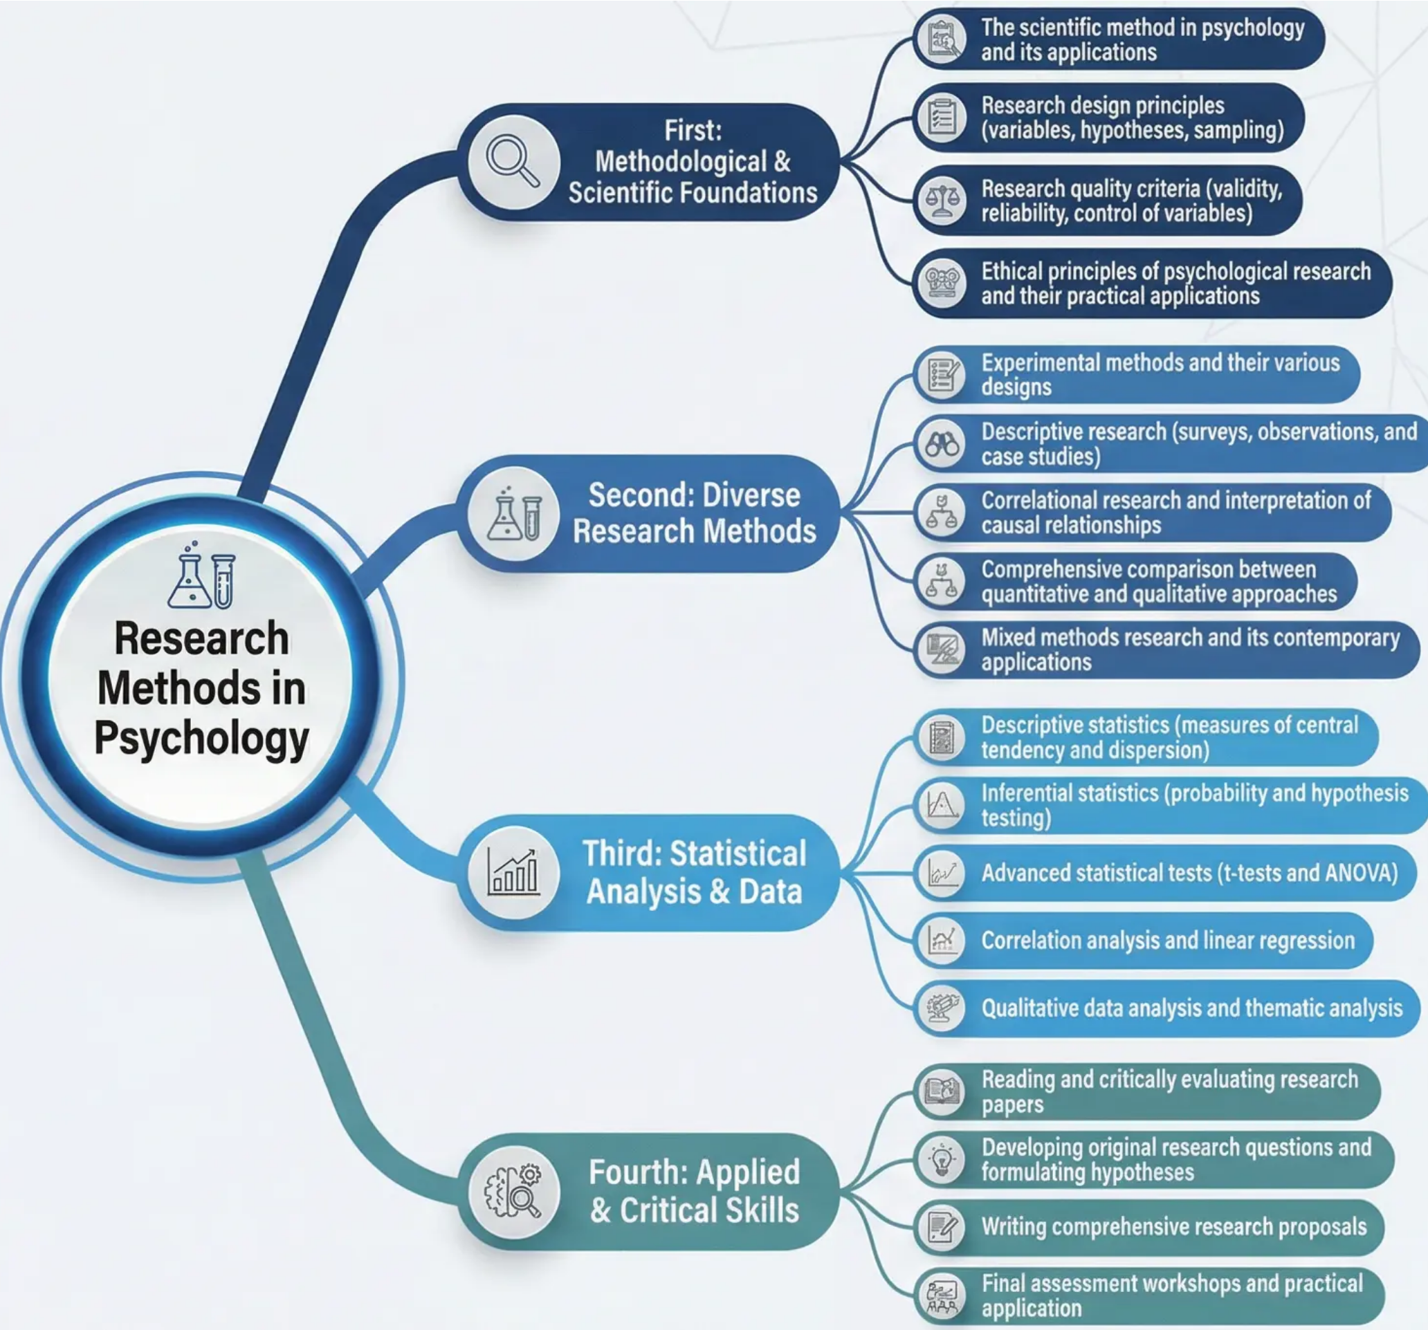
Unit Overview
This unit is a core component of the Level 5
Extended Diploma in Psychology. It equips
students with a comprehensive and in-depth
understanding of research methods, going
beyond surface-level knowledge to provide
critical and applied analysis of nssarch design
principles, experimental and descriptive
methods, data analysis, and research ethics.
How can a deep understanding of research
methods change our perspective on
psychological information circulated in the
media and society? Discuss the importance
of critical thinking in evaluating scientific
claims in the field of psychology.

Slide 3


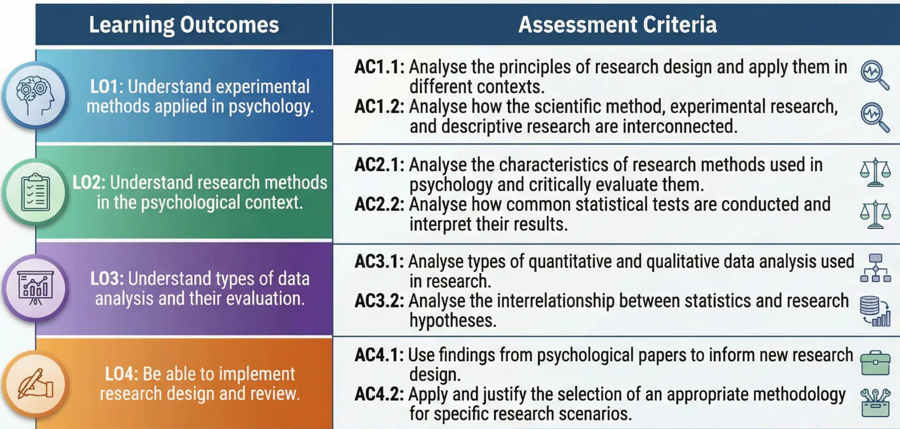

Learning Outcomes & Assessment Criteria
This unit identifies the core learning objectives and the criteria through which achievement of these objectives will be assessed. It aims to
guide students toward a deep understanding of the concepts and skills required in psychological research at the Advanced Diploma level.
The outcomes align with Level 5 standards, requiring students not only to understand core concepts but also to analyse, apply, and critically
evaluate them in diverse research contexts.
Key Focus: This unit
requires critical
analysis and practical
application, not mere
memorisation and
recall.
Discussion Prompt: How do the assessment criteria at Level 5 differ from lower levels? And why does the assessment focus on analysis and
application rather than mere understanding?

Slide 4

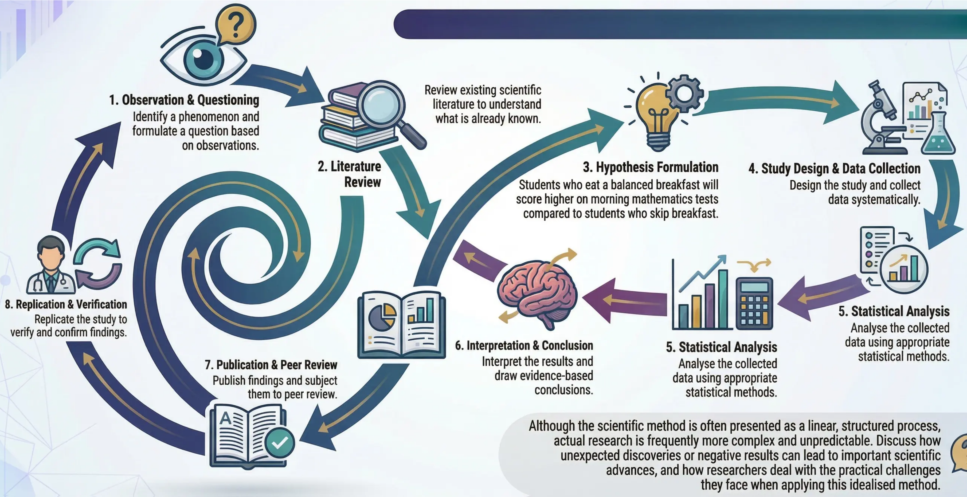

The Scientific Method in Psychology
The foundation of psychology as a scientific discipline, producing objective and replicable knowledge.
1. Observation & Questioning
Identify a phenomenon and
formulate a question based
on observations.
Review existing scientific
literature to understand
what is already known.
2. Literature
Review
3. Hypothesis Formulation
4. Study Design & Data Collection
Students who eat a balanced breakfast will
score higher on morning mathematics tests
compared to students who skip breakfast.
Design the study and collect
data systematically.
8. Replication & Verification
Replicate the study to
verify and confirm findings.
5. Statistical Analysis
Analyse the collected
data using appropriate
statistical methods.
6. Interpretation & Conclusion
Interpret the results and
draw evidence-based
conclusions.
5. Statistical Analysis
Analyse the collected
data using appropriate
statistical methods.
7. Publication & Peer Review
Publish findings and subject
them to peer review.
Although the scientific method is often presented as a linear, structured process,
actual research is frequently more complex and unpredictable. Discuss how
unexpected discoveries or negative results can lead to important scientific
advances, and how researchers deal with the practical challenges
they face when applying this idealised method.

Slide 5

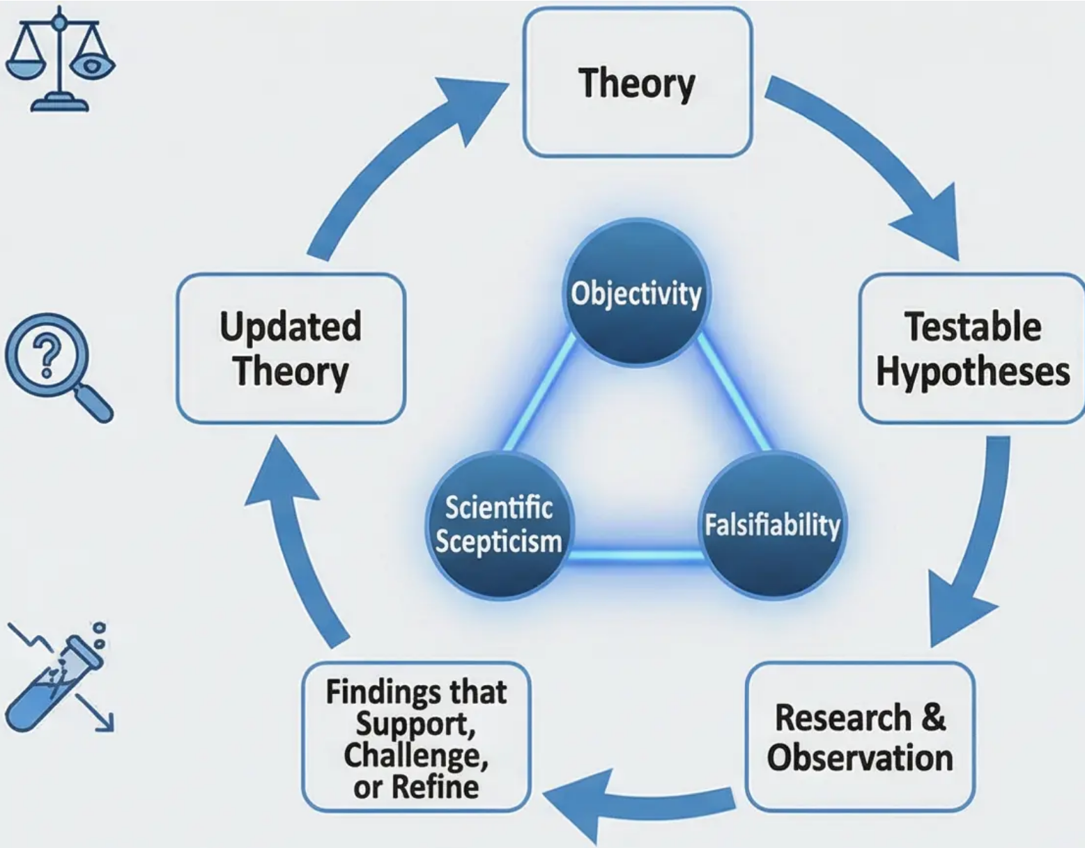

Scientific Principles & Critical Evaluation of Theories
Core principles and the philosophy of research in psychology
These principles go beyond merely applying the steps of the scientific method — they form the philosophy of research
and distinguish scientific knowledge from other ways of knowing, such as intuition, authority, or personal experience.
Critical Example:
Freud's concepts such as
the 'Id' and 'Superego' are
criticised for being
unfalsifiable, placing
them in a grey area
between science and
philosophy.
Objectivity
Aims to minimise personal bias in
observation and interpretation; the
objective researcher seeks to separate
personal beliefs from empirical data.
Scientific Scepticism
Requires strong evidence before
accepting any scientific claim;
encourages constant questioning and
re-examination of theories.
Discussion Prompt:
The scientific method is often
messy and unpredictable.
What role do chance and
serendipity play in scientific
progress while still
maintaining core principles?
Falsifiability
Karl Popper's principle: a scientific
theory must be testable in a way that
allows it to be proven wrong.

Slide 6

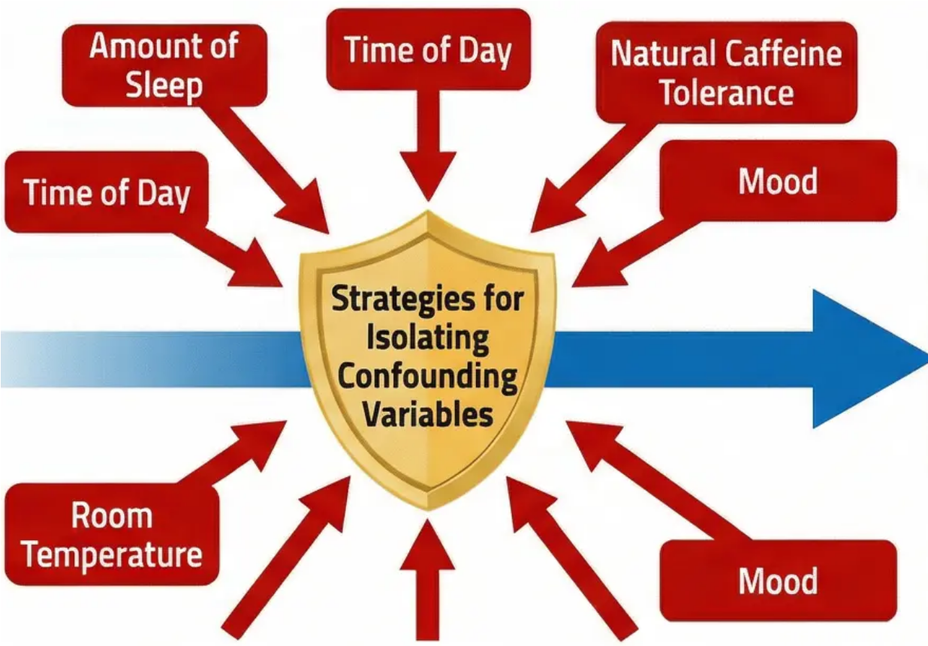
Research Design Principles: Variables
Variables are the fundamental building blocks of any research study in psychology. Understanding
their nature and how to handle them is the cornerstone of sound scientific research design.
Independent Variable (IV)
Dependent Variable (DV)
The variable that the researcher manipulates or
controls to study its effect on other variables;
it represents the 'cause' in a causal relationship.
The variable that the researcher measures
to determine whether manipulating the IV
has had an effect; it represents the
'outcome' in a causal relationship.
Applied Example: In a study on the effect
of caffeine on cognitive performance, the IV is
the amount of caffeine given to participants
(0 mg, 100 mg, 200 mg).
Applied Example: In the same study, the DV
is reaction time or accuracy of responses in
various cognitive tasks.
Strategies for Isolating
(Extraneous/Confounding Variables)
Standardisation: Ensuring identical conditions for all participants. • Random Allocation: Randomly assigning participants to groups. •
Experimental Control: Using appropriate control groups. • Counterbalancing: Arranging experimental conditions to avoid order effects. •
Discussion Prompt: In a study on the effect of a new teaching method on student performance, how can a researcher ensure that the improvement
in grades is genuinely attributable to the teaching method and not to other factors such as teacher motivation or student characteristics?

Slide 7


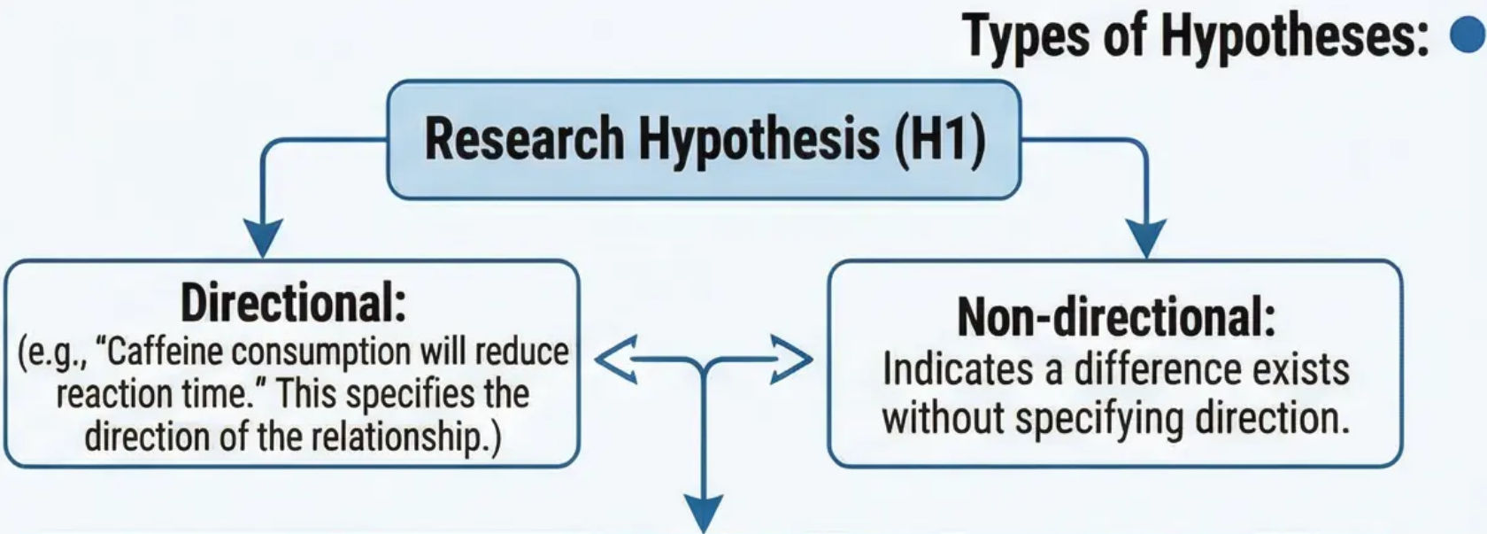
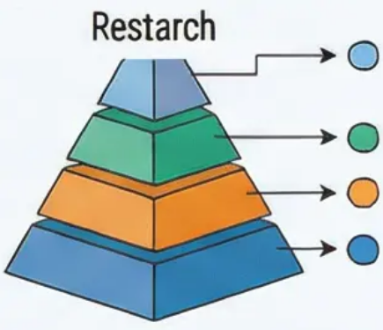




Hypothesis Formulation & Sampling Methods
Sampling Methods
Hypothesis Formulation & Operational Definitions
Selecting an appropriate sample is vital to ensure the research population
is represented and findings can be generalised.
Hypothesis formulation is a critical step in transforming theoretical ideas
into scientifically testable predictions. It emphasises the necessity of
clearly operationally defining the variables under study.
Probability Samples:
Simple Random
Stratified
Cluster
Non-Probability Samples:
Convenience
Null Hypothesis (H0)
States that there is no relationship or difference between variables;
represents the statistical starting point for testing.
Snowball
Purposive
Operational Definition:
Defines a variable by the specific procedures used to measure or
control it. Example: "Anxiety" is defined as a score on the Beck
Anxiety Inventory or as heart rate.
Challenge of Representation: Balancing scientific rigour with
practical research constraints.
Discussion Prompt: How does selecting a convenience sample of psychology students affect the generalisability of
findings from a memory study? What potential biases exist and how could they be addressed in future studies?

Slide 8

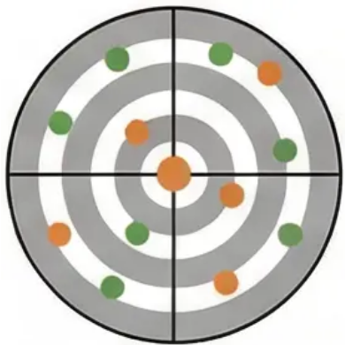
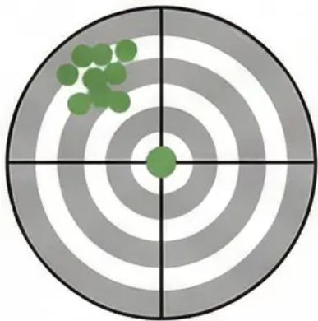
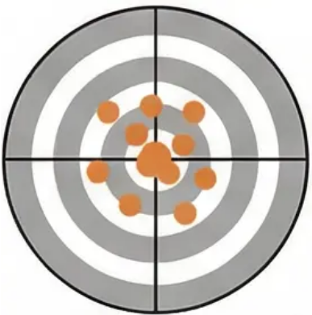
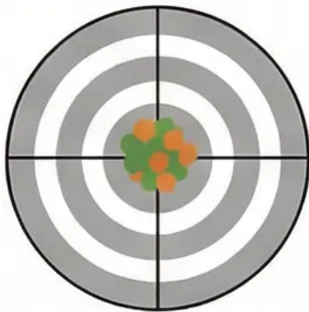
Research Quality: Validity & Reliability
Assurances of Quality in Psychological Measurement
Reliability
Validity
Refers to the consistency and stability of measurement across
different conditions; answers the question: "Do we obtain the
same results when the measurement is repeated?"
Refers to the accuracy of measurement in measuring what it is
supposed to measure; considered more complex than reliability as
it relates to meaning and interpretation.
Types of Reliability:
Types of Validity:
• Test-Retest Reliability: Measures consistency over time.
Example: A personality test should yield similar results if
administered today and again one month later.
• Internal Validity: Confidence in the causal relationship being
tested; asks whether the change in the DV is genuinely caused
by manipulation of the IV.
• External Validity: Generalisability of findings to other settings
(ecological validity), other people (population validity), and
across time (historical validity).
• Inter-Rater Reliability: Measures the degree of agreement
between independent observers, e.g., two researchers observing
aggressive behaviour in children on a playground.
• Construct Validity: The extent to which a measurement tool
accurately measures the theoretical concept it targets, e.g.,
whether an intelligence test truly measures "intelligence."
Critical Analysis Zone
The Critical Trade-off:
A measurement can be reliable without being valid, but it cannot
be valid without being reliable. Reliability is a necessary but
not sufficient condition for validity.
Neither Reliable
nor Valid
Reliable but
Not Valid
Valid but Not
Reliable (noted as
“rare in practice”)
Both Reliable
and Valid
Discussion Prompt: How can a researcher achieve a balance between internal and external validity in their study design?
Discuss with practical examples from psychological research.

Slide 9

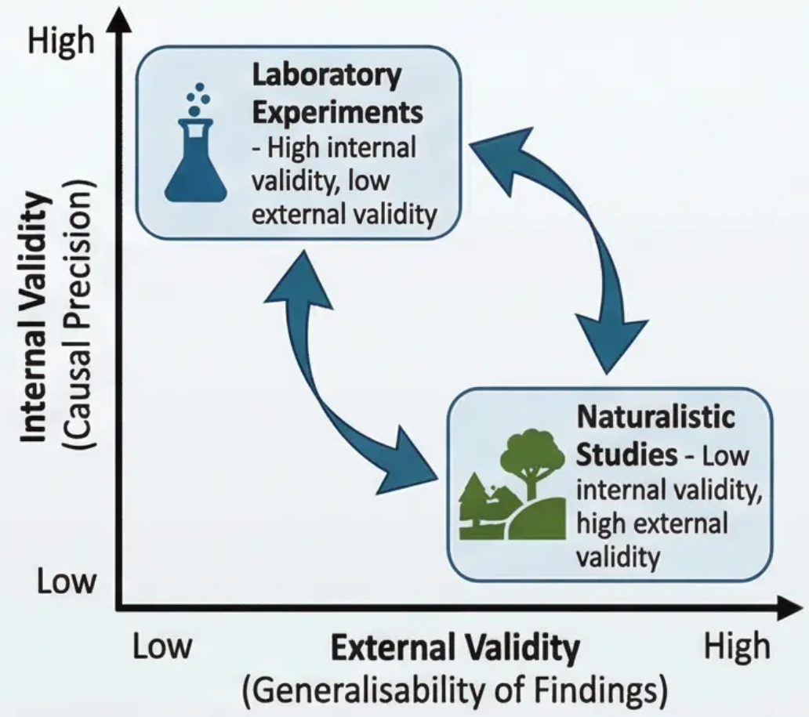
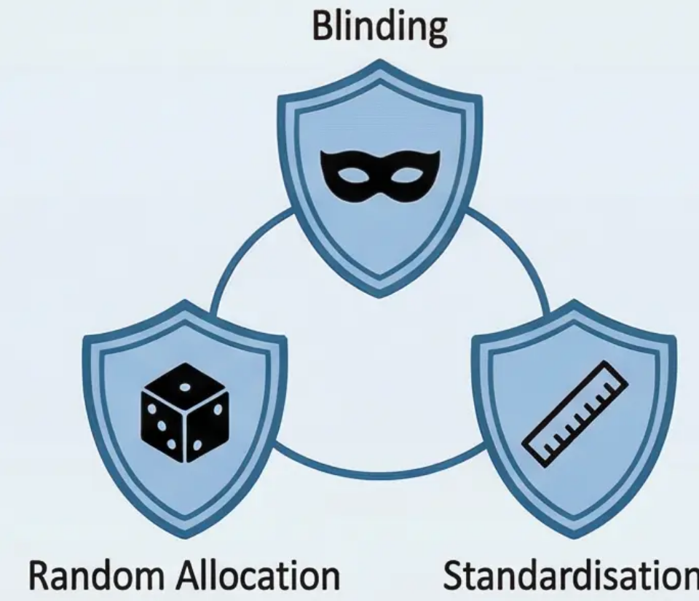
The Trade-off: Internal vs. External
Validity
Control Strategies & Design Trade-offs
• The Fundamental Trade-off: Internal vs. External Validity
1. Internal Validity focuses on causal certainty – is the change in the dependent variable truly
caused by the manipulation of the independent variable? While External Validity concerns the
generalisability of findings beyond the specific study's framework.
2. Laboratory experiments achieve exceptional control over extraneous variables through an
artificial, controlled environment, leading to high internal validity. However, this sterile
environment may be far removed from the natural context of human behavior, limiting external
validity. In contrast, field and naturalistic studies maintain the authenticity of behavior in its real
environment, enhancing external validity, but face difficulties in controlling confounding
variables, which may weaken internal validity.
• Advanced Control Techniques
1. 🎲 Random Allocation represents the gold standard tool for ensuring group equivalence before
experimental intervention, by randomly assigning participants to different conditions. We ensure
that any individual differences are distributed evenly across groups, eliminating their influence as a
confounding variable.
Research Control Shields
2. 🕶️ Blinding protects against expectation bias, whether from participants or researchers. Single-
blinding conceals from participants the nature of the treatment they receive, while double-blinding
extends to include the researchers as well, reducing the influence of their expectations on the
results.
3. 📏 Standardisation ensures the identical application of procedures across all participants and
situations, reducing unwanted variability and increasing measurement precision.
Discussion: How can a clinical psychologist balance the need to study psychological therapy in a
controlled laboratory setting with the need to understand its effectiveness in real-world clinical
practice? Discuss specific strategies to achieve this balance.

Slide 10



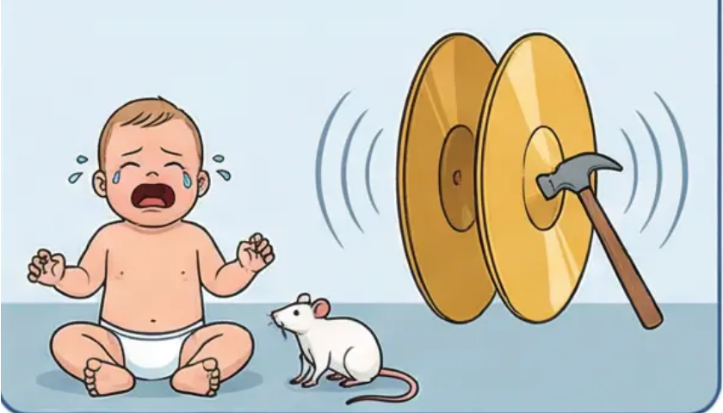
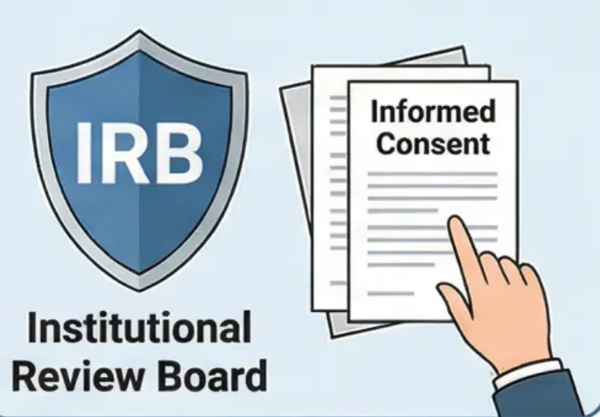
Ethics in Psychological Research: A Historical Perspective
This discussion represents a critical turning point in understanding ethical responsibilities in psychological research, and how ethical
standards evolved in response to the harm inflicted on participants in early research.
Milgram's Obedience
Experiment (1963)
Stanford Prison
Experiment (1971)
Little Albert Experiment
(1920)
Evolution Towards
Modern Standards
This landmark study examined individuals'
willingness to obey authority even when it
required harming others. Participants were
asked to administer electric shocks to
"learners" (actors). Results showed that 65%
continued to the highest apparently lethal
shock level.
Philip Zimbardo designed this experiment to
study the effects of social roles. Stanford
University's basement was converted into a mock
prison; students were randomly assigned as
"prisoners" or "guards." The experiment collapsed
after just six days due to guards' sadistic behaviour
and prisoners' psychological breakdown.
John Watson and Rosalie Rayner conducted
this experiment to demonstrate that fear could
be conditioned in humans. An 11-month-old
infant was conditioned to fear white rats by
pairing them with loud noises. The
conditioning was never reversed, and the child's
fear generalised to all soft white objects.
These and other studies compelled the
scientific community to radically
reassess research practices. The shock
of these violations led to the development of
strict ethical codes and the
establishment of Institutional Review
Boards (IRBs).
Ethical Violations:
• Extensive deception, severe psychological
distress, no genuine right to withdraw, and
long-term psychological trauma from
discovering their capacity to "harm" others.
Ethical Violations:
• No clear boundaries, exposing participants to
genuine psychological trauma, Zimbardo losing
scientific objectivity by becoming the "prison
superintendent," and failure to terminate the
experiment when signs of harm appeared.
Ethical Violations:
• Inflicting permanent psychological harm on a
child, absence of genuine informed consent,
failure to reverse the harmful conditioning,
and using a participant incapable of
understanding or consenting to the experiment.
Discussion: These historical studies, despite their clear ethical violations, provided valuable knowledge about human nature. Can this knowledge be justified
in light of the harm inflicted on participants? How can contemporary researchers study similar topics while adhering to modern ethical standards?

Slide 11











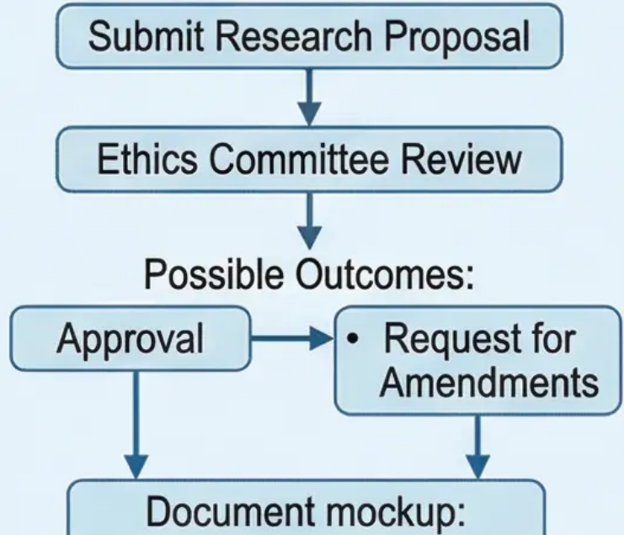

Core Ethical Principles & the Consent Process
Ethical standards in psychological research are not merely procedural rules — they are moral commitments
to protect participants, their dignity, and to contribute to the advancement of scientific knowledge.
Institutional Ethical
Approval Process
Informed
Consent
Right to
Withdraw
Confidentiality
& Anonymity
Deception &
Debriefing
All research involving human participants
undergoes rigorous review by Institutional
Review Boards (IRBs) or ethics commit-
tees. These independent committees
consist of research and ethics experts
and community representatives. They
evaluate each research proposal to ensure
compliance with ethical standards before
data collection begins.
• Refers to the participant's
right to receive comprehen-
sive and clear information
about the nature of the
research before participating.
• Affirms participants'
absolute right to withdraw
from the study at any time,
for any reason, without
penalty.
• Protecting participants'
privacy is a sacred
commitment.
• Refers to cases where the
nature of the research
requires withholding certain
details in advance to
ensure the validity of
results; deception must be
limited and scientifically
necessary.
• Confidentiality: Keeping
personal information secure
and protected from
unauthorised access.
• This includes the study's
purpose, procedures,
potential risks and benefits,
and duration of participation.
• Ensures participation
remains voluntary and
participants do not feel
coerced.
• Anonymity: The researcher
cannot link data to the
participant's real identity;
data encryption and
protection systems must be
used.
• In such cases, a final
debriefing session becomes
mandatory to explain the
true purpose, correct any
misconceptions, and
provide psychological
support if needed.
• Information must be
presented in simple,
understandable language,
with the opportunity to
ask questions and make
an informed decision.
• Management
Recommendation
• Study Purpose
• Risks and Benefits
• Participant Signature
Discussion Prompt: Ethical standards differ across cultures. How can researchers reconcile universal ethical
principles — such as individual consent and confidentiality — with cultural values that may emphasise
collective consent or community transparency? Discuss the practical and ethical challenges of conducting
cross-cultural research.

Slide 12


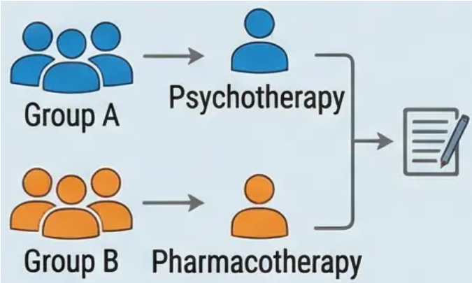
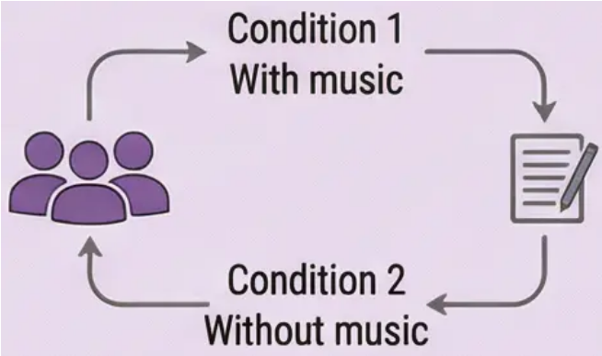
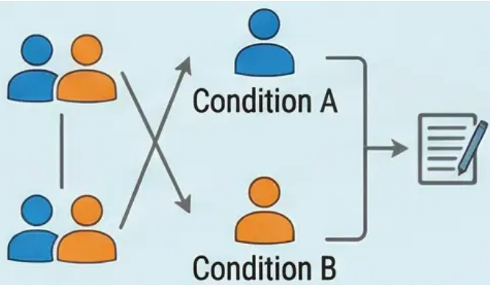
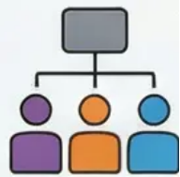
Experimental Research Methods & Their Designs
Experimental research is the gold standard for establishing cause-and-effect relationships in psychology. The
power of the experiment lies in the systematic manipulation of the independent variable and strict control of
extraneous variables, allowing researchers to draw strong causal conclusions.
True Experiments vs. Quasi-Experiments
Comparison of Main Experimental Designs
True Experiments
Independent Groups Design
Repeated Measures Design
Matched Pairs Design
Characterised by random allocation of
participants to groups to ensure group
equivalence before the intervention – the
primary safeguard for valid causal
conclusions.
Quasi-Experiments
• How it works: Different
participants in each experimental
condition.
• Applied Example: One group
receives psychotherapy; another
receives pharmacotherapy.
• Key Advantage: Avoids order
effects (practice and fatigue).
• Main Disadvantage: Individual
differences may act as a
confounding variable.
• Best Used: When the intervention
is permanent or irreversible.
• How it works: The same
participants go through all
experimental conditions.
• Applied Example: Testing
memory with music then without
music for the same individuals.
• Key Advantage: Complete control
of individual differences; greater
statistical power.
• Main Disadvantage: Order effects
require careful counterbalancing.
• Best Used: When studying short-
term changes.
• How it works: Different
participants but matched on
important characteristics.
• Applied Example: Matching
individuals by IQ – one to
treatment, one to control.
• Key Advantage: Combines the
advantages of both previous
designs.
• Main Disadvantage: The
matching process is difficult and
complex.
• Best Used: When important
individual variables are known.
The IV is a pre-existing characteristic of
participants (e.g., gender, age, or
nationality).
The inability to randomly allocate limits the
strength of causal conclusions.
Example: Comparing cognitive skills
between children of different ages, where
random assignment is not possible.

Slide 13











Descriptive Research Methods
Descriptive Research Methods
1. Surveys
(Surveys)
2. Observation
(Observation)
3. Case Studies
(Case Studies)
Descriptive research focuses
on describing behaviour and
mental processes as they
occur naturally, without
manipulating variables. These
methods aim to answer questions
such as ‘what’, ‘where’, and
‘when’, and provide a foundation
for understanding psychological
phenomena before moving to
experimental research.
Collecting self-report data from a
large sample using questionnaires or
structured interviews.
Systematically watching and recording
behaviour in natural or controlled
settings.
An intensive, in-depth investigation of
a single individual, small group, or
specific event.
Strengths
Naturalistic Observation:
Strengths
• Rapid data collection from large
numbers
• Cost-effective
• Suitable for studying attitudes
and beliefs
• Observing behaviour in its natural
environment
• High external validity
• Example: Jane Goodall's
chimpanzee studies
• Rich, detailed information
• Useful for studying rare
phenomena
• Generates new hypotheses
• Classic examples: Phineas Gage,
Freud's cases
Structured Observation:
Weaknesses
• Observation in a controlled setting
• Greater control but less naturalistic
• Uses structured observation
schedules
• Social desirability bias
• Question wording effects on
responses
• Reliance on self-report
Weaknesses
• Difficulty generalising to a wider
population
• High subjectivity in interpretation
• Potential researcher bias
Challenges:
• Observer effect (Hawthorne effect)
• Observer bias in interpretation
• Difficulty establishing causality
Discussion Prompt: A researcher wants to study online behaviour. Naturalistic
observation may yield more valid data but raises ethical concerns, while a survey is
more ethical but susceptible to social desirability bias. Evaluate the methodological and
ethical trade-offs and recommend the most appropriate method with justification.

Slide 14






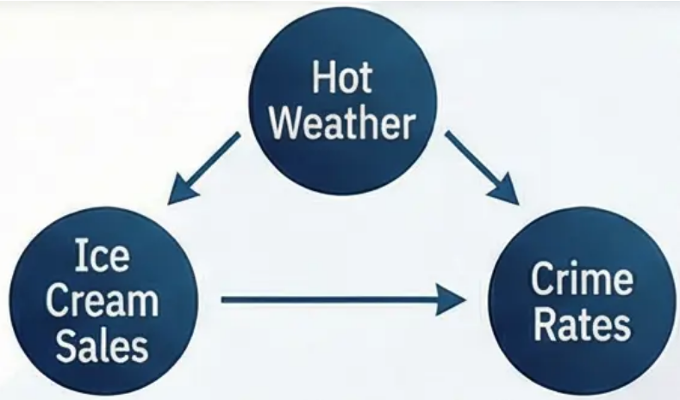
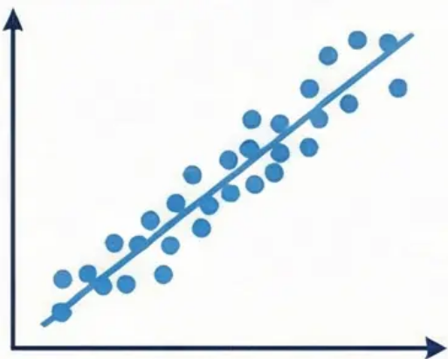
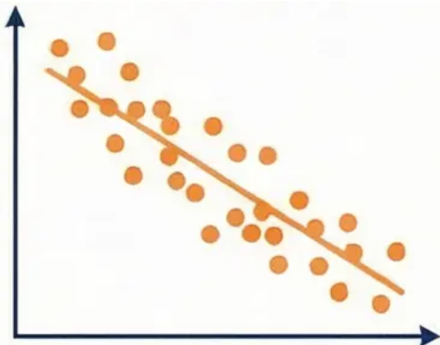
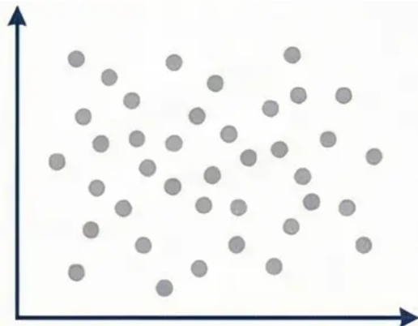
Correlational Research & Interpreting Relationships
What is Correlational Research?
Measures the statistical relationship between two or more variables
without manipulating any of them.
Critical Warning: Correlation Does Not Imply Causation
The primary goal is to determine whether a relationship exists and to
describe its strength and direction using the correlation coefficient (r).
This principle states that inferring causal relationships from
correlational data is erroneous for two reasons:
Third Variable Problem: There may be an unmeasured
variable causing the observed relationship (e.g., hot weather
leads to increased ice cream sales AND increased crime
rates, but ice cream does not cause crime).
Understanding the Correlation Coefficient (r)
A number ranging from -1.0 to +1.0 that describes the relationship between
two variables.
Strength:
Close to 1.0 (e.g., 0.8 or -0.8) = Strong
relationship
Close to 0.5 = Moderate relationship
Close to 0 (e.g., 0.1) = Weak or no relationship
Direction:
Positive correlation (+): As one variable
increases, the other increases.
Negative correlation (-): As one variable
increases, the other decreases.
Directionality Problem: Even when a causal relationship
exists, correlation does not determine direction (i.e., it
cannot tell whether variable A causes B or B causes A).
Applied Examples:
Study hours and exam grades (positive correlation) •
TV watching hours and physical fitness (negative correlation) •
Does ice cream cause crime? Of course not!
The third variable: hot weather increases both.
Discussion Prompt: Although correlational studies do not prove causation,
they remain valuable research tools. Discuss the circumstances in which
a correlational design is appropriate or even superior to an experimental
design, taking into account ethical and practical constraints.
Strong positive
correlation
Moderate negative
correlation
No correlation

Slide 15



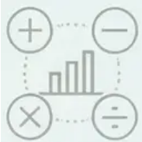
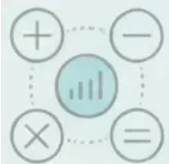

Quantitative vs. Qualitative Research Approaches
A comprehensive philosophical and methodological comparison of two
fundamental paradigms in psychological research
Quantitative Research
Qualitative Research
Philosophy & Approach
Philosophy & Approach
Deductive approach starts with a specific hypothesis •
Seeks to test existing theories •
Aims to identify general laws of behavior •
Focusses on objectivity and minimizing personal bias •
Inductive approach starts with a broad exploratory question •
Seeks to generate deep understanding and develop new theories •
Aims for holistic understanding of phenomena in context •
Acknowledges the researcher's role in interpretation and understanding •
Nature of Data
Nature of Ditra
Numerical, measurable data •
Reaction times, test scores, measured ratings •
Variables that can be controlled and manipulated systematically •
Non-numerical, meaning-rich data •
Interview transcripts, field notes, open-ended responses •
Lived experiences and personal meanings for participants •
Methods Used
Methods Used
Controlled and quasi-experimental designs •
Large-scale correlational studies •
Structured surveys with closed-ended questions •
In-depth and semi-structured interviews •
Focus groups and naturalistic observation •
Comprehensive case studies •
Analysis Methods
Analysis Methods
Statistical analysis (t-tests, ANOVA, Correlation) •
Hypothesis testing and statistical significance •
Precise measurement of relationships and differences •
Thematic analysis and pattern identification •
Content analysis and discourse analysis •
Interpretation of meanings and cultural contexts •
Comparison of Key Points
Goal: Testing vs. Exploration •
Data: Numbers •
Understandings vs. Words & Meanings •
Generalization: From sample to population •
Interpretive trustworthiness & authenticity •
Validity
17

Slide 16

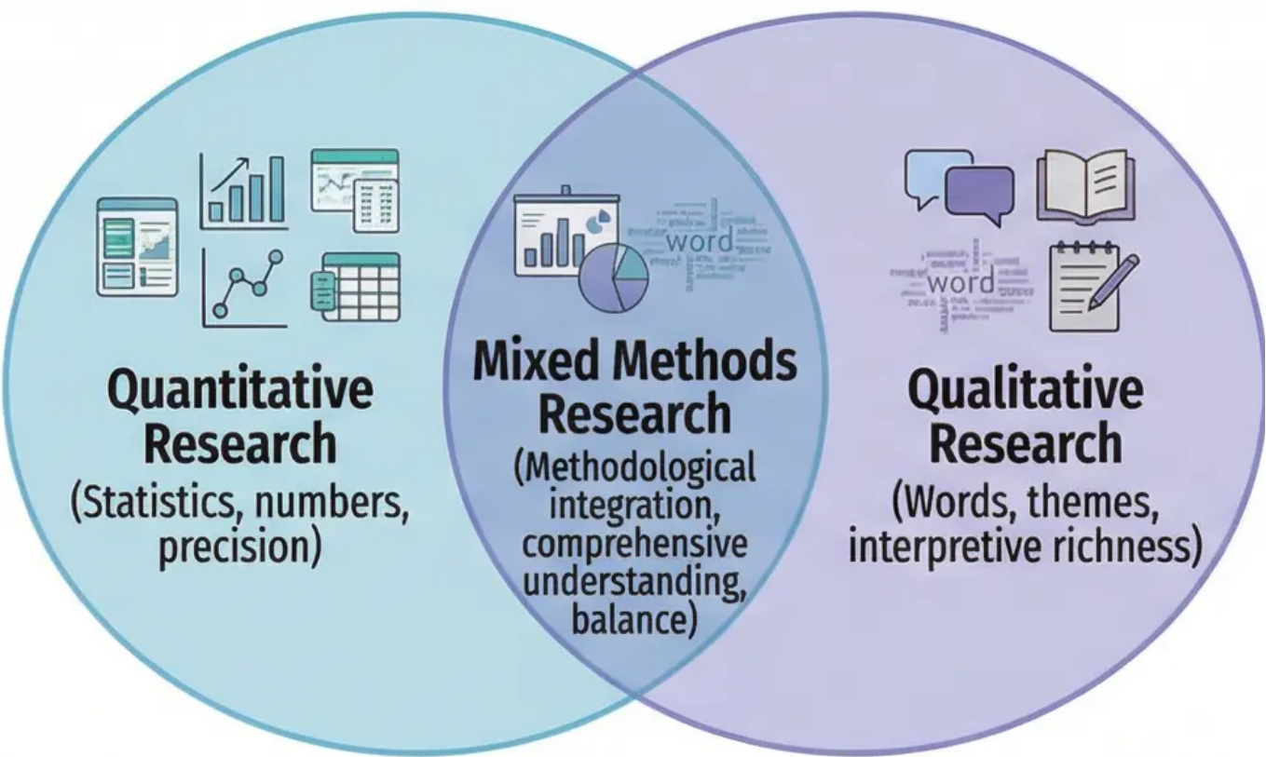
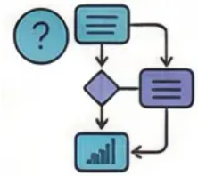
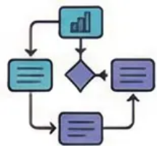
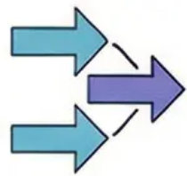
Mixed Methods Research & Critical Evaluation
Advantages, Criteria, & Application
Foundations & Designs
Foundations of Mixed Methods Research: Mixed methods
research is grounded in the philosophy of pragmatism and can be
implemented in various ways.
Exploratory Sequential Design: Begins with qualitative
research to explore a phenomenon, then uses its findings to
design a more precise quantitative study.
Example: Studying social anxiety in adolescents.
Strategic Advantages of Mixed Methods (Strategic Advantages):
• Methodological Triangulation: Enhances credibility.
• Integration: Provides comprehensive understanding.
• Expansion: Allows exploration of different aspects.
• Development: Enables improvement of subsequent phases.
Explanatory Sequential Design: Begins with collecting and
analysing quantitative data, then uses qualitative research to
interpret and deepen understanding of the statistical findings.
Example: A statistical study on declining academic
performance.
Selection Criteria for the Most Appropriate Method (Selection Criteria):
Consider the nature of the research question • Evaluate available resources
• Identify the research goal
Convergent Concurrent Design: Collects quantitative and
qualitative data simultaneously, then integrates the findings at
the interpretation stage to provide a comprehensive picture.
Discussion Prompt:
How can mixed methods research benefit a study on a new
treatment for depression? What are the potential challenges in
integrating quantitative and qualitative data, and how can they
be overcome?

Slide 17

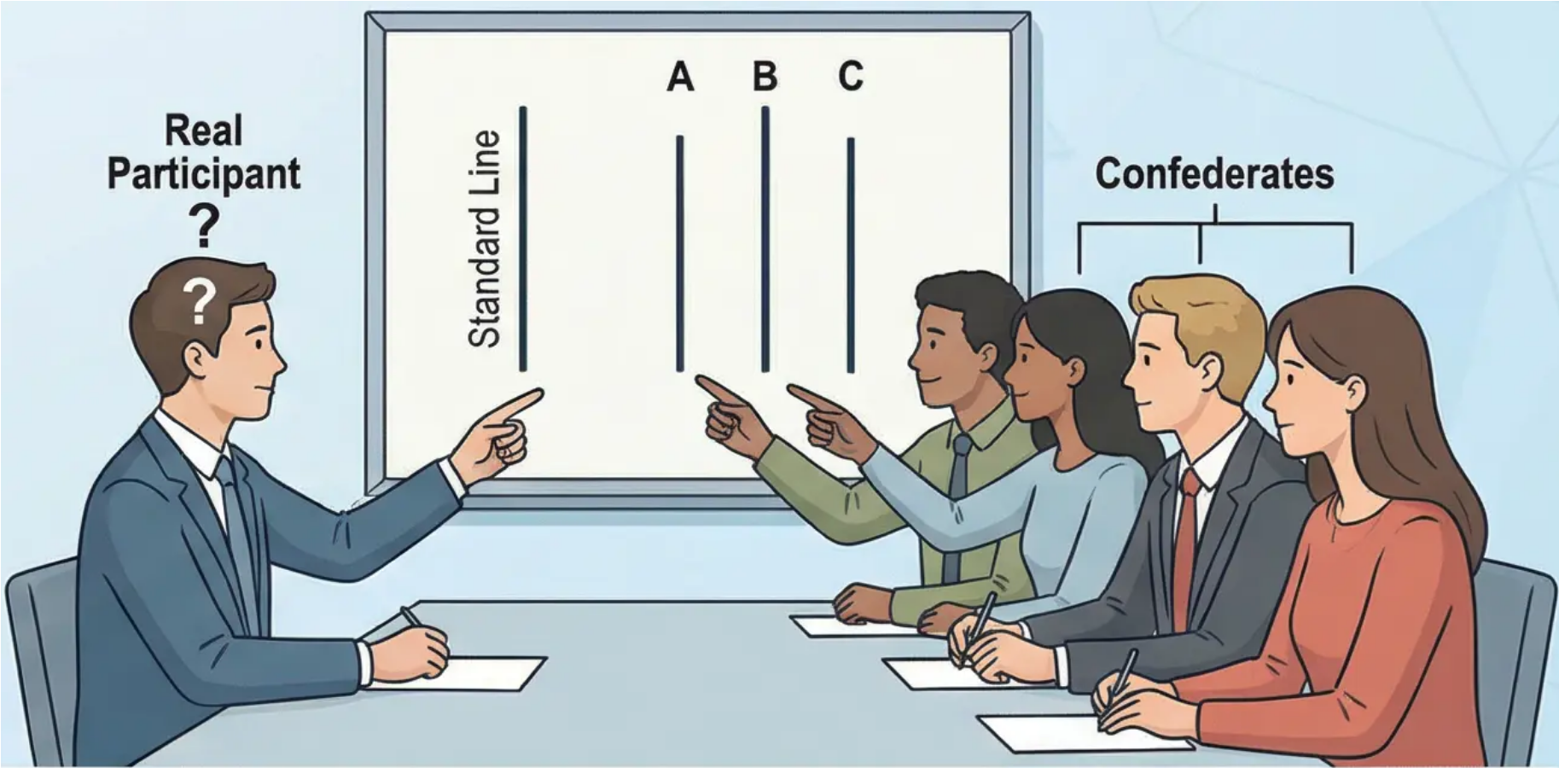



Analysing Classic Studies (Asch's Experiment): Application to
Formative Assessment — Bridging Theory and Critical Analysis
This session represents a bridge between theory and application. Asch's experiment is not merely a historical study — it is an ideal
model demonstrating how to apply the critical analysis framework required in the formative assessment.
Identifying & Justifying the Research Method:
Asch's study is a true experiment with experimental design elements.
IV: The confederates' consensus on a wrong answer.
DV: The real participant's conformity behaviour.
A control group was used, demonstrating the task was very simple without
social pressure.
Analysing Quantitative & Qualitative Data:
Asch collected quantitative data (37% of trials in which participants
conformed to the wrong answer) and qualitative data (post-experiment
interviews to understand psychological motivations).
Key Findings & Theoretical Implications:
Findings reveal individuals' willingness to abandon their perceptual
judgement under the pressure of social consensus. Reveals the
fundamental power of normative social influence on human
behaviour.
Systematic Analysis Framework for Asch's Experiment
Ethical Dilemmas & Critical Evaluation:
The central ethical issue is systematic deception — participants
did not know the true purpose of the study, leading to notable
psychological distress (anxiety and hesitation). Questions
whether the psychological harm is justified by the scientific value.
Method
(Research Method
& Justification)
Data
(Quantitative & Qualitative)
Findings
(Theoretical Implications)
Ethics
(Dilemmas & Evaluation)
True experiment, control
groups, justification.
37% conformity rate, normative social
pressure, power of consensus.
37% conformity rate,
post-experiment interviews.
Systematic deception,
psychological distress.
?
Application to Formative Assessment: This analysis shows students the precise
framework required in their task, emphasising the need to go beyond superficial
descriptive analysis and reach critical evaluation that links methodology to findings
and ethical implications.
Discussion Prompt: How would you design a modified study to investigate the
same phenomenon of social pressure while adhering to modern ethical
standards? What methodological compromises might be necessary and how
would they affect the strength of conclusions?
?

Slide 18




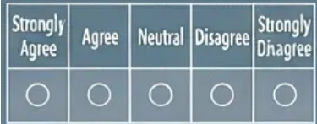



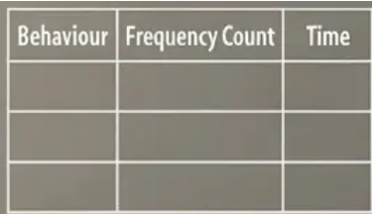

Data Collection Techniques & Pilot Studies
This session focuses on the practical side of data collection, exploring •
specific tools researchers use to gather information. The choice of tool
must align with the research question and overall study design.
Questionnaires
Basic tool consisting of a set of written questions to obtain information from respondents:
Closed-ended questions: Provide pre-defined answer options (e.g., multiple choice, Yes/No).
Common Likert scales where respondents rate their agreement from 'Strongly Agree' to
'Strongly Disagree'.
Interviews
Questionnaires
Open-ended questions: Allow respondents to answer in their own words, providing
rich and in-depth data.
Rabia •
Rabia new •
Rabia yré •
Principles of effective design: Questions must be clear, unambiguous, neutral, •
avoiding double-barreled questions and leading questions that bias the response.
Interviews
Pilot Study
Structured conversations between researcher and participant to gather
in-depth information:
Structured: Specific questions in a fixed order, ensuring consistency among participants. •
Semi-structured: Guided conversation allowing for exploration and flexibility in flow. •
open-ended questions.
Observation Schedules
Strenized conversations between researcher and participant to gather
in-depth information:
Observation Schedules
Recording systems: Taking event samples (counting consistency or target behaviours.
Unstructured: Informal dialogue providing a flexible framework and flexibility in flow.
Systematic templates for recording behaviour in observational research:
Defining behaviours: Place clear and specific definitions for target behaviours.
Recording systems: Taking event samples (counting frequencies) or taking time
samples (recording in specific intervals).

Slide 19

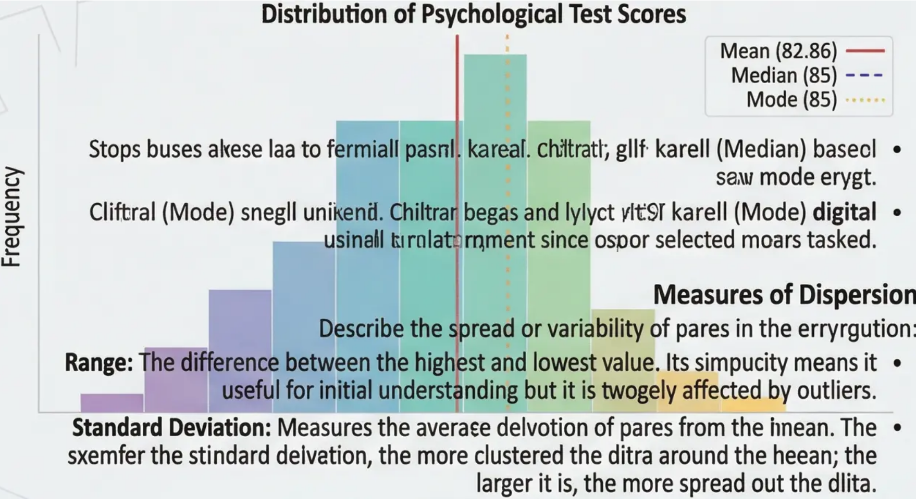
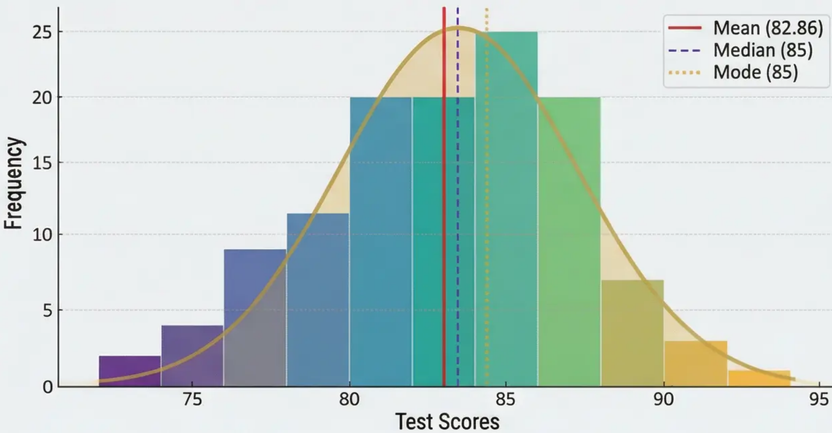
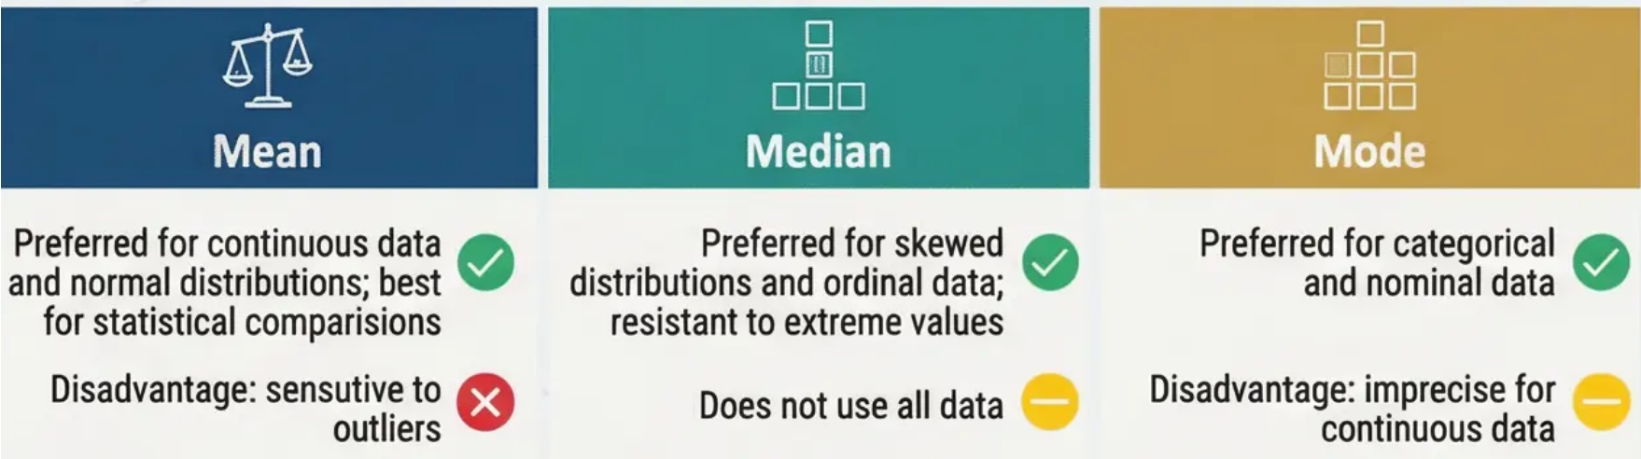
Descriptive Statistics in Pusheiligo
Visual Representation of Data
Descriptive statistics represent the foundational stage of data analysis, transforming
raw numbers into meaningful stories. They provide the necessary tools to
summarize and understand the key characteristics of a dataset without drawing
conclusions that go beyond the data studied.
Frequency histograms transform simbers into a visual image that reveals the drale of the erryrotion
and dllira patterns. Used to identify the nature of the erryrotion — whether it is normally, skewed,
or multimodal.
Measures of Central Tendency:
Mean: The gaon of pares nawked by the seed of the parie. Most commonly •
assutal to threat in Psychigical research, but sums is highly cumulate to
outliers.
Median: The vare that pauids the ortidant olitra wil urtoor englaut reawais. •
A zoof rastilan uniead to extreme pares, allowed it, making it used to mem the
erryrotion is skkeed.
When to Use Each Measure
Discussion Prompt:
When you find that the mean salary in a company is £50,000 while the median is £35,000, what
does this tell you about the nature of the salary distribution? Which measure gives a more
accurate picture of the typical employee's salary?

Slide 20

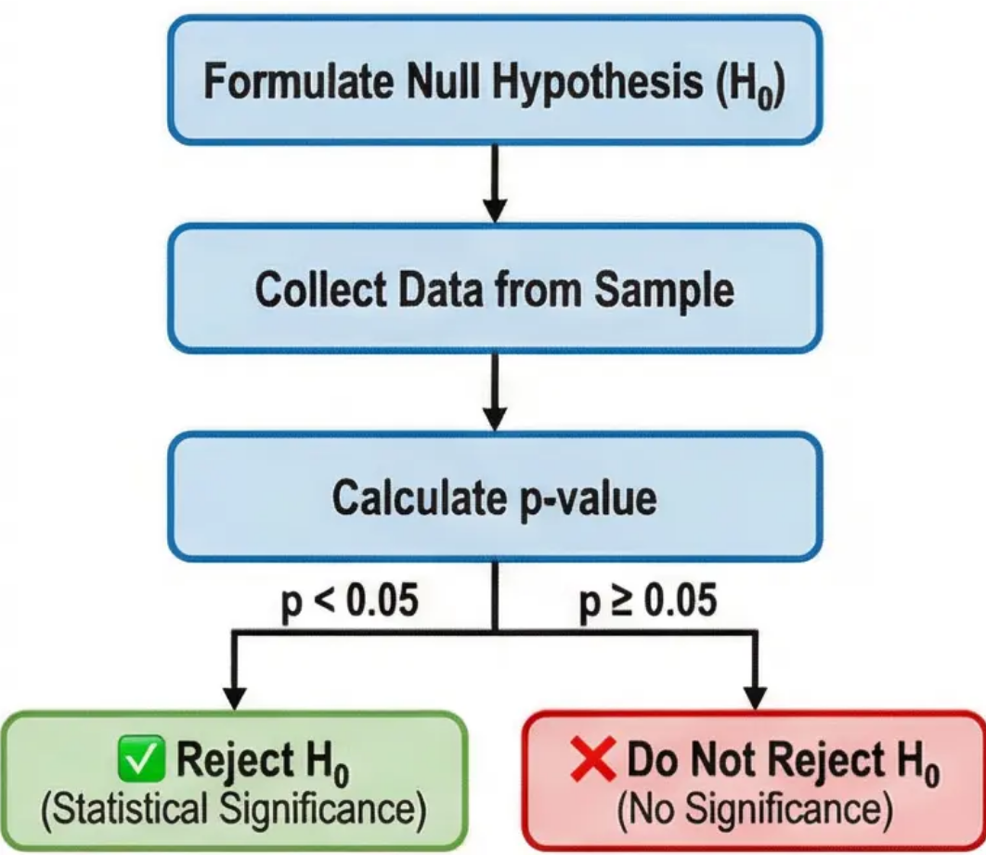
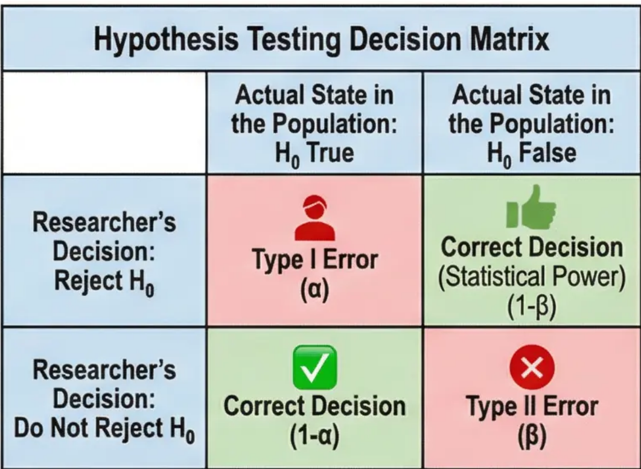
Inferential Statistics: Probability & Hypothesis Testing
Logic of Null Hypothesis Statistical Testing (NHST)
Inferential statistics acts as a bridge between sample data and conclusions about the broader population.
NHST is the logical system that helps researchers determine whether their results reflect a genuine effect or
are merely due to chance.
Basic Process of Hypothesis Testing:
• Start with a sceptical stance: assume the null hypothesis (H₀) is true — meaning there is no real effect or
relationship in the population.
• Collect data from the sample.
• Ask the crucial question: “What is the probability of obtaining these results, or more extreme results, if the
null hypothesis were actually true?”
• This probability is the p-value. A small p-value indicates that the results are rare under the assumption of
the null hypothesis, leading to scepticism about its validity.
Decision-Making Criterion:
• The alpha level (α = 0.05) is used as a cut-off point. If p < 0.05, the null hypothesis is rejected and statistical
significance is inferred. This means the probability of the result occurring by chance is less than 5%.
Errors in Statistical Decision Making:
• Type I Error: Occurs when a true null hypothesis is rejected (concluding an effect exists when it doesn't).
Its probability equals the chosen significance level (α).
• Type II Error: Occurs when a false null hypothesis is not rejected (failing to detect a real effect). Related to
“Statistical Power”—the probability of detecting a real effect when one exists.
Discussion Prompt: The over-reliance on the strict p < 0.05 cut-off has faced widespread criticism in
recent years, particularly in light of the replication crisis in psychology. Discuss how this approach can
lead to practices such as “p-hacking” and what methodological alternatives offer a more nuanced
understanding of research findings.

Slide 21


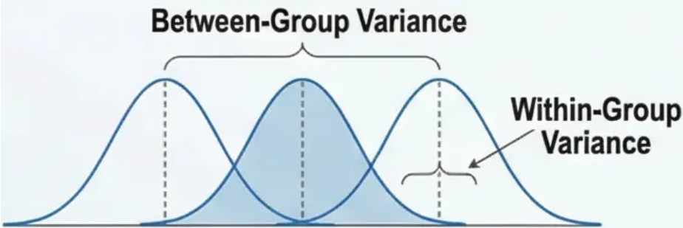

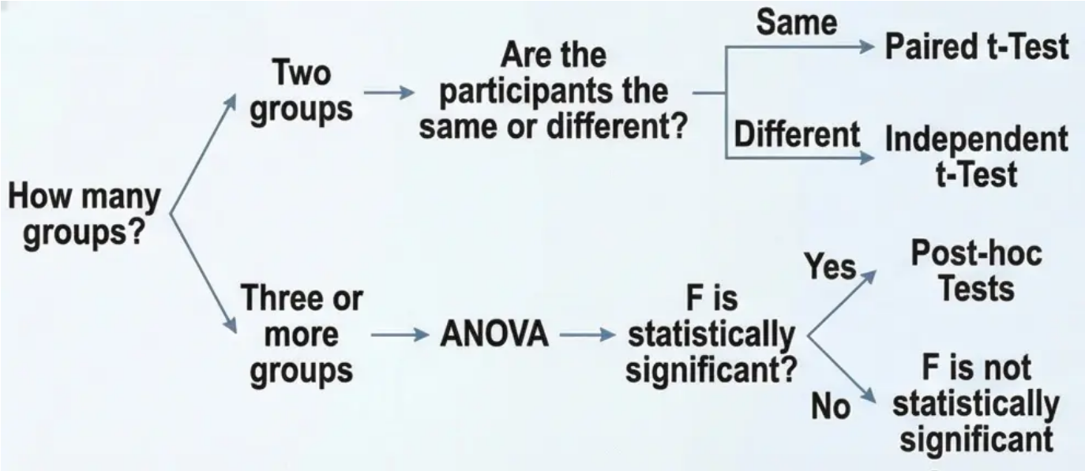

Statistical Tests: t-Tests & Analysis of Variance (ANOVA)
Foundations
This slide presents the fundamental statistical tests used to compare means in psychological research. These tools enable researchers to determine whether
observed differences between groups are genuine or merely random variation.
Analysis of Variance ANOVA
t-Tests
• When to use: When we want to compare three or more groups, we cannot
conduct multiple t-tests as this increases the probability of a Type I error. The
solution is to use ANOVA.
• When to use: Used when comparing the means of only two groups. The goal is
to determine whether the difference between the two means is statistically
significant.
• Logic behind ANOVA: Compares the variance between groups to the variance
within groups. If the experimental effect is genuine, the between-group
variance will be significantly greater than the within-group variance.
• Independent Samples t-Test: Used when the two groups consist of entirely
different participants.
• Example: Comparing anxiety levels between a group receiving a new
psychological treatment and a control group receiving conventional
treatment.
• Key assumptions: normal distribution, homogeneity of variance,
independence of participants.
• Paired Samples t-Test: Applied when measurements come from the same
participants or carefully matched pairs.
• Emphasises the importance of post-hoc tests such as Tukey or Bonferroni to
avoid "error rate inflation" in multiple comparisons.
• Applied Example: Comparing the effectiveness of four different treatments for
depression — Cognitive Behavioural Therapy, Psychoanalytic Therapy,
Pharmacotherapy, and a Control Group. ANOVA will tell us whether there is a
statistically significant difference among these four
treatments.
• Example: If we have four groups, we would need six separate comparisons to
examine all possible pairs.
• Post-hoc Tests: Applied when measurements come from
the same participants or carefully matched pairs. The
classic example is measuring participants' cognitive
performance before and after caffeine intake. Each
participant is measured twice, creating "pairs" of data. The
advantage of this design is that it controls for individual
differences between participants, making the test more
powerful in detecting genuine differences.
Discussion Prompt: A researcher
conducts an ANOVA on four groups and
obtains F(3,76) = 4.23, p = .008. They
conclude that all four groups differ from
each other. Discuss why this conclusion
is incorrect and what additional steps are
required to reach valid conclusions
about which specific groups differ.

Slide 22

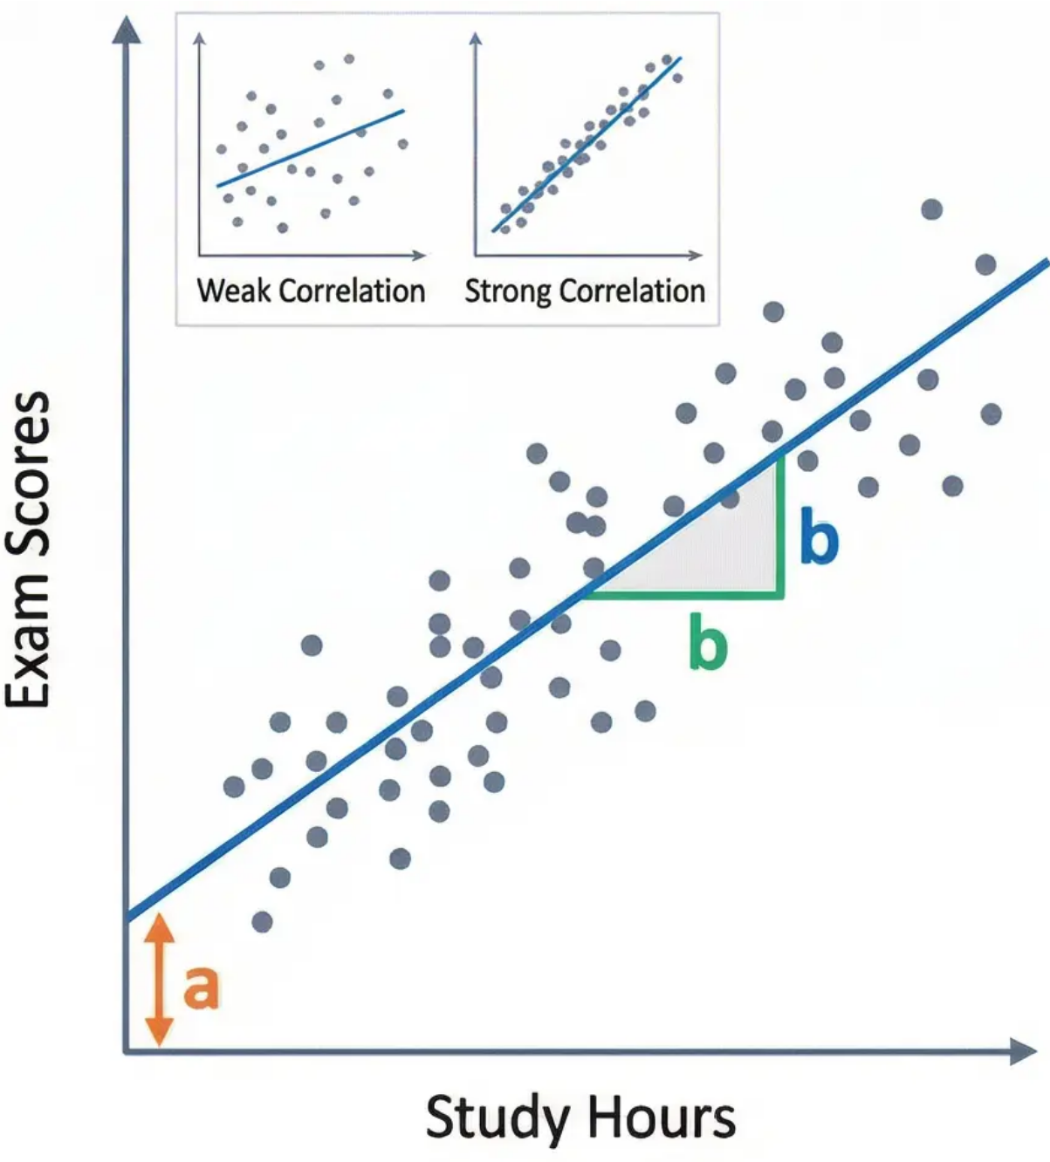

Correlation Analysis & Linear Regression
Linear Regression Analysis
Testing the Significance of Correlation
Defines regression as a powerful predictive
tool by finding the 'line of best fit' through data
points. This allows predicting the value of the
criterion variable based on the predictor
variable.
Goes beyond merely calculating the correlation
coefficient (r) to include testing statistical
significance. When we find a correlation in our
sample, we need to determine if this is a real
relationship in the population or just due to
random chance.
• Null Hypothesis: There is no correlation
between the two variables in the
population (ρ = 0).
- Y: Criterion variable (Predicted)
- X: Predictor variable
- b: Slope of the line (Rate of change)
- a: Y-intercept
• Alternative Hypothesis: There is a
statistically significant correlation between
the two variables (ρ ≠ 0).
Applied Example: A university uses a
regression equation to predict student success:
First Year GPA = 0.5 + (0.08 × High School
Score). This enables the university to predict
the performance of new applicants and make
informed admissions decisions.
Applied Example: A study on the relationship
between study hours and test scores for 50
students showed a positive correlation of r =
+0.45. The significance test yielded p = .008.
Since p < .05, we conclude there is a
statistically significant positive relationship.
Discussion Prompt: Simple linear regression uses one predictor variable, but human behavior is complex and rarely determined by a single
factor. How can multiple regression provide a more precise understanding? Propose a research question in psychology that requires
multiple regression instead of simple, and explain the multiple predictor variables involved.

Slide 23




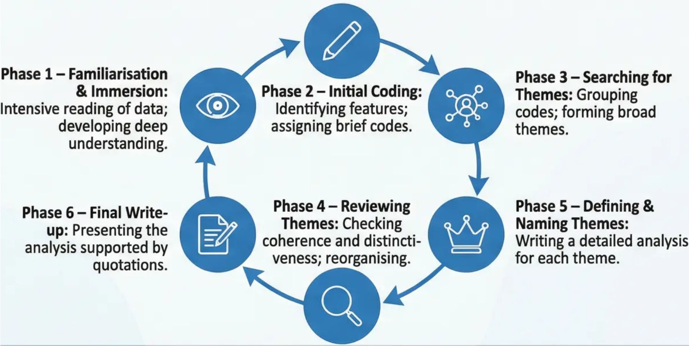



Qualitative Data Analysis (Thematic Analysis)
Introduction to Qualitative Analysis & Thematic Analysis
Trustworthiness in Qualitative Research:
Qualitative data analysis represents a shift from numbers to meanings and
human experiences. Unlike quantitative research which seeks absolute
objectivity, qualitative research acknowledges that the researcher is an
integral part of the interpretive process, requiring rigorous methodology to
ensure analysis quality and trustworthiness.
Quantitative Research
(Traditional Concepts)
Qualitative Research
(Trustworthiness Criteria)
Braun & Clarke's (2006) Thematic Analysis: Thematic analysis is one of the
most popular and flexible methods in qualitative research. It aims to identify
and analyse recurring patterns (themes) within qualitative data. The process
requires deep immersion in the data and advanced analytical thinking.
Credibility: Reflects the true
reality of participants.
Validity
Transferability: Possibility of
application in similar contexts.
Six Phases of Thematic Analysis:
Reliability
Dependability: Consistency of
the research process.
Confirmability: Objectivity of
interpretations.
Trustworthiness is enhanced through strategies such as
triangulation, reflexivity, and member checking.

Slide 24

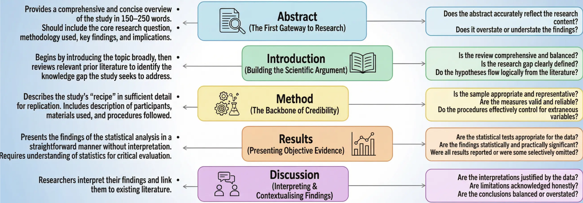
Reading & Critically Evaluating Research Papers
The ability to read and critically evaluate research literature is a fundamental academic skill for advanced psychology students. This skill is not limited to
understanding the content; it requires deep methodological analysis to evaluate the quality of the research and the credibility of the conclusions drawn.
Critical Reading Strategies:
First, read the abstract and discussion to understand the big picture, then study the method carefully to evaluate design quality. Next, examine the results to ensure
conclusions are supported by evidence. Finally, contextualise the research: how does it contribute to the field? What are its theoretical and practical implications?
Discussion Prompt: When reading the discussion section, how can you distinguish between justified interpretation of findings and unsupported speculation?
What warning signs indicate that a researcher may be overstating the importance of their findings or ignoring alternative explanations?

Slide 25

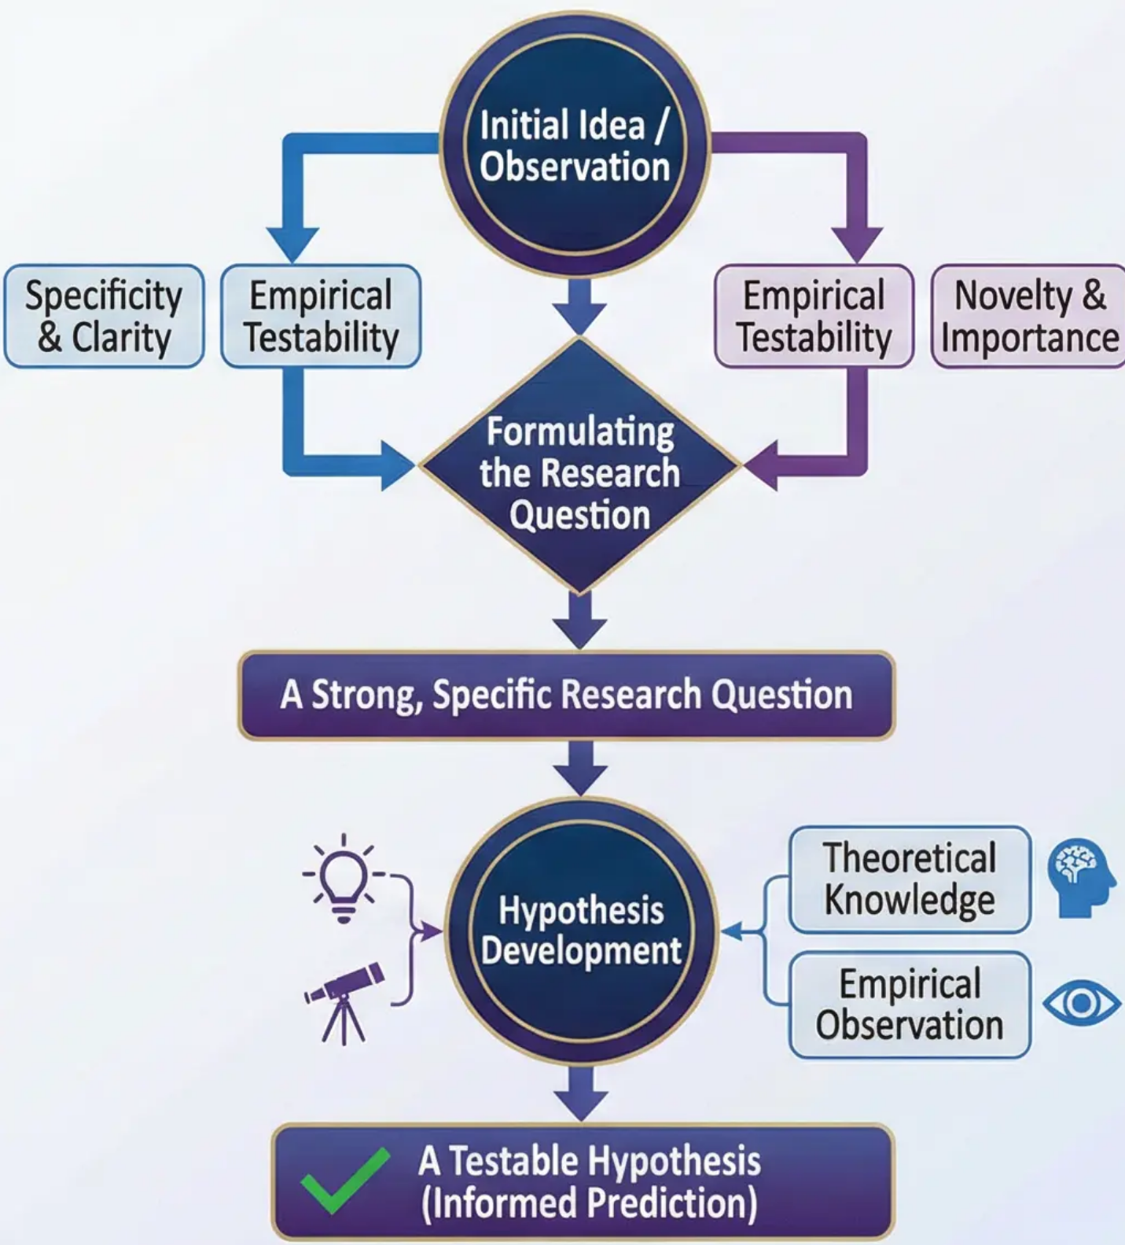



Developing the Research Question & Formulating Hypotheses
Content
Visual Framework: From Idea to Hypothesis
This stage represents the critical transition from evaluating others' research to
envisioning one's own research. Developing a strong research question is the
foundation upon which any successful research project is built, requiring a
combination of creativity, methodological rigour, and awareness of the current
scientific context.
Criteria for a Good Research Question:
Specificity & Clarity: The question must be specific and clearly defined.
Example: "What is the relationship between the number of hours spent on
social media platforms and the level of social anxiety in adolescents?"
Empirical Testability: Must allow for data collection, observation, and
measurement; distinguishes between philosophical and research questions.
Novelty & Scientific Importance: The question must contribute to
knowledge — either through a new discovery, filling a gap, or applying a
theory.
Sources of Research Ideas:
Everyday observation and personal experience
Existing psychological theories
Hypothesis Development Process:
Once the research question is identified, the hypothesis formulation stage
begins. A good hypothesis is not a random guess but an informed prediction
grounded in existing theoretical and empirical knowledge. The hypothesis
must be specific, testable, and formulated in a way that allows it to be
accepted or rejected based on the collected data.

Slide 26




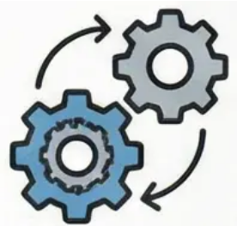

Research Proposal Structure (1)
A research proposal is the essential roadmap for any scientific study, the document defining the
research path and justifying methodological choices. At this advanced stage, it goes beyond merely
describing procedures to providing in-depth scientific justification for every research decision.
Core Components of the Research Proposal:
1. Literature Review & Theoretical Framework
This section represents the proposal's backbone, establishing the scientific context and
building the logical rationale. It is not a mere summary of past studies, but a critical
analysis revealing knowledge gaps and justifying the need for the current study. It should
focus on critical synthesis rather than mere description of at least three key studies.
Critical Point:
Methodological
justification is what
distinguishes an advanced
academic proposal from
from a mere description
of procedures. Every
choice must be supported
by a convincing scientific
argument.
2. Formulating the Scientific Hypothesis
The hypothesis is the pulsating heart of the proposal—a specific, testable prediction
logically derived from the literature review. It must be clear, specific, measurable, and
reflect a deep understanding of the expected relationships between variables.
3. Proposed Method — Research Design
Selecting the research design requires precise scientific justification. Is the design
experimental or correlational? Why? How does this design serve the research objectives?
What are the available alternatives and why were they rejected?
4. Participants & Sampling Strategy
Defining the target population and justifying the sampling method by linking sample
characteristics to the generalisability of findings. Sample size must be grounded in
statistical power principles and practical considerations.
16

Slide 27



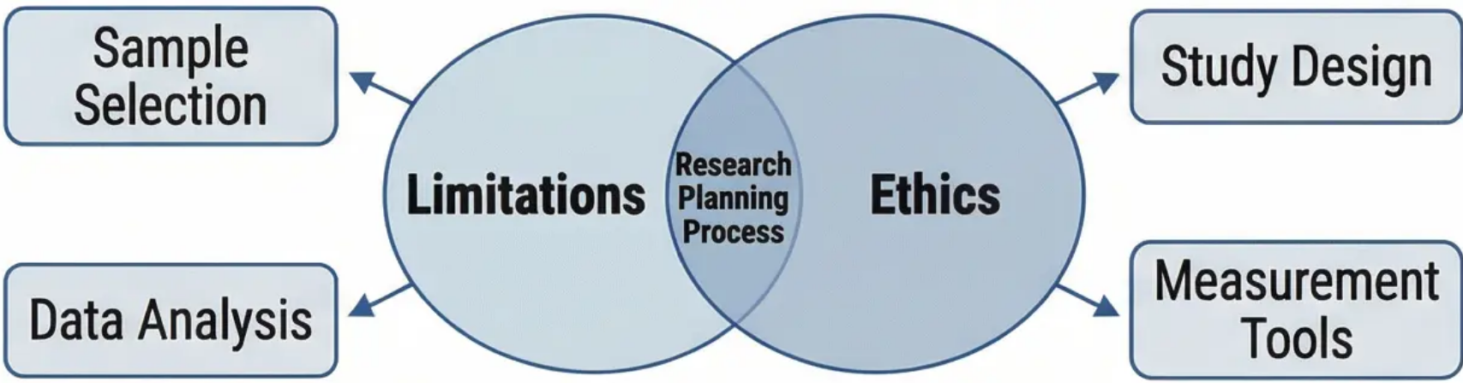
Research Proposal Structure (2): Ethics & Limitations
These considerations and the acknowledgement of limitations are among the most important elements that distinguish a mature
and scientifically responsible research proposal. They reflect the researcher's critical capacity and proactive thinking about
potential challenges.
Identifying Expected Methodological Limitations
Ethical Considerations in the Research Proposal
• Analysis of sampling limitations (e.g., small size, lack of
representativeness, impact on generalisability).
• Discussion of measurement tool limitations (e.g., reliance on
self-report and social desirability bias).
• Methodological design limitations (e.g., failure to control
extraneous variables, time constraints).
• Impact of limitations on the validity and reliability of findings
• Careful analysis of potential ethical risks (psychological or
physical to participants).
• Mechanisms for obtaining informed consent (especially for
vulnerable groups).
• Ensuring data confidentiality and protecting participant identity.
• A full debriefing plan for participants at the end of the study.
• Justification of deception and explanation of how to minimise
its potential psychological harm (if necessary).
Integration with the Research Process
Both aspects (ethics and limitations) are an integral part of comprehensive
planning. Early acknowledgement of limitations helps develop strategies to
mitigate their impact. Meticulous ethical planning ensures responsible and
ethical research that respects participants' dignity and protects their rights.
Discussion Prompt
The 'Limitations' section of a proposal is not merely about listing weaknesses – it is about demonstrating critical awareness. For a proposed
study on the relationship between social media use and mental health in adolescents, identify potential limitations related to: (a) sampling, (b)
measurement, and (c) causality, and suggest a specific way a more advanced future study could address each.

Slide 28



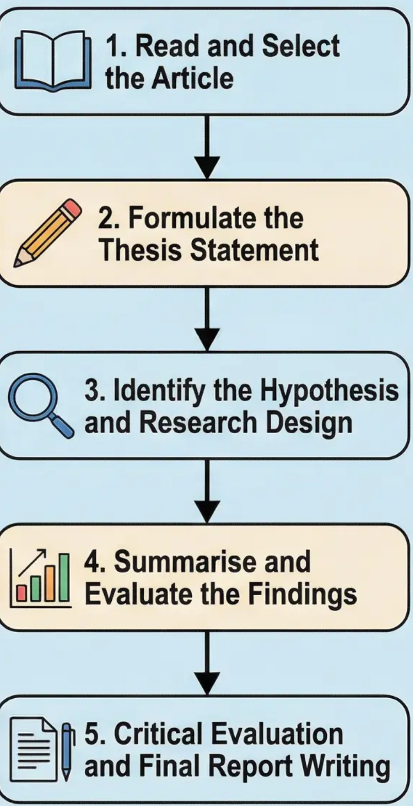










Final Assessment Workshop: Essay Analysis
Sequence of Critical
Analysis Stages
Workshop Preparation for Critical Analysis
This workshop is dedicated to practical preparation for Part 1 of the final
assessment.
Analysis Completion
Checklist
Core Task Requirements
• Requires finding a peer-reviewed research article and producing a
comprehensive critical analysis of 1,000 words.
Thesis statement is clear
and comprehensive.
Five Core Components of the Analysis
1. Thesis Statement
Write a single sentence summarising the overall critical judgement of the
study.
Original hypothesis is
precisely identified.
2. Original Hypothesis
Identify the hypotheses tested by the researchers and restate them
clearly.
Research design and
variables have been
analysed.
3. Research Design Analysis
Examine the study's methodology, including the type of research,
identification of variables, description of the sample, and analysis of data
collection tools.
Findings are summarised
and compared to
hypotheses.
4. Summary of Key Findings
Summarise the findings and compare them to the original hypotheses.
5. Critical Evaluation
Analyse methodological limitations, evaluate sample quality, and
examine ethical considerations.
Methodological and
ethical limitations have
been evaluated.
Discussion Prompt
When analysing an experimental study on the effect of Cognitive
Behavioural Therapy on anxiety, you find that the researchers used a
sample of university students only. How does this affect the validity of the
findings? What specific recommendations would you make to improve the
research design in future studies?

Slide 29





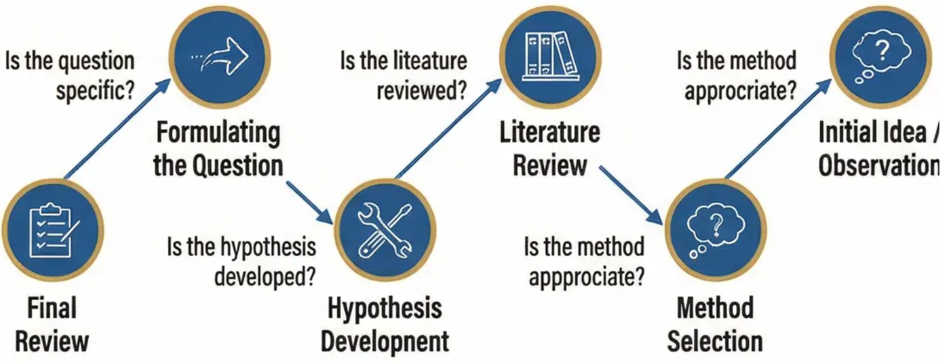


Final Assessment Workshop: Proposal Writing
This final session represents a practical culmination of everything learned in this unit, where
we transform theoetical knowledge into practical skills in writing persuasive research proposals.
Core Idea:
A successful research proposal is not
merely a description of what will be
done – it is a convincing and justified
argument that anticipates challenges
and limitations.
Workshop Observe:
The goal of the workshop is to develop your ability to transform innovative research questions into
integrated and convincing research proposals, with proficiency in the styles of linking logic between the
literature and the proposed methodological design.
The Practical Dongs of the Workshop:
Stage 1: From Idea
to Specific Question
Stage 2: Building the
Theoretical Foundation
Stage 3: Rigorous
Methodological Design
You will work on refining research
questions using quasity criteria
discussed: specificity, feasibility,
significance, and innovation. We will apply
brainstorming techniques to transform
general observations into precise
research questions.
Learn how to conduct a critical review
of literature that goes beyond mere
summarization to analysis and
synthesis. We will focus on identifying
knowledge gaps and building a lobiral
argument justifying the necessity
of the proposed research.
Applying research design principles
to select the most appropriate method,
with a detailed justification for each
methodological dicion. We will discuss
how to balance considerations of intel
validity, and dealing with practical
and ethical constraints.
Common Challenges and Solutions:
• Weem connection between theory and application: Strategies to build logical bridges
• Lack of clarity in methodological justification: Developing scientific argumentation skills
• Neglecting ethical considerations: Integrating ethics as a fundamental part of the design
Imagine you are presenting your research proposal to a committee of skeptical
experts. How will your argument be built to convince them that your research is not
just interesting, but necessary and feasible? Discuss effective scientific communicati
strategies that transform the proposal from an academic document into a
compelling story about the importance of discovering new knowledge.
• Group Practical Activity
Working in small groups to review peer proposals with their oeer assumm co-listics, using
specified evaluation criteria, providing constructive feedback to help with improvement.

