Slide 1

PSYCH501: Psychological
Approaches to Depression
and Schizophrenia
Qualifi Level 5 Extended Diploma in Psychology
Comprehensive Academic Presentation
Academic Year 2026

Slide 2

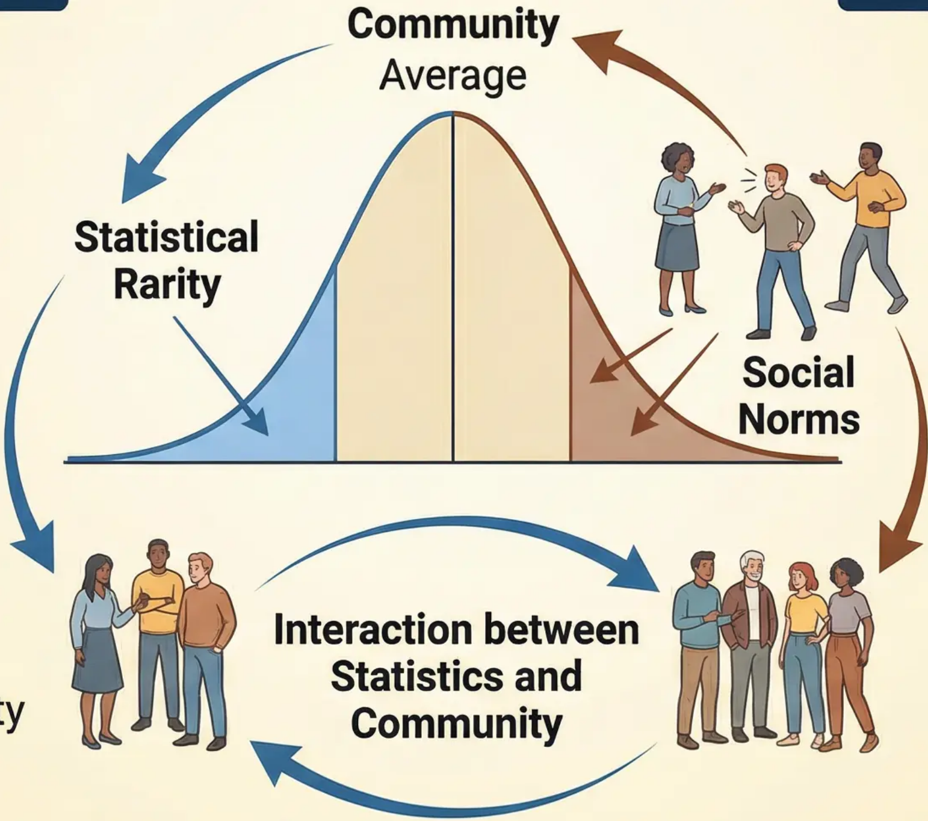
Introduction to Psychopathology and
the Definition of Normality
Statistical Rarity
Deviation from Social Norms
Definition: Behaviour or
characteristic that is statistically
rare in society
Definition: Behaviour that
violates social rules
Example: IQ score below 70 or
above 130
Example: Talking loudly to
oneself in public places
Strengths:
• Objective and quantitative
criterion
• Clear cut-off point for
diagnosis
Strengths:
• Considers social context
• Appropriate for cultural
situation
Limitations:
Limitations:
• Does not distinguish between
desirable and undesirable rarity
• Common conditions may be
pathological
• Cultural and temporal
relativity
• Risk of societal labelling

Slide 3

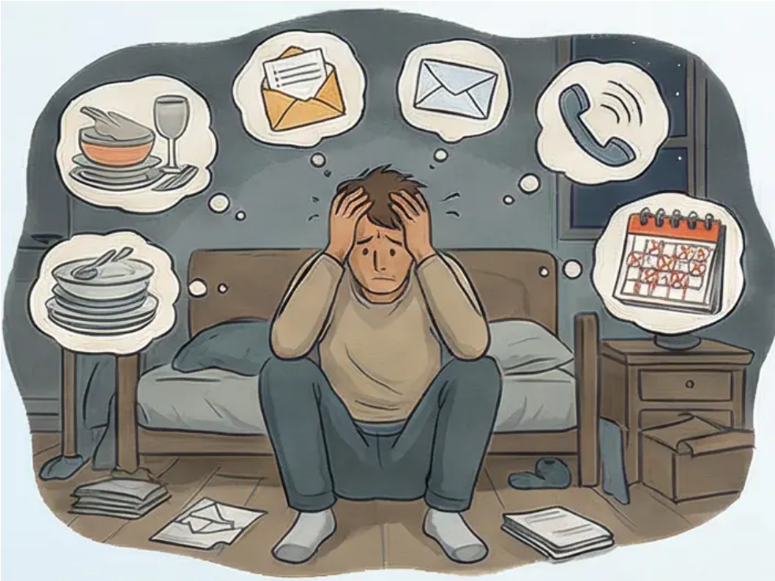

Abnormality: Failure in Functioning
and Ideal Mental Health
Ideal Mental Health Criteria (Jahoda, 1958)
Failure in Adequate Functioning
► Personal distress and psychological suffering
► Maladaptive behaviour in daily life
► Inability to predict behaviour and irrationality
► Discomfort caused to observers and those around
1. Positive self-attitude
2. Self-actualisation and realising potential
3. Autonomy and self-determination
4. Resistance to stress and resilience
5. Accurate perception of reality
6. Environmental mastery
Example: A person with agoraphobia who has not
left their home for years, unable to work or shop

Slide 4
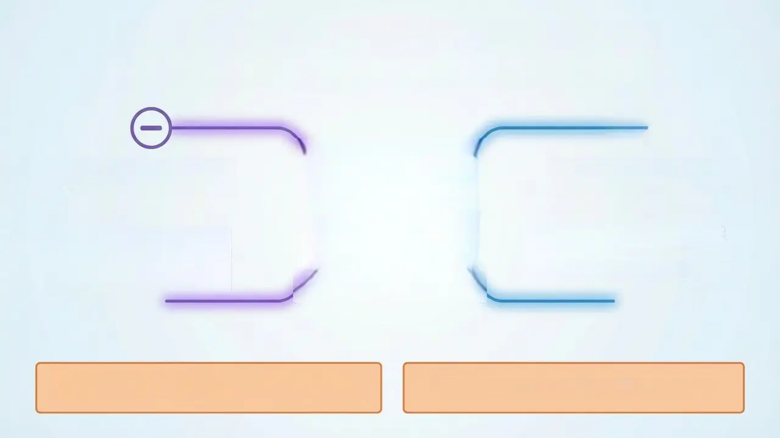

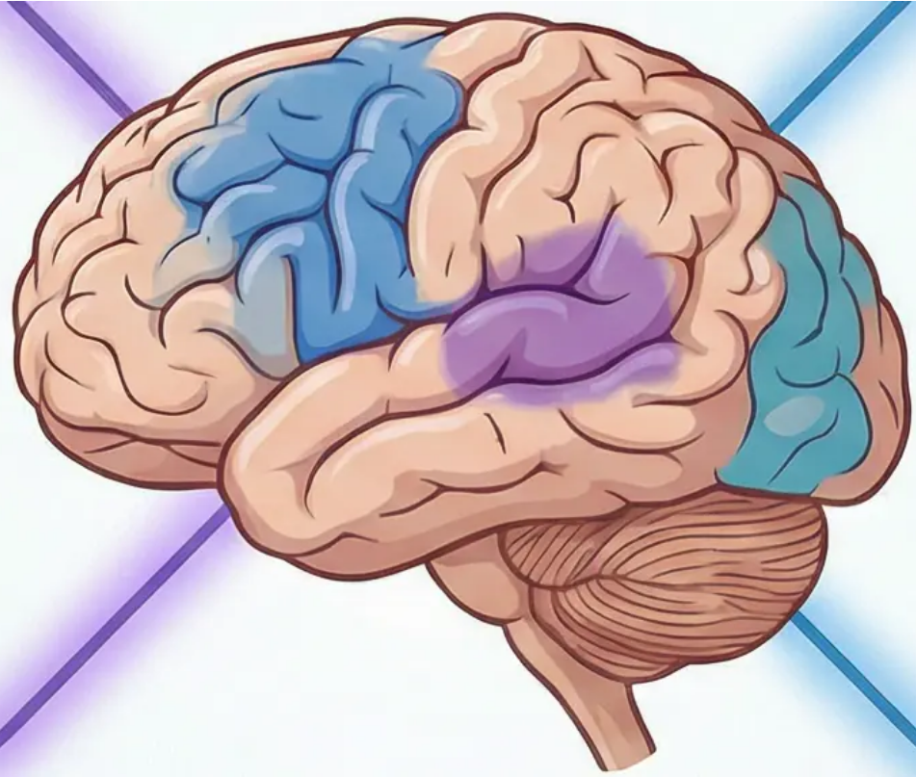
Schizophrenia: Clinical Characteristics
and Diagnostic Criteria
Negative Symptoms
(Loss of normal functions)
Positive Symptoms
(Addition of abnormal experiences)
• Flat affect
• Alogia (poverty of speech)
• Avolition (lack of motivation)
• Decreased motivation and
energy
• Hallucinations (hearing voices)
• Delusions (fixed false beliefs)
• Disorganised speech
• Disorganised behaviour
Diagnostic Criteria
DSM-5: At least two symptoms for one month +
functional impairment for 6 months
ICD-10: First-rank symptoms for one month

Slide 5

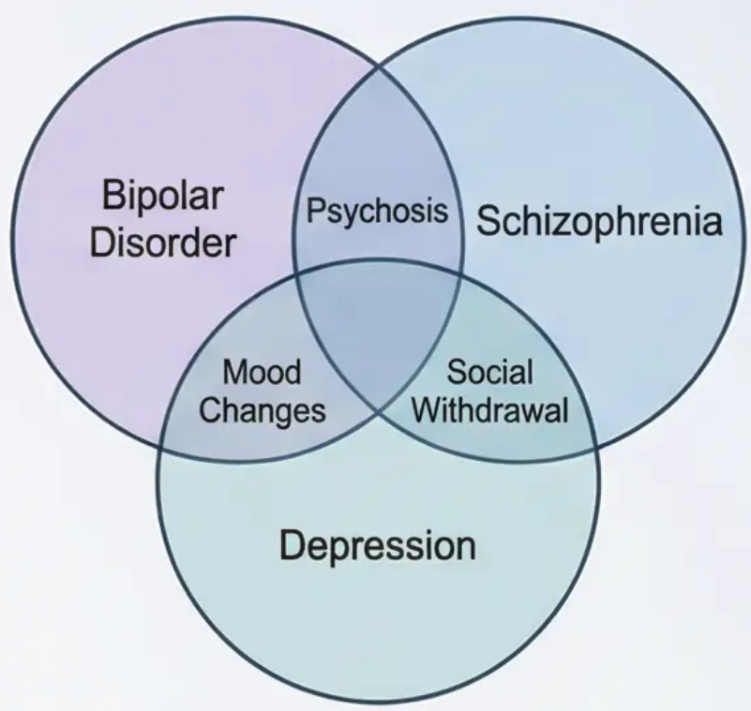

Issues of Reliability and Validity in the
Diagnosis of Schizophrenia
Section 1: The Main Challenges
Section 2: Biases in Diagnosis
• Overlapping symptoms
with other disorders
• Co-morbidity
• Difficulty in differential
diagnosis
• Lack of specific
biological tests
• Cultural bias: interpreting
cultural beliefs as symptoms
• Gender bias: differences in
diagnosis rates between
genders
• Impact of socio-economic
background
People of Afro-Caribbean descent are several times more likely to be
diagnosed with schizophrenia than white people in the United Kingdom

Slide 6



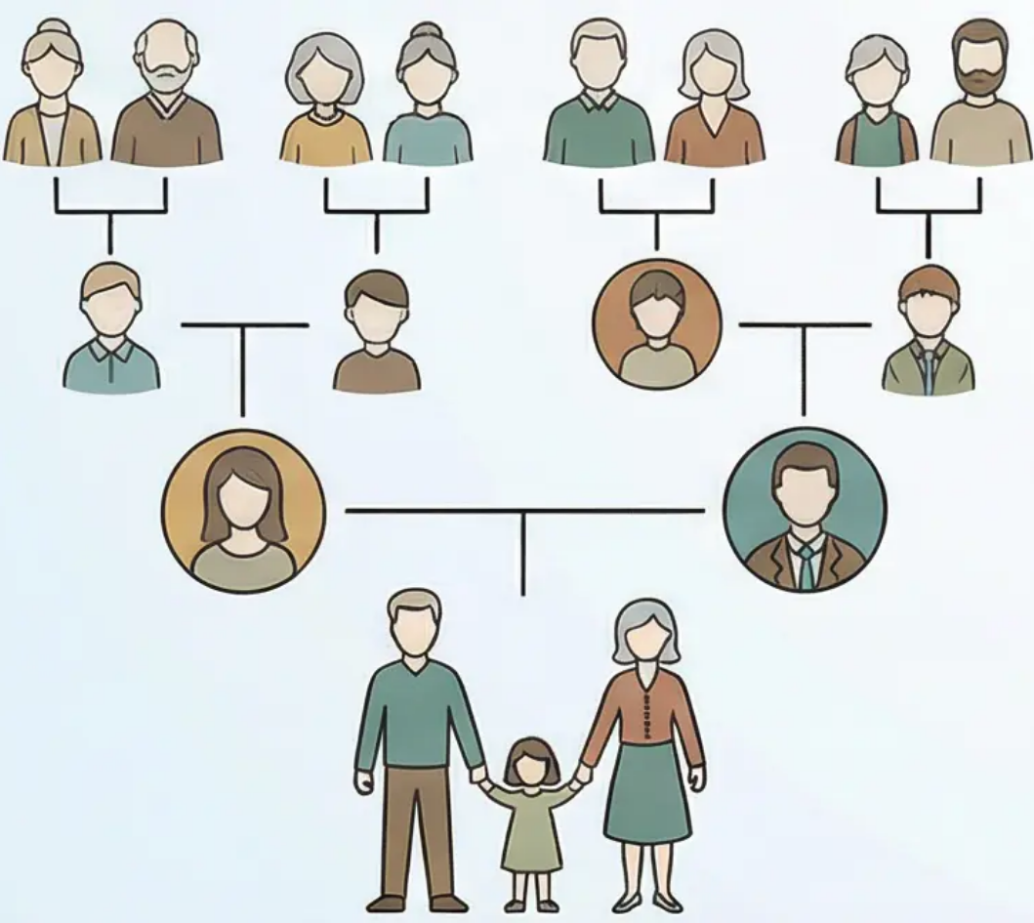
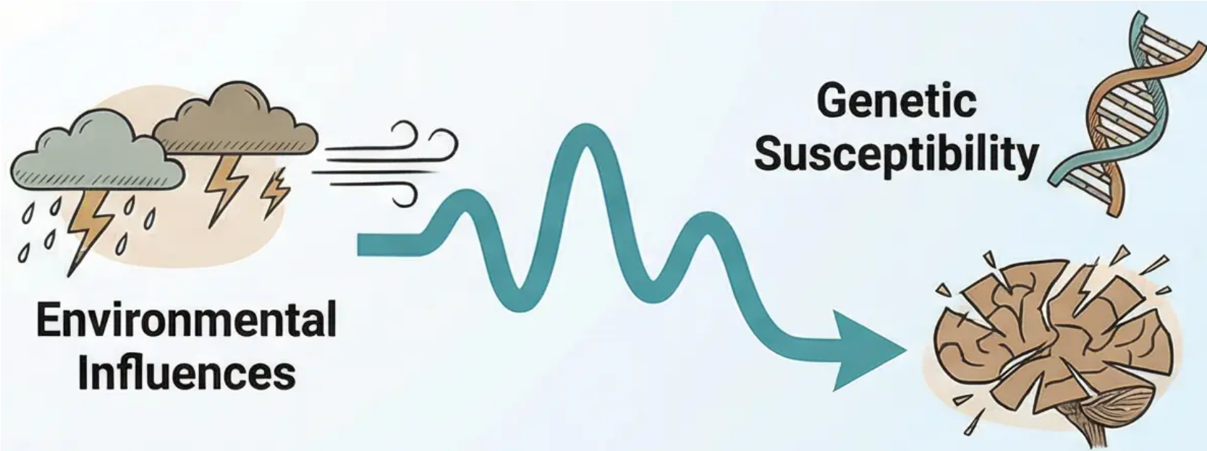
Biological Explanations for Schizophrenia: Genetics
Methods of Genetic Research
Key Findings
Studies of identical vs. non-identical twins •
Adoption studies to separate nature from nurture •
Family and kinship studies •
• Identical twins: 48% concordance rate
• Non-identical twins: 17% concordance rate
• General population: 1% prevalence rate
Diathesis-Stress Model
Development of
Schizophrenia

Slide 7

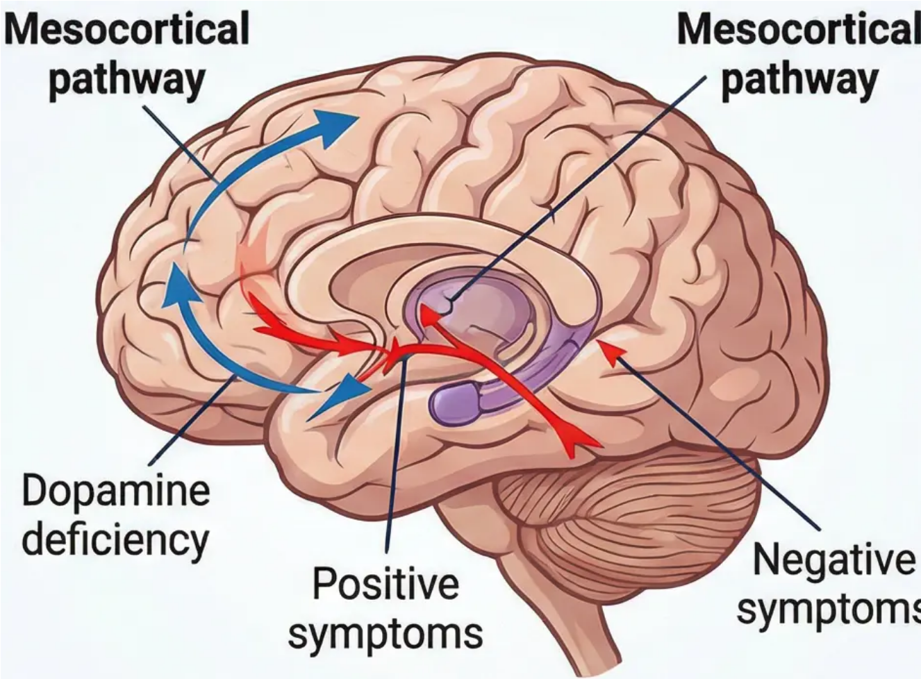









The Dopamine Hypothesis in Explaining Schizophrenia
Professional academic PPT slide on the reclime symptoms of the dopamine total dopamine
psychosis within and innedocontical pathway: Dopaminie deficiency→Negative symptoms.
The Original Simple Model
The Refined Developed Model
Excess dopamine activity
causes all symptoms
Specialised neural pathways
Mesolimbic pathway:
Excess dopamine →
Positive symptoms
Evidence: Amphetamines
induce psychosis-like
symptoms
Mesocortical pathway:
Dopamine deficiency →
Negative symptoms
Antipsychotics block
dopamine receptors
The Old Model
The Modern Model
Excess dopamine
Positive Symptoms
Excess dopamine
Symptoms
(Positive and Negative)
Dopamine Deficiency
Negative Symptoms

Slide 8

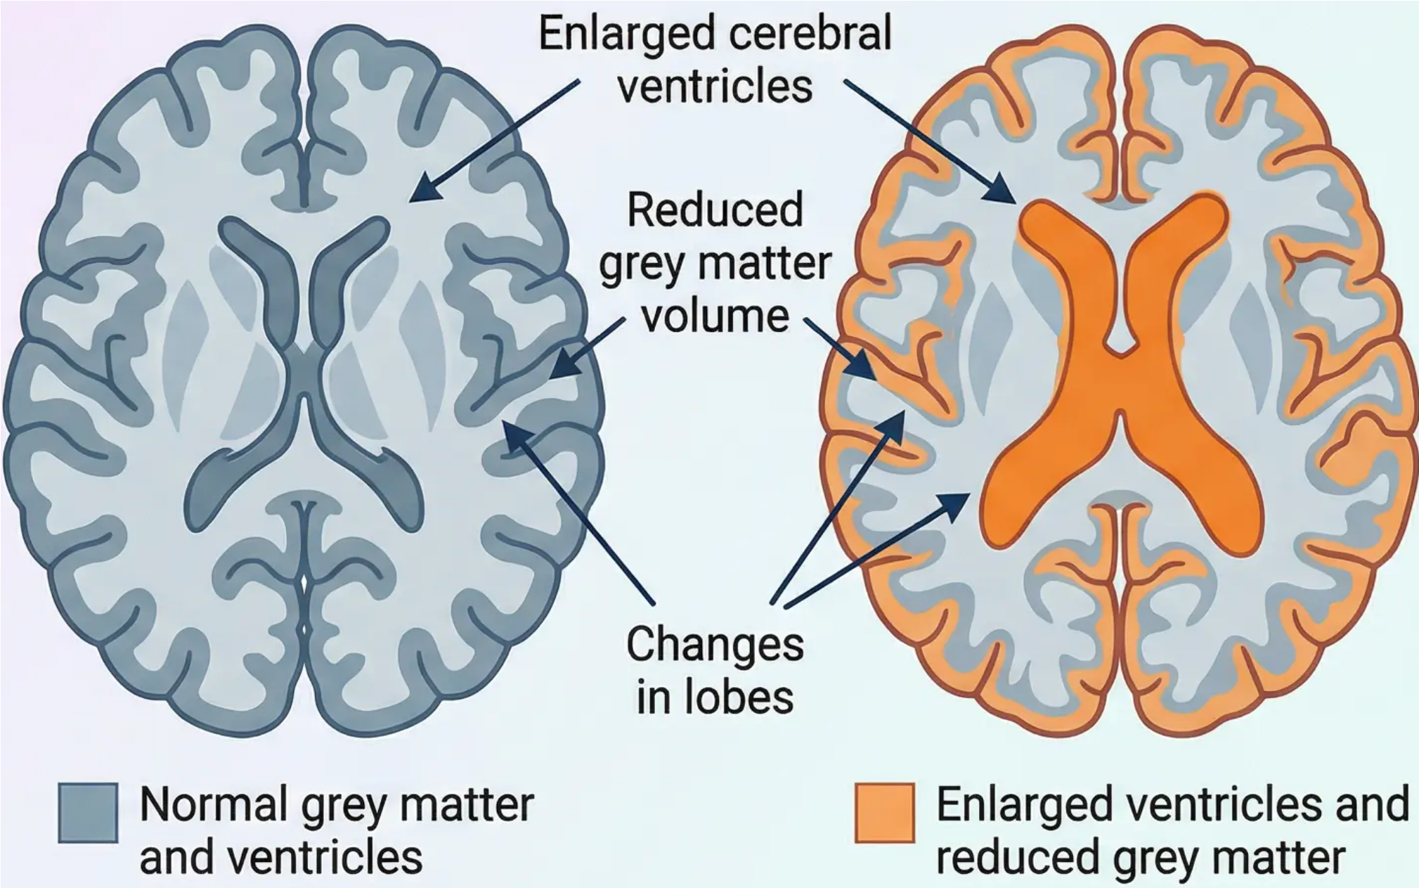
Neural Correlates and Structural Abnormalities
Brain Changes Associated with Schizophrenia
Structural Abnormalities
Healthy Brain
Schizophrenic Brain
• Enlarged cerebral ventricles
• Reduced grey matter volume
• Changes in temporal and frontal
lobes
Functional Abnormalities
• Reduced frontal lobe activity
(Hypofrontality)
• Disruption in neural activity
• Dysfunction in neural
connections

Slide 9

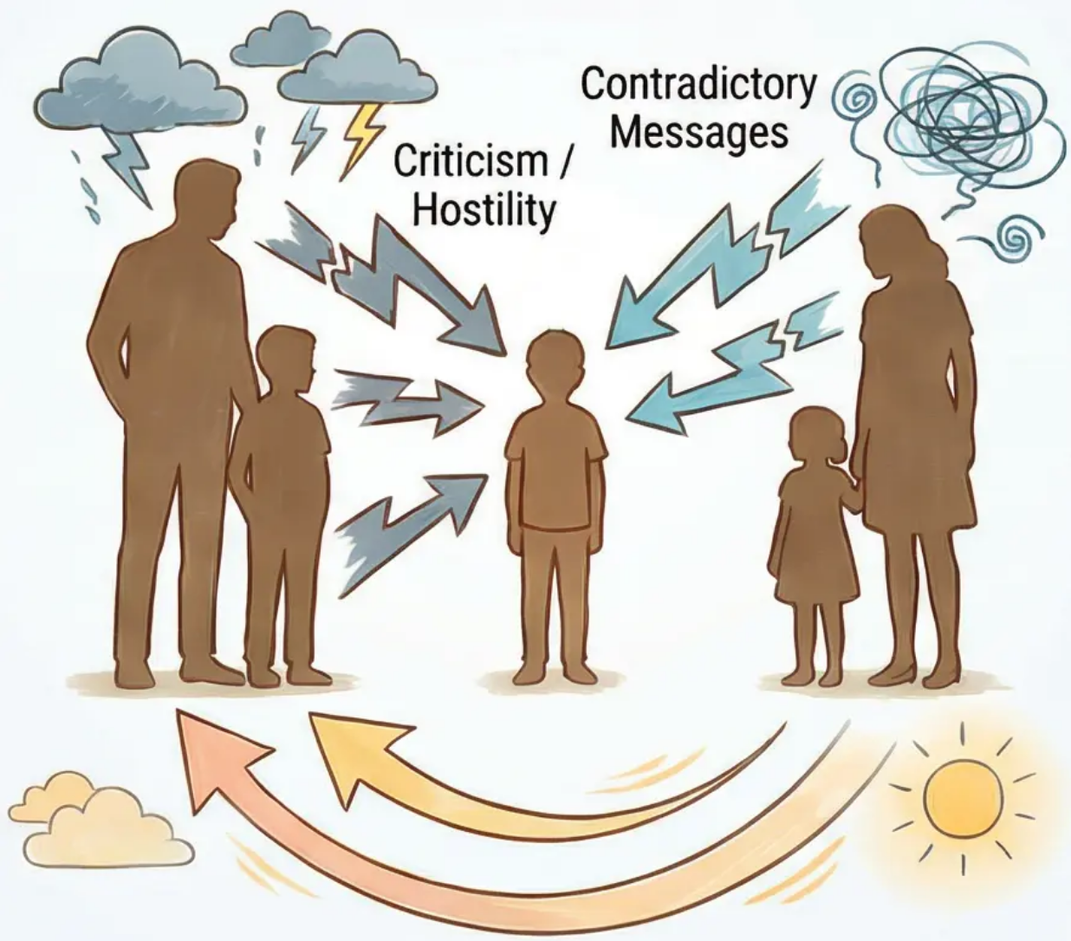
Psychological Interpretations: Family Dysfunction
The Role of the Family Environment in Schizophrenia
Concept of Expressed
Emotion (EE)
Dysfunctional
Communication Patterns
Excessive criticism of the patient
Contradictory messages
Hostility and emotional rejection
Lack of clarity in communication
Excessive emotional involvement
(over-involvement)
Negative emotional environment
Effects of Expressed Emotion
Therapeutic Implications
Fourfold increase in relapse rate
Importance of family therapy
Exacerbation of positive
symptoms
Training the family in positive
communication
Positive Communication /
Family Support
Poor response to treatment
Reducing environmental stressors

Slide 10

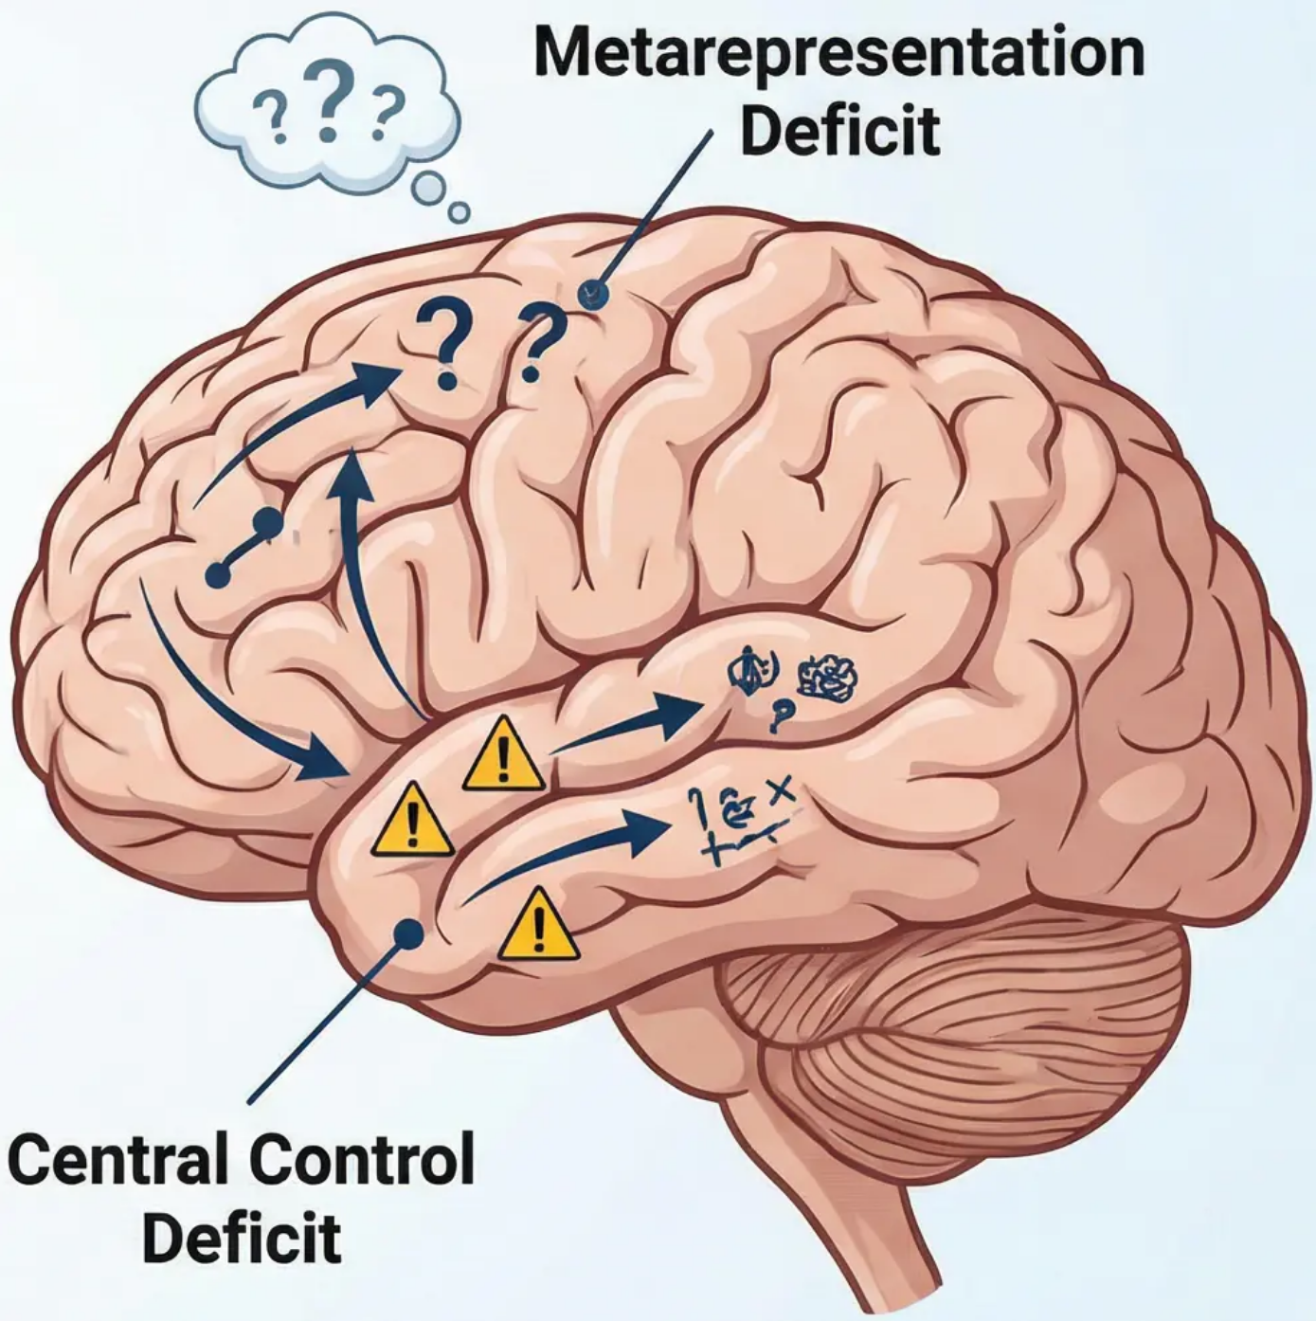


Cognitive Explanations of Schizophrenia
Frith's Cognitive Model and Information Processing Deficit
Attentional Biases
Tendency to pay excessive attention to threatening stimuli
Interpreting neutral events as hostile
Development of paranoia and delusions
Metarepresentation Deficit
• Loss of ability to think about one's own thoughts
• Inability to distinguish between internal and external thoughts
• Explains: delusions of control and thought insertion
• Auditory hallucinations as a failure to recognise inner speech
Central Control Deficit
• Inability to suppress automatic responses
• Difficulty in performing deliberate actions
• Explains: disorganised speech
• Lack of control over automatic mental associations

Slide 11

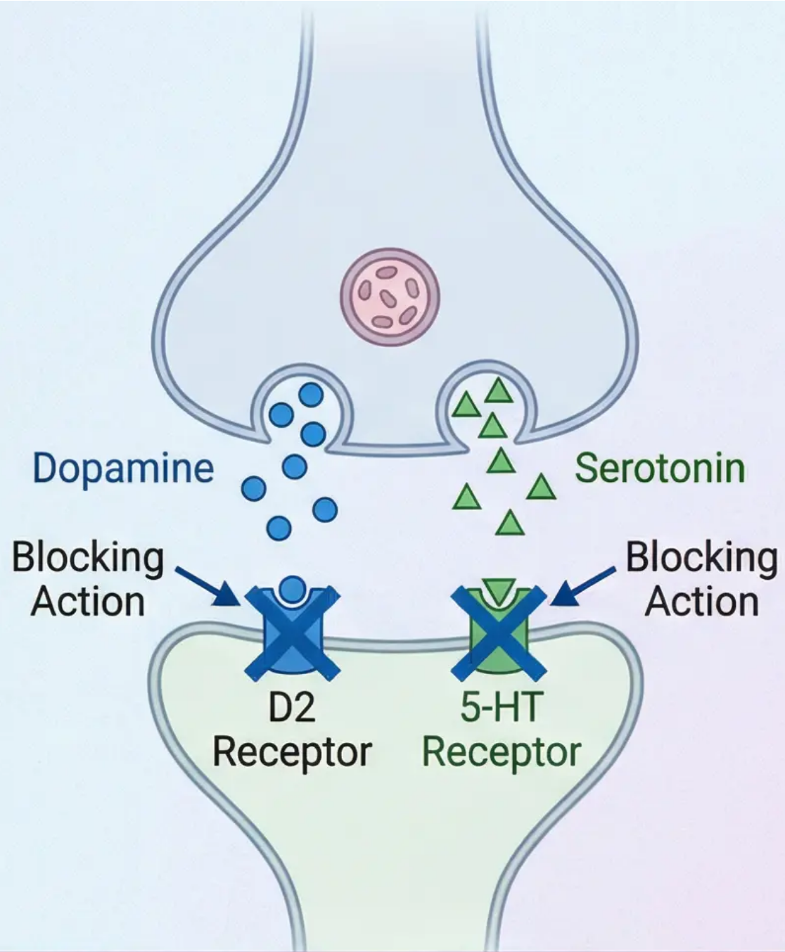




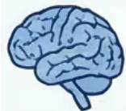
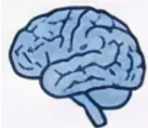

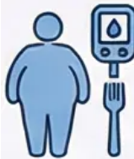
Biological Treatments: Antipsychotics
Comparing Drug Generations and Mechanisms of Action
Typical Antipsychotics
(First Generation)
Atypical Antipsychotics
(Second Generation)
• Examples: Chlorpromazine,
Haloperidol
• Examples: Clozapine,
Risperidone, Olanzapine
• Mechanism of Action:
Potent D2 Dopamine
Receptor Blockers
• Mechanism of Action:
Dopamine and Serotonin
Blockers
• Targeted Symptoms:
Positive Symptoms Only
• Targeted Symptoms:
Positive and Negative
Symptoms
• Side Effects:
Motor Symptoms – Tardive
Dyskinesia
• Side Effects:
Metabolic Effects (Weight
Gain, Diabetes)
Modern treatment favours atypical antipsychotics as a first-line option due to
improved negative symptoms and reduced motor risks

Slide 12


Electroconvulsive Therapy (ECT) and Ethical Issues
Electroconvulsive Therapy (ECT)
Key Ethical Issues
• Limited use in schizophrenia
• Informed consent and
cognitive capacity
• Effective in catatonic
schizophrenia cases
• Coercive treatment versus
autonomy
• Used when medications are not
effective
• Principle of beneficence versus
right to self-determination
• Performed under general
anaesthesia
• Challenges in cases of lack of
insight into the illness
• Main side effect: memory loss
• Ethical responsibilities of
practitioners

Slide 13


Cognitive Behavioural Therapy for Psychosis (CBTp)
Key Objectives
Main Techniques
• Develop effective coping strategies
• Change interpretation of psychotic
experiences
• Reduce psychological distress
associated with symptoms
• Improve daily and social functioning
Normalisation: "Unusual experiences
are common under stress"
• Collaborative reality testing
• Develop problem-solving skills
• Anxiety and stress management
techniques
Therapeutic Process
Effectiveness
• Build a safe therapeutic relationship
• Identify distorted thoughts and beliefs
• Explore alternative explanations
• Apply cognitive restructuring
techniques
Reduction in positive symptoms
• Improvement in quality of life
• Reduced relapse rates
• Increased self-confidence and
self-control

Slide 14

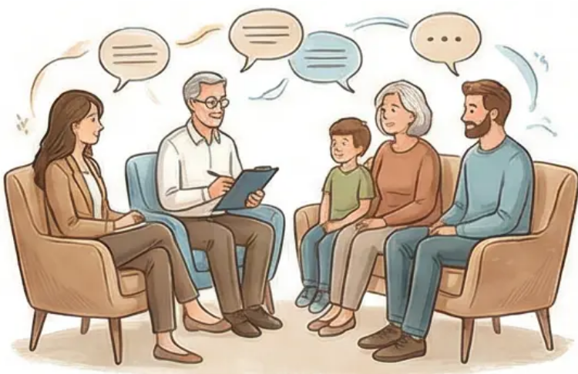
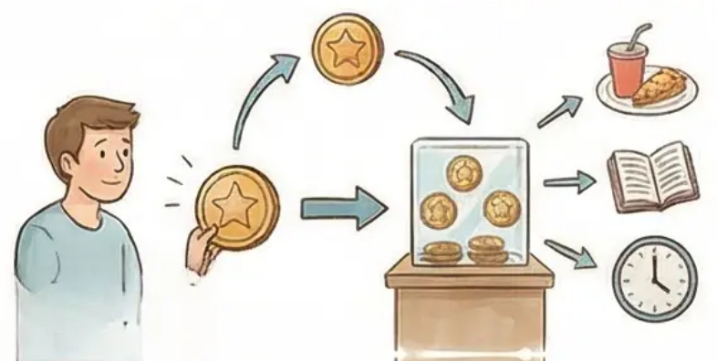
Additional Psychological Treatments for Schizophrenia
Family Therapy
Token Economies
Goal: Reduce high expressed emotion in the family
environment
Principle: Operant conditioning for behaviour
modification
Key Components:
• Psychoeducation about
schizophrenia
• Improve family
communication patterns
• Develop problem-solving
strategies
Application: Rewarding
desired behaviours with
redeemable tokens
Effectiveness: Useful
only in institutional
settings
Limitations: Difficulty generalising
outside the institution
Effectiveness: Reduces relapse rates by up to 70%
Historical Perspective: Psychoanalysis
Despite being the original psychological treatment, evidence has shown psychoanalysis to be
ineffective for treating schizophrenia, and may even be harmful in acute psychotic states.

Slide 15

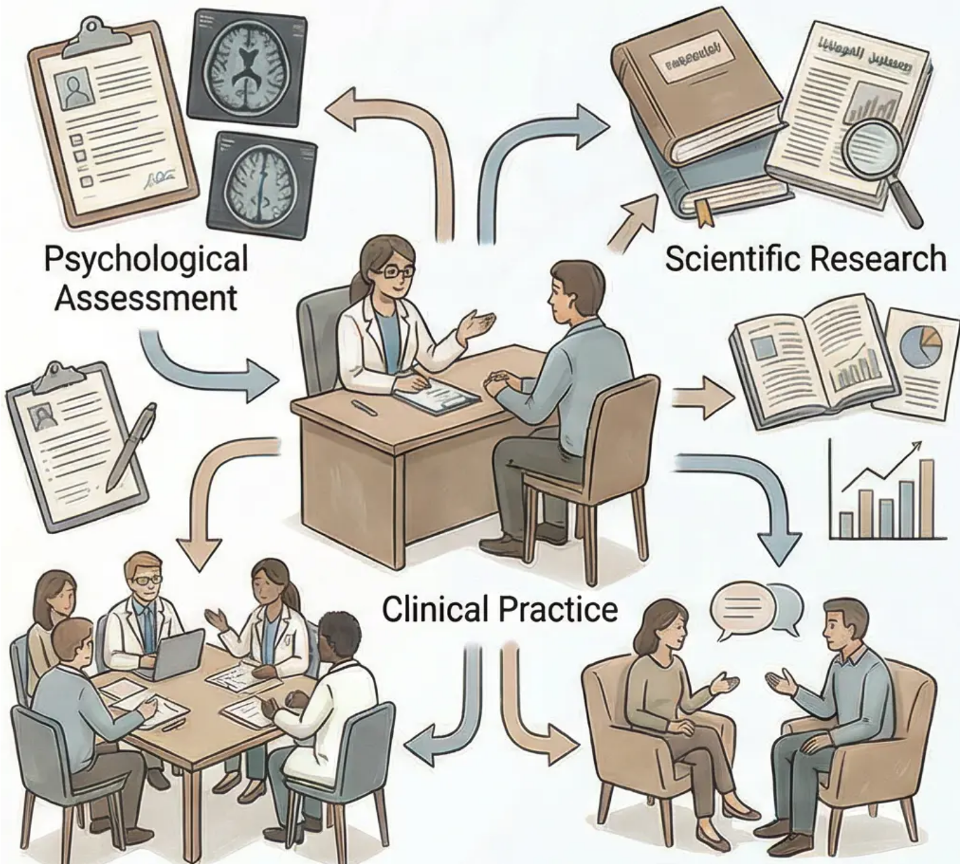
The Role of the Clinical Psychologist
Psychological Assessment: Gathering information
through clinical interviews and psychological tests
Psychological Formulation: Creating a shared
understanding of the origins of problems and factors
contributing to their persistence
Therapeutic Intervention: Providing evidence-based
psychological treatment
Evaluation and Follow-up: Monitoring progress and
systematically measuring the effectiveness of
intervention
The Scientist-Practitioner Model
Integrating scientific research and clinical
practice to ensure evidence-based treatment

Slide 16

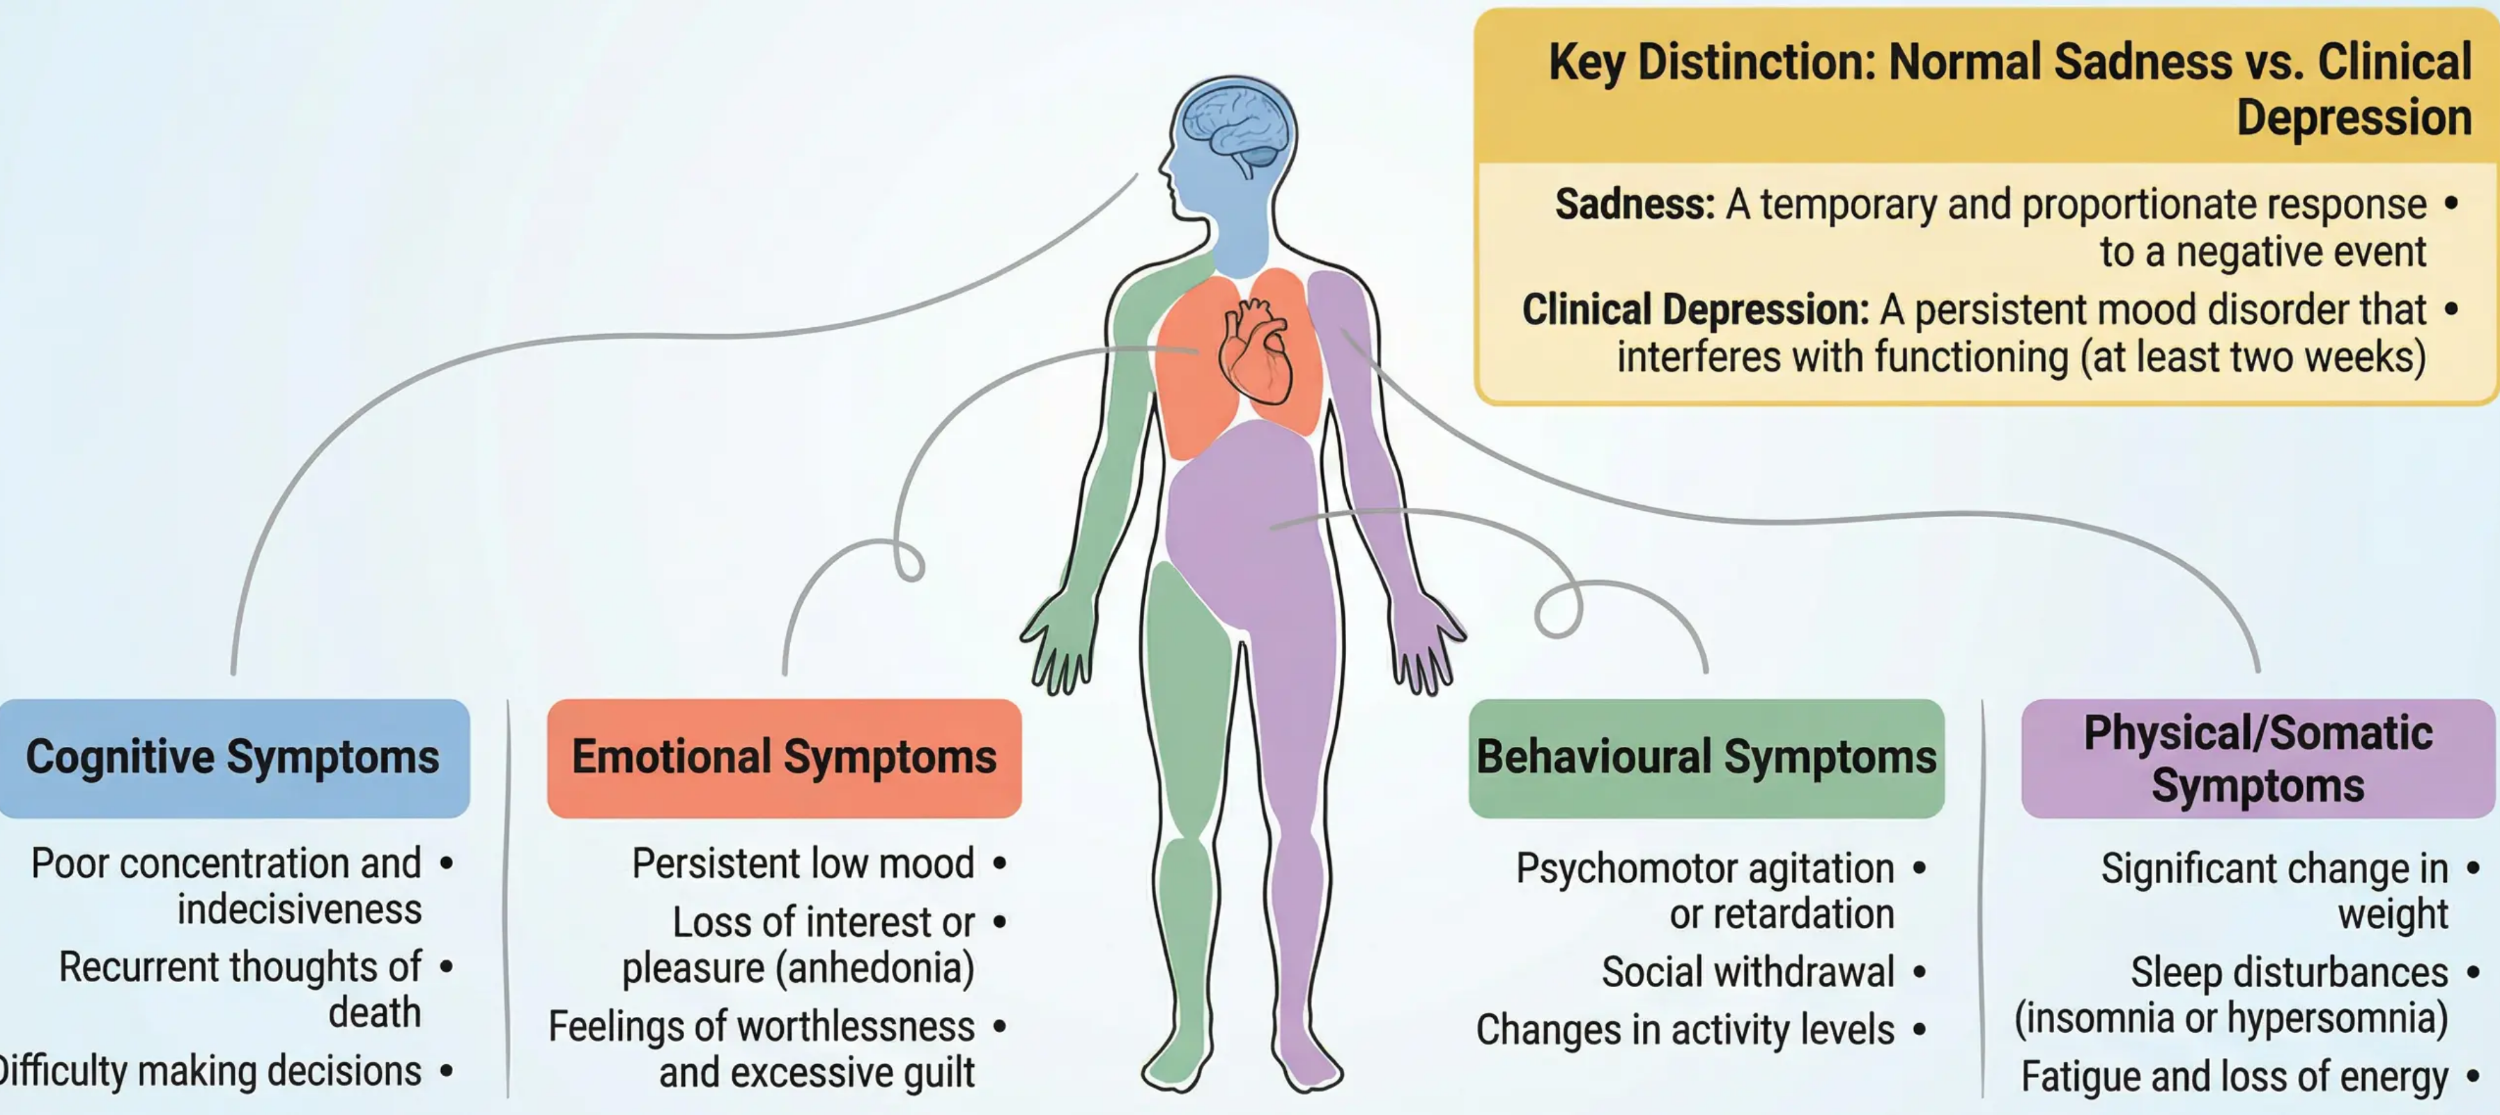
Depression: Clinical Characteristics and
Classification

Slide 17
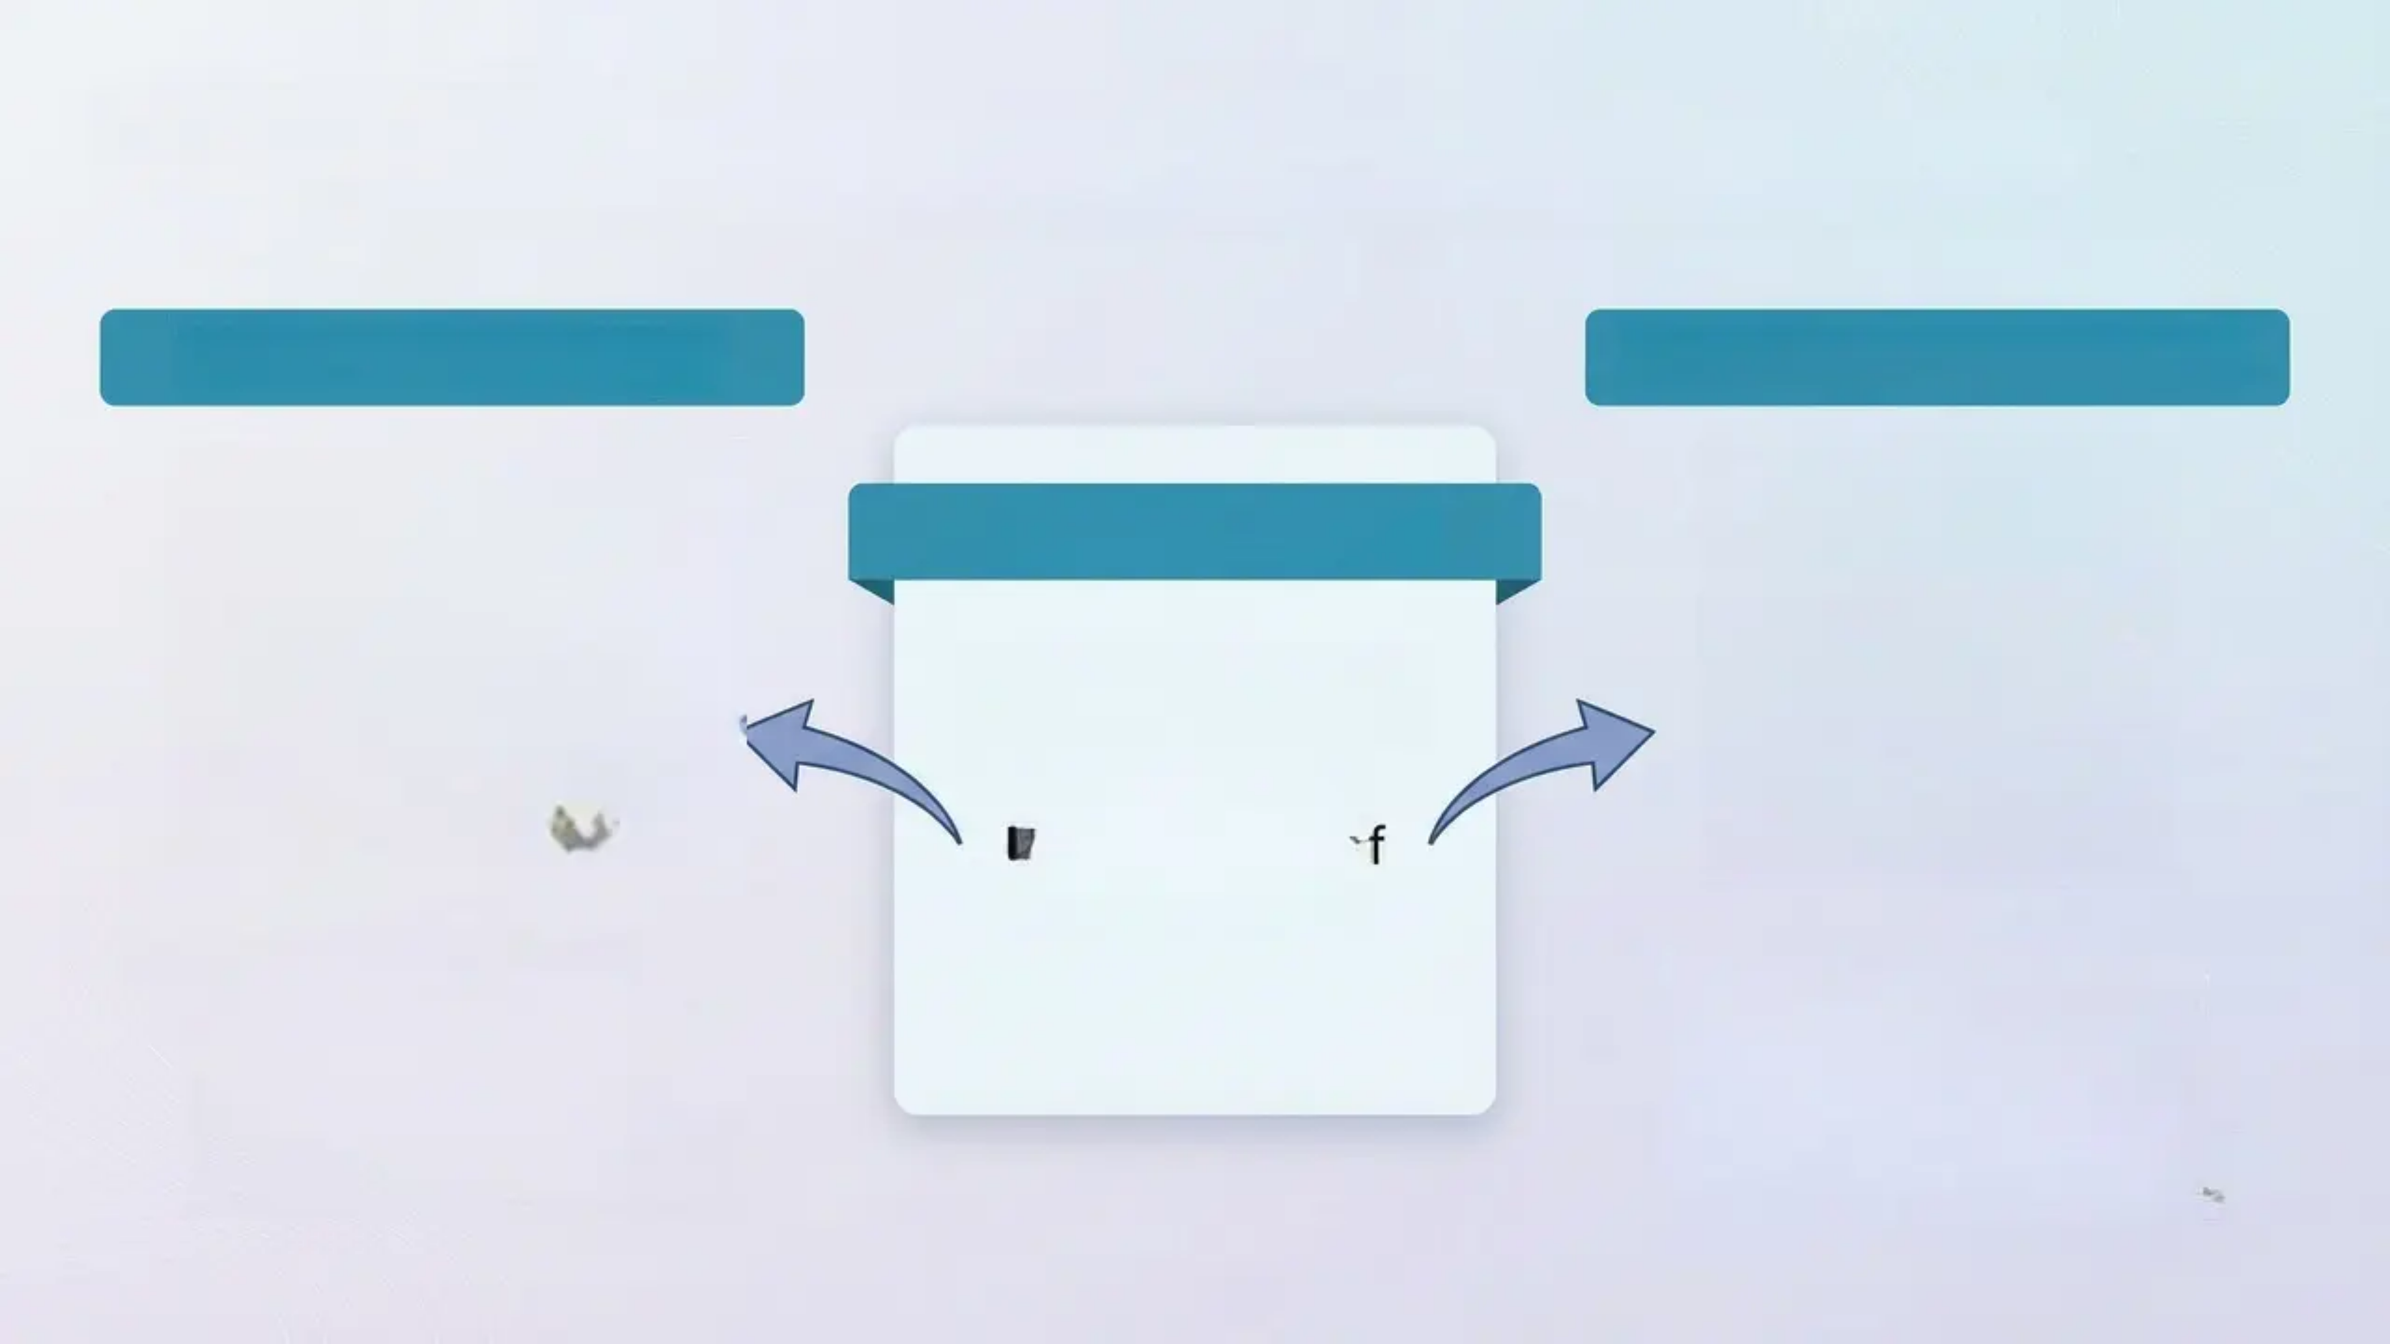
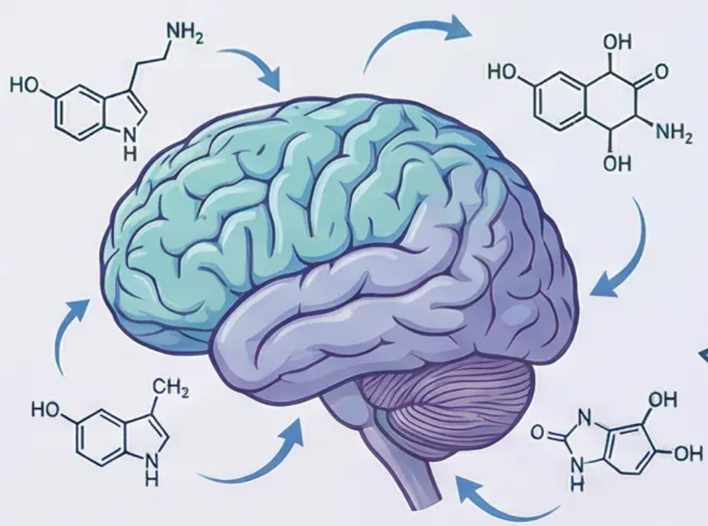
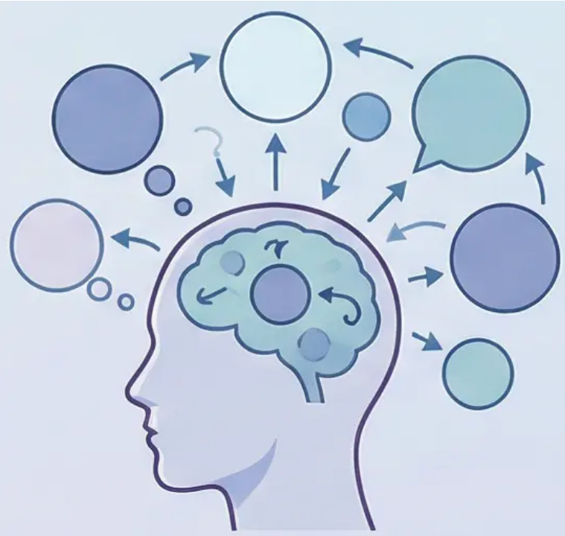
Explanations of Depression: Biological and Psychological Approaches
An Integrated Model for Understanding the Causes of Depressive Disorder
The Biological Approach
The Psychological Approach
The Integrated Model
Biology + Psychology
=
Comprehensive
Understanding of
Depression
• Monoamine Hypothesis
○ Decreased serotonin levels
○ Effect on mood and sleep
regulation
○ Response to pharmacological
treatment (SSRIs)
• Cognitive Models
○ Beck's Theory: The Cognitive
Triad (negative views of self,
world, and future)
○ Ellis's ABC Model: Activating
Events, Beliefs, Consequences
○ Distorted Thinking Patterns

Slide 18






Biological and Psychological Treatments for Depression
Comparing Efficacy and Relapse Prevention
Biological Treatments:
Antidepressants (SSRIs)
Psychological Treatments:
Cognitive Behavioural Therapy (CBT)
• Includes Fluoxetine (Prozac) and Sertraline
• Increases serotonin availability in the
synapse
• Effective within 4–6 weeks
• Suitable for moderate to severe depression
• Challenges negative automatic thoughts
• Behavioural activation and positive
activities
• Develops coping strategies
• Involves 16–20 therapy sessions
Advantages ✅
Advantages ✅
• Relatively quick response
• Ease of use and adherence
• Scientifically proven efficacy
• Lower relapse rate
• Lifelong skills
• No drug-related side effects
Challenges 🤕
Integrated Approach
Challenges 🤕
• Side effects (nausea, insomnia)
• Risk of relapse upon discontinuation
• Does not teach coping skills
Combining pharmacological and psychological treatment
often achieves the best results for severe depression,
benefiting from the immediate advantages of medication
and the long-term benefits of psychological treatment.
• Requires more time for improvement
• Needs active patient commitment
• Limited availability of qualified
therapists

Slide 19
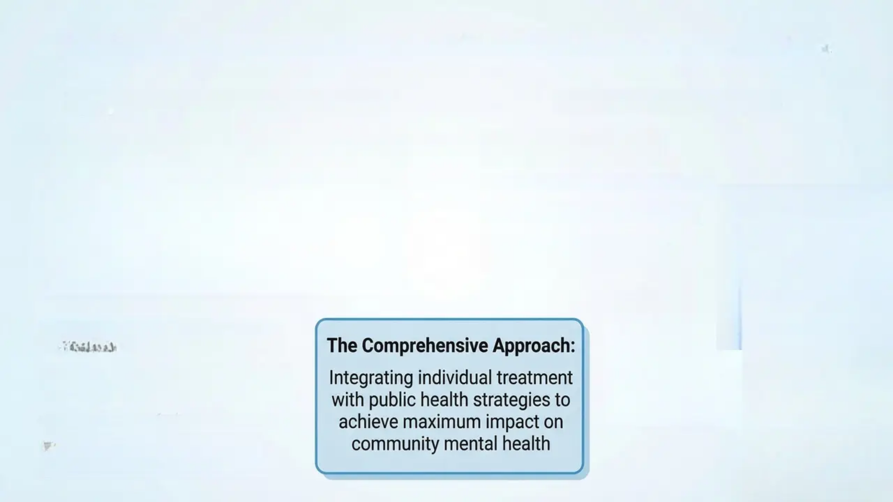
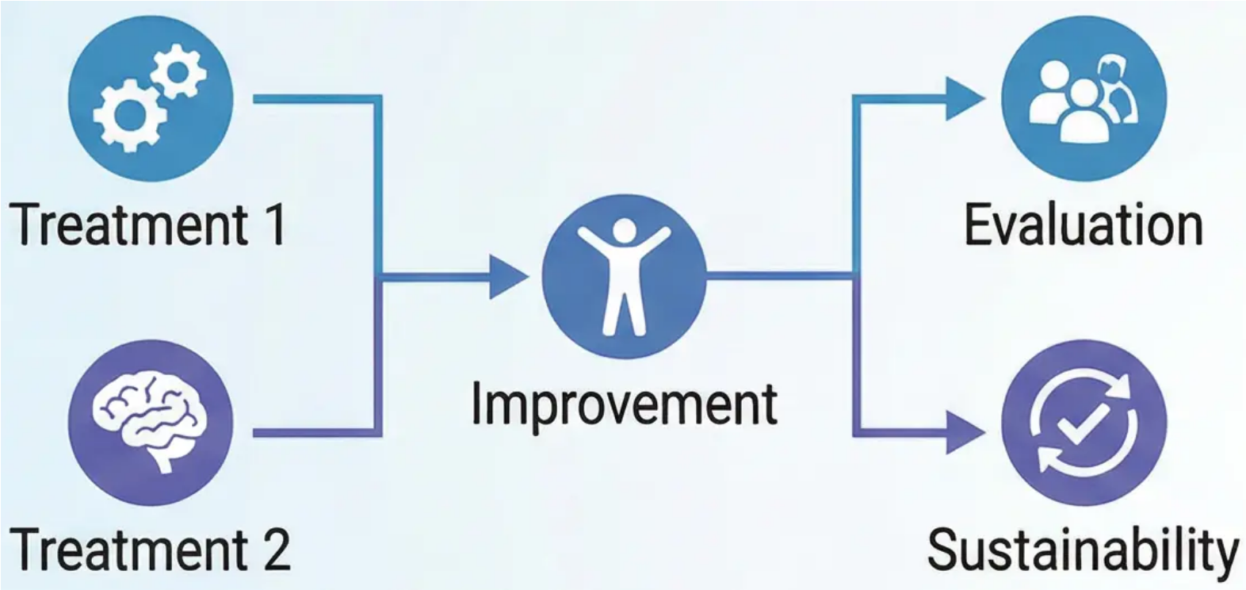
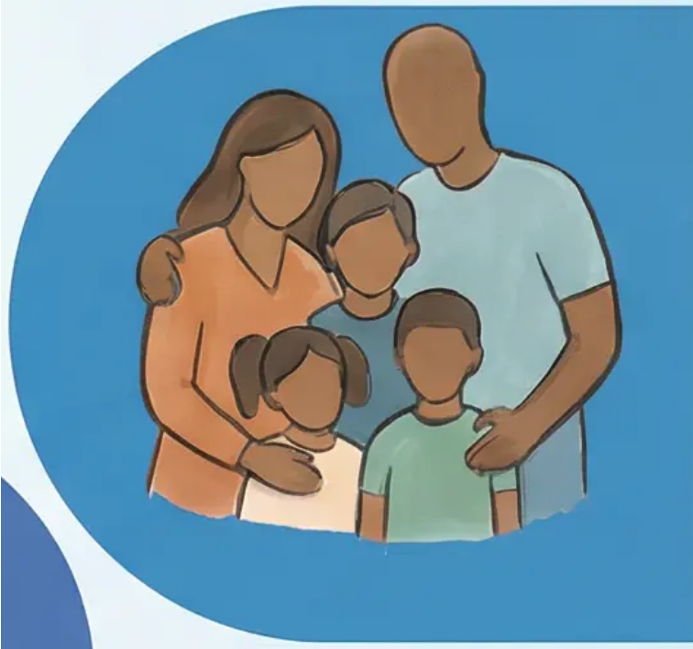


Evaluation of Treatments and Public Health Approaches
Analysis of Treatment Effectiveness
Public Health Strategies
Reducing the stigma of
mental illness
Strengthening social networks
Addressing social inequality
Programmes to promote
community well-being
Criteria for evaluating treatment
success
The Comprehensive Approach:
Comparing effectiveness between
different treatments
Integrating individual treatment
with public health strategies to
achieve maximum impact on
community mental health
Importance of relapse prevention
Avoiding the causal fallacy in
treatment

