Slide 1

Unit PSYCH502: Individual
Differences, Intelligence,
Personality, and Criminology
Level 5 Extended Diploma in Psychology
A Comprehensive Introduction to Theories,
Assessment, and Practical Application in
Understanding Human and Criminal Behaviour

Slide 2
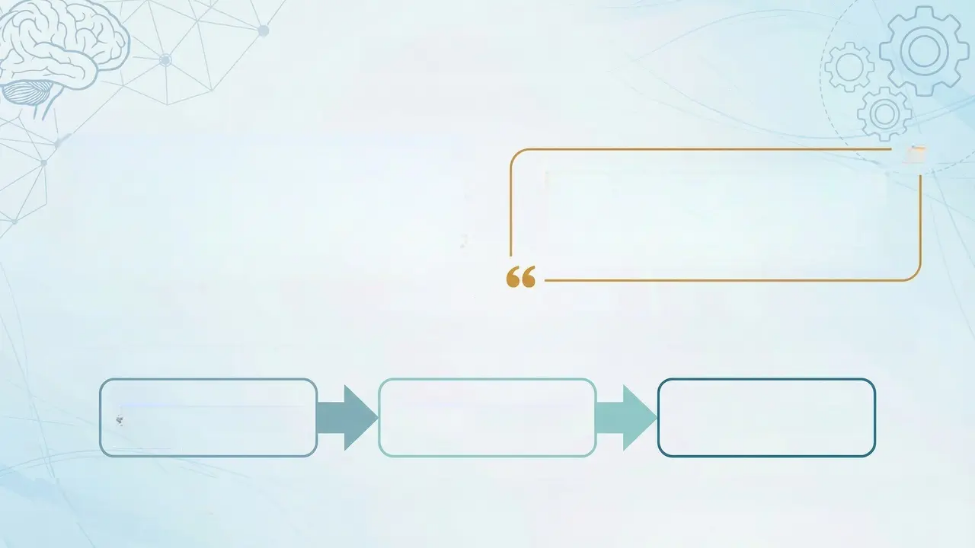

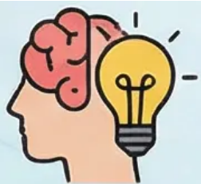


Unit Overview
Exploring the Dimensions of Human Distinctiveness
This unit invites you on a profound journey of exploration
into what makes every human being a unique and
distinctive entity. We examine two central constructs in
psychology — intelligence and personality — analysing
how psychologists define and measure them, and
revisiting the classical debates that have shaped this
scientific field, such as the enduring 'Nature versus
Nurture' controversy.
By the end of this unit, you will be able to
critically evaluate psychological theories
and apply them to complex human
behaviours — from everyday actions to
extreme criminal conduct.
The unit transcends purely theoretical perspectives to connect this understanding with a vital and contemporary
application: forensic psychology.
Intelligence
Personality
Criminology
We will apply our understanding of individual differences to analyse the motivations behind criminal behaviour, examine
how law enforcement agencies investigate complex cases, and explore what can be done to treat and rehabilitate offenders.

Slide 3

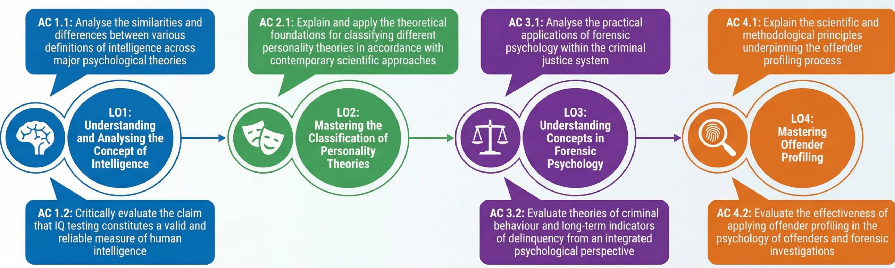
Targeted Learning Outcomes
Learning Outcomes
Your academic progress in this unit will be assessed through mastery of four core learning outcomes, each containing
specific assessment criteria designed to ensure a deep and critical understanding of the content:
These outcomes represent a progressive educational journey
– from understanding fundamental individual differences to
applying them in complex criminal justice contexts.

Slide 4
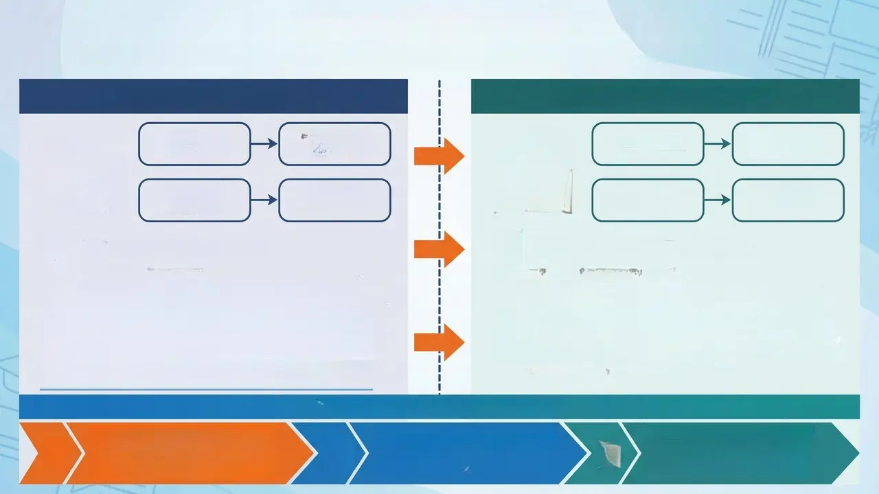







Academic Assessment Strategy
A Comprehensive Evaluation of Critical Analysis and Theoretical Application Skills
(Formative Assessment)
(Summative Assessment)
Intelligence
Theories
Personality
Theories
Case Study
Theory
Application
Critical
Analysis
Criminal
Behaviour
Case Analysis
Critical
Evaluation
Critical Analytical Essay
In-Depth Criminal Case Study
• Word Count: 800–900 words
• Objective: Apply theories of intelligence and personality to
criminal behaviour
• Target Skills: Critical analysis, theoretical integration, academic
evaluation
• Focus: Synthesising core concepts from different modules and
analysing causal relationships
• Purpose: Preparing students for the final task and developing
academic writing skills
• Word Count: 2,500–3,000 words
• Content: Comprehensive analysis of a known offender using
psychological theories
• Academic Requirements: Application of personality theories,
intelligence analysis, offender profiling techniques
• Assessment Criteria: Depth of analysis, accuracy of theoretical
application, quality of critical reasoning
• Weighting: Primary assessment for the unit
Timeline and Academic Support
Sessions 1–18: Content delivery and
formative assessment (practice). To
ensure optimal readiness and clarify
criteria for academic excellence.
Applied Workshop in Sessions 19
& 20: (Support and clarification of
excellence criteria)
Final Submission of Summative
Assessment: To ensure optimal
readiness and clarify criteria for
academic excellence.

Slide 5

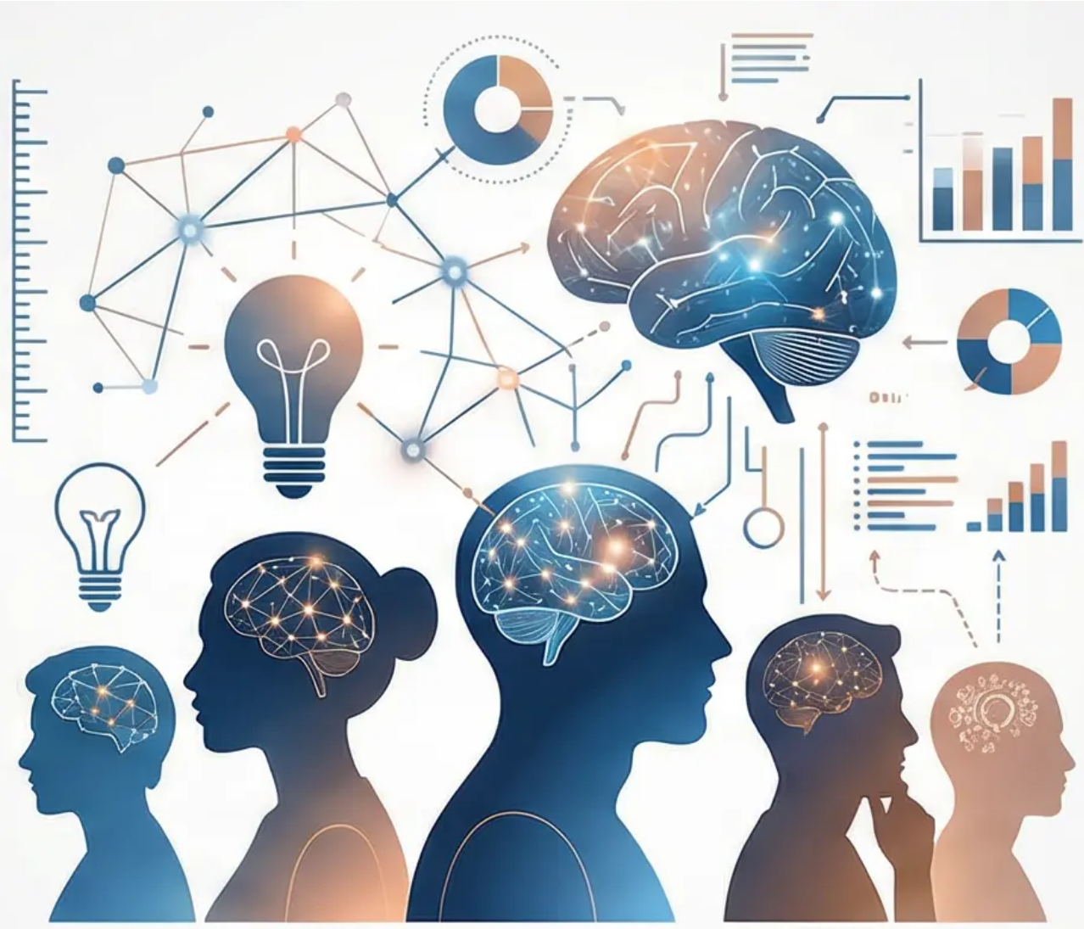





01
Session 1: Introduction to Individual Differences
and the Definition of Intelligence
Establishing the Foundational Concepts of Individual Differences and Transitioning from a General
Understanding of Intelligence to a Precisely Defined Academic Psychological Construct
This foundational session paves the way for understanding differential psychology
as a scientific field that studies individual differences in cognitive abilities and
personality traits. We begin by transforming the common conception of intelligence
from an intuitive idea into a theoretically precise construct.
Primary Session Objectives:
Define individual differences as a systematic scientific field
Distinguish between the lay and academic conceptions of intelligence
Explore intelligence as a capacity for learning and adaptation
Understand the historical development from Binet to contemporary theories
Core Themes:
The scientific definition of intelligence as a theoretical construct encompassing the
ability to learn from experience, solve novel problems, and apply knowledge to adapt
to changing environments — emphasising that this definition transcends mere
academic performance to include abstract reasoning and practical application.

Slide 6

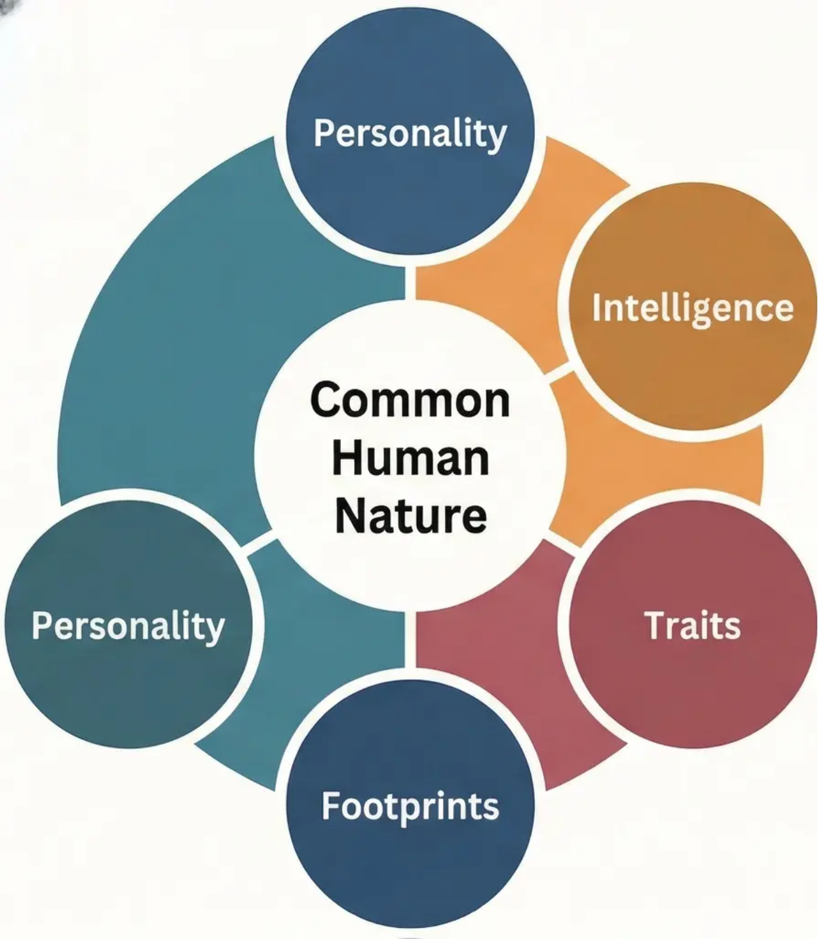

The Psychology of Individual Differences
The field of individual differences is among the most
intellectually stimulating domains in contemporary
psychology. It seeks to answer a fundamental question:
why do individuals differ so markedly in their cognitive
abilities and behavioural patterns, despite sharing a
common human nature?
Personality
"Individual differences are not
merely random variations; they
represent organised and stable
patterns that reflect the
complex interaction between
genetic and environmental
factors in shaping human
behaviour."
Core Issues in Individual Differences:
Intelligence
• Cognitive Dimension: Differences manifest
in the speed of cognitive processing,
memory capacities, thinking styles, and the
ability to solve complex problems. These
differences are not merely superficial
variation; they reflect distinct neurological
and cognitive mechanisms that influence
how individuals perceive the world and
process information.
Common
Human
Nature
Personality
Traits
• Behavioural Dimension: Differences
appear in relatively stable behavioural
patterns across situations and over time,
forming what we term 'personality'.
These patterns encompass
emotional responses, styles of social
interaction, and levels of activity and
motivation.
Scientific and Applied Significance:
Understanding these differences enables us to
develop more precise theories of human nature,
design tailored educational and therapeutic
interventions, and improve selection and
recruitment processes across diverse work
environments.
Footprints

Slide 7
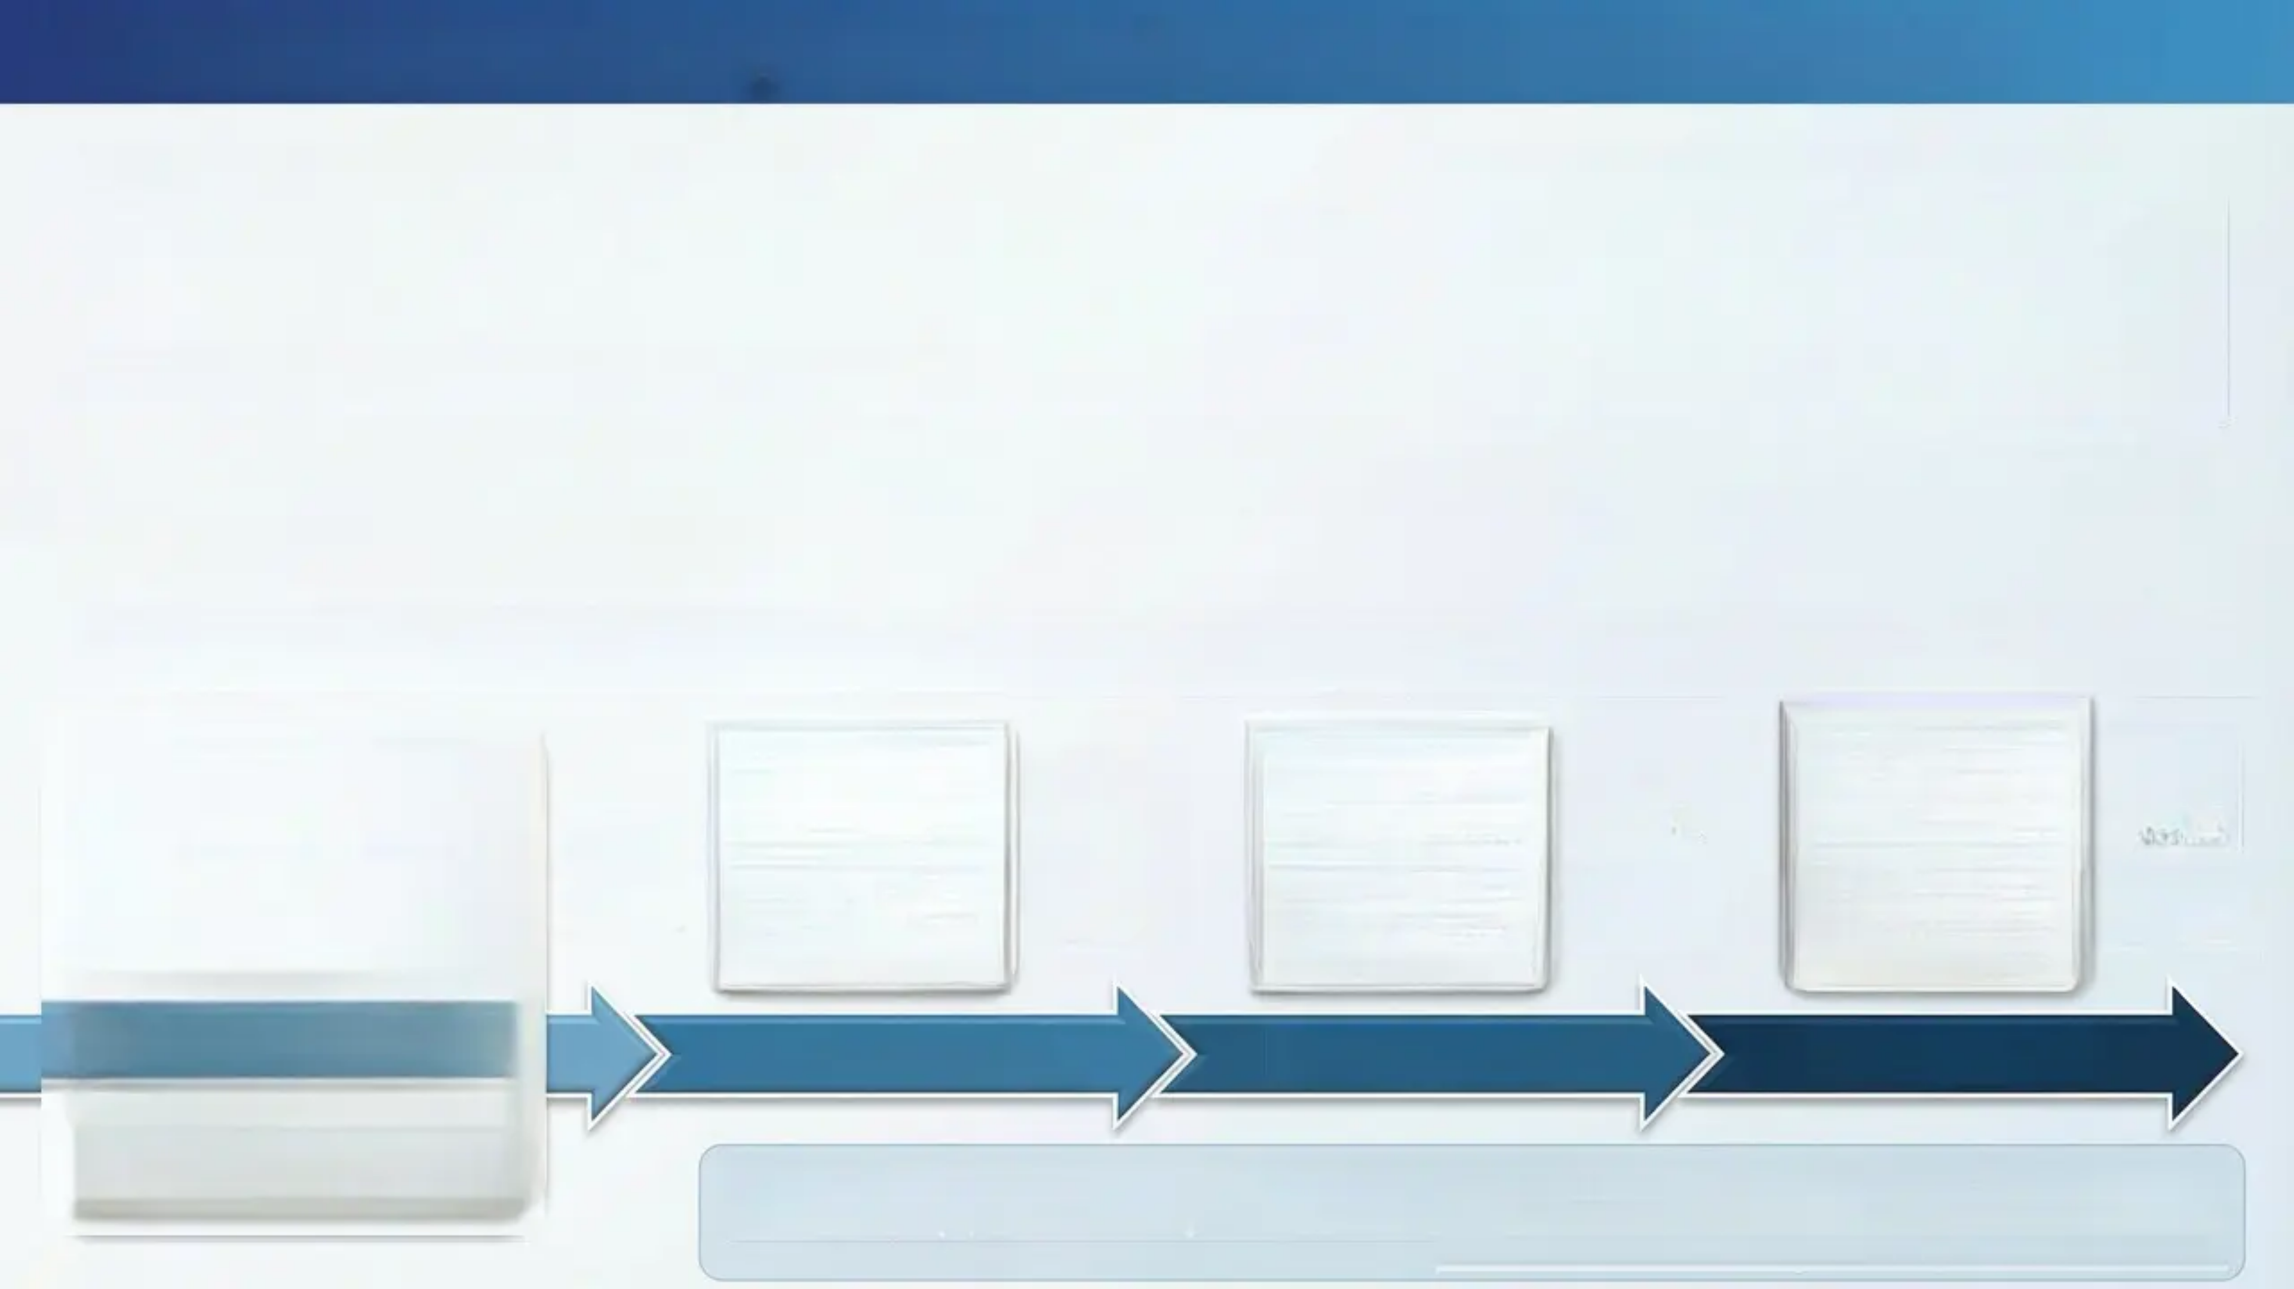

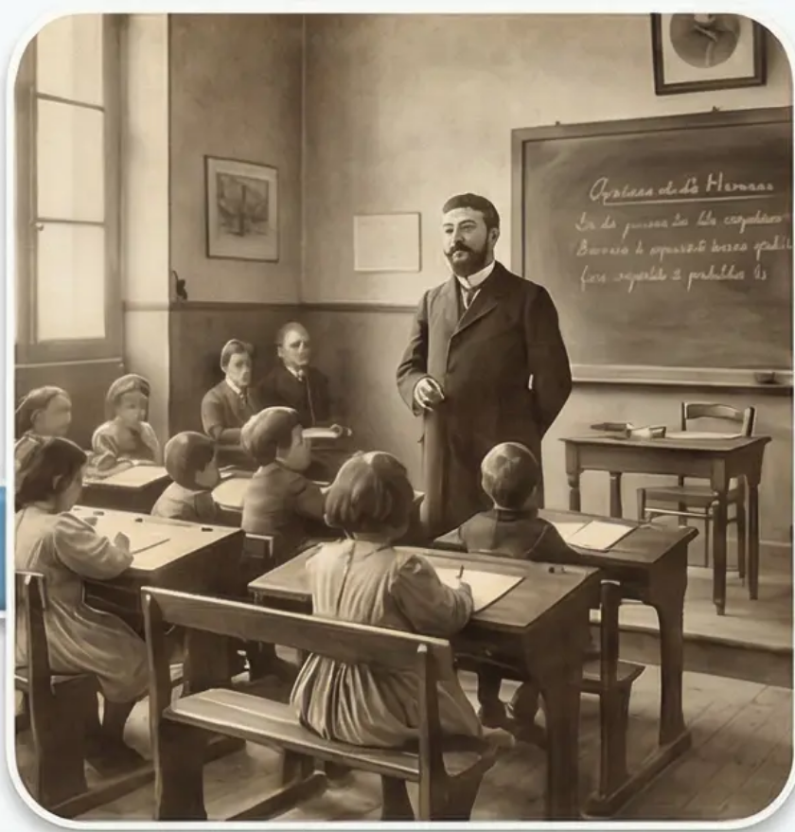
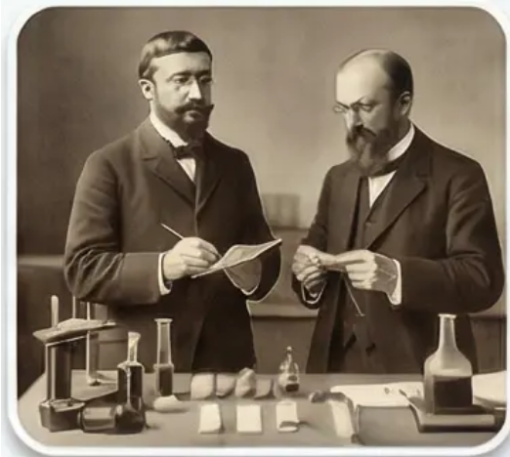
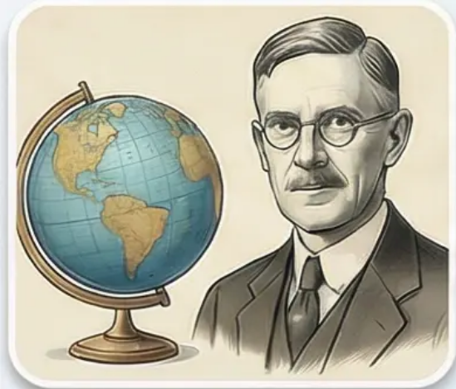
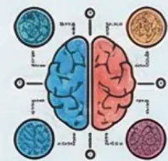
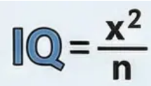
The Evolution of Intelligence: From Binet to Modern Measurement
Historical Roots and Practical Motivations
From Practical Tool to Scientific Theory
Alfred Binet is regarded as the true pioneer of modern intelligence measurement; however, his
motivations were not purely theoretical — they were practical and humanitarian. In the early
twentieth century, the Parisian education system faced a genuine challenge: how to identify
children requiring additional educational support without relying on the subjective impressions of
teachers.
What began as a practical instrument to assist children
gradually evolved into a complex research domain.
Psychologists began to ask: what exactly are we
measuring? Is intelligence a single ability or a cluster of
abilities? These questions led to the sophisticated
theories discussed in subsequent sessions.
Binet's Revolutionary Contribution: The Concept of Mental Age
In 1905, Binet and his colleague Théodore Simon developed the first systematic
intelligence test. Their core idea was simple yet revolutionary: constructing a series of tasks of increasing of increasing difficulty, each associated
with a specific chronological age. If a six-year-old child could solve tasks typically assigned to eight-year-olds, their mental age would be recorded as eight.
Development and Global Dissemination
Binet's ideas spread rapidly across continents. In the United States, Lewis Terman at Stanford University adopted and refined Binet's test, transforming it into the
S. which remains in use to this day. Terman incorporated the concept of the 'Intelligence Quotient' (IQ), originally proposed by William Stern.
1905:
Binet-
Simon
Laboratory
Stanford-Binet
Scale in
America
Intelligence
Quotient (IQ)
= MA/CA × 100
Modern
Measurement
and Theories
The Concept of Mental Age
Stanford-Binet Scale
in America
Modern Measurement
and Theories
Discussion Prompt: How did the shift from a practical objective (assisting children) to theoretical
inquiry (understanding the nature of intelligence) influence the development of this field?
What are the ethical implications of this transition?

Slide 8

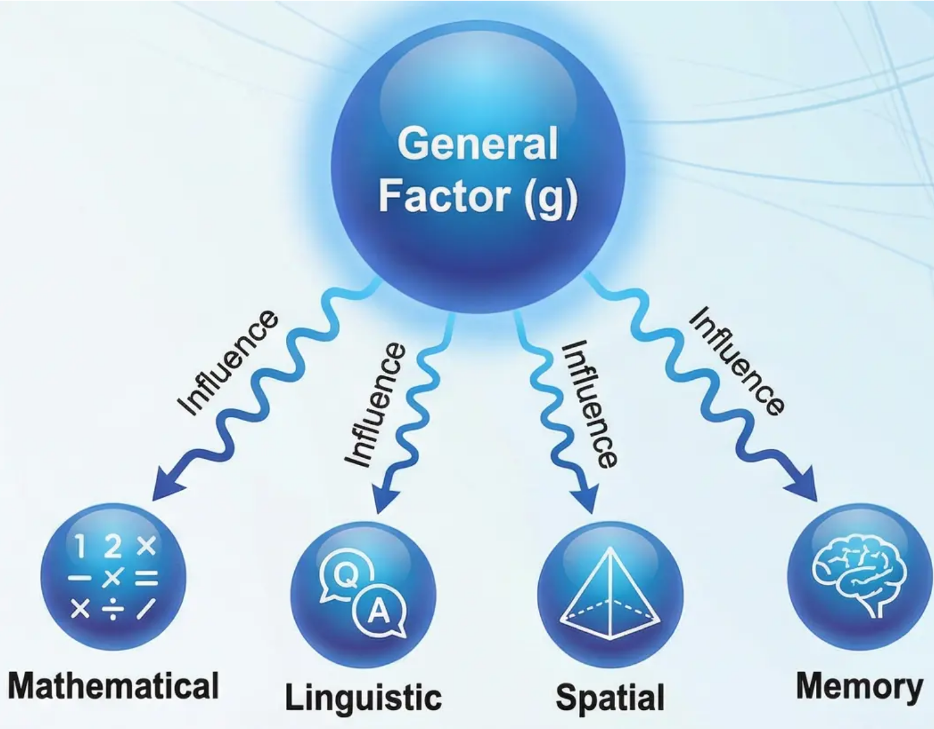
Spearman's Two-Factor Theory:
General Intelligence (g) and Specific Abilities (s)
Empirical Basis of the Theory
Through statistical correlation analysis, Spearman discovered that individuals
who excel in one mental test tend to excel in others. This consistent positive
correlation led to the hypothesis of a single underlying factor influencing all
cognitive abilities.
Components of the Theory
General Factor (g-factor):
• Represents the fundamental mental power or 'general cognitive energy'
• Influences performance across all mental tasks to varying degrees
• Accounts for positive correlations observed between diverse tests
• Regarded as an indicator of overall cognitive processing efficiency
Specific Factors (s-factors):
• Discrete abilities required for particular tasks (mathematical, linguistic,
spatial)
• Operate independently of the general factor
• Account for residual variance in performance unexplained by the g-factor
• Contribute to specialisation and excellence in specific cognitive domains
Practical Application:
Performance on any test = General Factor (g) + Specific
Factor (s) + Measurement Error
Discussion Question:
How does Spearman's theory account for the observation that some students excel across most academic subjects while others experience
pervasive learning difficulties? What are the theoretical limitations of this explanation?

Slide 9

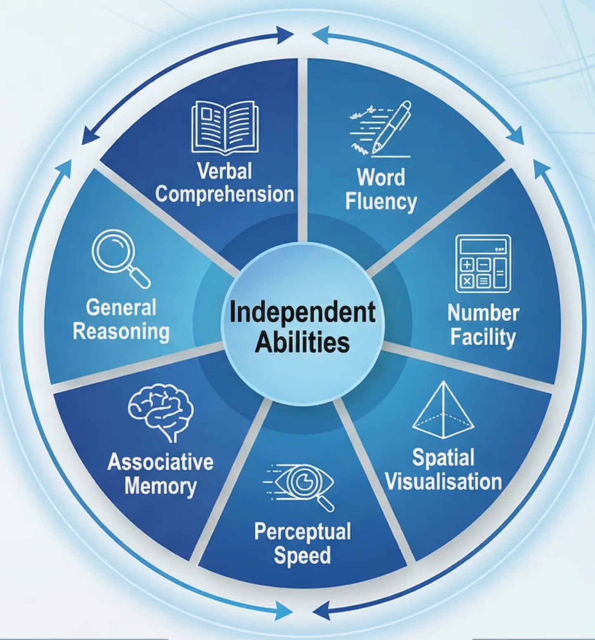
Thurstone's Primary Mental Abilities
Challenging the Unitary Model of Intelligence Through Multiple Independent Abilities
Theoretical Introduction:
American psychologist L.L. Thurstone fundamentally disagreed with Spearman's unitary
theory of intelligence. Employing advanced factor analysis, Thurstone argued that
intelligence is not a single general ability, but rather a cluster of seven independent and
distinct primary mental abilities.
The Seven Primary Mental Abilities:
• Verbal Comprehension: The ability to understand word meanings and complex linguistic
relationships, encompassing vocabulary and analytical reading.
• Word Fluency: The speed of producing words according to specific constraints, such as
finding words beginning with a particular letter.
• Number Facility: Proficiency in basic arithmetic operations and the ability to handle
numbers with speed and accuracy.
• Spatial Visualisation: The capacity for mental manipulation of shapes and objects in
three-dimensional space.
• Associative Memory: The ability to memorise and recall associated information.
• Perceptual Speed: The ability to rapidly identify similarities and differences in visual stimuli.
• General Reasoning: The ability to discover logical rules and patterns and to solve abstract
problems.
The Conceptual Revolution:
Rather than a single intelligence score, Thurstone proposed a multidimensional ability profile.
This perspective implies that two individuals with the same general IQ may exhibit entirely
different patterns of cognitive strengths and weaknesses.
Discussion Question:
How does Thurstone's model account for the observation that a student may excel in mathematics yet struggle with language, while the reverse is true
for another student? What are the educational implications of this perspective?

Slide 10

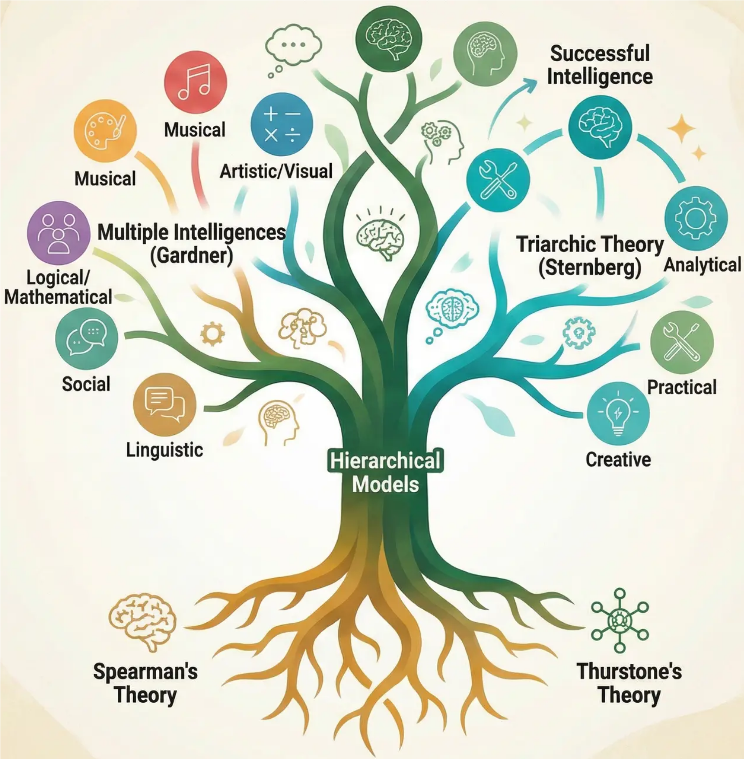
02
Hierarchical and Alternative
Models of Intelligence
Examining the Reconciliation of Classical Theories
Through Hierarchical Models, and Exploring Contemporary
Theories That Have Extended the Scope of Intelligence
Beyond Traditional Academic Frameworks
This session aims to resolve the historical 'one versus many'
debate from the preceding session, and subsequently to
broaden the definition of intelligence beyond conventional
psychometric measurement. We will explore how theories
evolved by building upon or engaging with prior frameworks,
and trace the transition from accepted psychological consensus
to innovative alternative models.
Learning Objectives:
• Understand the hierarchical reconciliation between Spearman's
and Thurstone's theories
• Analyse Gardner's Theory of Multiple Intelligences and its
practical applications
• Examine Sternberg's Triarchic Theory and the concept of
successful intelligence
• Critically evaluate alternative theories against traditional models

Slide 11

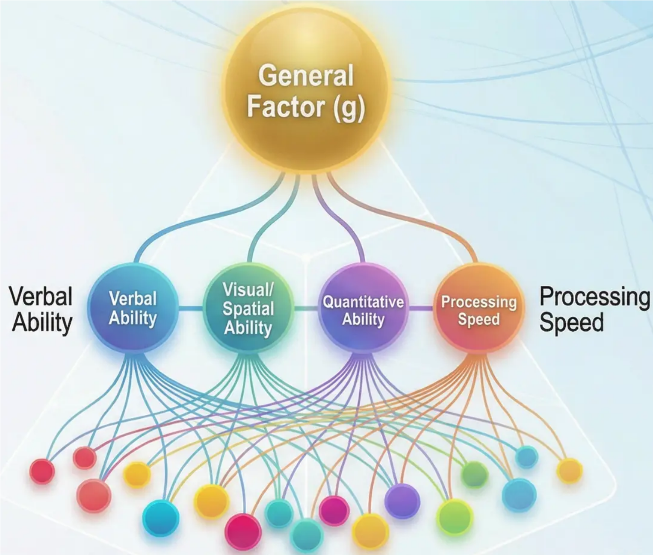
The Hierarchical Reconciliation: Integrating Spearman and Thurstone
Resolving the Debate Between Unitary and Multiple Perspectives on Intelligence
How Can the Apparent Contradiction Be Resolved?
How can the apparent contradiction between Spearman's general factor
theory and Thurstone's multiple abilities theory be resolved? Subsequent
research demonstrated that both perspectives are valid, leading to the
development of hierarchical models that now represent the prevailing view
in cognitive psychology.
Empirical Basis:
Contemporary factor analyses support this hierarchical organisation by
demonstrating:
• Positive correlations among all cognitive abilities (evidence for 'g')• Clustering of similar abilities (evidence for group factors)• Specialisation in specific tasks (evidence for narrow abilities)
Practical Applications:
This model permits a deeper understanding of the individual cognitive
profile, whereby a person may exhibit:
• General strength in 'g' alongside variation in specific abilities• Weakness in a particular group factor while retaining other abilities• Outstanding performance in a narrow domain within an average general
ability
Narrow specific abilities
measured by particular tasks
Discussion Question:
How can this hierarchical model account for the phenomenon of individuals who excel in one domain (e.g., mathematics) while experiencing
difficulties in others (e.g., language)?

Slide 12

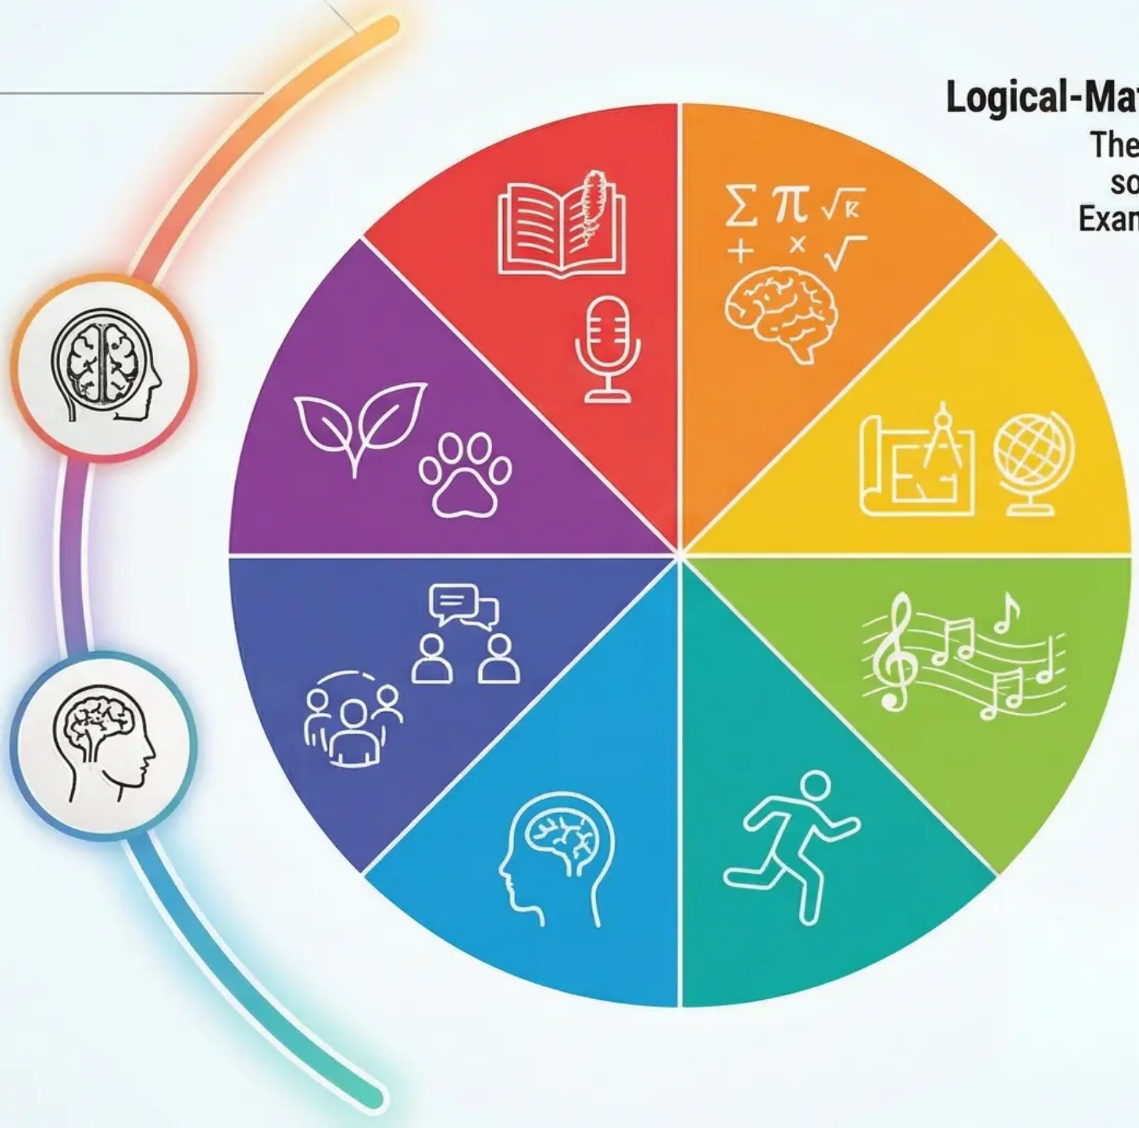


Howard Gardner's Theory of Multiple Intelligences
Challenging the Traditional View of Unitary Intelligence
General Overview of the Theory
Logical-Mathematical Intelligence
Spatial Intelligence
The Radical Challenge:
Musical Intelligence
Intrapersonal Intelligence
developmental history
of each intelligence.
Bodily-Kinesthetic Intelligence
Interpersonal Intelligence
Can these intelligences be regarded as mere 'talents', or do they merit the status of genuine
intelligence? How does Gardner's theory account for the success of certain individuals in life
despite their poor performance on traditional intelligence tests?

Slide 13

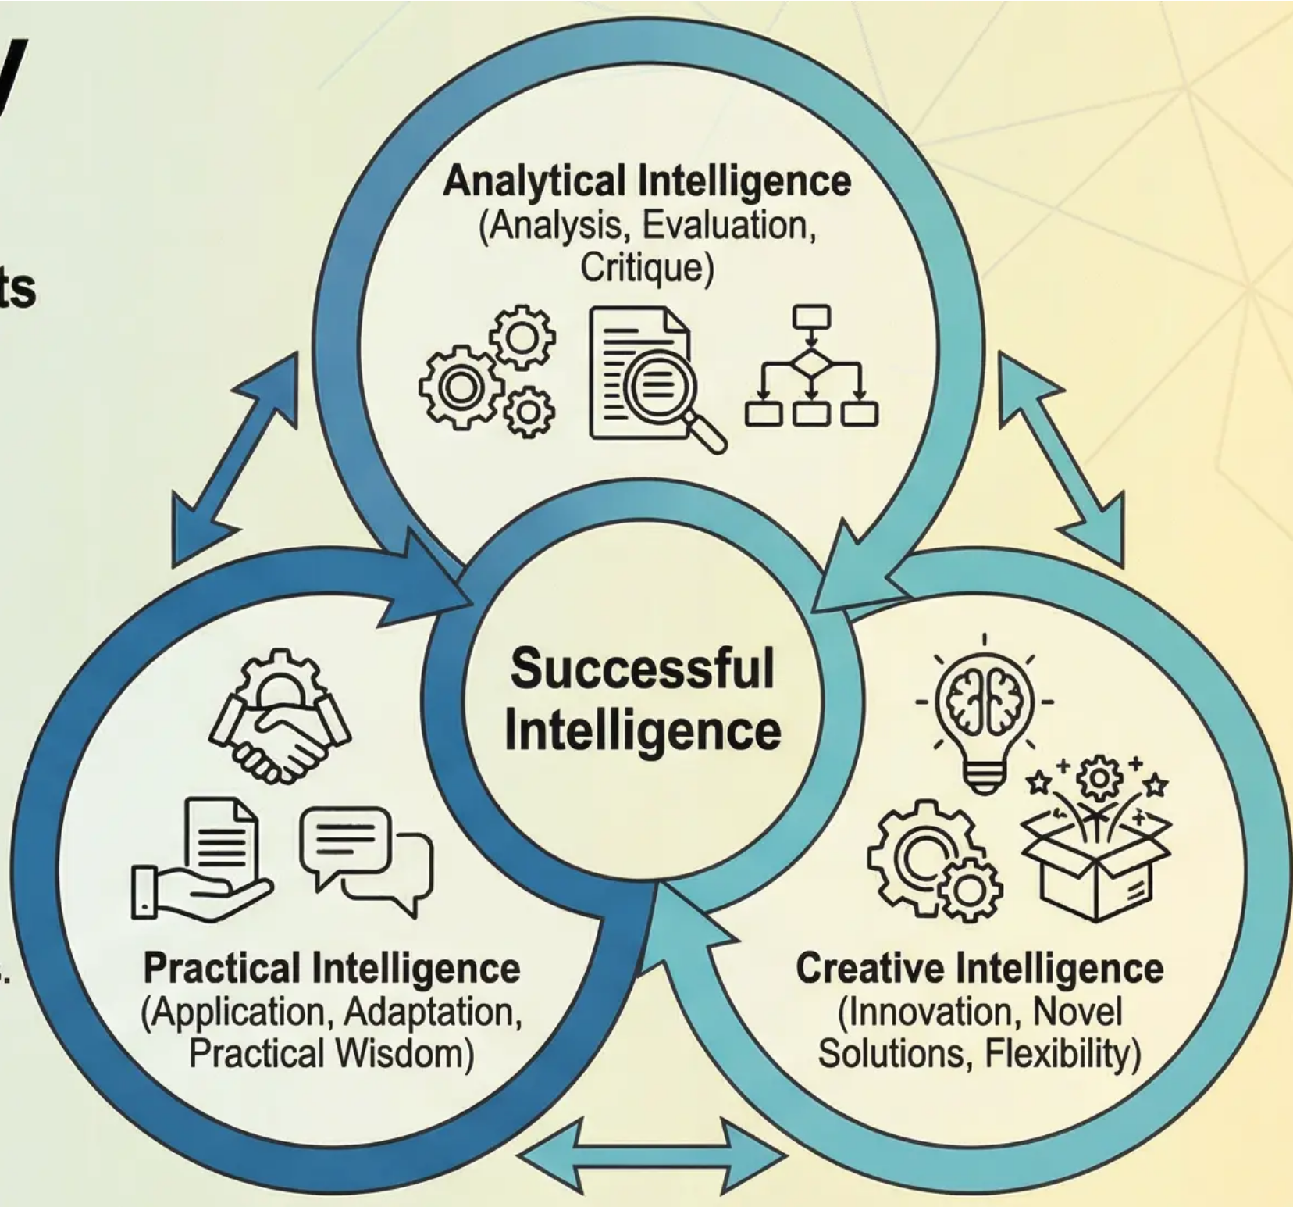
Sternberg's Triarchic Theory
of Successful Intelligence
An Integrated Model of Cognitive Abilities in Real-Life Contexts
Psychologist Robert Sternberg developed his Triarchic Theory as a comprehensive
alternative to the traditional concept of intelligence, asserting that genuine success in
life requires the interaction of three distinct types of cognitive ability.
The Three Components of Successful Intelligence:
Analytical Intelligence:
• The ability to analyse, evaluate, and critique information and situations.
• Encompasses the skills measured by traditional intelligence tests.
• Essential for solving structured academic and logical problems.
• Includes critical thinking and abstract reasoning.
Creative Intelligence:
• The ability to engage with novel situations and generate innovative solutions.
• Involves thinking outside conventional frameworks and adapting to unfamiliar challenges.
• Essential for innovation, invention, and artistic development.
• Encompasses cognitive flexibility and originality of thought.
Practical Intelligence:
• The ability to apply knowledge in real-world everyday situations.
• Also referred to as 'street intelligence' or practical wisdom.
• Involves understanding and adapting to social and cultural contexts.
• Essential for professional and social success.
Discussion Prompt
How might an understanding of Sternberg's theory contribute to the
development of more inclusive educational approaches? What are the
practical challenges in measuring creative and practical intelligence
compared to analytical intelligence?
Interaction and Integration:
According to Sternberg, genuine success does not depend on a single type of
intelligence, but rather on the balance and integration of all three types in accordance
with situational demands and the individual's cultural and social context.

Slide 14


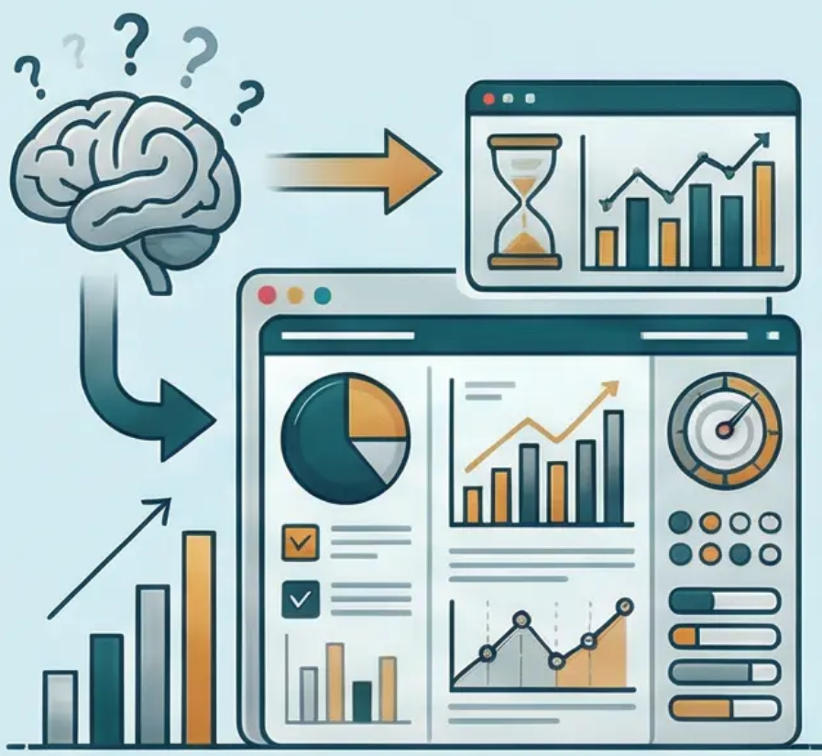

03
Measuring Intelligence and IQ Tests
From Theory to Practical Application
Key Focus Areas
Translating abstract theoretical concepts of intelligence into
precise scientific measurement instruments requires a deep
understanding of statistical and psychological foundations.
This session explores the developmental journey from Binet's
initial test to sophisticated contemporary intelligence scales.
Learning Objectives Preview
• Understand the evolution of the concepts of mental age and
intelligence quotient
• Analyse the normal distribution curve and score distributions
• Examine the Wechsler and modern Stanford–Binet scales
• Evaluate validity and reliability in psychological measurement

Slide 15

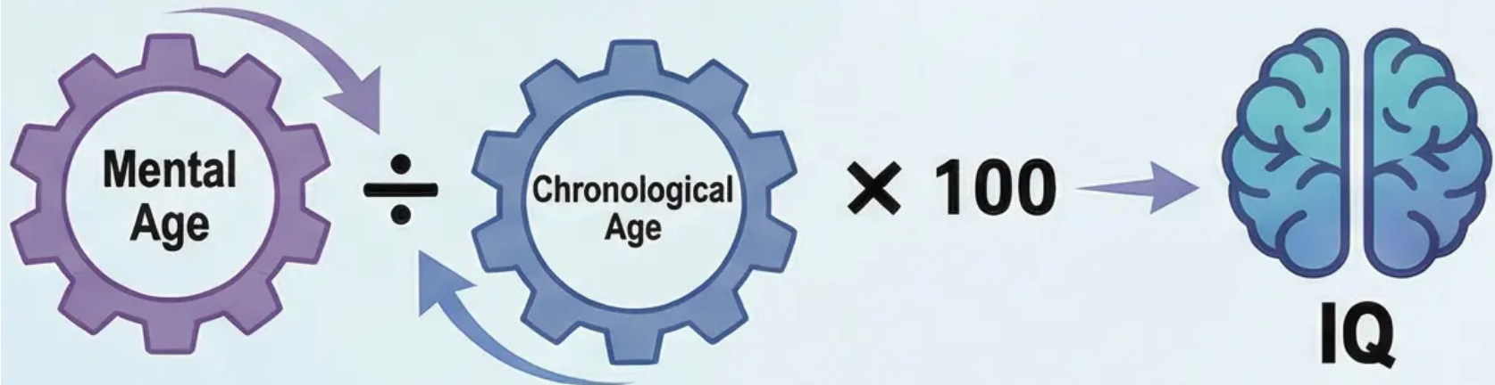
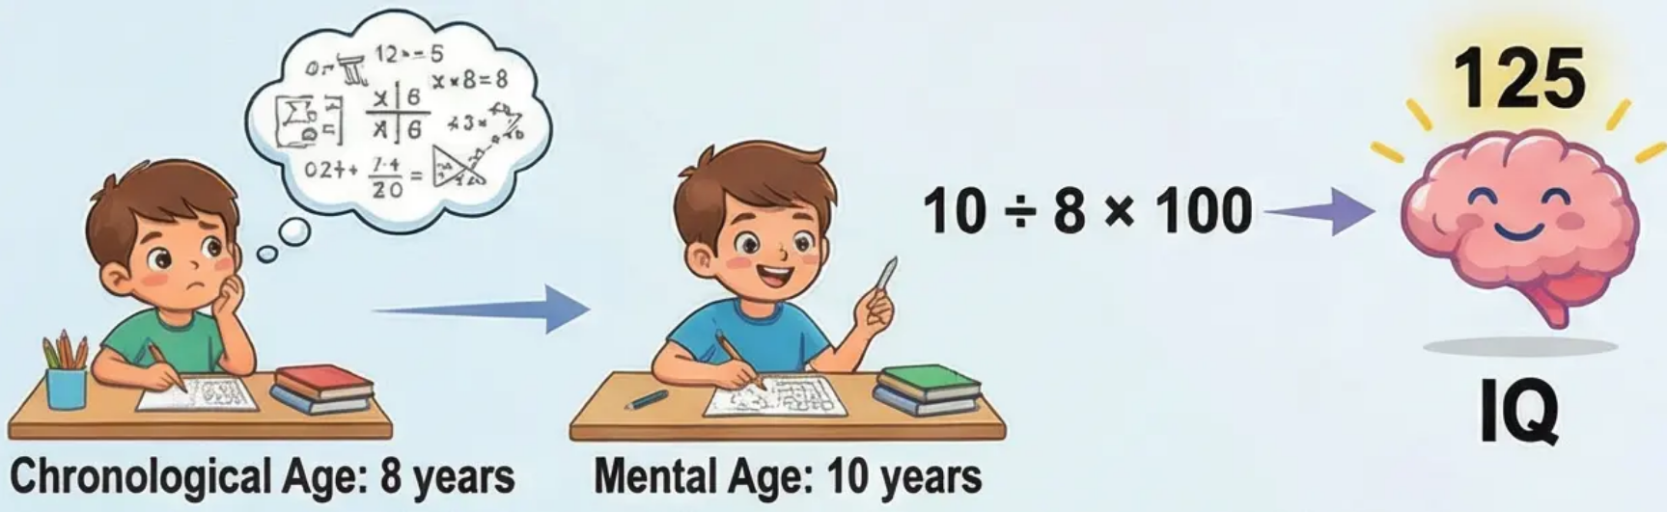
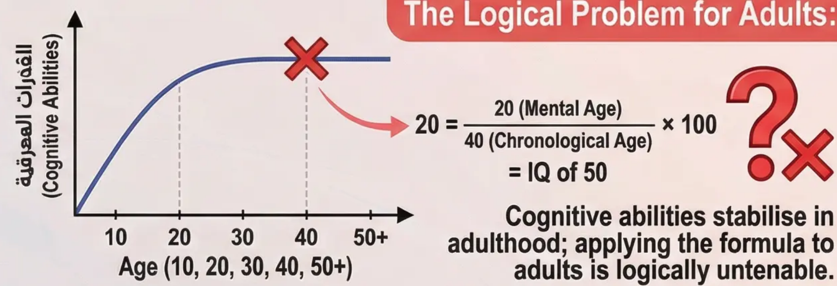
The Concept of Mental Age and the Traditional Intelligence Quotient
Applying the Formula to Children:
Historical Development of the Concept:
Following Binet's pioneering work in developing intelligence tests,
German psychologist William Stern made a decisive contribution to
intelligence measurement by formulating the concept of the 'Intelligence
Quotient' (IQ). Lewis Terman of Stanford University subsequently
adopted and refined this concept in the renowned Stanford-Binet Scale.
The Original IQ Formula:
Where mental age represents the intellectual level achieved by the
individual relative to normative age standards, and chronological age is
the individual's actual age in years.
Illustrative Example:
A child aged 8 years who successfully completes intellectual tasks
typically solved by 10-year-olds has a mental age of 10 years, yielding an
IQ of (10 ÷ 8) × 100 = 125.
Logical Critique of the Formula:
Despite its success with children, this formula encounters serious logical
problems when applied to adults. Is it reasonable that a 40-year-old
performing at the level of a 20-year-old should receive an IQ of 50? This is
untenable, as cognitive abilities stabilise relatively in early adulthood.
The Contemporary Solution:
For this reason, modern intelligence tests employ the 'Deviation IQ', which
compares an individual's performance to that of their age-matched peers
using the normal distribution.

Slide 16

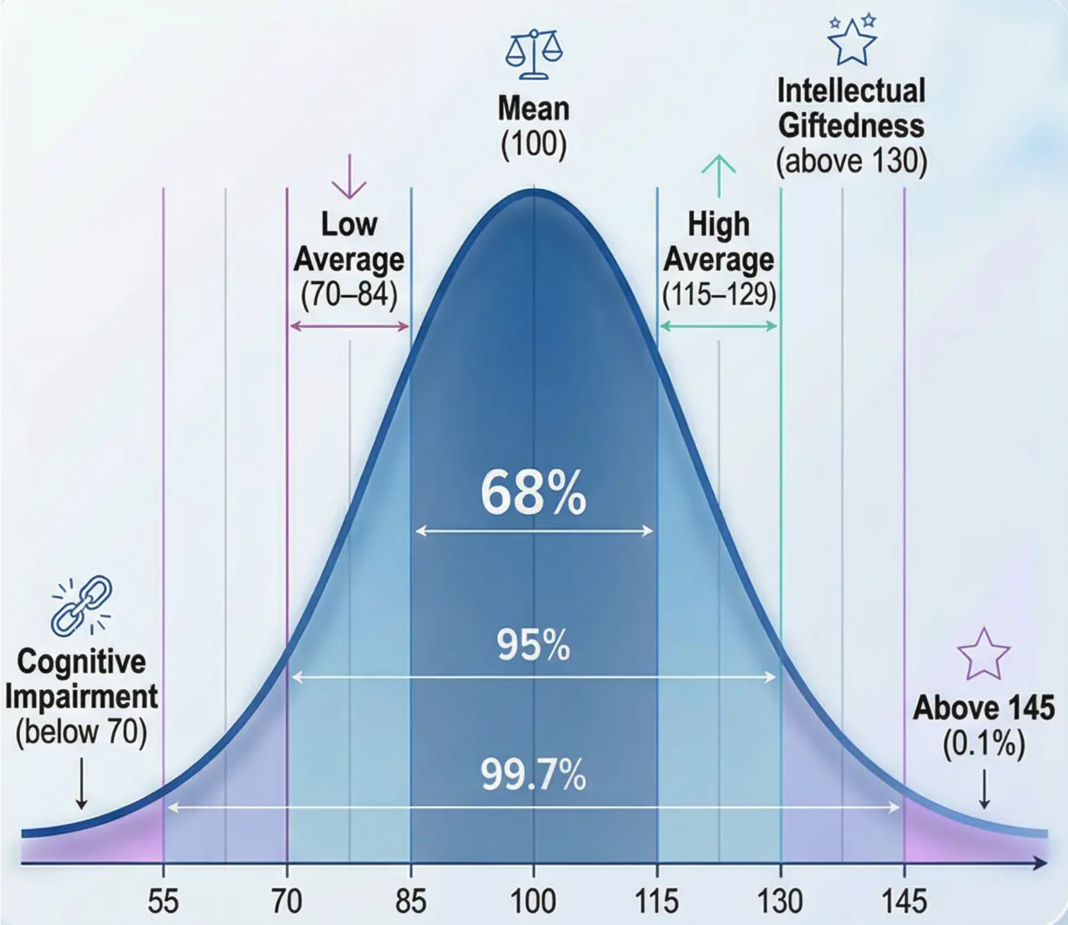

The Normal Distribution Curve (The Bell Curve)
The Statistical Foundation for Understanding the Distribution of Intelligence Scores
Statistical Basis:
The normal distribution curve, or 'bell curve', constitutes the statistical
foundation for understanding how intelligence scores are distributed
across the population. This curve demonstrates that the majority of
individuals obtain scores close to the mean, with numbers decreasing
progressively as scores deviate from the centre.
Key Characteristics of the Distribution:
• Mean: 100 (central point)
• Standard Deviation: 15 points
• Perfect symmetry around the mean
• 68% of the population fall within one standard deviation (85–115)
• 95% of the population fall within two standard deviations (70–130)
• 99.7% of the population fall within three standard deviations (55–145)
Practical Applications:
⭐ Intellectual Giftedness: Scores above 130 (2% of the population)
⬆️ High Average: 115–129
⚖️ Average: 85–114
⬇️ Low Average: 70–84
🧠 Cognitive Impairment: Below 70 (2% of the population)
Discussion Point: How can an understanding of the normal distribution
contribute to a more equitable interpretation of individual differences?
What are the potential risks of employing these classifications in
educational settings?

Slide 17

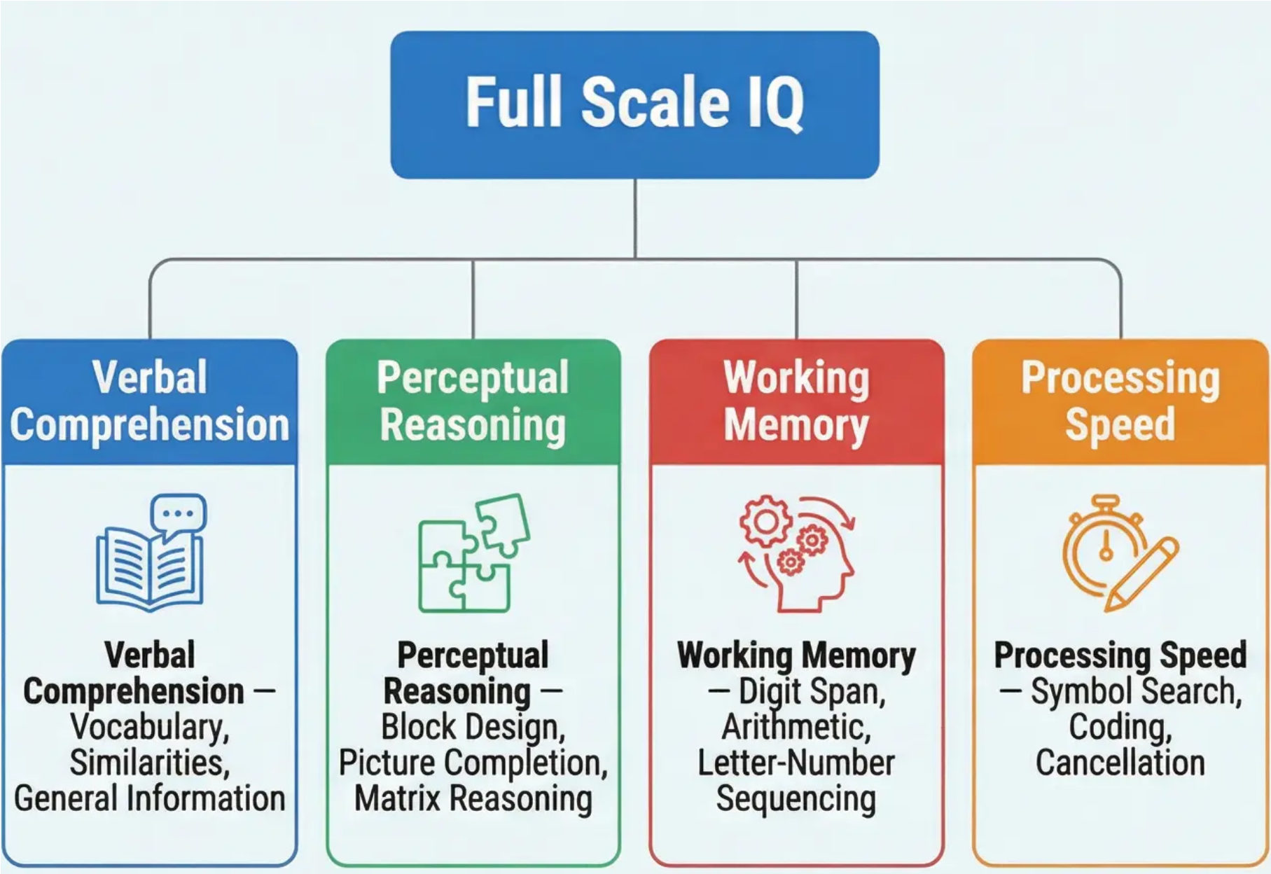


Wechsler Intelligence Scales (WAIS/WISC)
Historical Introduction
Psychologist David Wechsler developed a series of the most widely used intelligence
tests globally, representing a revolution in the measurement of cognitive abilities.
Wechsler's primary innovation was the transition from a single intelligence score to
a comprehensive analytical profile that reveals an individual's distinct cognitive
strengths and weaknesses.
Structural Framework of the Scales:
First: WAIS (Wechsler Adult Intelligence Scale)
• Target Age: 16–90 years
• Provides a Full Scale IQ alongside four core indices.
Second: WISC (Wechsler Intelligence Scale for Children)
• Target Age: 6–16 years
• Same analytical structure, adapted for the developmental stage.
The Four Core Indices:
1. Verbal Comprehension Index (VCI) – Measures the ability to understand and process
verbal information. Includes: Vocabulary, Similarities, General Information.
Example: “In what way are an orange and a banana alike?”
2. Perceptual Reasoning Index (PRI) – Measures the ability to solve visual-spatial
problems. Includes: Block Design, Picture Completion, Matrix Reasoning.
Example: Arranging blocks to replicate a specified pattern.
3. Working Memory Index (WMI) – Measures the ability to retain and mentally
manipulate information. Includes: Digit Span, Arithmetic, Letter-Number Sequencing.
Example: “Repeat these digits in reverse: 9-5-3-8.”
4. Processing Speed Index (PSI) – Measures speed and accuracy in simple cognitive
tasks. Includes: Symbol Search, Coding, Cancellation.
Example: Scanning a page to identify specific symbols as quickly as possible.
Discussion Prompt: How can this detailed analysis of cognitive abilities contribute to understanding various learning difficulties?
What is the significance of identifying relative strengths and weaknesses rather than relying on a single score?
LOGO
17

Slide 18


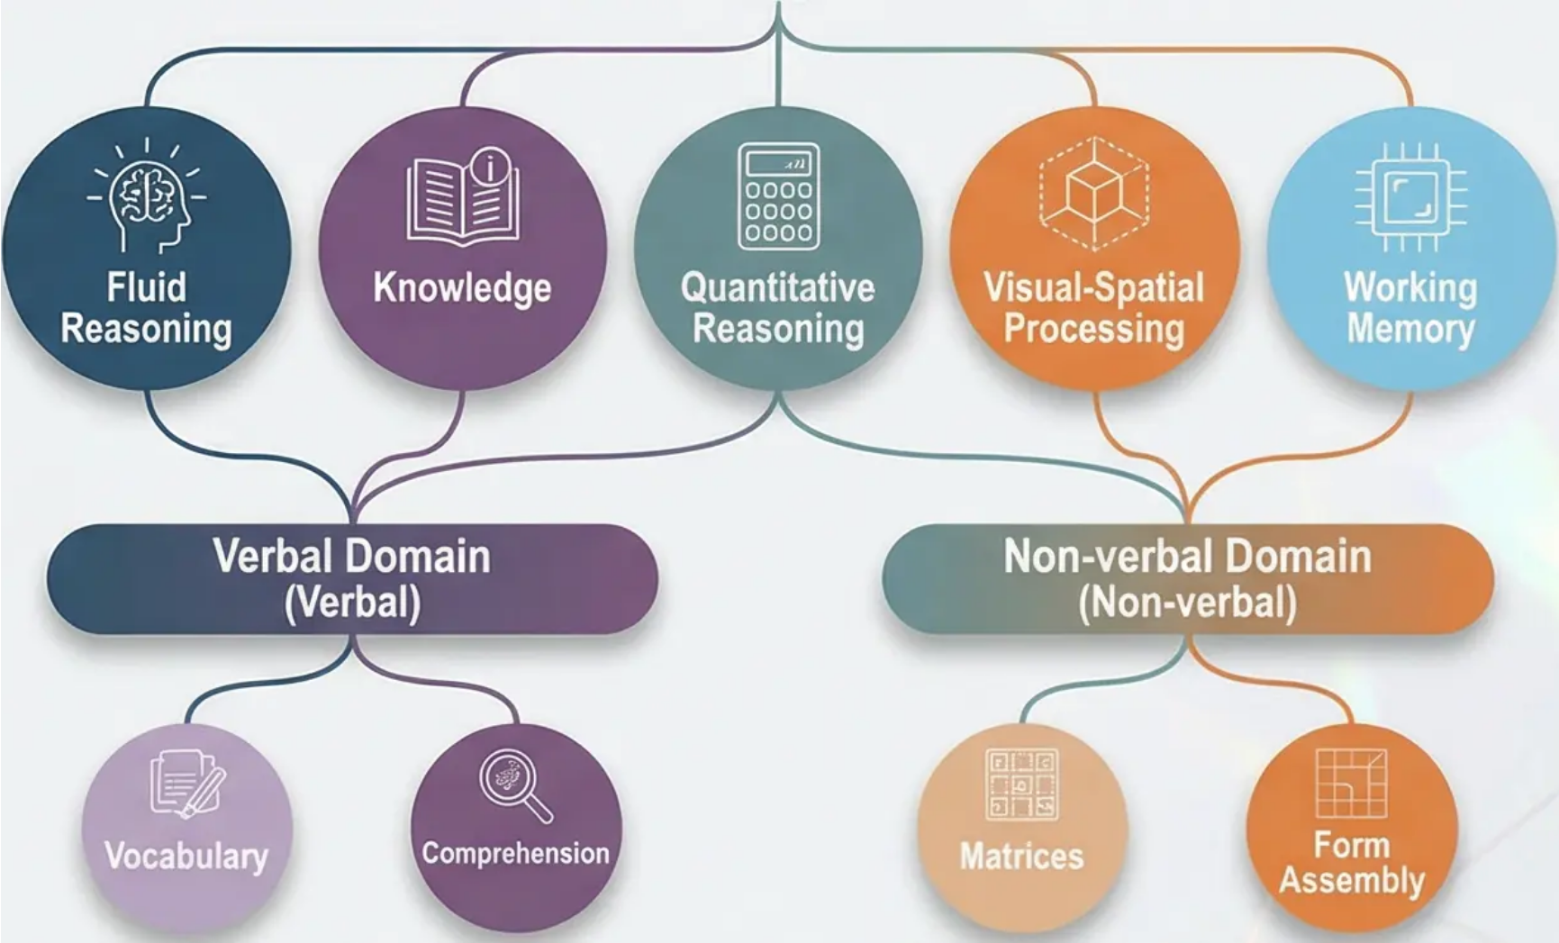
Modern Stanford–Binet Scales
Contemporary Developments in Diagnostic Psychometric Assessment
Core Advantage of SB5: Balanced measurement of verbal and non-verbal abilities, making it suitable for individuals from
diverse cultural and linguistic backgrounds.
Historical and Contemporary Development:
The Five-Factor Cognitive Structure:
The modern Stanford–Binet scales (Fifth Edition, SB5) represent a radical
evolution from Binet's original test. While retaining the theoretical
foundations of psychometric measurement, they adopt a sophisticated
cognitive model that assesses five core cognitive factors across two
domains (verbal and non-verbal).
• Fluid Reasoning: The ability to solve novel and complex problems using
logical and inductive thinking, independent of previously acquired
knowledge.
• Knowledge: Information acquired and stored through prior learning and
experience.
• Quantitative Reasoning: The ability to solve mathematical problems and
engage with numerical concepts.
• Visual-Spatial Processing: The ability to perceive, analyse, and
synthesise visual and spatial information.
• Working Memory: The ability to retain and mentally process information
over brief periods.
Diagnostic Innovations:
SB5 is distinguished by an 'adaptive routing' approach, whereby the difficulty level of items is selected based on the examinee's performance,
reducing testing time and enhancing measurement precision. It also provides detailed subscale scores that assist in accurately identifying cognitive
strengths and weaknesses.
How does the multidimensional assessment of SB5 contribute to a deeper understanding of an individual's cognitive profile compared to a
single IQ score? Discuss the practical implications for psycho-educational diagnosis.

Slide 19




Evaluating Intelligence Tests
(Validity and Reliability)
04
Critical Evaluation of Psychometric Instruments
This session represents a critical turning point in our understanding of
intelligence tests, as we transition from merely recognising these
instruments to evaluating them critically and scientifically. We will explore the
fundamental criteria that determine the quality of any psychological
measurement tool, with a focus on two pivotal concepts:
Validity
The ability of a test to measure what it purports to measure. Do intelligence
tests genuinely measure intelligence, or something else entirely?
Reliability
The stability and consistency of measurement across time and varying
conditions. Can the results of these tests be relied upon?
We will also examine fundamental challenges such as cultural bias and environmental
factors that may compromise the fairness and validity of measurement.

Slide 20

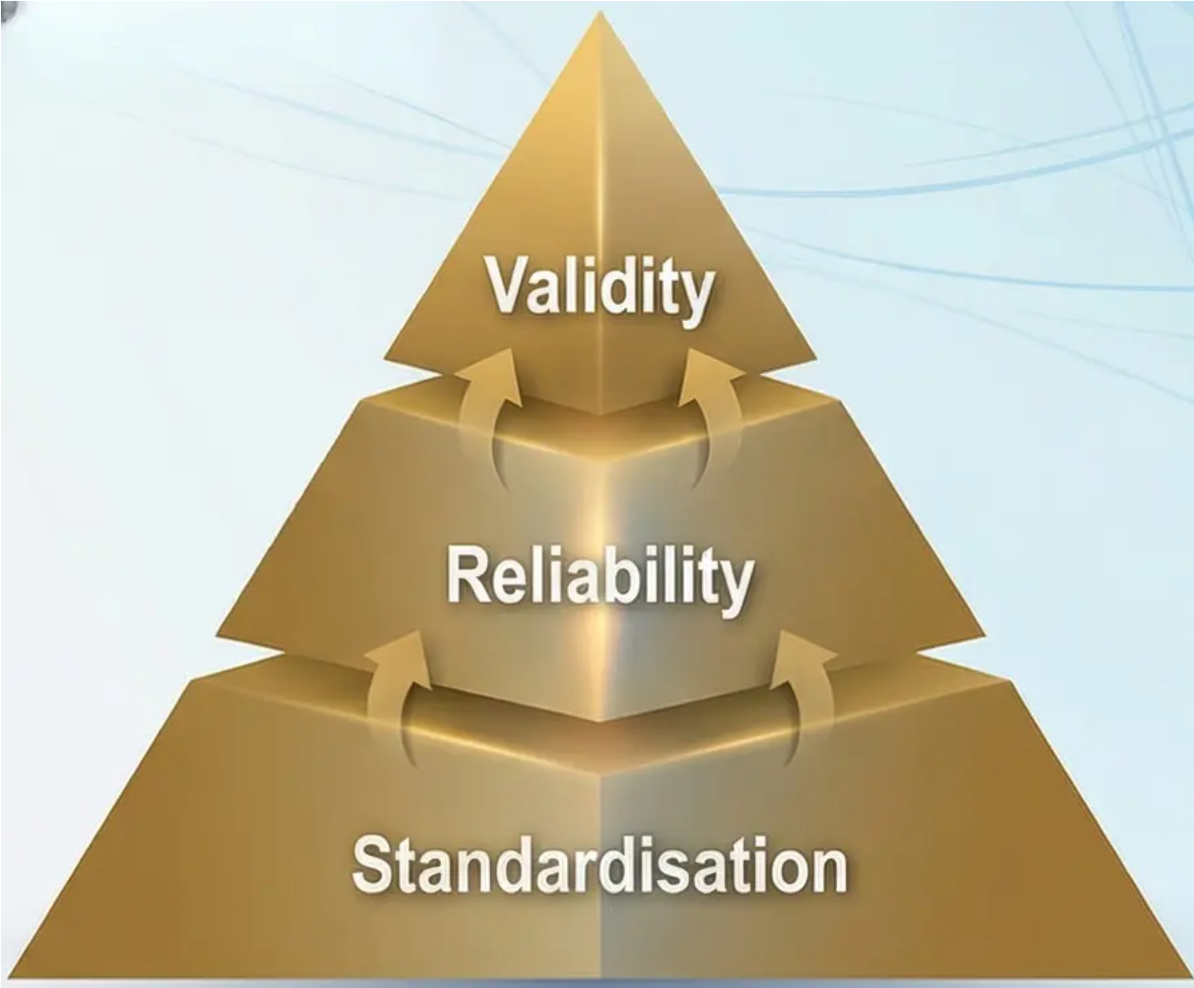


Criteria for a Good Test: Standardisation and Consistency
For any psychological test to be scientifically and practically useful, it must satisfy rigorous quality criteria that
ensure the accuracy of results and their reliability for informing important decisions.
Standardisation
Refers to the establishment of uniform procedures for administering the test
and recording results. This criterion encompasses two essential elements:
Validity
First, standardising administration procedures so that all examinees are
subjected to identical conditions, instructions, and time allocations.
Reliability
Second, establishing normative reference data by administering the test to
a large and representative sample of the target population, thereby
providing a reliable benchmark for interpreting individual scores.
Reliability
Standardisation
Reflects the degree of consistency in test results across different
measurement occasions. Reliability is assessed through several principal
methods:
The Relationship Between Criteria
Test-retest reliability (the same individual obtaining similar scores upon
re-administration after an appropriate interval).
It is important to understand that a test may be reliable
without being valid; however, it cannot be valid without
first being reliable. Reliability is a necessary but not
sufficient condition for validity.
Internal consistency (the coherence of items within a single test).
Inter-rater reliability (agreement between different raters on the same
responses).
Discussion:
How might inadequate standardisation compromise the reliability of a test? What environmental and procedural factors may threaten the
consistency of results?

Slide 21



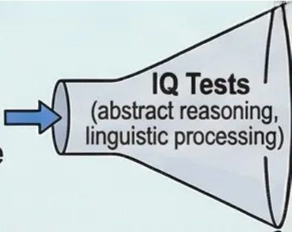



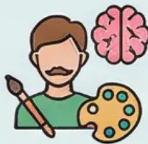

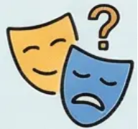


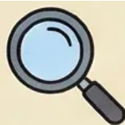
Analysing Predictive and Content Validity
Do Intelligence Tests Measure What We Actually Need to Measure?
Part One: Predictive Validity — Strengths
Part Two: Critique of Content Validity — Narrow Focus
Decades of scientific research demonstrate that IQ
tests possess impressive predictive power across
several vital domains:
Despite their predictive power, the content of IQ tests faces
fundamental criticisms:
Emotional Intelligence
(self-understanding, relationships)
Complex
Human
Intelligence
Predictive Validity
Creative Intelligence
(divergent thinking, innovation)
Academic Performance: IQ scores are among the
strongest individual predictors of scholastic and
university success, with correlation coefficients ranging
from 0.50 to 0.70 (with academic grades). This
correlation surpasses most other indicators, including
socioeconomic status.
Content
Limitations
Practical Wisdom
(real-world problem-solving, adaptation)
Cognitive Neglect: Tests focus on abstract reasoning and
linguistic processing, neglecting vital capacities such as creativity,
emotional intelligence, and practical wisdom — as emphasised
by Sternberg and Gardner.
Occupational Performance: In cognitively complex
occupations (medicine, engineering, law), IQ is a better
predictor of success than personal interviews or prior
experience. Correlations reach 0.60 in high-complexity
professions.
Cultural Bias: Test content may reflect a specific cultural and
social background, compromising the fairness of assessment for
culturally diverse groups.
Oversimplification: They reduce complex human intelligence to
a single numerical score, whereas reality points to an enormous
diversity of cognitive abilities and their complex interactions.
Life Outcomes: Higher IQ scores are associated with
greater longevity, higher income, and better health —
possibly because they facilitate the comprehension of
health information and the making of better life
decisions.
If IQ tests powerfully predict academic and occupational
success, does this justify the narrowness of their content? Or
do we require broader assessment instruments capable of
capturing the true complexity of human intelligence?

Slide 22
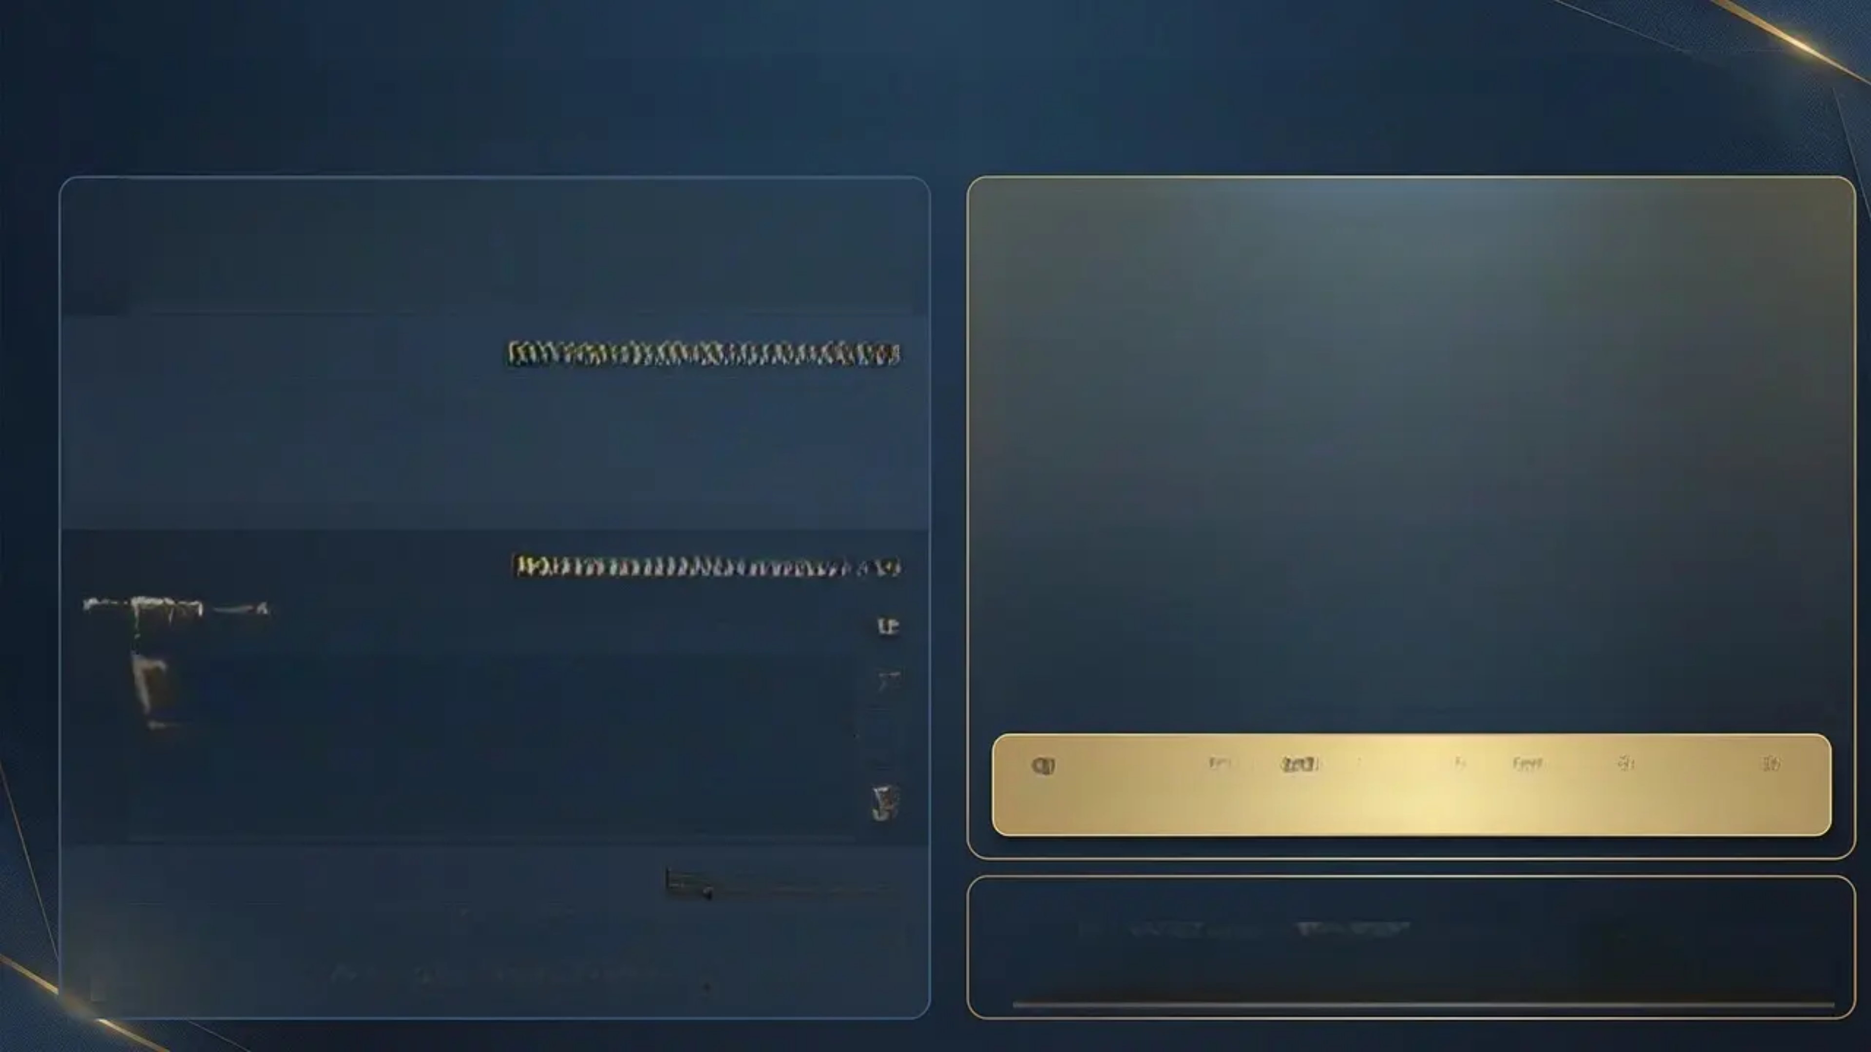
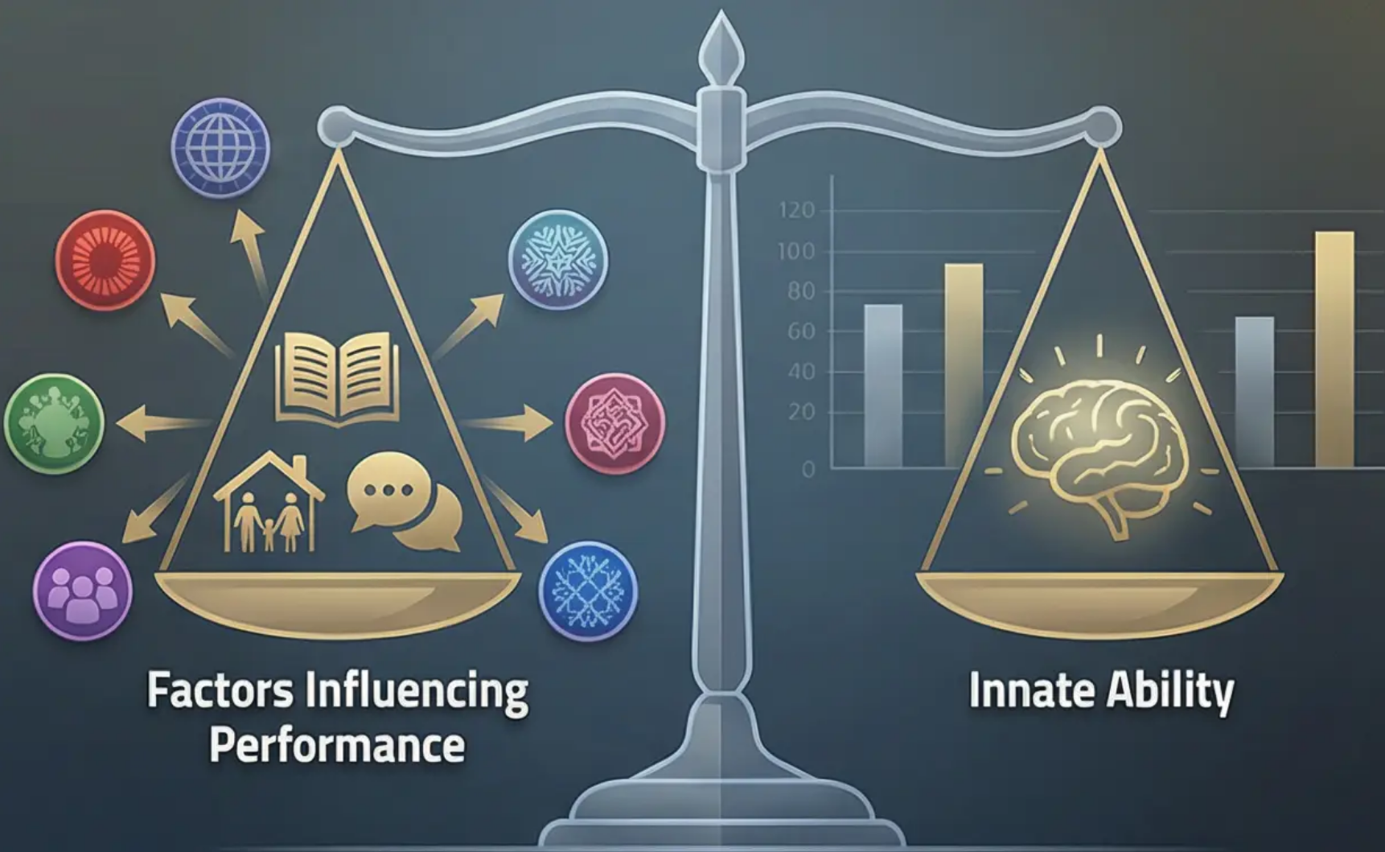




The Controversy of Cultural Bias in Intelligence Testing
Intelligence tests have generated widespread controversy regarding their
fairness across different cultures. This debate centres on a fundamental
question: do these tests measure innate intelligence, or do they reflect
cultural and social bias?
The Technical Definition of Bias
In psychometrics, a test is technically considered "biased" when it predicts
outcomes with differing accuracy for different groups. By this narrow definition,
most modern intelligence tests are not technically biased – they predict academic
performance with comparable effectiveness across different ethnic groups.
Manifestations of Cultural Bias
Linguistic Content: Use of vocabulary and cultural references more familiar
to certain social groups.
Problem-Solving Styles: Favouring modes of thinking associated with
specific Western cultures.
Social Context: The influence of test anxiety and social expectations
on performance.
Fairness versus Technical Bias: A test may be technically unbiased yet socially
inequitable if groups face differential educational and environmental opportunities.
Educational Experience: Tests relying on educational experiences not
equally accessible to all.
Empirical Evidence
Data reveal persistent score gaps between demographic groups; however, the
scientific consensus indicates that these gaps reflect environmental and
social inequalities rather than innate genetic differences.
Discussion Prompt
How can intelligence tests be developed to be more culturally fair without
sacrificing scientific validity? What is the ethical responsibility of educational
institutions in interpreting and applying the results of such tests?

Slide 23

The Nature versus Nurture
Debate in Intelligence
Examining the Complex Interaction Between Genetic Inheritance and
Environmental Factors in Shaping Cognitive Abilities
This classical debate in psychology transcends the simplistic
question of "Is intelligence inherited or acquired?" to a deeper
understanding of how genetic and environmental factors
interact in shaping cognitive abilities. We will explore the
concept of heritability as a statistical measure, examine
evidence from twin and adoption studies, and investigate how
environmental factors such as education, nutrition, and cultural
stimulation influence cognitive development.
Key Topics Preview
The concept of Heritability and its statistical measurement
Identical (monozygotic) and fraternal (dizygotic) twin studies
Adoption studies and biological separation
The Flynn Effect and historical changes in IQ scores
Gene-Environment Interaction
Contemporary critiques of the traditional nature-nurture dichotomy

Slide 24

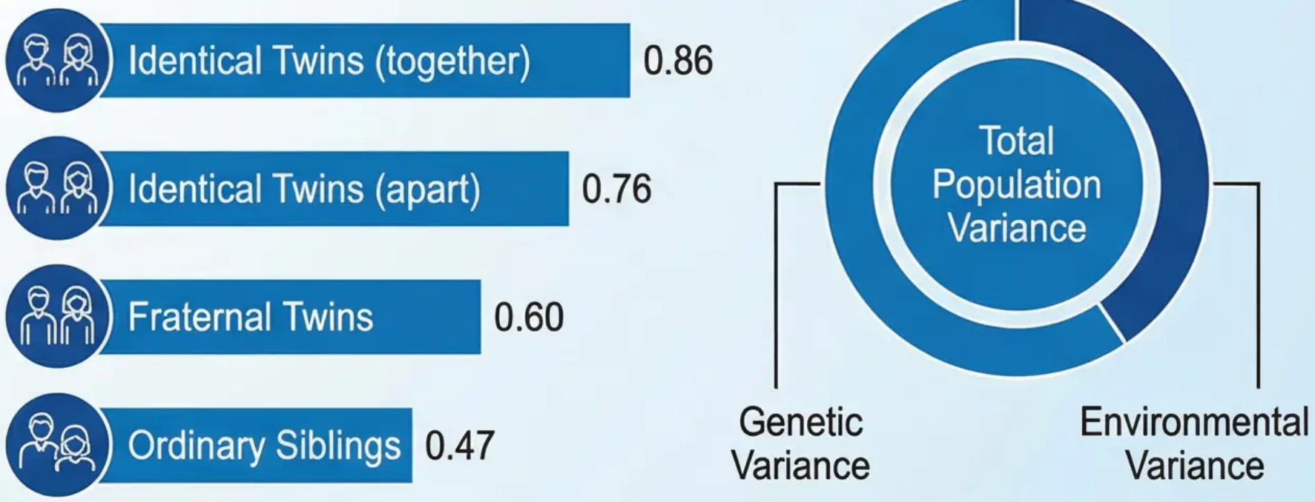

The Concept of Heritability in Intelligence
The Statistical Definition of Heritability:
Heritability represents a statistical estimate of the proportion of variance
in a given trait (such as intelligence) within a specified population that is
attributable to genetic differences between individuals. It is crucial to
understand that heritability does not refer to the percentage of an
individual's intelligence determined by genes; rather, it measures the
extent to which genetic factors account for differences between
individuals within a population.
Correlation Coefficients:
• Identical twins (reared together): 0.86
• Identical twins (reared apart): 0.76
• Fraternal twins: 0.60
• Ordinary siblings: 0.47
Twin Studies: Decisive Evidence:
Twin studies are the most powerful method for estimating
heritability. By comparing identical twins (monozygotic), who share
100% of their genes, with fraternal twins (dizygotic), who share only
50%, the effect of genes can be isolated. Consistent findings
demonstrate that identical twins exhibit significantly more similar
intelligence scores than fraternal twins.
Comparison of Correlation Coefficients
for Intelligence Scores
The Minnesota Classic Study:
The Minnesota Study of Twins Reared Apart provided compelling
evidence for the genetic basis of intelligence. The study found that
identical twins raised in different environments retained a remarkable
degree of similarity in their intelligence scores, strongly supporting the
role of genetic factors.
Discussion Prompt: How can the difference in correlation coefficients between identical twins reared together versus those
reared apart be interpreted? What does this tell us about the interaction between genes and environment?

Slide 25

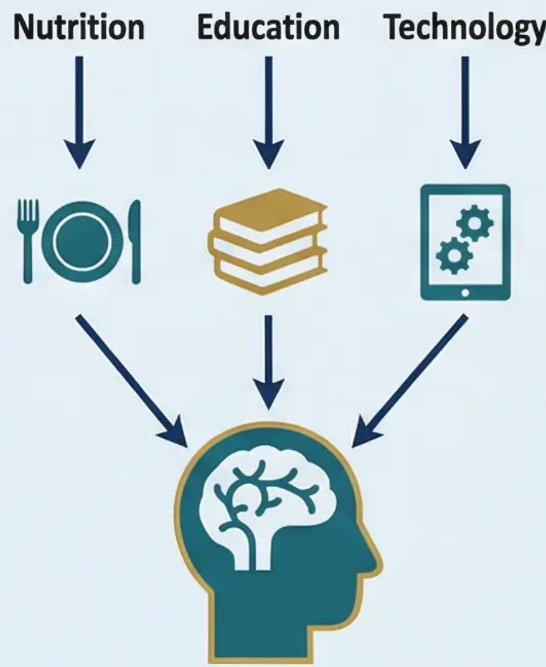
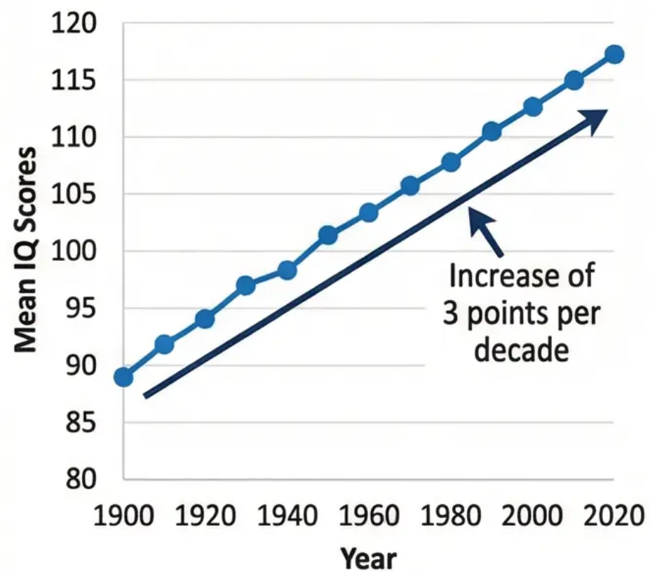



Environmental Influences and the Flynn Effect (Flynn Effect)
Definition of the Flynn Effect:
The Problematic Issue:
The Flynn Effect is the scientifically documented phenomenon demonstrating a
continuous rise in mean scores on intelligence tests across successive generations.
New Zealand psychologist James Flynn identified this pattern in the 1980s, finding that
mean IQ scores increase at a rate of approximately 3 points per decade in
industrialised nations.
A line graph showing the continuous rise in
mean IQ scores from 1900 to 2020, with an
ascending trend line clearly indicating an
increase of approximately 3 points per decade.
Empirical Evidence:
• Longitudinal studies across more than 30 countries have demonstrated that this rise
occurs consistently since the beginning of the twentieth century.
• The most pronounced increases appear in tests of abstract reasoning and visual-
spatial processing, while gains are less marked in vocabulary and general
knowledge.
Explanatory Environmental Factors:
• Nutritional Improvements: Malnutrition in early childhood adversely affects
brain development. Improvements in nutrition — particularly protein, iodine, and
iron — have contributed to enhanced cognitive performance.
• Educational Development: Increases in years of compulsory education and
improvements in teaching methods have developed the abstract and analytical
thinking skills required by modern intelligence tests.
• Technological Complexity: The modern environment demands the processing
of increasingly complex information — from reading maps to using technology —
thereby stimulating the development of cognitive abilities.
Discussion Prompt: How can the persistence of the Flynn Effect be explained despite nutrition and education having reached high levels in
developed countries? What is the impact of digital technology on current generations?

Slide 26
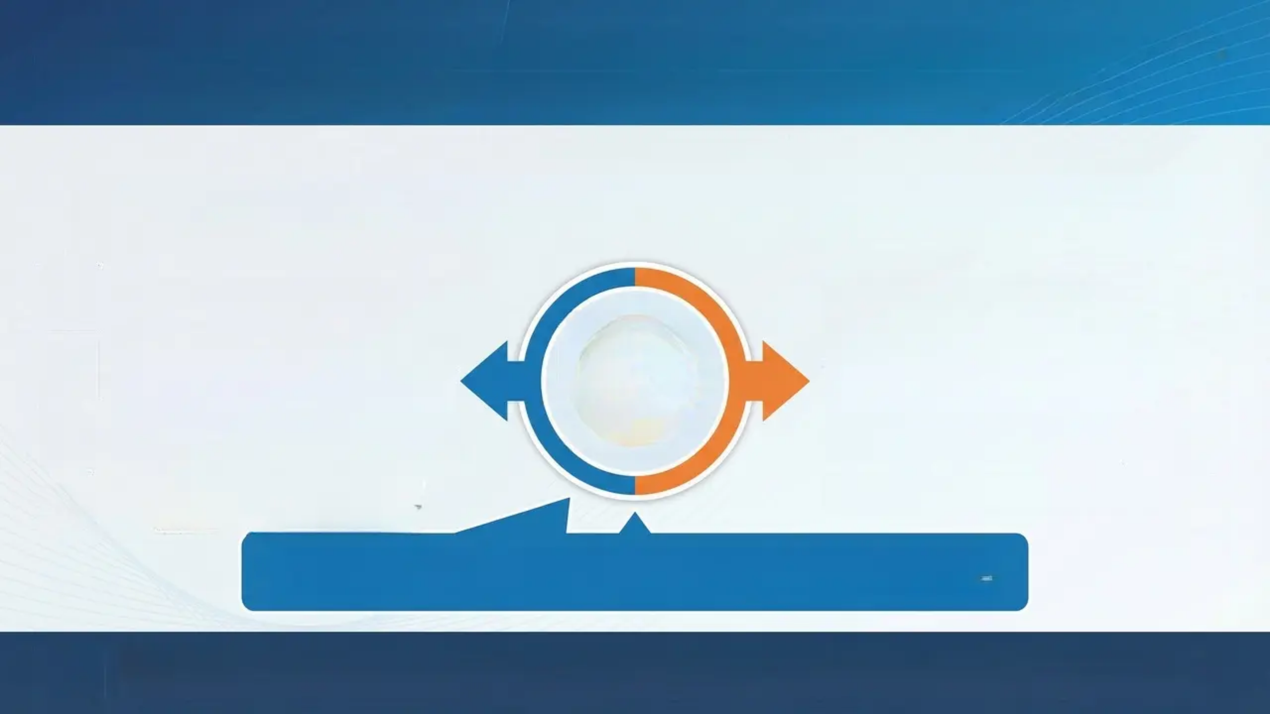











Session 6: Introduction to Personality and the Classification of Theories
Defining Personality and the Major Frameworks for Classifying Theories
Defining Personality
Personality is the unique and relatively stable pattern of thoughts, feelings, and behaviours that distinguishes one
individual from another. It encompasses the internal psychological characteristics that influence how a person interacts
with their environment and determines their consistent responses across situations and over time.
Nomothetic Approach
Idiographic Approach
• Seeks to establish general laws
applicable to all individuals
• Focuses on quantitative measurement
and inter-individual comparison
• Employs standardised instruments such
as questionnaires and normative tests
• Assumes the existence of common
personality dimensions that can be
measured
• Focuses on understanding the unique
personality of each individual
• Employs qualitative methods such as
case studies and in-depth interviews
• Emphasises the complexity and
uniqueness of human experience
• Holds that each person requires their
own interpretive framework
The Fundamental Challenge: How do we balance the search for general patterns of
human behaviour with the recognition of the essential uniqueness of each personality?
Discussion Point: Consider a well-known personality (historical or contemporary): which approach — nomothetic
or idiographic — would be more effective in understanding and explaining their complex personality?

Slide 27
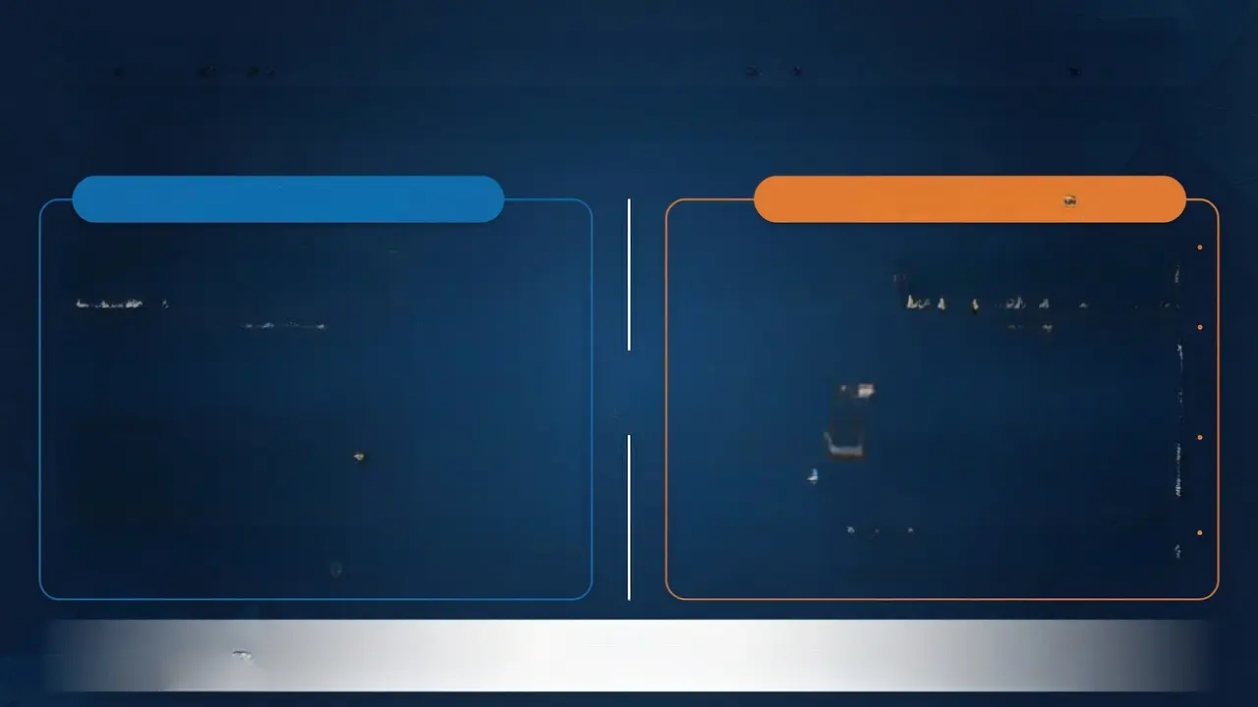
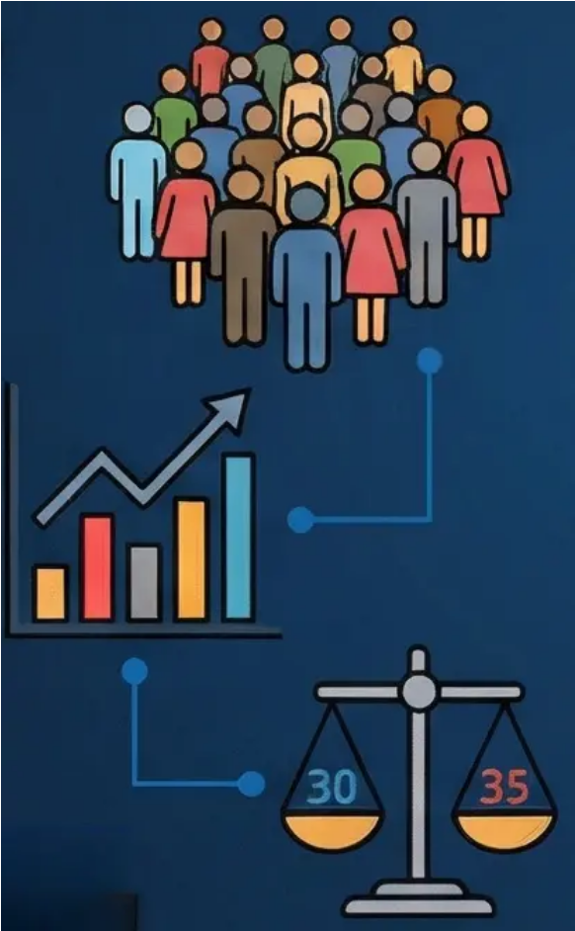



Comparing Approaches: Nomothetic vs. Idiographic in Personality Studies
This distinction represents one of the most significant philosophical and methodological divisions in personality research,
reflecting the fundamental tension between the pursuit of general scientific laws and the understanding of human uniqueness.
Nomothetic Approach
Idiographic Approach
• Primary Goal: Discover general laws of
personality applicable to all individuals; identify
common dimensions for comparison and
classification.
• Primary Goal: Pursue an in-depth
understanding of the unique personality of
each individual. Each person is regarded as
a unique system of traits and motivations.
• Methodology: Large-scale studies on
substantial samples, employing standardised
questionnaires, factor analysis, and
quantitative methods. Personality is conceived
as consisting of measurable and comparable
dimensions.
• Methodology: Intensive case studies, in-
depth interviews, qualitative analysis of
personal documents, and longitudinal
observation. Understanding the internal
organisation of personality through
qualitative methods.
• Core Belief: Understanding personality by
locating individuals on continua of common
traits. Each person represents a unique
combination of degrees on the same
fundamental dimensions.
• Core Belief: Each individual is a unique,
integrated whole. Common traits fail to
capture the essence of individual personality
and the interaction of its constituent
elements.
• Practical Applications: Developing standardised
personality tests, epidemiological research, personnel
selection, and comparative clinical diagnosis.
• Practical Applications: Individual psychotherapy,
psychological autobiography, understanding
exceptional cases, and personalised interventions.
Discussion Question:
How might a contemporary researcher draw upon both approaches within a single study? Can the pursuit of general laws be
reconciled with the understanding of individual uniqueness?

Slide 28

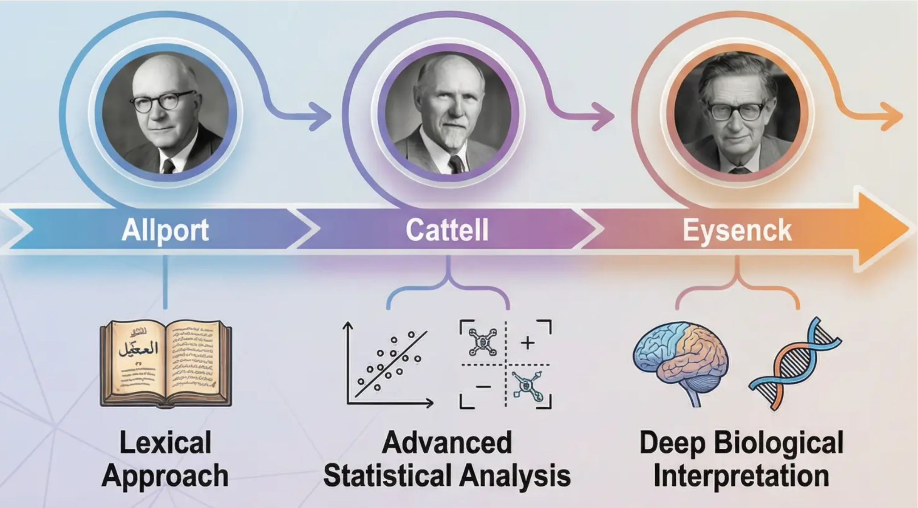
Session 7: Trait Theories (Allport, Cattell, and Eysenck)
Analysing the Fundamental Building Blocks of Personality from the Perspective of Stable
Trait Theories and Their Underlying Biological Foundations
Trait theories represent the most dominant perspective in contemporary
personality research, founded on the core assumption that personality
consists of stable and enduring internal characteristics known as traits.
These traits are understood as dispositions to behave in a particular
manner across diverse situations and contexts.
Core Principles of the Trait Approach:
• Traits as stable, fundamental units of
personality
• Measurability and comparability across
individuals
• Prediction of behaviour across different
situations
• The search for the underlying structure of
human personality
Trait theories evolved through three significant
historical stages: beginning with Allport's
comprehensive lexical approach, progressing
through Cattell's advanced statistical analysis,
and culminating in Eysenck's profound biological
interpretation. Each theorist contributed to advancing
our understanding of the fundamental structure of
personality and how it is organised and measured.

Slide 29

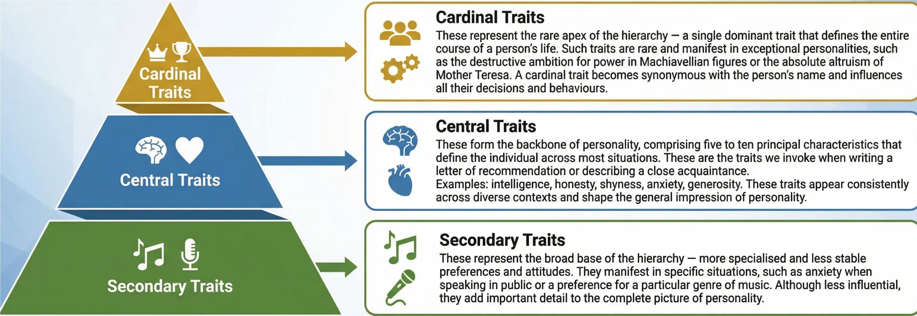

Allport's Hierarchical Trait Taxonomy
Constructing Unique Identity Through a Graduated Trait Hierarchy
Gordon Allport is regarded as the pioneer of modern personality psychology. He developed a sophisticated hierarchical model for understanding
the structure of human personality. Allport divides personality traits into three graduated hierarchical levels, each playing a distinctive role in
shaping the unique identity of the individual.
How can Allport's hierarchical model be applied to understanding the personal development of individuals across
different life stages? What are the methodological challenges in distinguishing central from secondary traits?

Slide 30

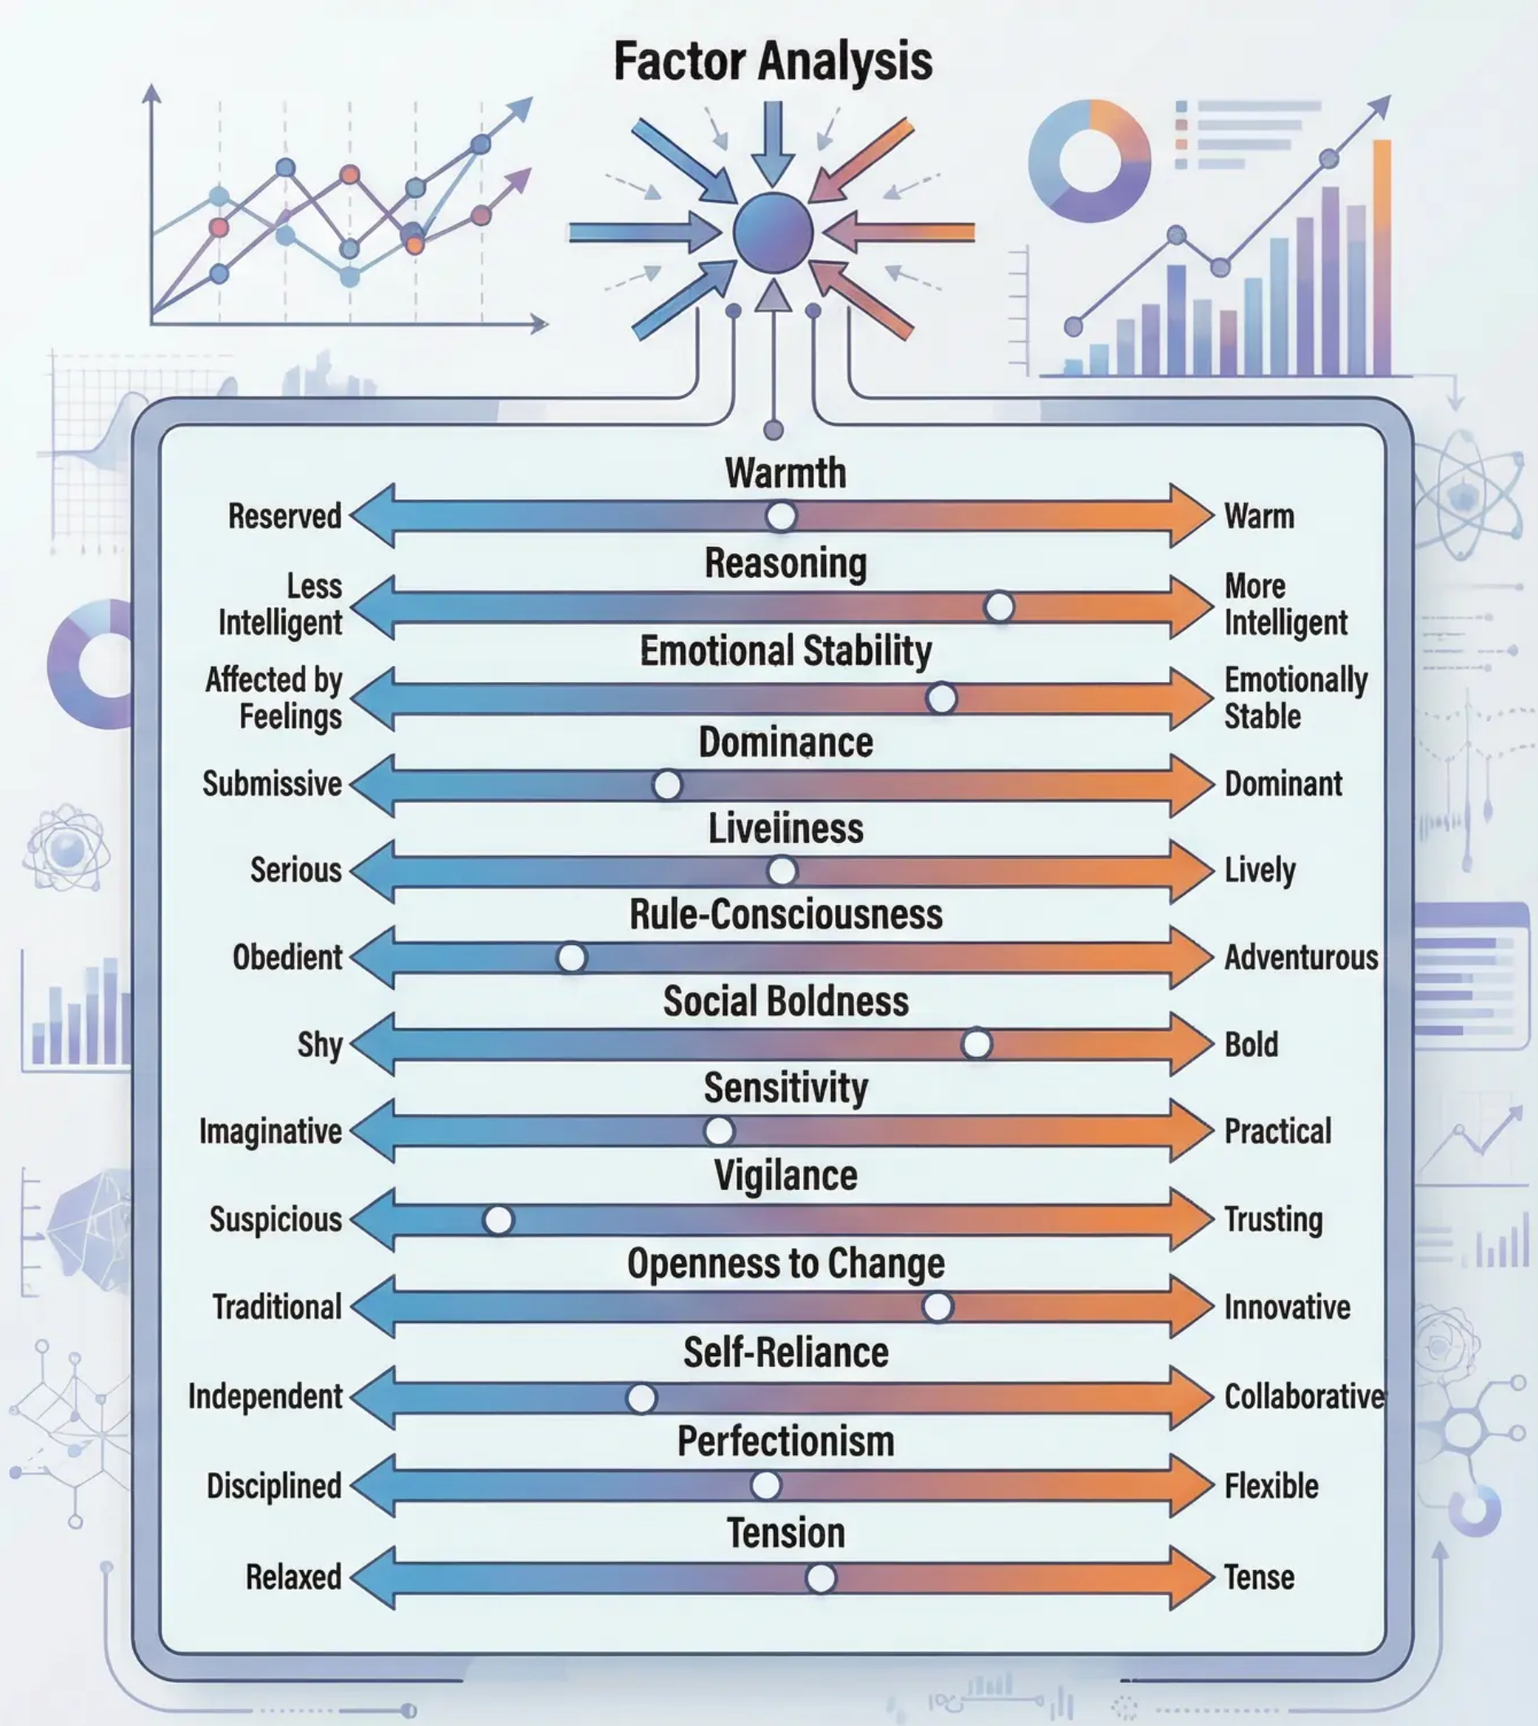
Cattell's Sixteen Personality
Factor Model
Factor Analysis and the Revolution in Quantitative
Personality Measurement
Cattell's Scientific Methodology: Raymond Cattell adopted a purely
nomothetic approach to the study of personality, employing statistical
factor analysis to reduce Allport's extensive list of trait descriptors to a
more manageable number. Cattell sought to construct a "periodic table"
of personality — a systematic scientific framework identifying the
fundamental elements underlying the vast diversity of human behaviour.
The Sixteen Source Traits: Through complex factor analysis, Cattell
identified sixteen primary source traits constituting the fundamental
dimensions of personality. These traits are measured on bipolar continua,
meaning that each individual occupies a position somewhere between
two opposing poles for each trait.
Examples of Key Traits: Warmth (Reserved ↔ Warm), Reasoning (Less
Intelligent ↔ More Intelligent), Emotional Stability (Affected by Feelings ↔
Emotionally Stable), Dominance (Submissive ↔ Dominant),
Liveliness (Serious ↔ Lively).
The 16PF Questionnaire: Cattell developed the Sixteen Personality
Questionnaire (16PF) to measure these traits objectively. The questionnaire
comprises hundreds of items designed to assess an individual's position
on each of the sixteen continua, yielding a detailed and unique personality
profile for each respondent.
How might the 16PF profile be utilised in personnel selection?
What are the potential ethical concerns?

Slide 31

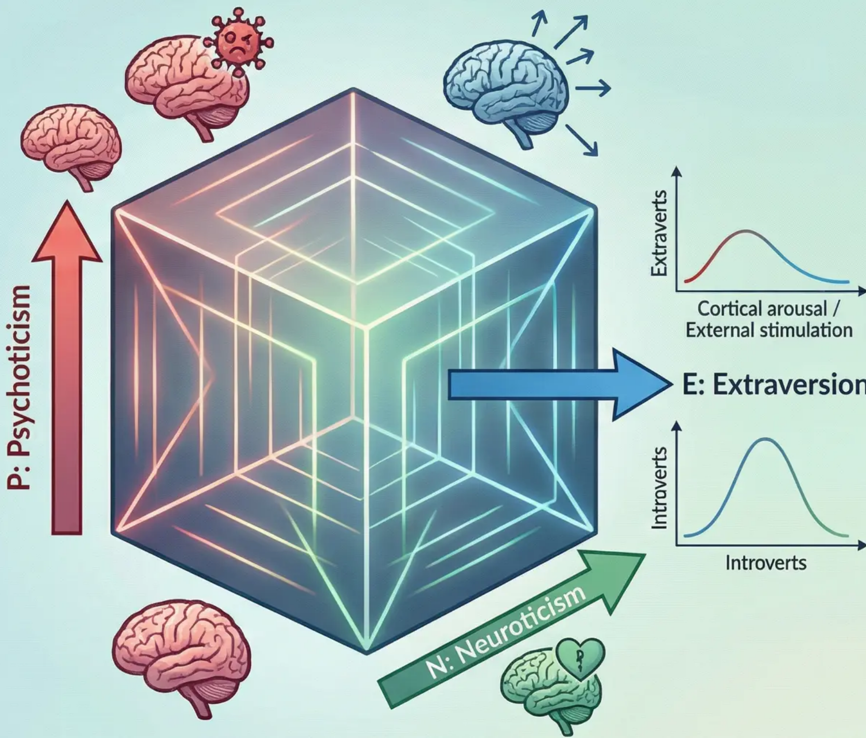
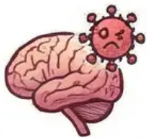
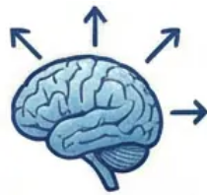

Eysenck's Biological PEN Model
The Neurological Basis of Personality and Cortical Arousal
Hans Eysenck's personality model represents a paradigm shift in
understanding the biological foundations of human behaviour. Eysenck
developed a three-dimensional model linking core personality traits to
distinct mechanisms of the nervous system:
Psychoticism (P)
Represents the tendency towards aggression, lack of empathy, and cognitive
rigidity. Associated with levels of sex hormones and neurotransmitters.
High scores indicate difficulty in social adaptation and impulse control.
Extraversion (E)
Cortical Arousal Theory: Extraverts have a low baseline level of cortical
arousal. They seek external stimulation to achieve optimal performance
levels. Introverts have high cortical arousal and avoid excessive stimulation.
Neuroticism (N)
Associated with the reactivity of the autonomic nervous system.
Individuals with high scores exhibit an excessive response to stress. They
display chronic anxiety and emotional instability.
Theoretical Significance:
The model provides a biological explanation for individual differences,
making it a foundational framework for understanding criminal behaviour
and psychological disorders.

Slide 32
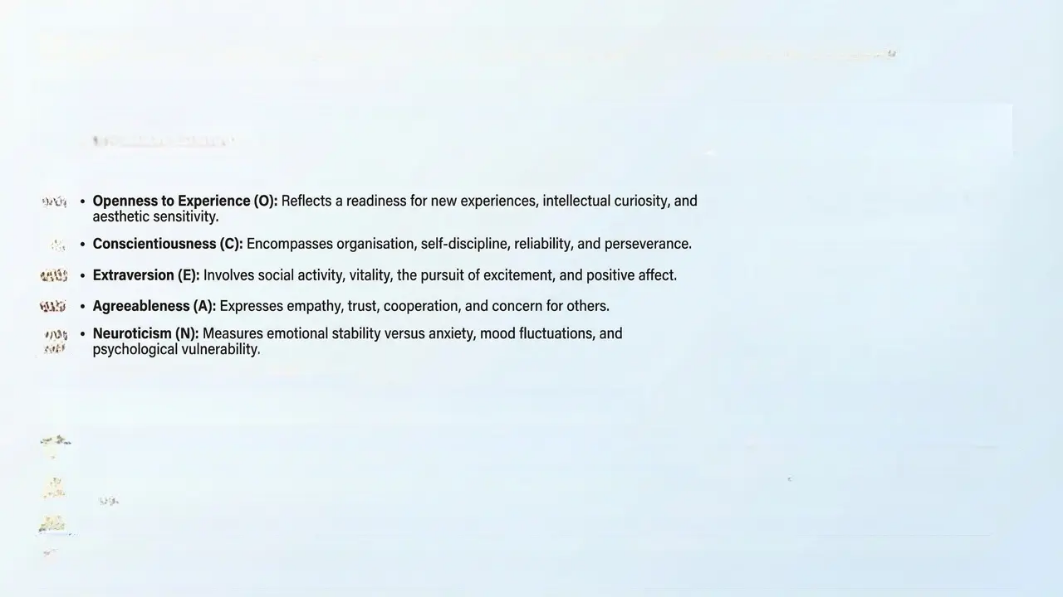
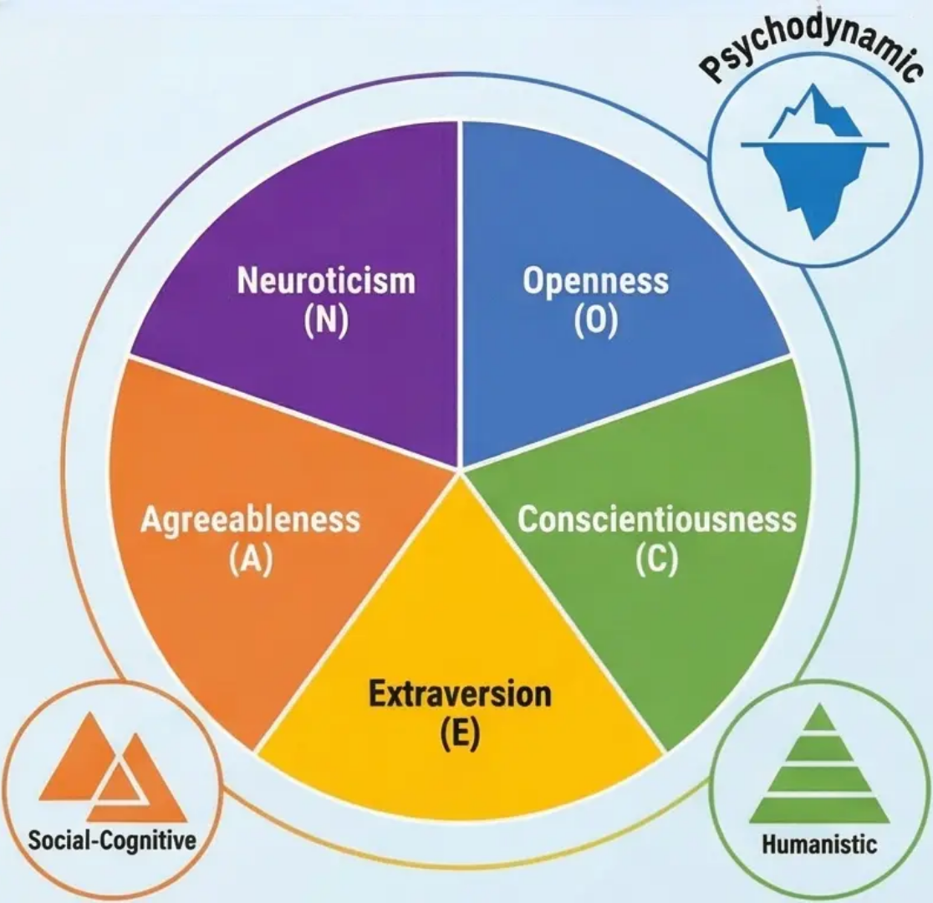









Session 8: The Big Five Model and Alternative Theories
Scientific Consensus: The Big Five Factor Model (OCEAN)
After decades of intensive research and theoretical debate, personality psychologists arrived at a rare consensus regarding the fundamental structure of
human personality. The Big Five Factor Model — or the "Big Five" — represents the most widely accepted and prevalent model in contemporary
personality psychology.
The Five Core Dimensions:
• Openness to Experience (O): Reflects a readiness for new experiences, intellectual curiosity, and
aesthetic sensitivity.
• Conscientiousness (C): Encompasses organisation, self-discipline, reliability, and perseverance.
• Extraversion (E): Involves social activity, vitality, the pursuit of excitement, and positive affect.
• Agreeableness (A): Expresses empathy, trust, cooperation, and concern for others.
• Neuroticism (N): Measures emotional stability versus anxiety, mood fluctuations, and
psychological vulnerability.
Alternative Theoretical Perspectives:
Despite the dominance of the trait model, other theoretical schools offer complementary — and
sometimes contrasting — perspectives for understanding personality:
• Psychodynamic Theory: Focuses on unconscious conflicts and repressed drives as primary
motivators of personality, emphasising the influence of early experiences in shaping psychological
structure.
• Humanistic Theory: Affirms the human potential for growth and self-actualisation, focusing on subjective experience and the pursuit of meaning and
purpose in life.
• Social-Cognitive Theory: Emphasises the dynamic interaction between cognitive, behavioural, and environmental factors in shaping personality.
“The consensus around the Big Five does not signal the end of theoretical debate; rather, it provides a shared framework for understanding human
diversity while acknowledging the necessity of complementary perspectives for a comprehensive understanding of personality.”

Slide 33


The Dimensions of the Big Five Model (OCEAN)
Universal Dimensions for Describing Human Personality
The Big Five model represents a scientific consensus regarding the fundamental structure of human personality. These five
dimensions constitute a comprehensive framework for understanding individual differences across diverse cultures and age groups.
Openness to Experience (O)
Conscientiousness (C)
• High scorers: Imaginative, creative,
intellectually curious, appreciating
diversity and novelty, open to new
values and ideas.
• High scorers: Organised, responsible,
disciplined, persevering, future-oriented.
• Low scorers: Flexible, spontaneous;
may be disorganised or negligent.
• Low scorers: Practical, traditional,
preferring routine and the familiar,
conservative in values.
Extraversion (E)
• High scorers: Sociable, energetic,
optimistic, seeking social stimulation.
• Low scorers: Quiet, reserved,
independent, preferring calm
environments.
Neuroticism (N)
• High scorers: Prone to anxiety,
tension, mood fluctuations, and
sensitivity to stress.
Agreeableness (A)
• High scorers: Empathetic, cooperative,
trusting, concerned with the welfare of
others.
• Low scorers: Emotionally stable, calm,
resilient in the face of challenges.
• Low scorers: Competitive, sceptical,
direct in expressing their views.

Slide 34

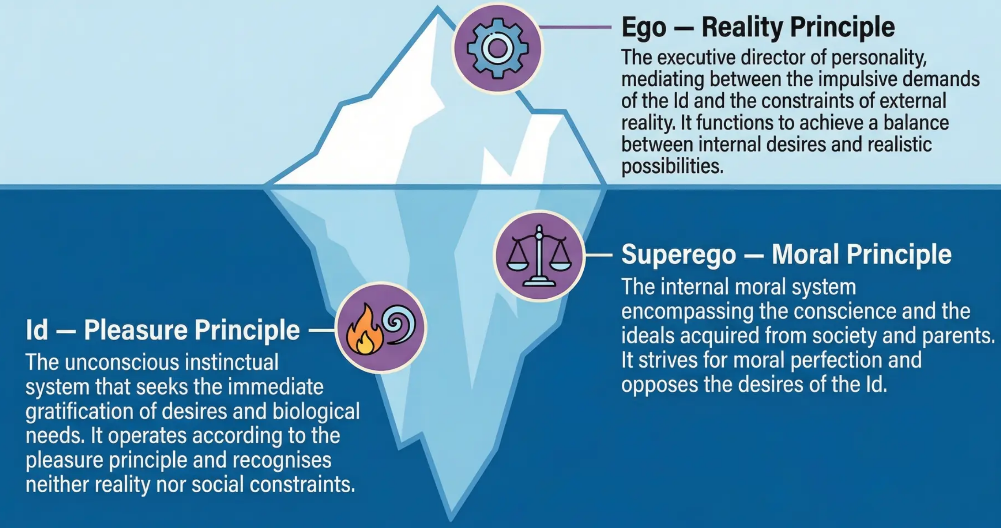
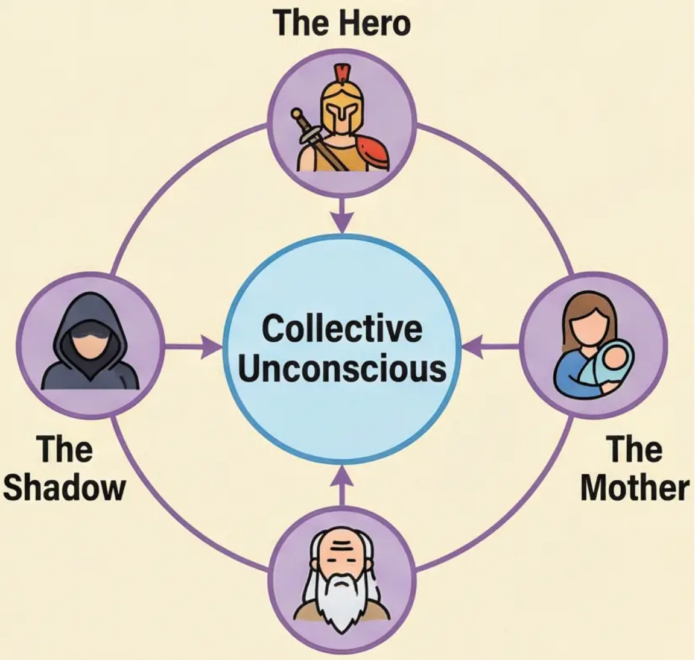
The Psychodynamic Perspective (Freud and Jung)
Freud's Theory of Psychic Structure:
Carl Jung's Contributions:
The psychodynamic theory rests on the premise that personality is shaped through a continuous
dynamic conflict between three interacting psychological systems:
Jung expanded the concept of the unconscious
to include the collective unconscious — a shared
and inherited repository of primordial memories
containing universal archetypes such as the
Hero, the Mother, and the Shadow.
The Sage
Discussion Question: How might psychodynamic theory explain the behaviour of an individual experiencing
conflict between personal desires and social responsibilities? What is the role of the unconscious in this conflict?

Slide 35

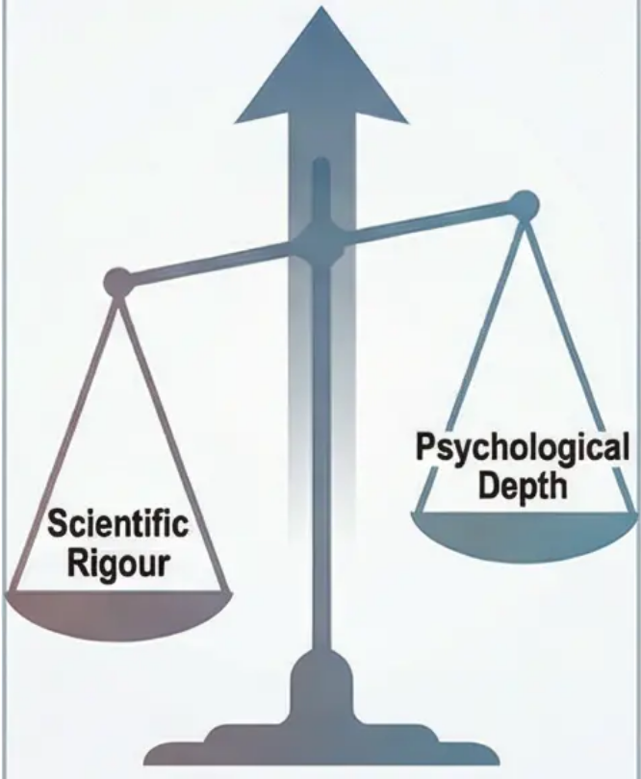


Session 9: Personality Assessment —
Objective and Projective Tests
Objective Tests: The Systematic Scientific Approach
Projective Tests: Exploring the Unconscious
Methodological
Integration
Objective tests are grounded in
the principles of rigorous psychometric
measurement, whereby the examinee
responds to clearly defined statements.
The Minnesota Multiphasic Personality
Inventory (MMPI-2) is the most
prominent example. It comprises 500
statistically designed items to differentiate
between various personality patterns.
These tests are characterised by high
test-retest reliability and empirically
validated predictive validity. They also incorporate sophisticated
validity scales that detect attempts at faking or random
responding, thereby enhancing their scientific precision.
In contrast, projective tests are
premised on the assumption that
individuals project their unconscious
conflicts and motivations onto
ambiguous stimuli. The Rorschach
Inkblot Test and the Thematic
Apperception Test (TAT) are among
the most well-known of these
instruments. They require high
interpretive skills from the psychologist
and provide a richness of qualitative
information about the individual's
psychological organisation — particularly
aspects that may not be directly expressible.
Critical and Comparative Evaluation
Although objective tests excel in scientific rigour and statistical reliability, projective tests retain clinical value in understanding deep psychological
complexities. Integration of both approaches is recommended to achieve a comprehensive understanding of personality.
Discussion Prompt: In light of recent advances in neuropsychology and artificial intelligence, how might personality assessment
instruments be developed to combine the precision of objective measurement with the depth of projective understanding?

Slide 36
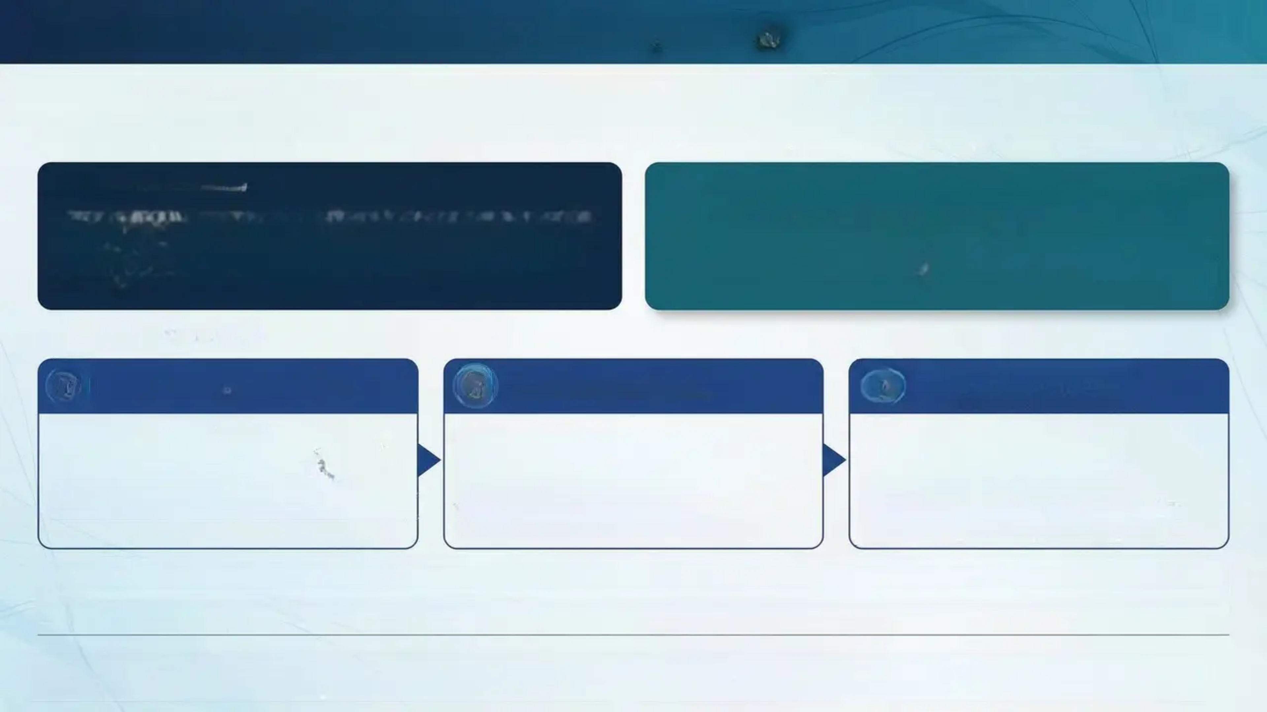





Session 10: Introduction to Forensic Psychology
Forensic psychology represents a vital intersection between theoretical psychological principles and their practical application within the criminal
justice system. This specialised field aims to understand and explain criminal behaviour from a psychological perspective, focusing on
fundamental questions: why do people commit crimes? And how can psychological knowledge contribute to investigations, trials, and rehabilitation?
Academic Definition:
The ultimate objective of forensic psychology is not merely to
understand crime, but to contribute to the construction of a more
effective and humane justice system that achieves a balance
between protecting society and rehabilitating offenders.
Forensic psychology is the systematic application of psychological
principles, theories, and research methods to understand, assess,
and address criminal behaviour within the context of the criminal
justice system.
Core Areas of Application:
1. The Investigation Phase:
2. The Judicial Phase:
3. Treatment and
Rehabilitation Phase:
• Psychological analysis of crime scenes
• Development of suspect profiles
• Enhancement of interrogation techniques
• Assessment of witness testimony reliability
• Assessment of fitness to stand trial
• Analysis of the defendant's psychological
state
• Provision of expert testimony
• Evaluation of criminal responsibility
• Design of specialised treatment
programmes
• Assessment of recidivism risk
• Development of prevention strategies
• Monitoring of therapeutic progress
How can a deep understanding of individual differences in intelligence and personality contribute to the development of more specialised and
effective approaches to addressing criminal behaviour?

Slide 37















Session 11: Eysenck's Theory of Criminal Personality
and Antisocial Personality Disorder (APD)
Antisocial Personality Disorder (APD)
Eysenck's Theory of Criminal Personality
Core Diagnostic Criteria:
Hans Eysenck proposed that individuals exhibiting a specific combination of
PEN model traits are more susceptible to criminal behaviour due to the
difficulty of their socialisation:
• Failure to conform to social and
legal norms
• Persistent deceitfulness and lying
• Impulsivity and failure to plan
ahead
Traits Associated with
Criminality:
The Red
Zone of
Criminal
Behaviour
High Extraversion (E):
Deficient cortical arousal leads
to sensation-seeking and poor
responsiveness to punishment.
• Irritability and repeated
aggressiveness
The Distinction Between APD and Psychopathy:
High Neuroticism (N):
Emotional instability impedes
learning from negative
consequences.
High Psychoticism (P):
Emotional coldness, absence
of empathy and conscience.
The Socialisation Mechanism:
Individuals with high levels of E and N are more difficult to condition
behaviourally, impeding the development of a robust conscience.
When combined with the emotional coldness of high P, the
likelihood of criminal behaviour increases substantially.
APD is a behavioural diagnosis focused on actions, whereas psychopathy is
a broader concept encompassing emotional deficits and grandiosity. Most
psychopaths meet criteria for APD, but the converse is not necessarily true.
Discussion Prompt: Can a ruthless executive who displays traits of deceitfulness and absence of remorse, yet does not violate the law,
be considered to have Antisocial Personality Disorder? What does this suggest about the definition of 'disorder' in a social context?

Slide 38



Session 12: Indicators of Delinquency (Age, Gender, and Longitudinal Studies)
The Age-Crime Curve: A Universal Pattern
The Gender Gap in Crime
Global statistics reveal a pronounced gender gap, with males committing
significantly more crimes than females – particularly violent offences. The
ratio reaches 4:1 across most crime categories.
Theoretical Explanations for the Gap:
Biological Explanations: The influence of testosterone on aggression •
and risk-taking,
Socialisation Explanations: Differences in child-rearing practices and •
societal expectations for each gender.
Opportunity Explanations: Historical differences in access to criminal
opportunities.
The age-crime curve is one of the most robust and consistent findings in
criminology. It demonstrates that criminal activity rises sharply during adolescence,
peaks in late adolescence and early adulthood, and then declines progressively with
advancing age. This pattern is consistent across cultures and historical periods.
Key Longitudinal Studies:
Cambridge Study: Followed 411 London boys over 50 years. •
Dunedin Study: Followed 1,037 New Zealand children from birth. •
Key Finding: 5% of offenders commit 50% of crimes. •
Explanatory Factors for the Adolescent Peak:
Biological Factors: Incomplete maturation of the prefrontal cortex, •
responsible for impulse control and decision-making.
Psychological Factors: Identity formation, risk-seeking behaviour, and the •
influence of peer pressure.
Social Factors: Reduced parental supervision, school transitions, and •
desire to attain adult status.

Slide 39




Session 13: Cognitive and Social Theories of Crime
This session transitions from a focus on stable personality traits to an understanding of the dynamic processes that shape criminal
behaviour. It explores how distorted thinking patterns, incomplete moral development, and social learning influence the acquisition
and perpetuation of criminal conduct.
Part One: Cognitive Theories of Crime
Part Two: Kohlberg's Theory of Moral Development
Part Three: Bandura's Social Learning Theory
Kohlberg's Model of Moral Reasoning:
Stage 6:
Universal Ethical
Principles
Denial of
Responsibility:
Attributing blame
to external
circumstances or
victims.
Minimisation of
Harm:
Downplaying the
consequences of
criminal actions.
Post-
Conventional
Stage 5:
Social Contract and
Individual Rights
Stage 4:
Maintaining Social
Order and Law
Self-Justification:
Reframing criminal
acts as acceptable
or necessary
behaviour.
Denial of the
Victim:
Perceiving
victims as deserving
of harm or as
aggressors.
Conventional
Stage 3:
Conformity to Social Expectations
🤔
Stage 2:
Instrumental Purpose and Exchange
Pre-
Conventional
Stage 1:
Obedience and Punishment Avoidance
Application in Criminology: Studies have
demonstrated that offenders frequently remain
arrested at the early stages of moral development,
which influences their behavioural decision-making.
Practical Applications:
• The influence of violent media on criminal behaviour.
• The role of criminal role models in the local environment.
• The importance of social reinforcement in the
perpetuation of criminal behaviour.
Walters' Criminal Thinking Style Model: Mollification,
Cutoff, Entitlement, Power Orientation, Sentimentality,
Superoptimism, Cognitive Indolence, and Discontinuity.
Discussion Prompt: How might these three theories be integrated to develop comprehensive intervention programmes for crime prevention and offender
rehabilitation? What are the practical challenges in applying these concepts within the judicial system?

Slide 40





Session 14: Offender Profiling
Offender profiling is an investigative technique that aims to infer the psychological, behavioural, and demographic characteristics of
an unknown offender through the analysis of crime scene evidence. This field represents a direct practical application of the
personality and criminal behaviour theories examined throughout this unit.
The British Statistical
Approach
• Assumes behavioural
consistency: the offender's
behaviour at the crime scene
reflects their personality in
actual crimes.
• Psychological Uniqueness
Principle: each offender
has a distinctive
psychological signature,
but it is assumed that most
offenders in a specific
geographical area are
linked to their daily lives.
The American Approach (FBI Approach)
Core Principles of Profiling
Developed within the FBI's Behavioural Science Unit, this approach
draws on clinical expertise and in-depth interviews with convicted
offenders. It classifies crimes into two principal categories:
• Organised Offenders: Demonstrate premeditation, exercise self-
control, and leave minimal evidence.
• Disorganised Offenders: Commit spontaneous crimes, leave chaotic
crime scenes, and leave substantial evidence.
• Behavioural Consistency Assumption: The offender's behaviour at the crime
• Psychological Uniqueness Principle:Each offender possesses a
distinctive psychological signature that manifests in their modus operandi.
• The relationship between personality and specialised criminal behaviour.
Critical Evaluation
Strengths: Useful in rare and complex crimes; provides investigative leads.
Weaknesses: Limited accuracy; relies on assumptions that may be
erroneous; risk of confirmatory bias.
What are the ethical and practical risks of employing offender profiling in investigations? How can its scientific accuracy be improved?

Slide 41



Final Assessment: Case Study Analysis
Academic Guidelines for the Final Assignment
Academic Assignment Intro
This final assessment requires the application of studied psychological theories to a detailed case study
of a known offender, with a focus on critical analysis and the practical application of theoretical concepts.
First: Psychological Analysis of Personality •
Academic Assessment
Criteria:
Applying the Big Five model to the behaviours of the selected case –
Using Eysenck's PEN theory to interpret behavioural patterns –
Assessing indicators of Antisocial Personality Disorder according –
to DSM-5 criteria
Depth of theoretical
analysis and practical
application
Second: Assessment of Cognitive Abilities •
Analysing intelligence indicators through recorded behaviours and –
decisions
Use of empirical evidence •
from contemporary research
Applying Sternberg's Triarchic Theory of practical and creative intelligence –
Discussing environmental and genetic factors influencing cognitive –
development
Critical evaluation of the
limitations of applied
theories
Third: Identification of Criminal Traits •
Quality of academic
writing and referencing
Applying Offender Profiling techniques to the case –
Analysing behavioural patterns and psychological motivations –
Linking personal traits to the nature of the crimes committed –
How can the integration of different theories provide a deeper understanding
of criminal behaviour compared to the application of a single theory?

Slide 42



Conclusion and Cognitive Integration
Integrating Individual Differences with Applied and Social Psychology
The Completed Intellectual Journey:
In this unit, we have explored the complex interaction between
cognitive abilities, personality traits, and criminal behaviour. From the
classical intelligence theories of Spearman and Thurstone, through
the contemporary Big Five models, to the practical applications of
offender profiling — this journey reveals the richness and
complexity of human nature.
Theoretical Integration:
Individual differences are not merely academic distinctions; they are
the key to understanding how individuals interact with their social and
professional environments. The theories examined throughout this
unit constitute the scientific foundation for psychological practice in
the fields of education, therapy, and criminal justice.
Future Connections:
“Individual differences are the window
through which we glimpse the complexity and
rich diversity of human behaviour.”
This knowledge paves the way for exploring social psychology, where
we will examine how individual characteristics interact with group
dynamics. It will also serve as a foundation for understanding applied
psychology in the domains of organisational behaviour and mental health.

