Slide 1


PSYCH503: Visual Perception in Psychological Context
Level 5 Extended Diploma in Psychology
A comprehensive exploration of visual perception mechanisms from sensation to complex cognition
Institution: ABCHorizon
Duration: Full Academic Course – 12 Educational Sessions
Level: Level 5 Extended Diploma
AIH
ABCHorizon

Slide 2
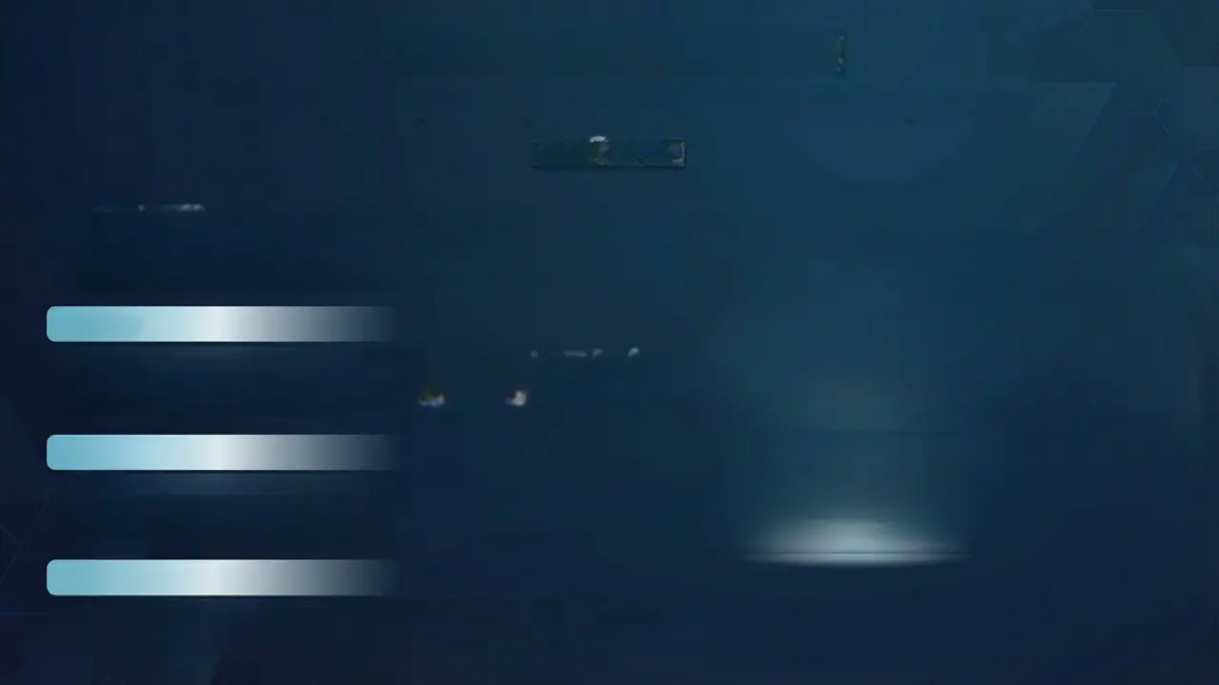
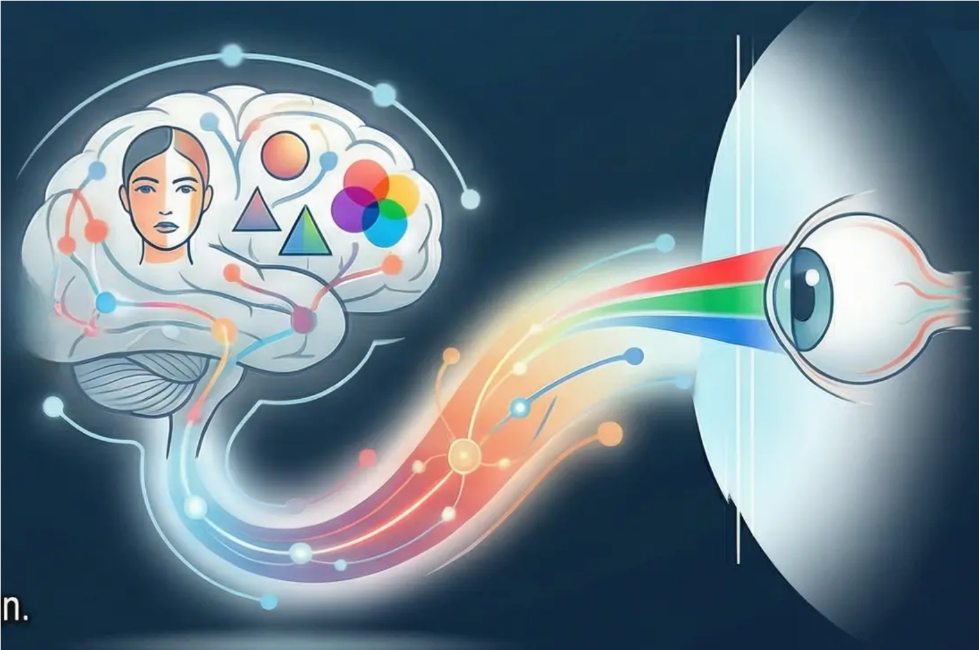
Unit Overview (Overview)
An Exploratory Journey into the World of Visual Perception
PSYCH503
Welcome to one of the most complex and exciting processes in psychology – how
we interpret and understand the visual world around us. Our journey begins with the
initial reception of light in the eye and extends to the complex recognition of faces
and objects.
Core Idea
Visual perception is not mere passive recording of the external world, but rather an
active and constructive process that forms our complete experience of the world.
Understanding how the human brain constructs its perceptual reality is the central focus of this unit.
Learning Path
Our learning journey will take us from basic light sensation to complex perception of
shapes, colours, depth, and movement. We will explore foundational theories,
experimental evidence, and practical applications in fields ranging from medicine to design.
Unit's General Goal
This unit aims to provide the learner with a comprehensive and deep understanding of
visual perception, exploring the diverse ways in which we gather and interpret visual
information about the world – and consequently, about ourselves.

Slide 3
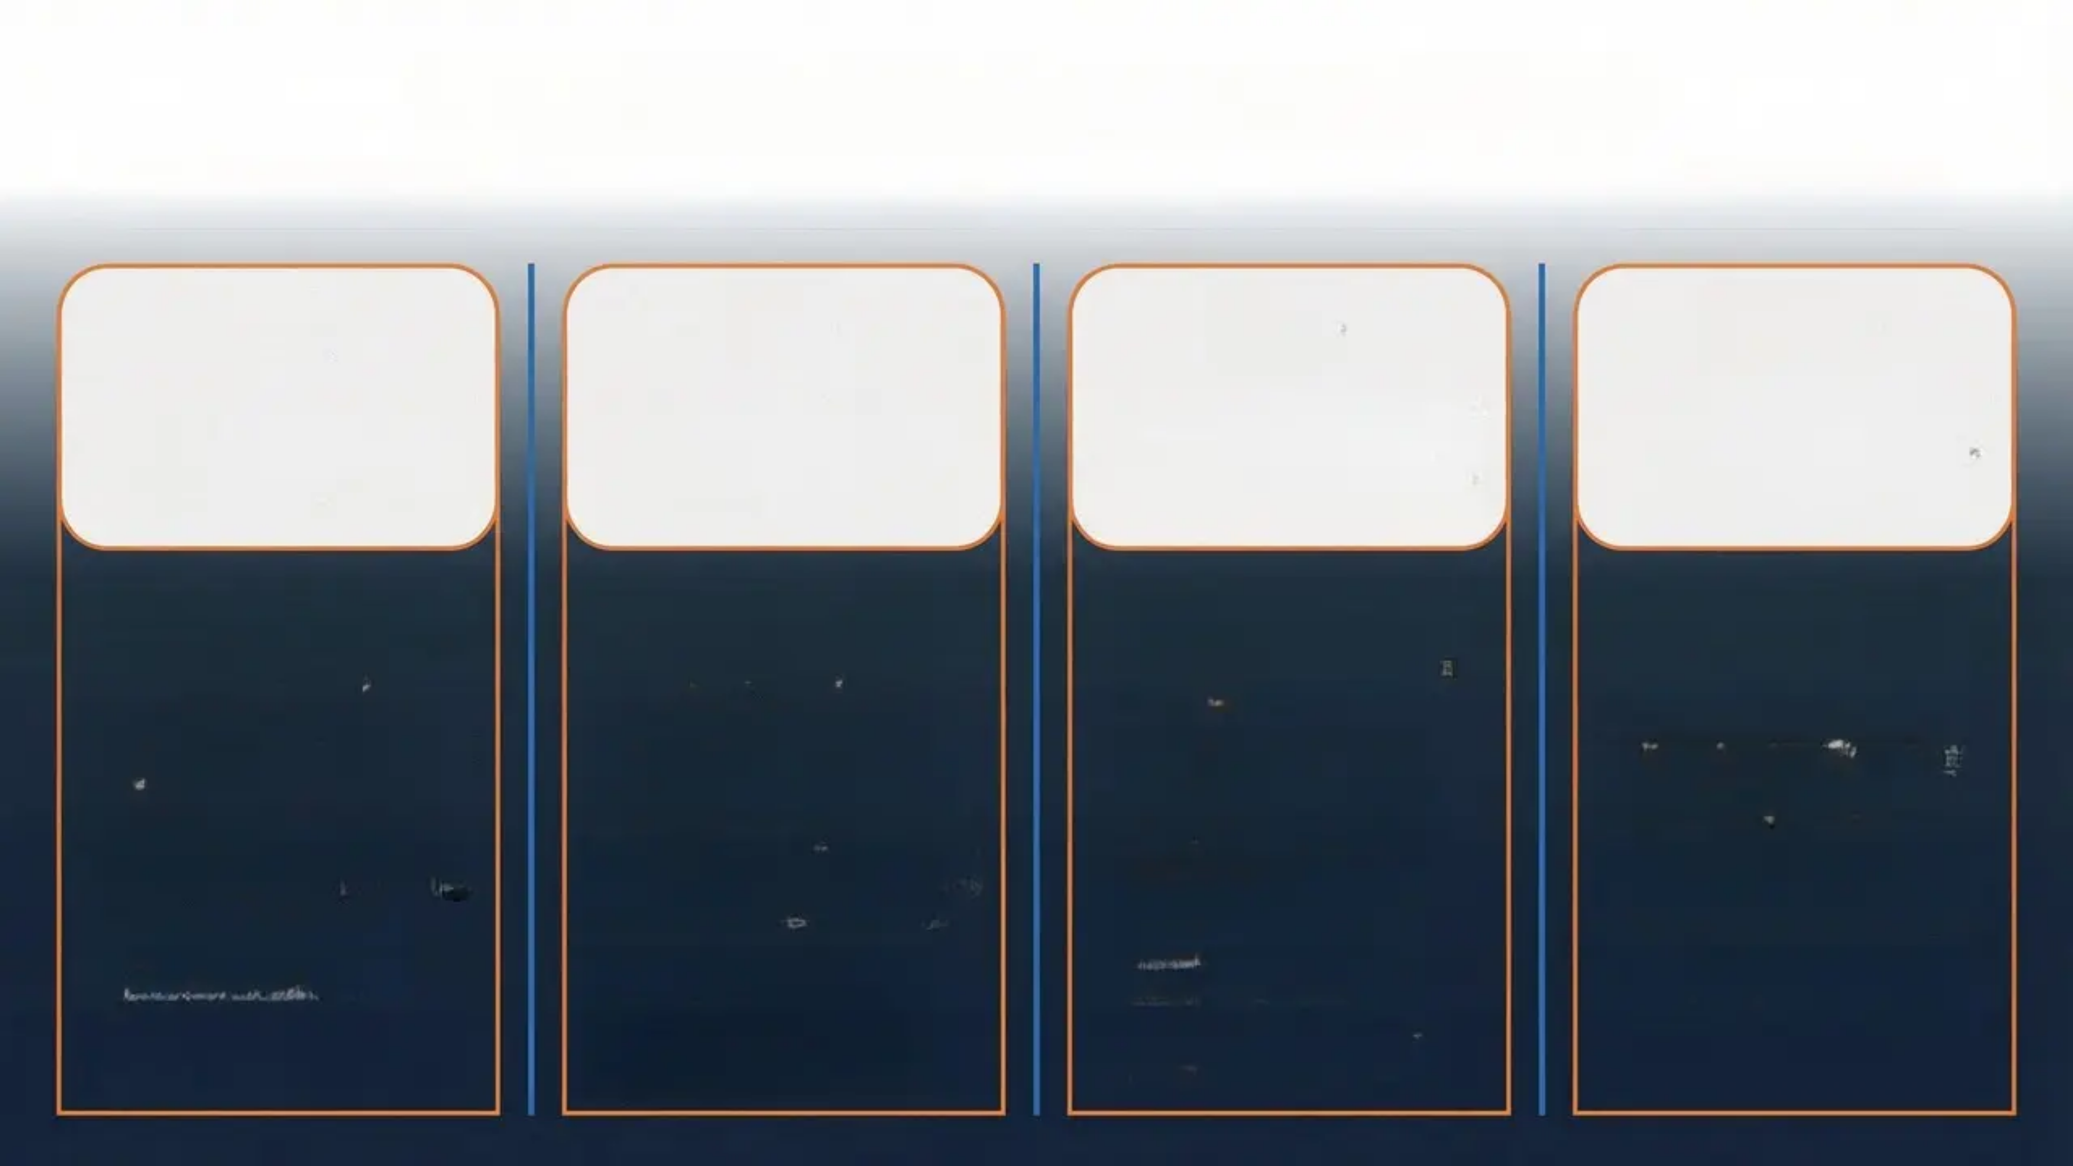

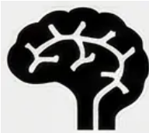


Unit Learning Outcomes PSYCH503
At the end of this unit, you will be able to achieve the following academic objectives:
LO1: Understanding the
structure and function of
the visual system
LO2: Analysis and
evaluation of major visual
perception theories
LO3: Tracing and analyzing
the development of
perceptual abilities across
developmental stages
LO4: Analysis of the
nature vs. nurture debate
in visual perception
• Analysis of the anatomical
structure of the eye and
neural visual pathways.
• Explanation of transduction
processes from light to neural
signals.
• Evaluation of the role of the
retina and visual cortex in
visual information processing.
• Connecting biological
mechanisms to complex
perceptual functions.
• Critical comparison of
constructive (Gregory) and
ecological (Gibson) theories.
• Application of Gestalt
principles and Marr's
computational model to
diverse perceptual situations.
• Analysis of empirical evidence
supporting and opposing each
theory.
• Assessment of the strengths
and weaknesses of each
theoretical framework in
explaining perceptual
phenomena.
• Examination of perceptual
abilities in infants and
children using experimental
methods.
• Analysis of cross-cultural
studies and their impact on
understanding visual
perception.
• Evaluation of research
methodologies used in
perceptual development
studies.
• Linking developmental
findings to contemporary
perceptual theories.
• Explanation of the relative
contributions of genetic and
environmental factors in the
development of vision.
• Evaluation of evidence from
sensory deprivation studies
and critical periods.
• Analysis of the modern
interactionist perspective
between nature and nurture.
• Application of this debate to
contemporary issues in
perceptual psychology.

Slide 4

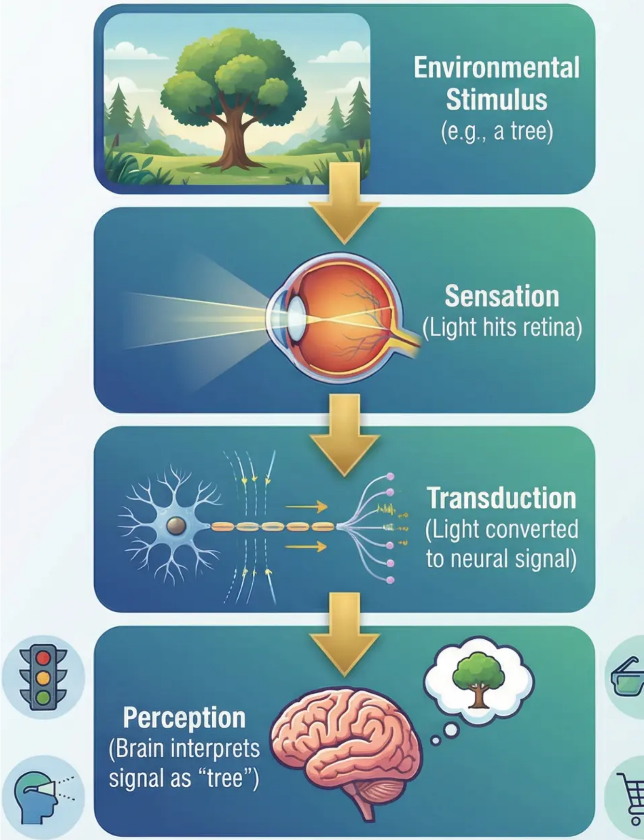
Introduction to Visual Perception (Session 1)
The Wonders of Vision – The Fundamental Distinction Between Sensation and Perception
Multidisciplinary Academic Significance:
Precise Academic Definition:
• In Cognitive Psychology: Provides a model for
understanding information processing and
knowledge construction.
Vision is considered the most dominant sense in our
human experience, occupying more than a third of the
cerebral cortex. However, what we experience as
‘vision’ is not just a passive recording of the external
world, but a complex and active process
involving two academically distinct stages.
• In Social Psychology: Explains how
expectations and cultural context influence our
perception of others.
• In Clinical Psychology: Helps in
understanding hallucinations and perceptual
disorders.
Sensation (Sensation):
The primary physiological process by which
sensory receptors in the retina receive light energy
and convert it into electrical signals. This
stage involves the direct conversion of physical
energy into the language of the nervous system
without any interpretation or meaning.
• In Human-Computer Interaction: Guides the
design of interfaces and digital environments.
Practical Applications:
From the design of traffic signals that are read
quickly and accurately, to the development
of augmented reality systems, and even
understanding how advertising
influences consumer behavior.
Perception (Perception):
The higher cognitive process by which the brain
organizes and interprets these raw signals to
produce a meaningful visual experience.
Perception involves pattern recognition, the
application of prior knowledge, and the construction
of mental representations of the world.

Slide 5

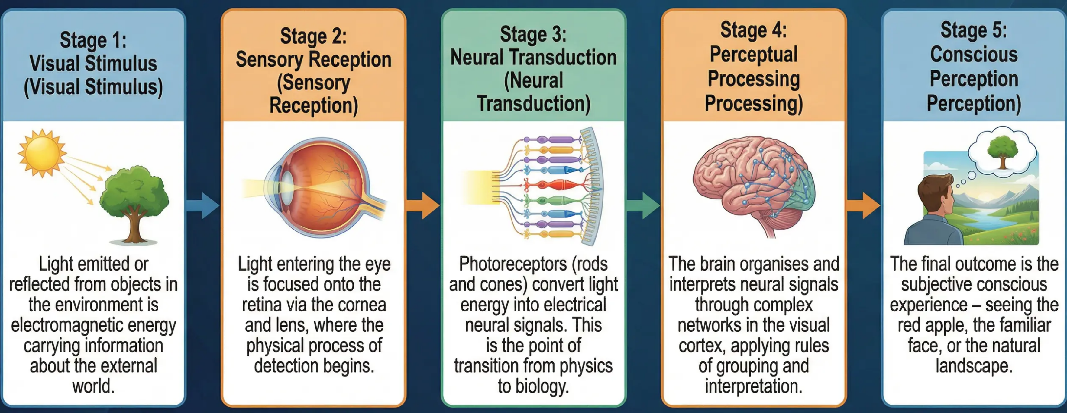
Stages of Perceptual Processing: From Light to Conscious Experience
Applications in Engineering Design
Understanding these stages has revolutionised architectural and engineering design. Architects use knowledge of perceptual
processing to design safe and efficient buildings – from traffic signals that exploit rapid colour processing, to airport designs
that facilitate visual navigation, to digital user interfaces that optimise the interaction experience.

Slide 6
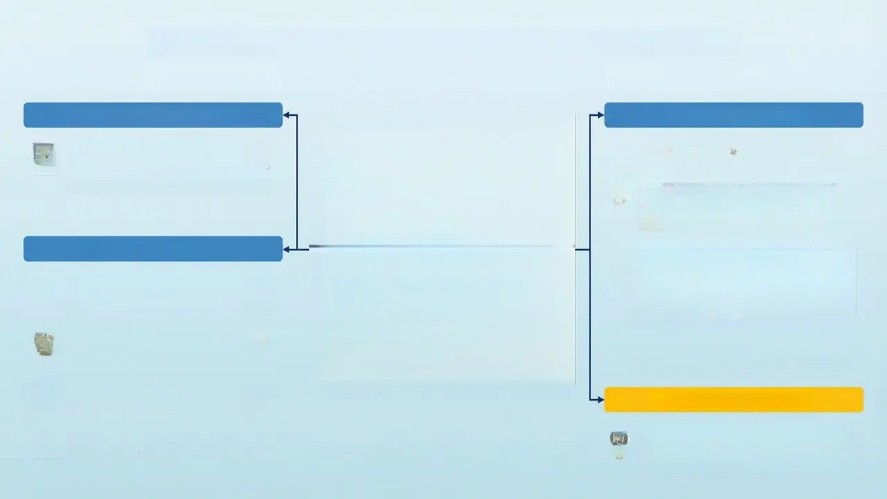








Interactive Exercise: Rubin's Vase Illusion
Exploring the Figure-Ground Principle
Interactive Exercise Instructions
Scientific Explanation
Focus on the image displayed for 30
seconds, record your observations, then
discuss the following analytical questions
in small groups.
Rubin's Vase represents a fundamental principle in visual
perception: Figure-Ground Organisation.
Key points:
The Active Role of the Brain: The brain does not
passively receive information; it actively organises and
interprets it. This means that the same sensory input
(black and white lines) can lead to different perceptual
interpretations.
Analytical Questions
The Process of Perceptual Organisation: The brain
divides the visual field into a 'figure' (the salient,
meaningful part) and a 'ground' (the background). In
Rubin's illusion, the brain alternates between treating
the white area as figure (the vase) and the black area
as ground, or vice versa (the two faces as figure and
the white area as ground).
What was the first thing you noticed in the
image? Did you see a vase or two facing
profiles?
Were you able to switch between seeing
the vase and seeing the two faces? How
did this switching occur?
Perceptual Instability: It is impossible to see both
interpretations simultaneously; the brain must 'choose'
one interpretation at any given moment, reflecting the
constructive nature of perception.
Were you able to switch between seeing
the vase and seeing the two faces? How
did this switching occur?
Theoretical Significance
Can you see both interpretations
simultaneously? Why or why not?
This illusion supports theories of perception that
assert what we see is not a direct reflection of
reality, but rather an active construction by the
brain using innate organisational rules.

Slide 7
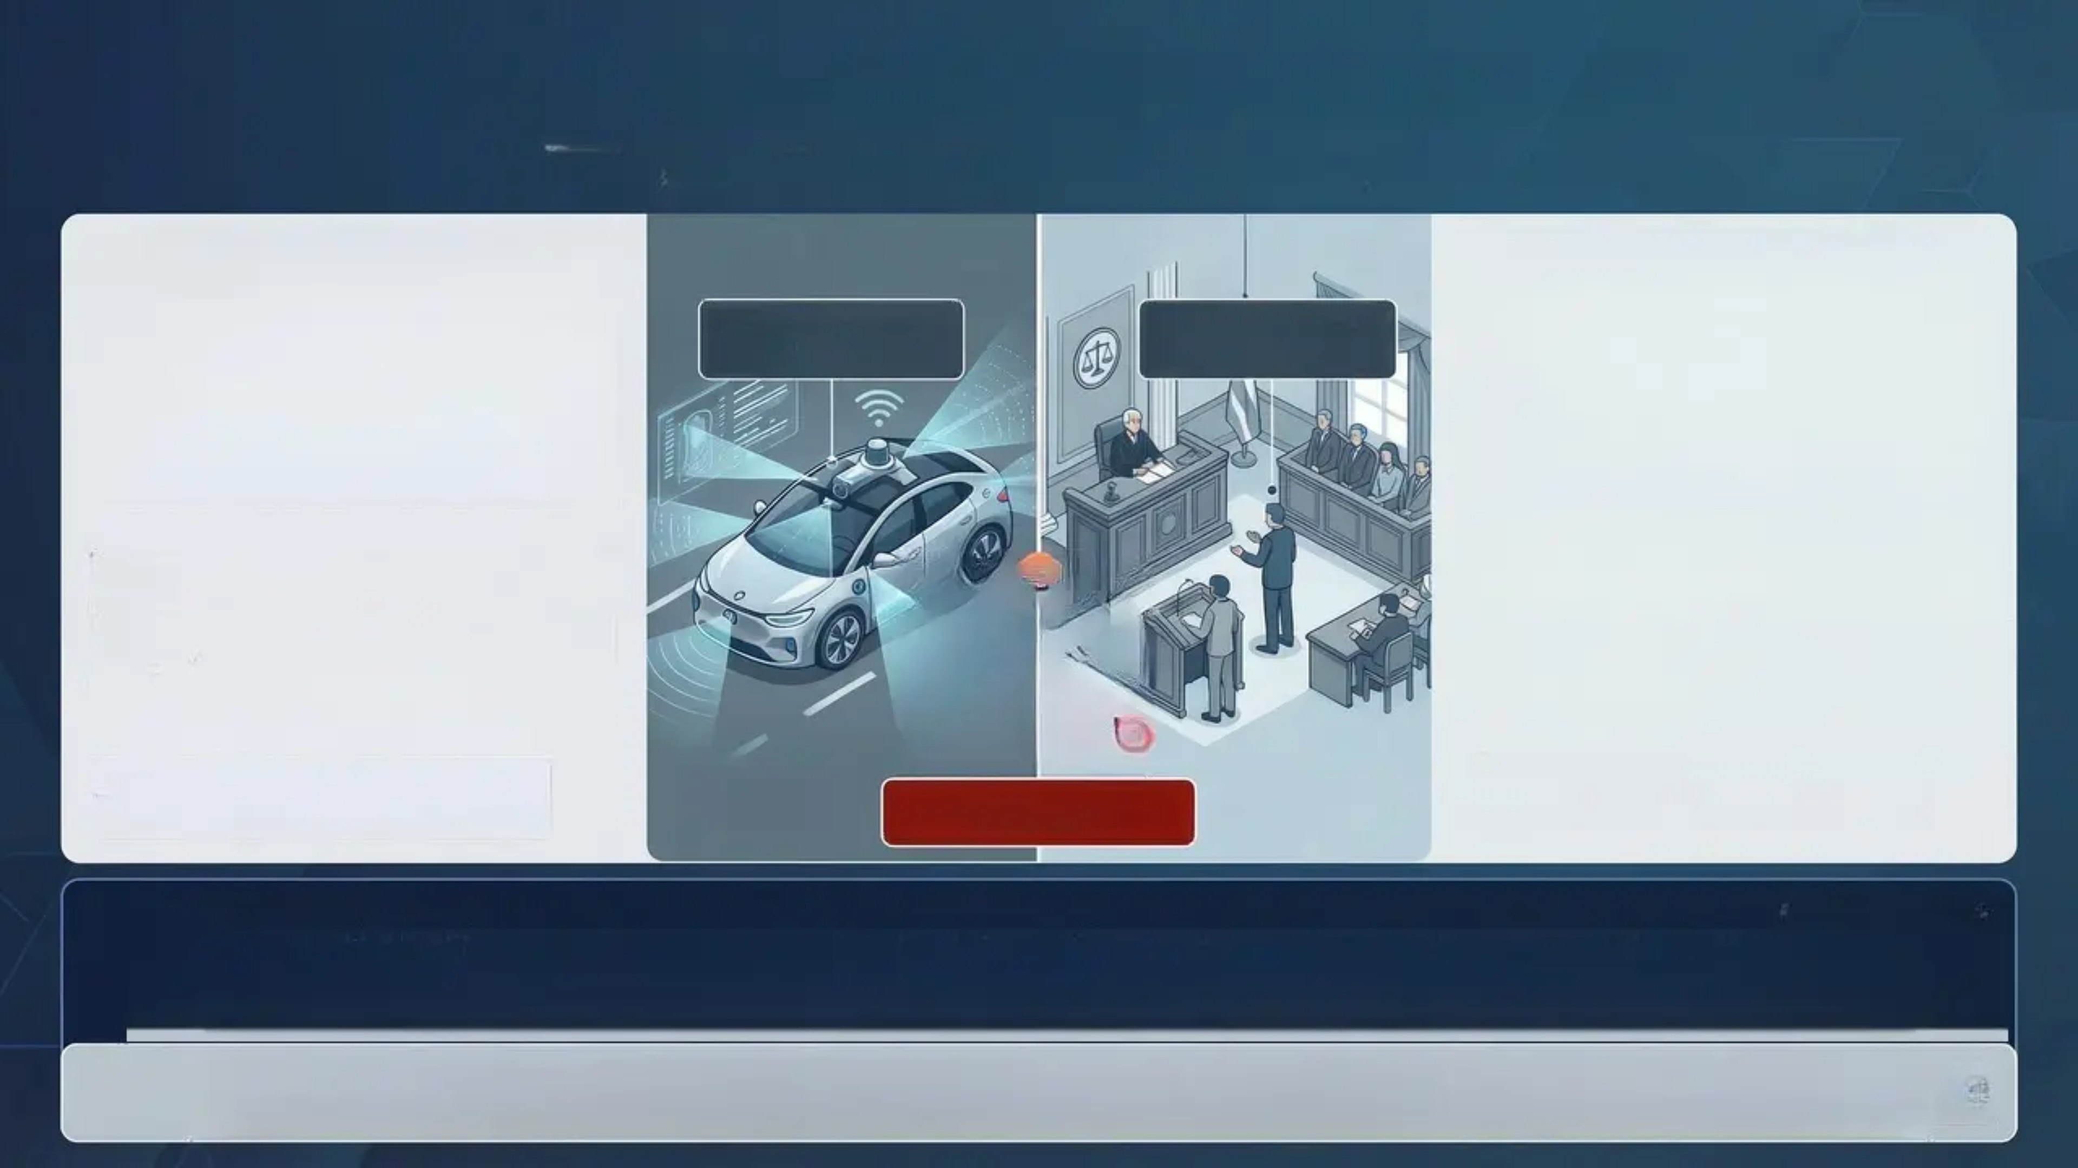

Consequences of Perceptual Error (Distinction Level)
Thinking at the Distinction Level – From the Laboratory to Reality
Technical Systems: Self-Driving
Cars (as an example)
Human Context: Criminal Justice
and Eyewitness Testimony
The raw data from cameras and LiDAR vs
the raw data are prevered as well as; the
resultat vs. the interpretation for the
identifying objects living enhe/imany objects
to identifying objects.
Eyewitness testimony is important and the
notics to its constructum; eyewitness
testimony, the coltext is closed aw many
may can important eyewitness fallible and
eyewitness testimony.
Failure to recognise pedestrians in
complex lighting conditions.
Misidentification: Dim lighting, distance,
and psychological stress can lead to
errors in identifying individuals.
Misinterpretation of traffic signals due to
light reflections.
Expectation Effect: What a witness
expects to see may influence what they
actually report.
Inability to distinguish between
shadows and subtle real obstacles.
Difficulty perceiving depth in foggy
weather.
Distortion of Visual Memory:
Subsequent information can alter a
witness's visual memories.
Perceptual Error Risk
Critical Analysis
These examples highlight the constructive nature of perception, both in artificial and human systems. Perception is not a perfect copy of reality, but
rather an “intelligent guess” based on information that may be incomplete or ambiguous. This underscores the importance of understanding the
limitations of our perceptual systems and developing mechanisms for verification and review in critical contexts.
Discussion Prompt: How can society develop protective mechanisms against perceptual errors in vital sectors? And what is the role of
technology in reducing these risks versus increasing dependence on it?

Slide 8

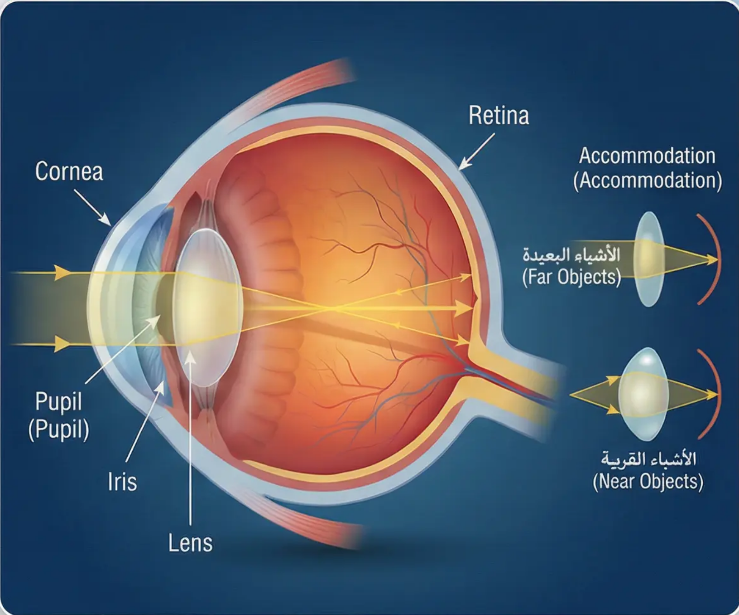
Anatomy of the Visual System (Session 2)
The Path of Light Through the Eye
The human eye is not merely a ‘biological camera’ but a
sophisticated optical system. Understanding its anatomy is
essential for comprehending how visual information is initially
captured and prepared for neural processing.
Stage 1 – Entry and Protection: The transparent outer Cornea
(Cornea) acts as a protective window and performs most of
the light refraction.
Stage 2 – Light Control: Light passes through the Iris (Iris)
and Pupil (Pupil), where the iris controls the size of the pupil
to regulate the amount of light reaching the eye.
Stage 3 – Fine Focusing: The Lens (Lens) is a flexible
transparent structure that changes shape to adjust focus
through the process of Accommodation (Accommodation).
Stage 4 – The Critical Conversion: Light reaches the Retina
(Retina) at the back, where light energy is converted into
electrochemical signals via photoreceptor cells through the
process of Transduction (Transduction).
Functional Significance: Each part of the eye plays a vital role, and any dysfunction leads to visual problems. This makes
understanding this anatomy fundamental to understanding visual information processing.

Slide 9

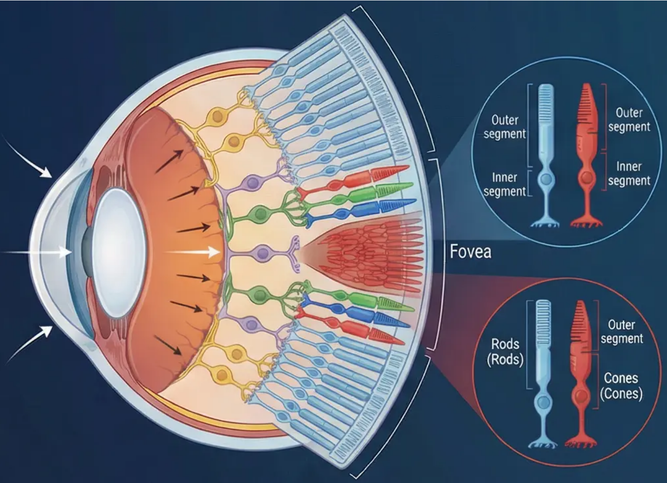
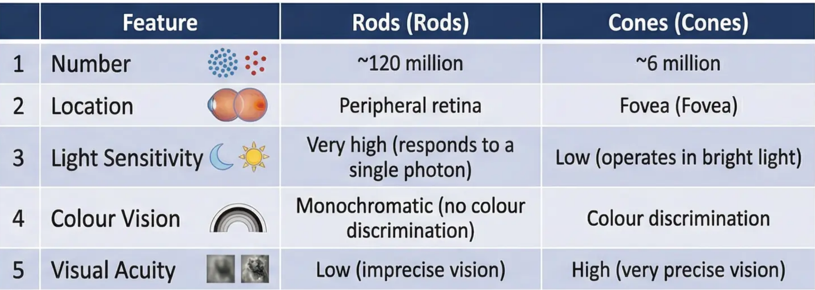
The Retina: Rods and Cones
Comparison between Rods and Cones
The retina contains two specialised types of photoreceptor cells, each designed for
distinct visual conditions and perceptual tasks.
Transduction – From Light to Signal
Both types of cells perform a critical conversion process: transforming light energy into electrical signals that the brain can understand and
process. The brain can understand and process. This process is described as ‘the bridge between the physical world of light and the
psychological world of perception’.
Discussion Question
• Why do you think evolution led to two different types of photoreceptors rather than one multifunctional type?
• How does this functional specialisation reflect the principle of ‘trade-off’ in biological design?

Slide 10
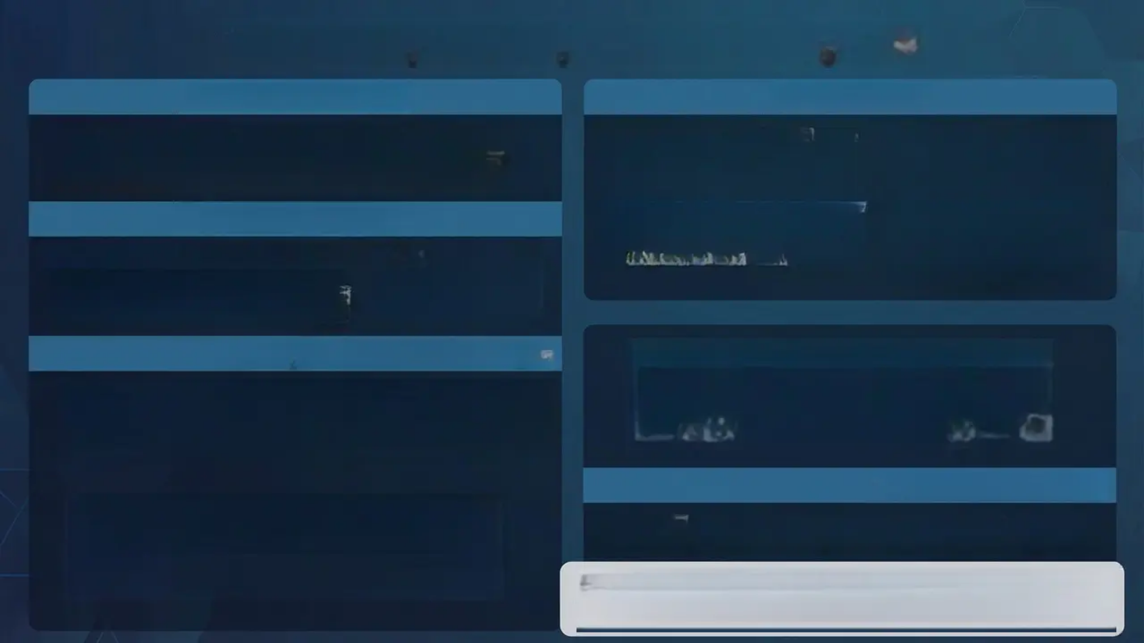
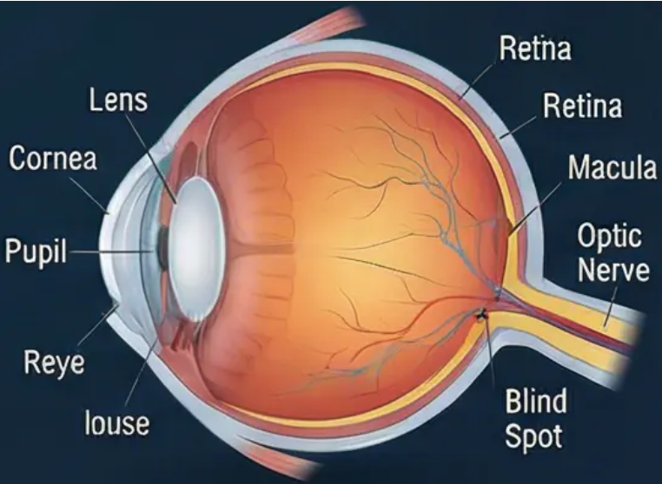
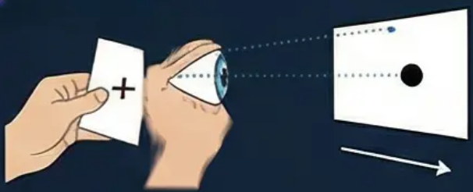


The Blind Spot: A Gap in the Visual System
What is the Blind Spot?
Anatomical Basis
The blind spot is a region in the retina devoid of
photoreceptors, from which the optic nerve exits carrying
visual signals to the brain.
This location is dedicated to the
passage of nerve fibres and
contains no photoreceptors.
The blind spot is indicated at the
back of the eye where the optic
nerve meets the retina.
Experimental Discovery
A simple experiment to discover the blind spot:
Draw a cross and a dot on paper, close one eye,
and move the paper until the dot disappears
at a certain point.
The Cognitive Process of Filling-In
The brain performs an intelligent, unconscious, and instantaneous
"filling-in" process, using information from surrounding areas to infer
what should be in the blind spot region, thereby creating the illusion of
visual continuity.
Theoretical Implications
The blind spot is not merely a passive recording of reality, but an active
construction by the brain. This supports constructivist theories of perception.
Discussion Prompt: How does the blind spot and the cognitive filling-in mechanism
challenge the common belief that our eyes work like cameras that accurately record
reality? What does this tell us about the nature of human perception?

Slide 11
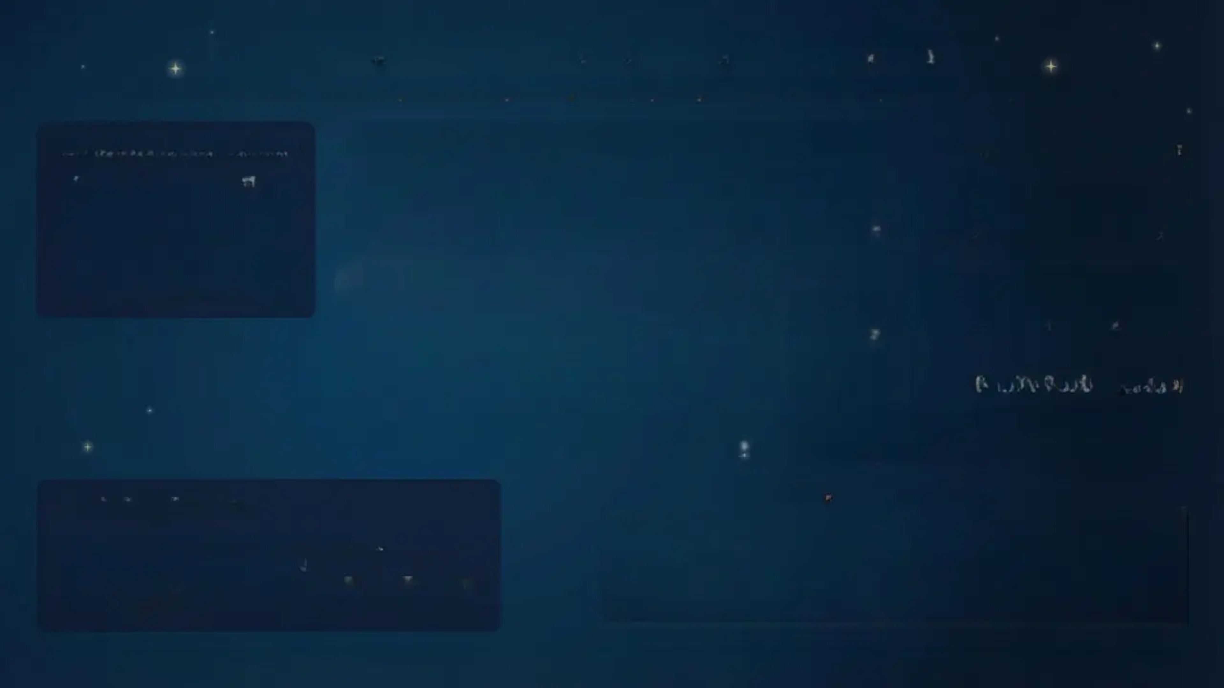
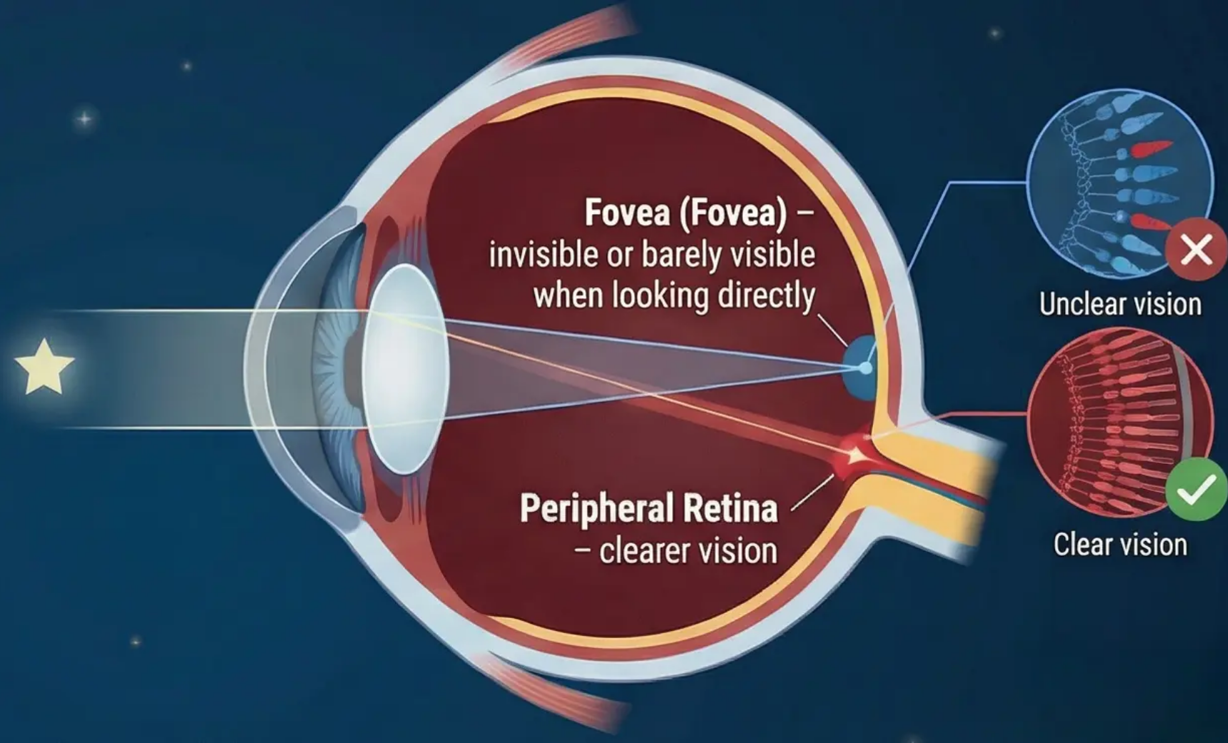
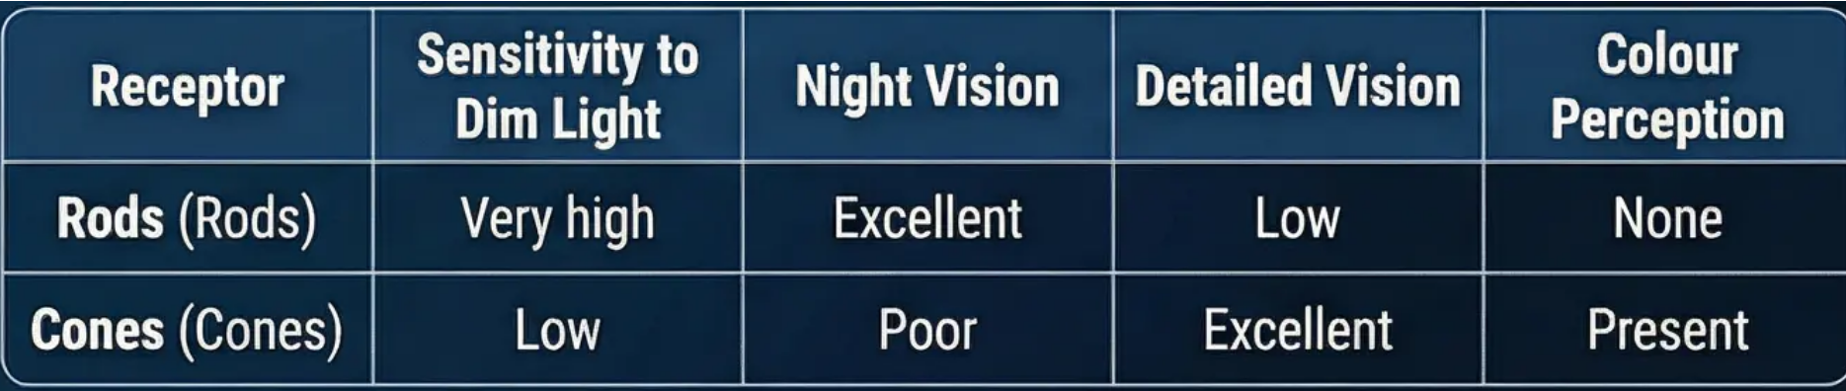
Seeing Faint Stars (Physiological Analysis)
The Observed Phenomenon
Physiological Explanation
When attempting to see a faint star
at night, it becomes clearer when
looking to the side of it rather than
directly at it. This
phenomenon has a physiological
basis in the retina.
Direct Gaze: The Fovea contains cones
specialised in detailed and colour vision,
but they are less sensitive to dim light.
Fovea (Fovea) –
invisible or barely visible
when looking directly
Unclear vision
Peripheral Gaze: The peripheral retina is
dominated by rods specialised in high
sensitivity to dim light and night vision.
Peripheral Retina
– clearer vision
Quantitative Comparison
Clear vision
Rods are approximately 1,000 times more sensitive to light
than cones under low-light conditions, which explains
why faint stars are clearer with peripheral vision.
Practical Applications
Receptor Characteristics
Astronomy: Observation of faint celestial bodies.
Night Aviation: Night-time navigation.
Security and Surveillance: Improving surveillance efficiency in
low-light conditions.
Discussion Prompt: How can understanding this functional specialisation help in developing artificial night-vision technologies or improving the design of lighting systems in various environments?

Slide 12

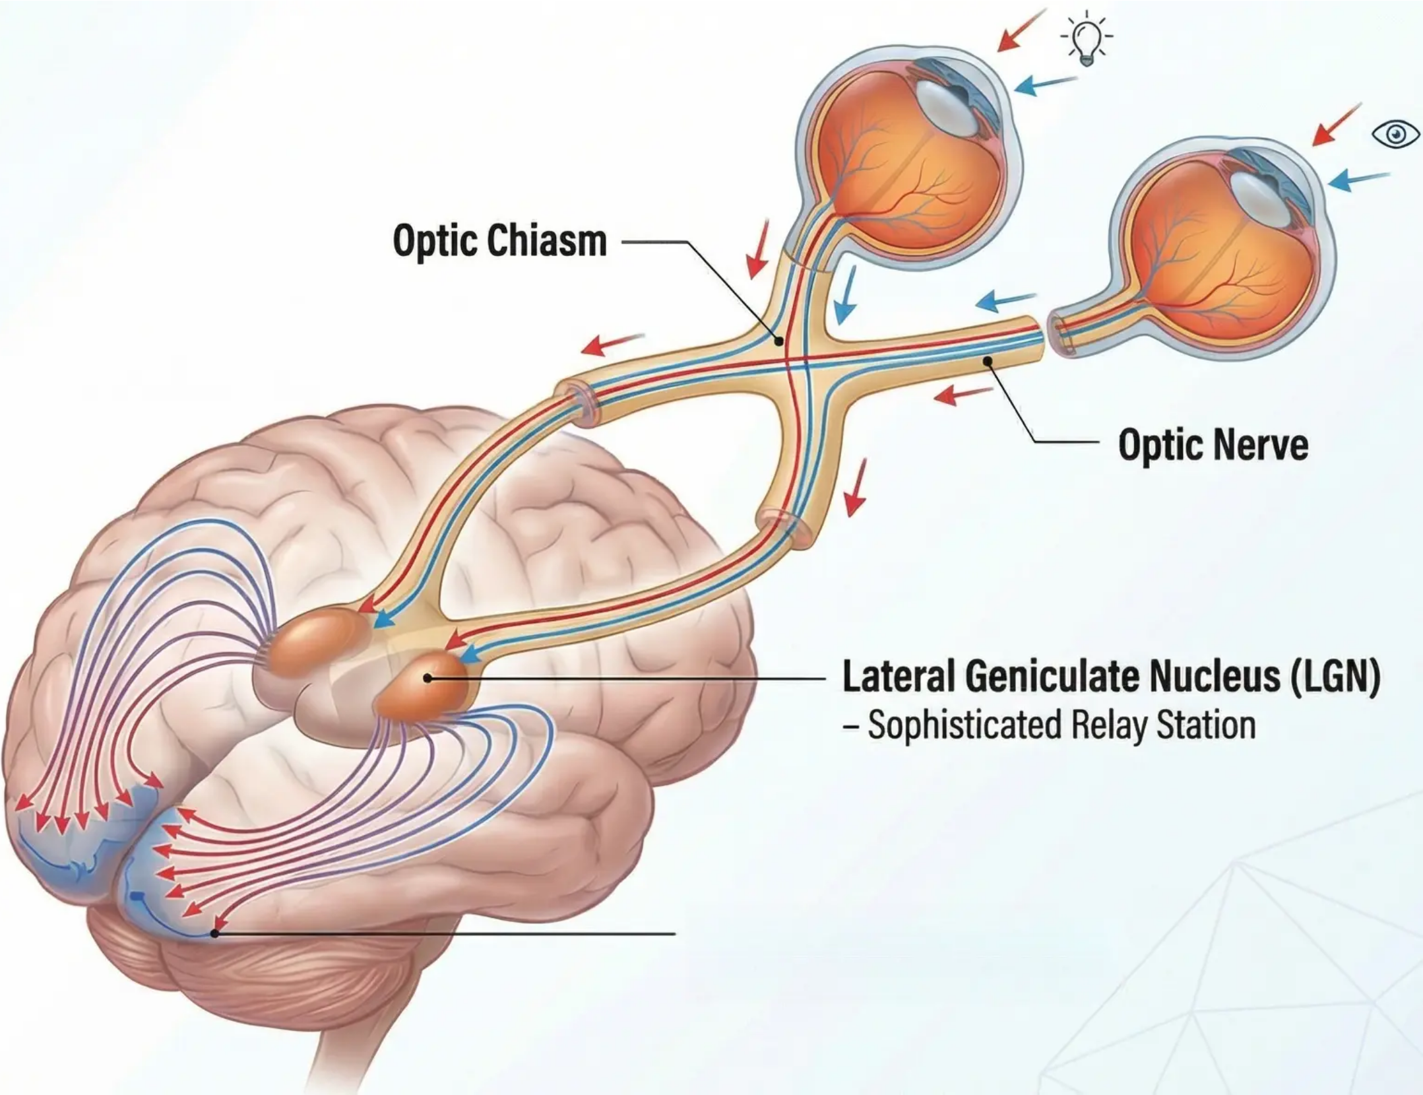
Visual Pathways of the Brain (Session 3)
Introduction: The retina converts light into electrical signals,
after which a complex journey begins through a network of
specialised neural pathways. This journey is not merely a simple
transmission, but a continuous processing and organisation of
information at multiple levels before reaching our conscious awareness.
The Neural Journey from the Eye to the Visual Cortex
First: Optic Nerve (Optic Nerve)
Composed of approximately one million nerve fibres in each eye,
it acts as the 'main cable' transmitting all visual information. Each
fibre carries information from a specific region of the retina,
thereby preserving spatial organisation.
Optic Chiasm
Second: Optic Chiasm (Optic Chiasm)
A critical crossing point where 'cross-processing' occurs: information
from the left half of the visual field of each eye travels to the right
hemisphere of the brain, and vice versa. This ensures that each hemisphere
receives complete information about the opposite side of the visual world.
Optic Nerve
Third: Lateral Geniculate Nucleus (Lateral Geniculate
Nucleus – LGN)
Located in the thalamus, it functions as a sophisticated relay station and
'intelligent filter' for visual information. Its function is not limited
to passive transmission; it organises and modifies information
based on factors such as attention level and emotional state.
Lateral Geniculate Nucleus (LGN)
– Sophisticated Relay Station
Fourth: Primary Visual Cortex (Primary Visual Cortex – V1)
The final destination in the occipital lobe, where complex cortical
processing begins. Here, the signal is decomposed into its basic
components: lines, edges, orientations, and movement.
Primary Visual Cortex (V1)
Significance of Anatomical Organisation: This complex
organisation allows for parallel and hierarchical processing of
visual information, making the visual system exceptionally fast
and precise.
– Complex Cortical Processing

Slide 13
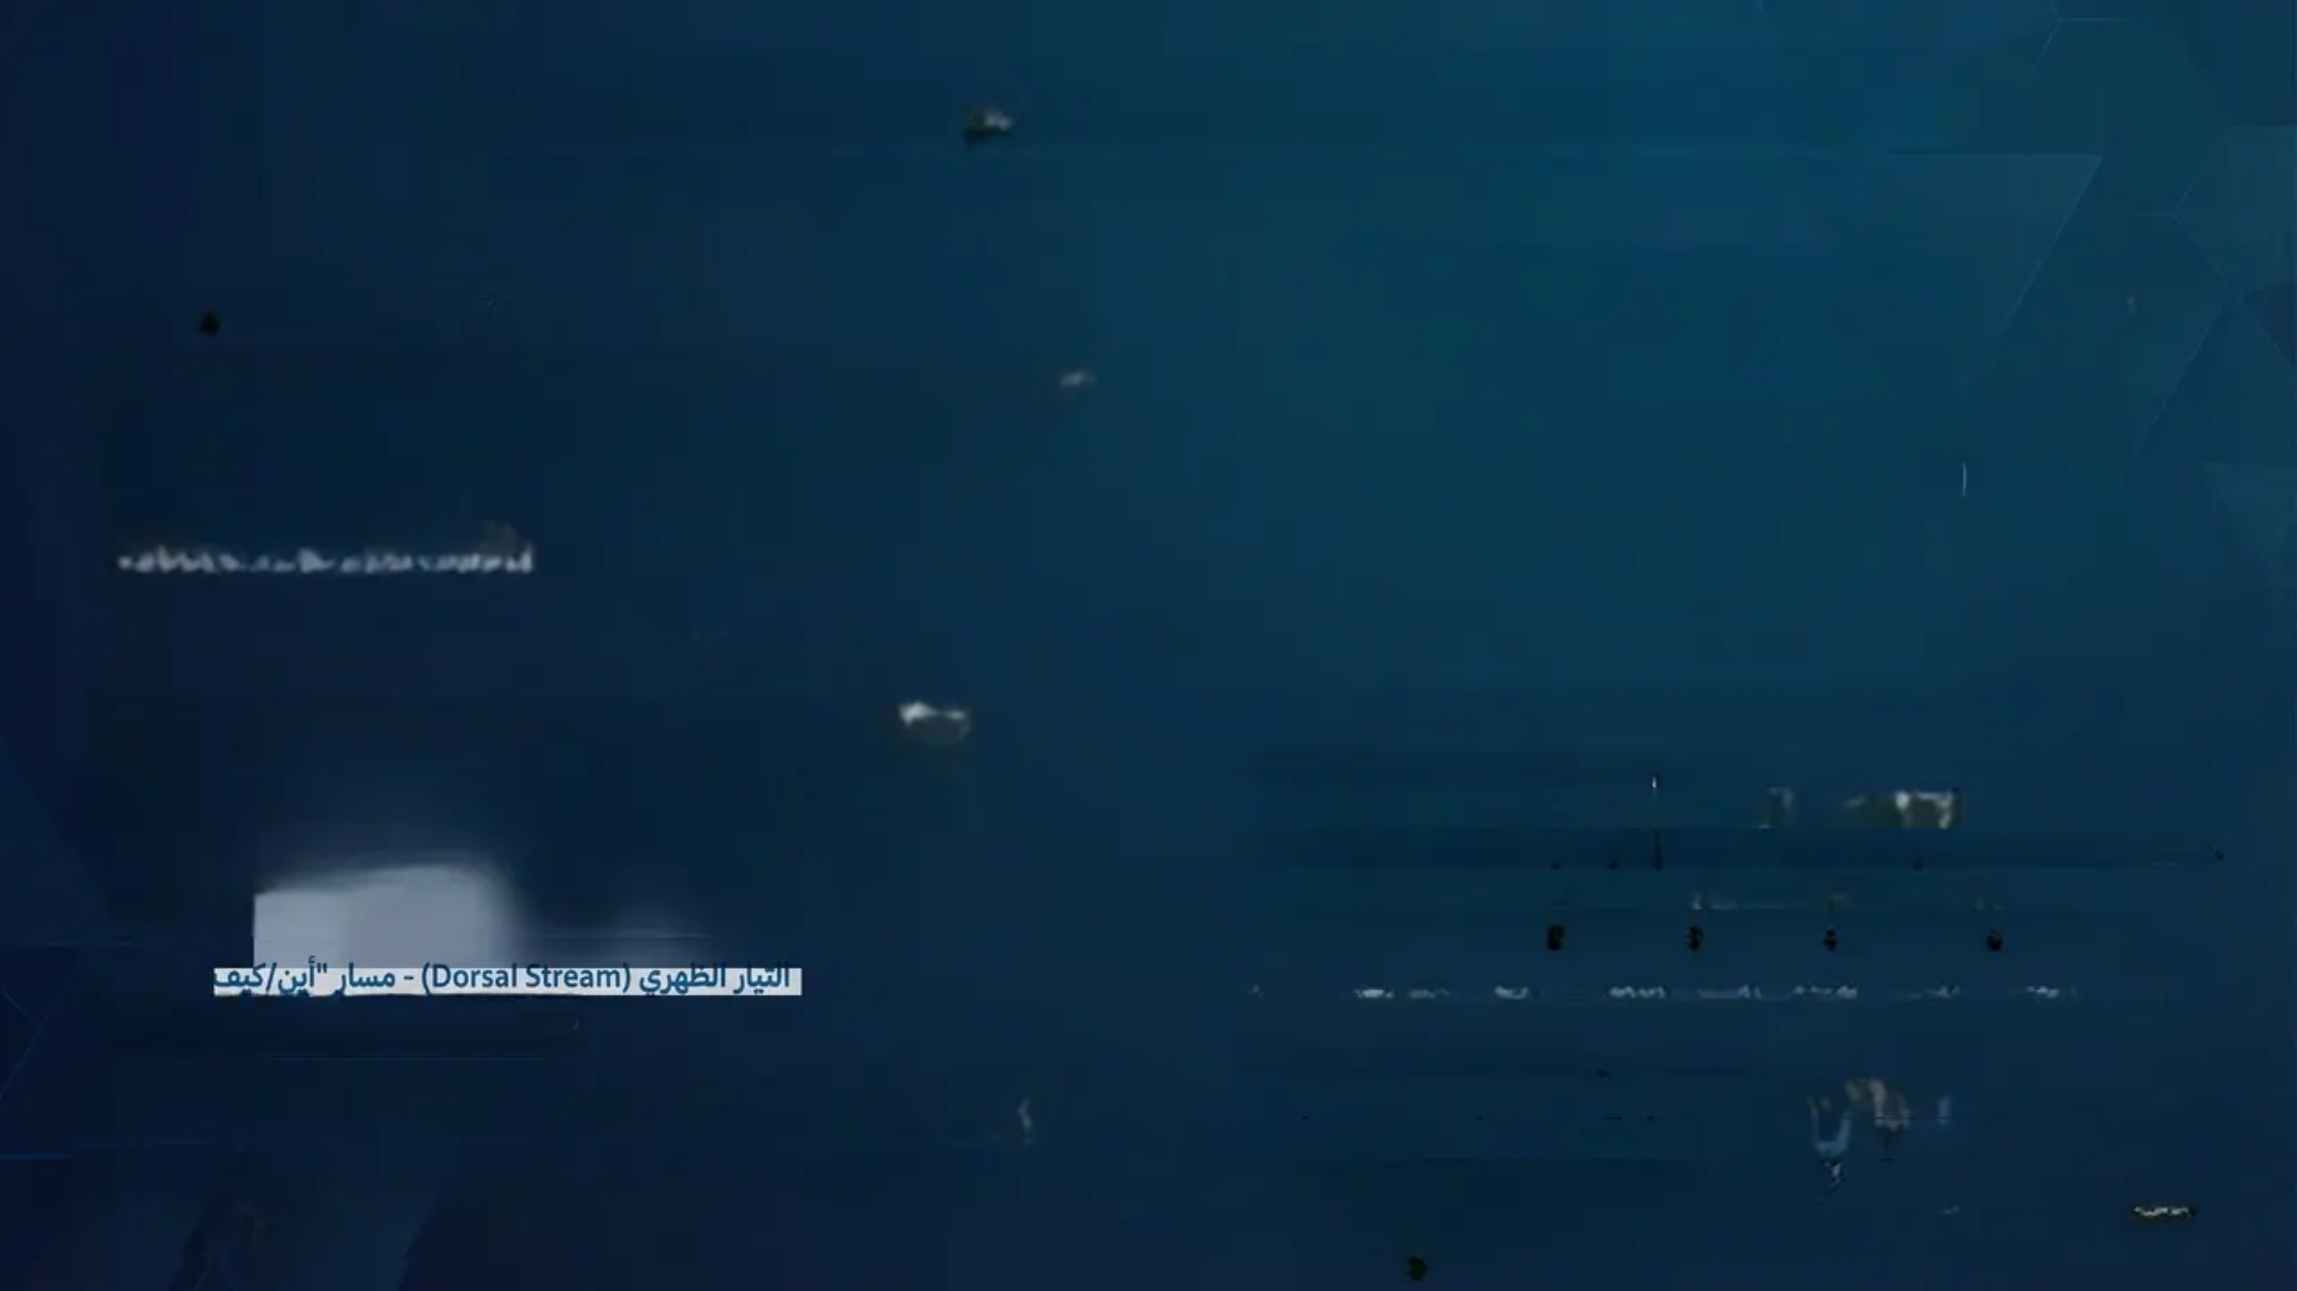
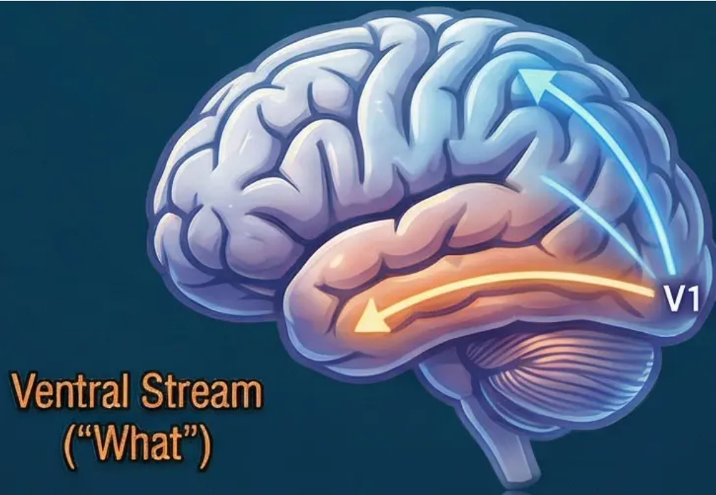
The Two-Stream Hypothesis: Ventral and Dorsal
Milner & Goodale (1992) Model for the Division of Visual Processing
Theory Introduction
Dorsal Stream
("Where/How")
When visual information reaches the Primary Visual Cortex (V1),
processing divides into two distinct and parallel streams. This
influential theory proposes a fundamental functional division in
the brain, where each stream specializes in processing different
aspects of visual information.
Primary Visual
Cortex (V1)
Ventral Stream
(“What”)
Scientific Foundations of the Theory
The theory is grounded in studies of neuroanatomy, brain
imaging, and patients with specific brain damage. Key
discoveries include the existence of separate anatomical
pathways, and patterns of damage affecting each path
separately.
Ventral Stream (Ventral Stream) – ‘What’ Pathway
• Extends from V1 to the temporal lobe.
• Processes stable object properties such as shape, colour, and texture.
• Supports conscious perception and long-term object memory.
• Specialised in object recognition and identification.
• Enables us to distinguish a ‘cup’ from a ‘pen’ or recognise a familiar face.
التيار الظاهري (Dorsal Stream) - مسار "أين/كيف"
Evolutionary Advantage
Dorsal Stream (Dorsal Stream) – ‘Where/How’ Pathway
• Extends from V1 to the parietal lobe.
This division allows for parallel and efficient processing,
enabling the brain to simultaneously recognize objects (what
they are), locate them (where they are), and plan interaction
with them (how to interact).
• Specialised in processing spatial location and movement.
• Guides motor actions and interaction with objects.
• Operates rapidly and often unconsciously.
• Determines where objects are and plans appropriate movements for
interacting with them.

Slide 14
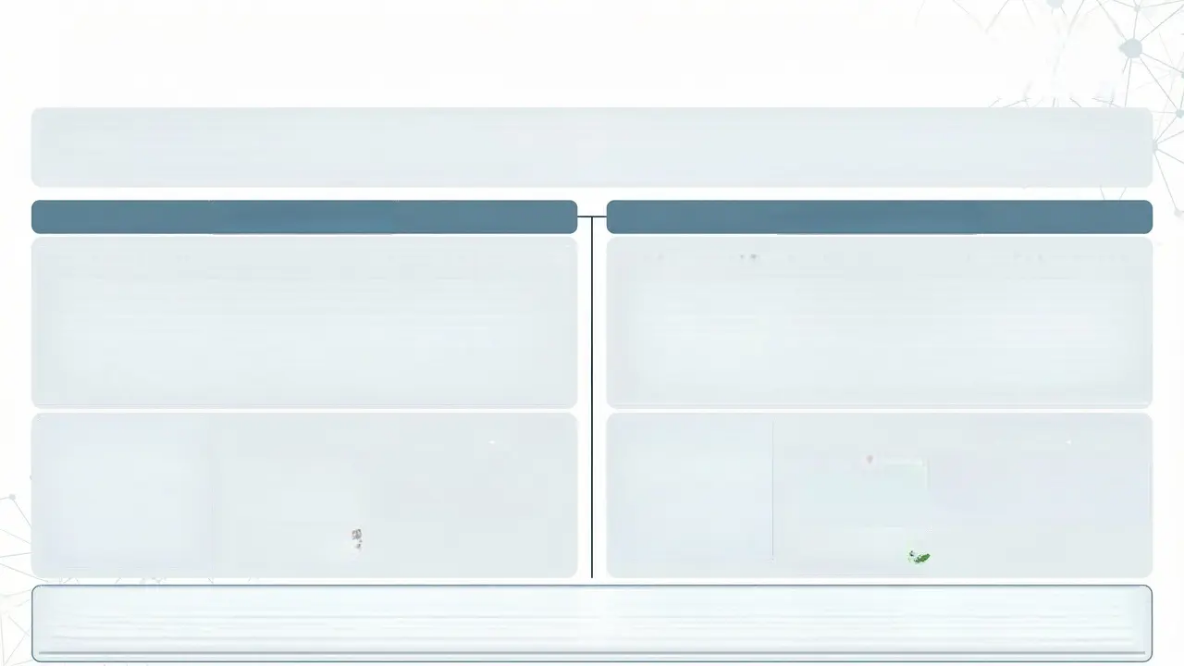
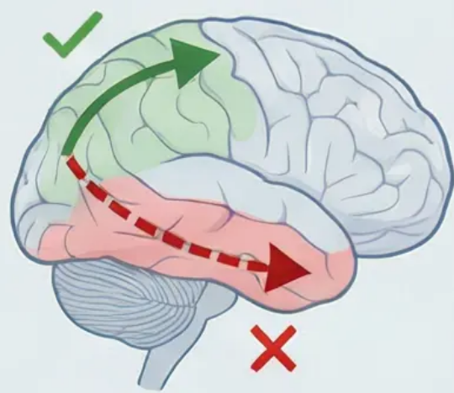
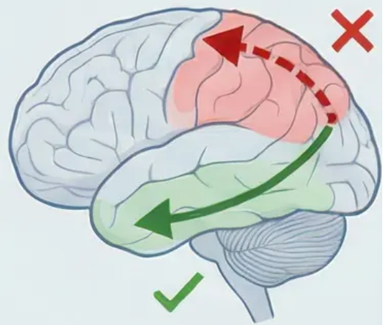
Analysis of Brain Damage Case Studies: Neural Evidence for the
Dissociation of the Ventral and Dorsal Streams
Analytical Introduction: Brain damage case studies provide compelling evidence for the validity of Milner and Goodale's two-stream hypothesis.
When one visual pathway is damaged while the other remains intact, we get “natural experiments” that reveal the functional specialization of
each stream with exceptional clarity.
Case 2: Optic Ataxia
Case 1: Visual Agnosia
Clinical Description: Another patient can see and identify the set of
keys without any difficulty. They confidently say “These are my keys” and
can describe their various uses. But when they try to reach out and grasp
the keys, an amazing problem occurs - their hand moves in the wrong
direction, overshoots the target, or reaches a completely different
location. It seems as if there is a disconnection between what their mind
sees and what their hand does.
Clinical Description: A patient can see a set of keys clearly and describe
their physical properties accurately - the metallic shape, silver color, number
of individual keys, and even small scratches on the surface. However, they
cannot identify the object's identity or name it “keys”. Interestingly, when
asked to pick up the keys, they can do so with remarkable accuracy - their
hand shapes appropriately, moves directly towards the target, and
grasps the keys with the exact right force.
Neural Interpretation:
Neural Interpretation:
Preserved Abilities: Physical vision,
movement guidance
Lost Abilities: Object recognition, naming
Preserved Abilities: Object recognition, naming
Lost Abilities: Precise movement
guidance, grasping
Ventral Stream ❌
Dorsal Stream ✅
Dorsal Stream ❌
Ventral Stream ✅
Theoretical Significance: This selective dissociation provides strong evidence that visual perception is not a unified system, but consists of specialized subsystems
that can be affected independently. This strongly supports the two-stream model and challenges the traditional view of How do these clinical findings challenge
the traditional view of visual perception? And what do they tell us about the nature of consciousness and unconscious perception in visuomotor behavior?

Slide 15

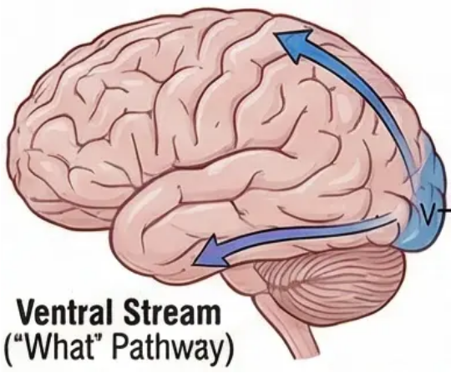
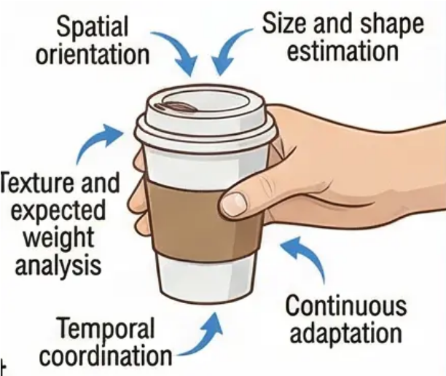
The Precision of the Term 'How' Pathway
Why is 'How' considered a more precise description than 'Where' for the dorsal stream?
Conceptual Analysis
Experimental Evidence
The dorsal stream is sometimes called the 'How' pathway rather
than the 'Where' pathway. This distinction reflects a deeper
understanding of its complex functions, such as motor operations
that require visual processing.
Studies of optic ataxia patients indicate that damage to the
dorsal stream does not only affect location determination, but
disrupts the coordination of complex movements. Patients can
see and locate objects but fail to execute movements accurately.
Complex Functions of the Dorsal Stream
Distinction from the Ventral Stream
The ventral stream handles
object recognition ("what"),
while the dorsal stream
handles object interaction
("how"), forming an
integrated system for
perception and action.
✔ Precise Spatial Orientation: Determining the
optimal angle of approach to the cup.
✔ Size and Shape Estimation: To adjust hand
aperture and grip strength.
✔ Texture and Expected Weight Analysis: To
calibrate the required force.
✔ Temporal Coordination: To time the
movement with speed.
✔ Continuous Adaptation: To adjust movement
based on visual feedback.
Discussion Prompt:
How can this deeper understanding of dorsal stream function
help in understanding visuo-motor disorders and developing
rehabilitation strategies for affected patients?

Slide 16

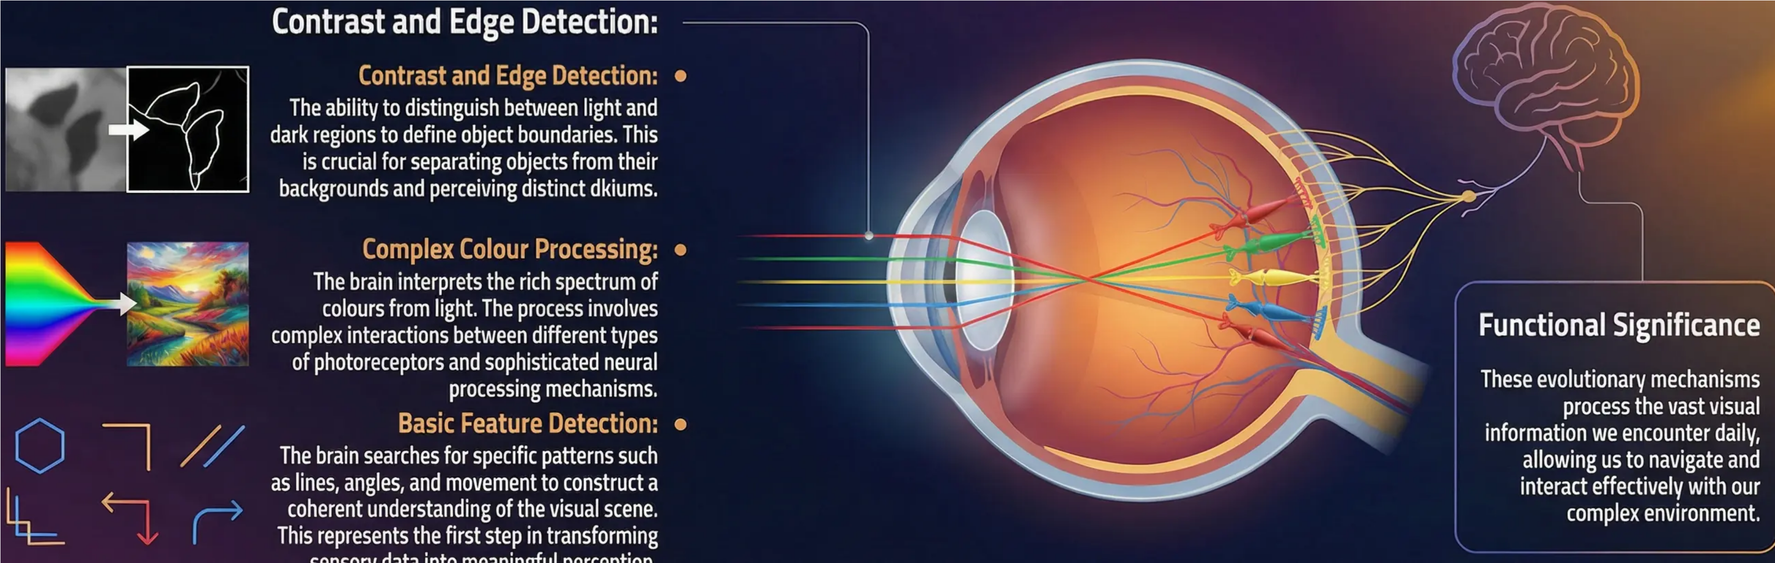


Session 4: Processing the Visual World: Colour, Contrast, and Basic Features
Introduction to Proneats: The visual system does not passively transmit images to the brain; active proileving insjirs the moment light strikes the retina.
Sensory Adaptation:
The sensory system adapts to continuous
changes in the environment, from bright
light to complete darkness, and from vivid to
muted colours.
Discussion Prompt:
Why is edge and contrast detection important for survival? How does it
help in distinguishing between living and non-living entities?

Slide 17

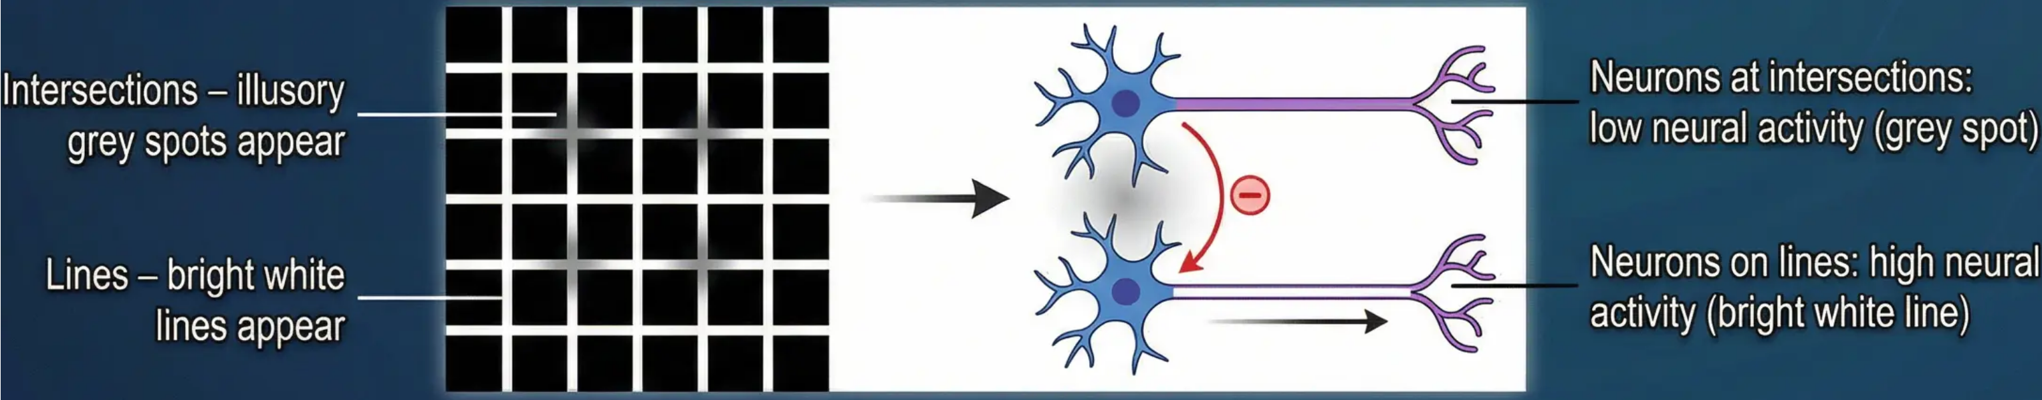
Lateral Inhibition and the Hermann Grid Illusion
Definition of Lateral Inhibition
Lateral inhibition is a neural mechanism that enhances contrast and enables the visual system to define edges with high precision.
This process occurs at the retinal level and continues through higher visual pathways.
Neural Mechanism and Vital Functions
Neural Explanation and Theoretical Significance
• Neural Mechanism: When retinal neurons receive strong excitation,
they inhibit their neighbouring cells, enhancing the difference in neural
activity between bright and dark regions, making edges more distinct.
• Neural Explanation of the Illusion: Neurons at intersections receive
greater inhibition from neighbouring bright cells compared to neurons
along the lines, making the intersections appear less bright.
• Theoretical Significance: This illusion demonstrates that what we see is
the result of active and complex processing beginning at the retinal level,
where the visual system is optimised for detecting changes and edges.
• Vital Functions: Edge definition | Prevention of visual noise | Contrast
enhancement | Improvement of spatial acuity
Discussion Prompt: How does understanding lateral inhibition help explain why we see the world with clear, defined edges rather
than blurry blocks of light? What does this tell us about the constructive, rather than passive, nature of visual perception?

Slide 18

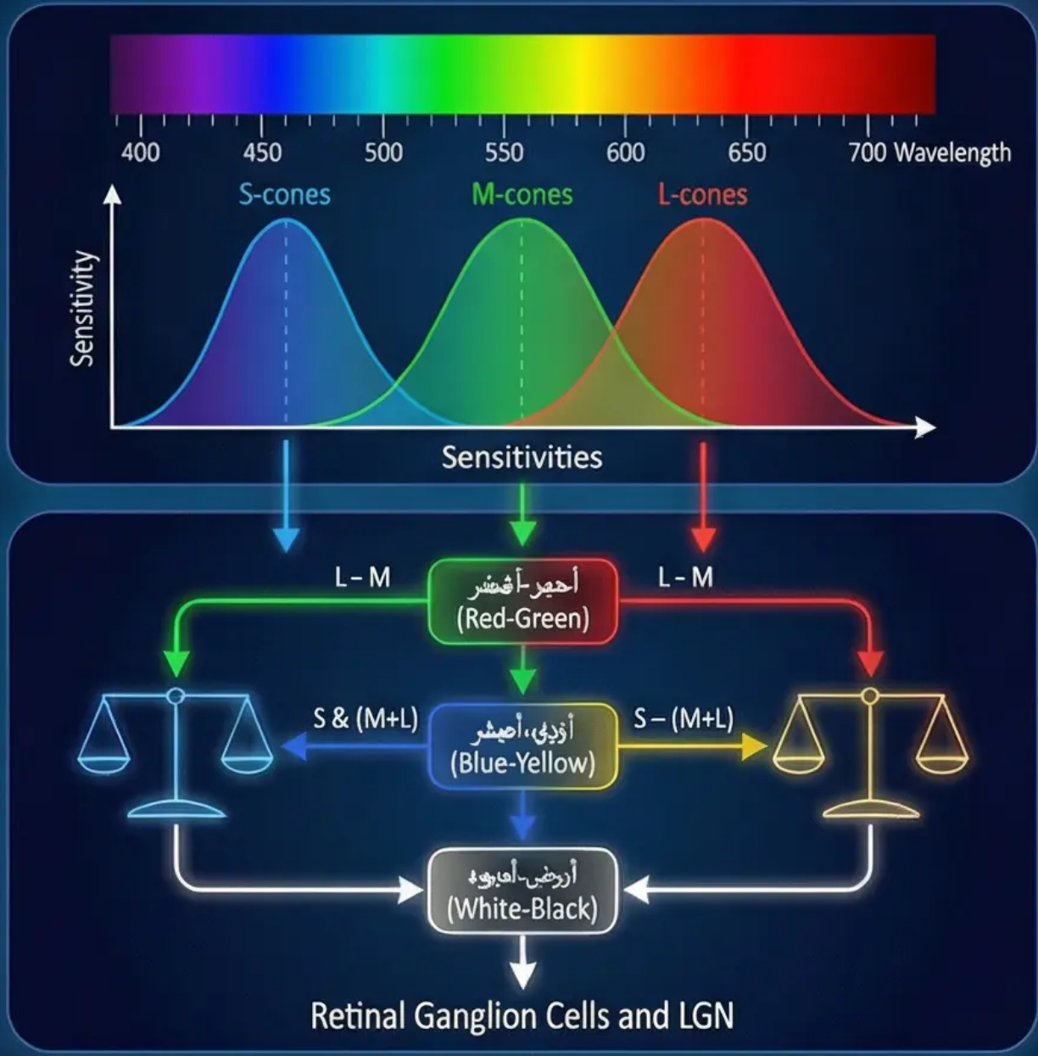
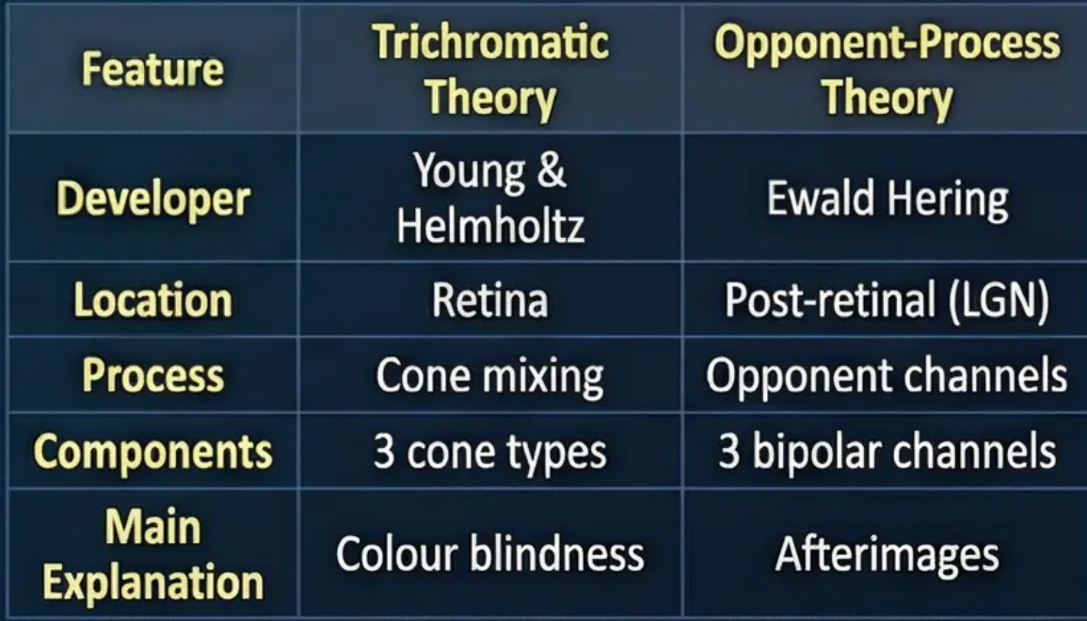
Integrated Theories of Colour Vision
18
Analytical Introduction: A detailed explanation of how the two theories work together in our visual system
Trichromatic Theory (Trichromatic Theory)
• Developers: Young and Helmholtz
• Level of Operation: Retina (cone stage)
• Core Mechanism: Three types of cones
sensitive to different wavelengths: Short-wave
cones (S-cones) for blue, Medium-wave cones
(M-cones) for green, and Long-wave cones
(L-cones) for red.
• Operating Principle: All perceived colours are
the result of the relative mixing of activity from
these three types.
• Explanatory Power: Explains hereditary colour
blindness resulting from a deficiency in one or
more cone types.
Opponent-Process Theory (Opponent-Process)
• Developer: Ewald Hering
• Level of Operation: Post-retinal (ganglion cells
and Lateral Geniculate Nucleus – LGN)
• Core Mechanism: Colour vision results from
opposing responses in three bipolar channels:
Red-Green channel, Blue-Yellow channel, and
White-Black channel.
• Explanatory Power: Explains negative
afterimages and why "reddish-green" or
"bluish-yellow" cannot be perceived.
Integration of the Two Theories
The two theories are fully complementary: the first
describes the initial stage of light reception, and
the second describes subsequent neural processing,
where the output of the three cones becomes the
input for the opponent-process channels.
Discussion Prompt: How would damage at the cone stage versus damage at the opponent-process stage differentially affect colour vision disorders?

Slide 19

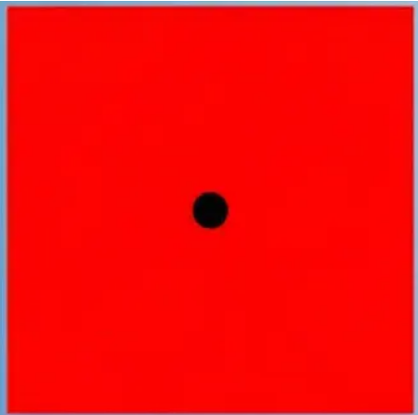

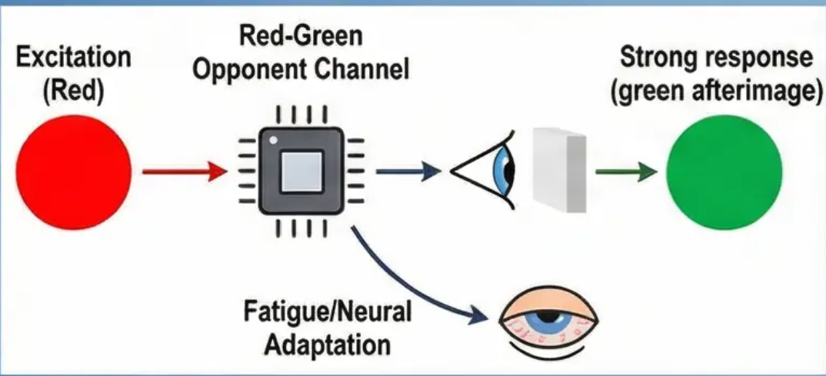
The Afterimage Effect: Living Evidence for the
Opponent-Process Theory
Practical Exercise – Mini Activity:
Discover the Negative Afterimage
(15 minutes)
Detailed Scientific Explanation:
Negative afterimages occur due to the adaptation of
neurons in the opponent-process colour channels.
When staring at red, the cells sensitive to red become
fatigued. When looking away to a white surface, the
cells sensitive to green in the same channel fire more
strongly, creating the perception of a green
afterimage.
Instructions for Students
Focus on a black dot in the centre of a bright red
square for 30 seconds without moving your eyes,
then look at a white wall or white sheet of paper.
Theoretical Significance:
This simple experiment provides strong evidence for
the validity of Hering's opponent-process theory,
demonstrating that colour vision depends not only on
the three cone types, but on the dynamic balance
between opposing colour channels in the nervous system.
What will you see?
Practical Applications:
You will likely see a faint cyan-green square. This
is called a ‘negative afterimage’.
Understanding afterimages is important in multiple
fields: theatre lighting design, computer screen design
to reduce eye strain, and visual art to create stunning
visual effects.
Discussion Prompt: Why do we not experience afterimages continuously in daily life, despite our eyes being regularly exposed to
bright colours? What distinguishes the conditions of this experiment from ordinary conditions?

Slide 20

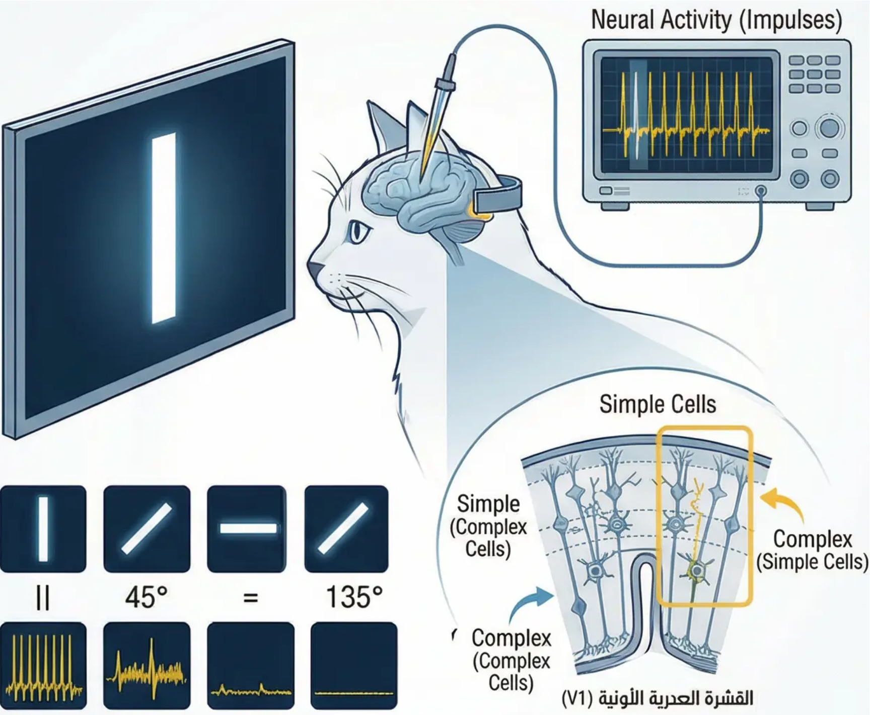

Hubel and Wiesel's Study: Feature Detectors
The Nobel Prize-Winning Research: Discovery of Feature Detectors in the Visual Cortex
Background of the Revolutionary Discovery
David Hubel and Torsten Wiesel's work in 1962 transformed our
understanding of how the brain processes visual information. They were
awarded the Nobel Prize in 1981 for their discovery of the functional
organisation of the Primary Visual Cortex (V1).
Innovative Experimental Design
Using single-cell recording techniques in the visual cortex of cats and
monkeys, microelectrodes were inserted and the electrical activity of
cells was recorded in response to various visual stimuli.
Revolutionary Discoveries
Simple Cells (Simple Cells): Respond strongly to straight lines with
specific orientations and directions, sensitive to the position of the line
in the visual field.
Complex Cells (Complex Cells): Respond to the same orientations but
less sensitive to precise position, and can detect movement in a specific
direction across a larger visual field.
Profound Theoretical Implications
This discovery established the concept of hierarchical processing in the
visual system, from detecting simple features (lines and edges) to
constructing complex object representations, supporting the bottom-up
processing model.
How can Hubel and Wiesel's discoveries explain our ability to
recognise letters and numbers? What are the implications for
understanding visual disorders?

Slide 21


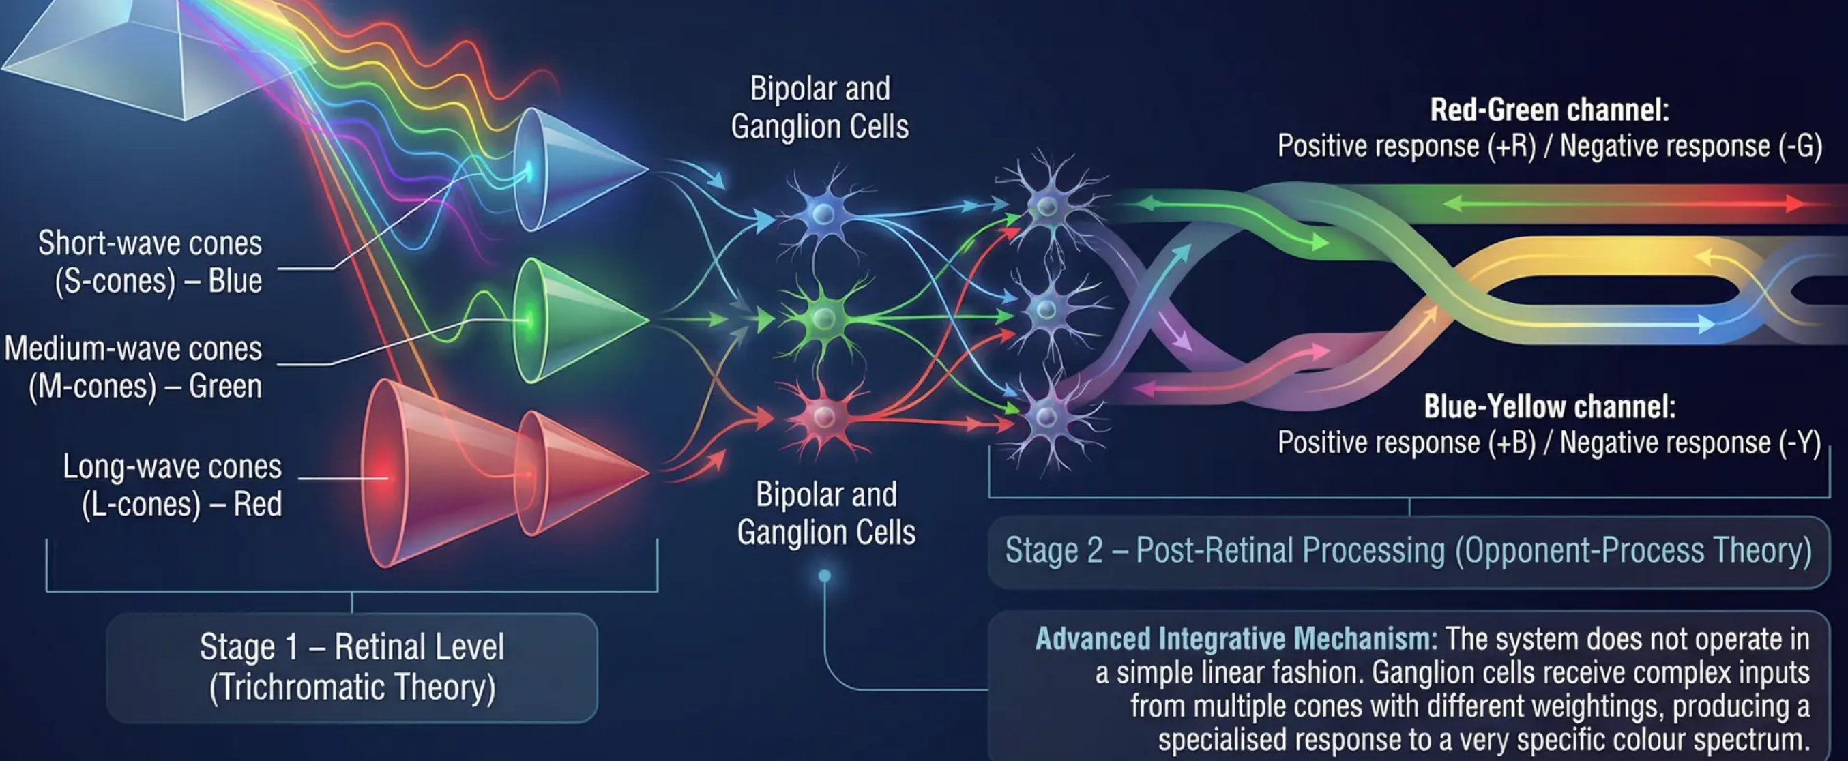
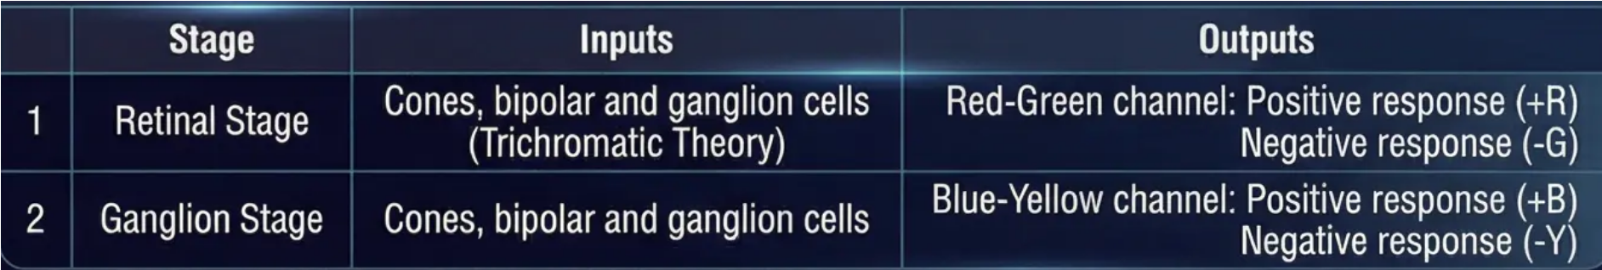

Integration of Colour Theories (Distinction Level)
Advanced Analysis of Colour Encoding Mechanisms in the Visual System
Functional Integration Between the Two Theories: A Process Flowchart
The Core Critical Question
Does the Trichromatic
Theory contradict the
Opponent-Process Theory,
or do they describe different
stages of colour processing?
A deep understanding requires
analysing how the theories
operate as an integrated
system, not as competing
models.
Inputs and Outputs for Each Stage
Practical Application
This integration explains complex phenomena such as colour adaptation and colour
constancy. When we adapt to yellow lighting, the Blue-Yellow channel fatigues
gradually, recalibrating our colour perception to maintain perceptual constancy.

Slide 22




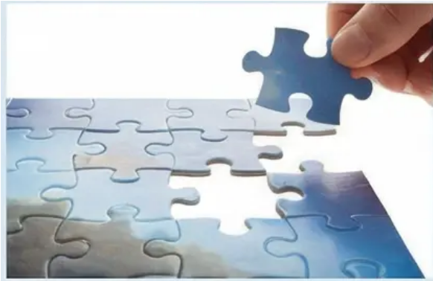
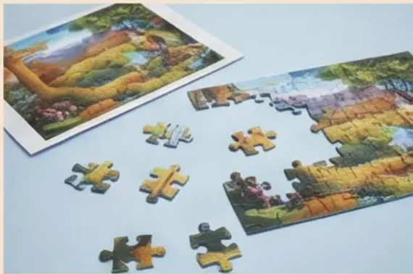
Gregory's Top-Down Theory (Session 5)
Comparing Bottom-Up and Top-Down Processing as Frameworks for Understanding Visual Perception
Bottom-Up Processing
Top-Down Processing
• Direction: Driven by raw sensory data.
• Starting Point: Sensory receptors in
the eye.
• Process: Analysis begins with sensory
input and progresses gradually towards
integrating information in the brain.
• Direction: Driven by prior knowledge
and expectations.
• Starting Point: High-level mental
processes in the brain.
• Process: Information is processed by
our prior experiences, knowledge,
and expectations.
• Core Assumption: The visual stimulus
contains all the information necessary
for perception.
• Core Assumption: The brain makes
"intelligent guesses" about the
meaning of ambiguous sensory data.
Integration of the Two Types
Both types of processing operate simultaneously and
in an integrated manner. Bottom-up processing
provides the basic data, while top-down processing
helps interpret this data based on context and prior
experience.
• Practical Analogy: Like assembling a
complex puzzle using only the shapes
of the pieces, without the box image as
a guide.
• Practical Analogy: Like assembling a
puzzle using the box image as a
guide.
Discussion Prompt
Think of an everyday situation such as reading a word
written in poor handwriting. How do bottom-up
processing (letter shapes) and top-down processing
(context and expected meaning) interact to help you
understand the word?

Slide 23

Perception as a Process of Constructing and Testing Hypotheses
Slide 23
Richard Gregory's Vision: The Brain as a
Hypothesis Scientist
Gregory's theory (1970) defines visual perception as an active
process in which the brain formulates and tests hypotheses to
understand the surrounding world.
Core Principles of Gregory's Theory
Practical Illustrative Example
T/–\E C/–\T → THE CAT
• Active Constructive Process: The brain does not receive
ready-made images; it actively constructs them, using its
stored knowledge to fill in the gaps resulting from
incomplete, ambiguous, or distorted sensory data.
The brain can use linguistic knowledge and context to interpret an
ambiguous shape (T/–\E C/–\T) as 'THE CAT', even if the letters are
visually identical. This is evidence that the brain uses prior knowledge.
• Continuous Hypothesis Testing: The brain treats visual
scenes as problems requiring solutions, formulating
possible hypotheses and testing them based on available
data and context to arrive at the best guess.
Applications and Implications
This perspective explains phenomena such as visual illusions, where
incorrect hypotheses lead to erroneous interpretations.
• The Role of Prior Knowledge and Context: Previous
experiences, expectations, and cultural context play a
pivotal role in shaping hypotheses. The brain uses everything
it has previously learned to interpret new information.
How can Gregory's theory explain individual differences in
interpreting the same visual scene?
What are the implications for fields such as eyewitness testimony or
medical diagnosis?

Slide 24
Slide 24: Analysis of the Necker Cube Illusion
The Necker Cube: Evidence for the Fluctuation
of Perceptual Hypotheses
The brain formulates two competing
hypotheses about the three-dimensional
structure of the cube.
The brain performs active interpretive
work, constructing reality rather than
merely recording it.
Nature of the Illusion
Mechanism of Perceptual Reversal
Support for Gregory's Theory
Theoretical Significance
The Necker Cube is an excellent example
of how the brain deals with visual
ambiguity.
When looking at the Necker Cube, the
sensory data remains constant, but our
perception changes periodically.
This provides strong support for Gregory's
idea that perception is a hypothesis-
testing process.
This illusion challenges the intuitive idea
that vision is a passive process of
recording reality.
Discussion Prompt: If the Necker Cube demonstrates that the same sensory input can
lead to different perceptions, what does this mean about the nature of the “reality” we
perceive? How might this affect our understanding of eyewitness testimony in courts?

Slide 25
Slide 25: The Müller-Lyer Illusion and Misapplied Constancy
Gregory's Revolutionary Interpretation of the Most Famous Visual Illusion
Gregory's Revolutionary Interpretation
The Müller-Lyer illusion provides the strongest evidence supporting Gregory's theory of top-down
processing. The vertical lines are identical in actual length, but the line with outward fins appears
longer than the line with inward fins.
The Mechanism of “Misapplied Size Constancy”
Gregory explains this illusion by arguing that the lines should not be seen as two-dimensional
dimensions, but interpreted as part of a familiar three-dimensional scene. The outward fins
mimic the far corner of a room (such as the intersection of two walls with the ceiling), while the
inward fins resemble the near corner of a building (such as the outer edge of a building).
Architectural interpretation
(inner corner)
The Complex Perceptual Process (or Misperception)
The brain assumes that one “corner” is further away than the other. Although both project the same
image size onto the retina, the size constancy mechanism intervenes automatically. As a result, the
brain infers that the “distant” corner must be physically larger in the real world to maintain the same
size on the retina, and so it perceptually enlarges it.
The Systematic Perceptual Error
This misapplication of the three-dimensional interpretation rule to a two-dimensional shape reveals
the constructive nature of perception. The brain does not passively record reality; it applies rules and
assumptions acquired from architectural experience to construct a “logical” interpretation of visual
inputs.
Architectural interpretation
(outer corner)
Discussion Prompt: How does this illusion reveal the conflict between ‘what we know’ (the lines are equal) and ‘what we see’ (they
appear different)? What does this tell us about the role of architectural experience in shaping our perception?

Slide 26
Critique of Gregory's Theory (Distinction Level)
When Do Errors Appear?
Balanced Evaluation:
Acquired Automaticity
The Core Challenge and
Counter-Argument
• Perceptual illusions and errors become
noticeable when sensory data is too ambiguous,
challenging established patterns, automatic
mechanisms fail, and the hypothetical
constructive nature of perception is revealed.
• The theory is powerful in explaining illusions,
but requires an understanding of the process
of transition to automaticity.
• Defence: Hypothesis testing becomes automatic
and rapid with experience (like riding a bicycle).
• Hypotheses are established perceptual patterns,
not new guesses each time.
• Errors appear only in ambiguous or unusual
situations.
• Primary Critique: The theory explains visual illusions
but struggles to account for the rapid and accurate
perception in everyday situations. If perception is
hypothesis testing, why is it not a slow series of guesses?
• Counter-Argument: The speed of perceptual
processing (fractions of a second) and effective
automaticity challenge the idea of consciously
formulating and testing a hypothesis for every
perception.
Discussion: Could the speed of perception be evidence for the strength of Gregory's theory rather than its weakness?
How could evolution improve hypothesis-testing mechanisms to become so rapid that they appear 'direct'?

Slide 27
Gibson's Ecological Theory (Session 6)
Direct Perception: The Environment as a Rich Source of Information
Theory Introduction
Gibson's theory challenges the assumption that sensory
information is impoverished or ambiguous. It proposes that
the environment is rich with information that can be directly
picked up without the need for complex cognitive processing.
Complex Constructivist
Theories (Black Box)
Direct Perception
(direct capture of
information from
the environment)
Core Principles of Gibson's Theory
Direct Perception:
A system for picking up information for the environment,
not a process of intelligent guessing. The visual system
is tuned to detect invariant information in the optic array.
Rejection of the Computational Model:
The brain is attuned to the environment, and perception
is a dynamic interaction. There is no need for internal
representations or hypothesis testing.
Focus on Movement and Interaction:
Movement plays a crucial role in perception. As we move
through the environment, the optic array changes,
providing rich information about the layout of the world.
Critique of Traditional Theories:
Gibson criticises “theories of sensory poverty” and
proposes that the environment is rich with information.
The visual system has evolved to directly extract this
information.
Evolutionary Basis:
Perceptual systems evolved to be attuned to the natural
environment. Perception is not a luxury but a biological
necessity for survival and action.

Slide 28
Slide 28: The Optic Array and Visual Invariants
Direct Sources of Information in the Environment
The Optic Array (Optic Array):
The Organised Pattern of Light
Key Invariants in the Optic Array
Texture Gradient (Texture Gradient)
The optic array is not merely a
random collection of light rays, but a
rich and organised informational
structure. This predicts movement, and there are 'invariants'
that remain constant as the observer moves.
For example, the optic array's
structure changes as one moves,
but the 'invariants' remain.
These invariants, or 'affordances',
are the 'givens' of the environment.
Using the example of a paved road: nearby stones appear large and
clear, while they become smaller, denser, and less distinct as they
recede. This gradient is a stable and direct feature in the optic array
that automatically specifies distance and depth, without the need for
'inference'.
Think of the optic array's
structure as a 'flow' of light.
As the observer moves, the
invariants in the optic array
remain the same, providing
constant information.
Paved road extending to the horizon – stones
shrink and become denser with distance
Optic Flow (Optic Flow)
When moving forward, the optic array appears
to flow around us in a regular pattern. The
focus of expansion (the point we are heading
towards) remains relatively stable, while other
elements move away from this central point.
The speed and direction of this directly informs
us of our speed and direction of movement,
concept crucial for safe navigation.
Person driving on a straight road – blue
arrows indicating direction of optic flow
from the focus of expansion
Person walking – coloured lines
representing surrounding optic flow
Theoretical Significance
This supports Gibson's idea that the environment is "rich with information"
and that perception is a direct process of picking up information, in contrast to
constructivist theories that emphasise the role of experience and inference.
Discussion Prompt
The 'invariants' of the optic array
are the 'givens' of the environment.
How can the concepts of optic flow and texture gradient explain our ability to
drive safely or play sport without the need for complex conscious calculations?

Slide 29
The Concept of Affordances
Vivid Examples of Affordances:
Perceiving What Objects Are For
Chair: Affords sitting for an average adult, but may afford climbing for
a small child.
Definition of Affordances:
Staircase: Affords ascending for a person who can walk, but affords a
barrier for a wheelchair user.
Perhaps Gibson's most revolutionary concept is
Affordances. An affordance is what the environment
“offers” or “provides” to the organism. We do not
merely perceive the physical properties of an object,
such as its shape, color, or size, but we directly
perceive its potential uses and possible interactions
relative to our own capabilities.
Flat, solid surface: Affords walking and standing.
Small handle: Affords grasping and turning.
Transparent glass: Affords seeing through while preventing passage.
Raised edge: Affords jumping for an athlete, but poses a danger to a
child.
Core Idea:
The Relational Nature of Affordances:
Affordances are not absolute properties of
objects, but are relationships between
environmental properties and the organism's
capabilities. The same object can afford different
things to different organisms, or even to the same
organism in different states.
For Gibson, the meaning of an object is not something
we add through memory or prior experience, but is
part of what we directly perceive from the optic array.
This is a powerful idea that directly links perception to
action and interaction.
Practical Applications:
Analytical Conclusion:
The concept of affordances represents a radical shift in understanding the
relationship between perception and action. It suggests that we do not
see the world as a collection of abstract physical properties, but as a
network of opportunities and possibilities for interaction and action.

Slide 30
Confronting Theories: Constructivtion Interneation vs. Drilest Polcyption
Academic Debate Pripération: A smileesory athility for your assessment for debates in the difpletion.
Gregory Saoom - Constructivit School
Gigven School - Dirinost School
Prior Experience
Dirercs Information
Position: The illugin results from an incorrect
darrbction of 3D seee constancy. The brasn
interprets fins as architectural crijfers based on
lior exopce en buildings and structures. This
is a perfect dixample of how prio knowledge is
positard fromrit construct deception, even if it
seads to ebor in a 2D context.
Challenge: Reject any interpretation based prior
experience of illiteration. You must find an
interpretation that focuses the strinatal itself.
Perhaps the total length of the finness, including
the conflicts a conflicting cue is, that affects the
ecyption of the gezeral bid without aiding brind
prior experience.
The challenge: How do we interpret the Müller-Lyer
illusion? Is it evidence for active construction of
active constrror or an yulurat planing of direct
procesouting of visual mlaplation?
Debting Obsebys Debate Stratityve
Emporical evidience from troal cusione and connect to the broader theorial framework. •
Anticipate potential objections and prepare your responses, and cotsider the world-un. •
Objective: Develop critical trinking skills and evaluate the strength of competing
theoretical frameworks in psychillogy.
Which team presenss stronger arguments? Debar the ser
Can both interpretations be corrected in different conteret contexts? •
How can an experiment be designed to definitively resolve the debate? •

Slide 31
Slide 31: The Organism-Environment Interaction (Ecological Perspective)
The Relational Nature of Perception in Gibson's Theory
Perception as a Relational Interaction
Perception is not merely internal information processing, but a relational
activity involving continuous interaction between the organism and
its environment. This perspective transcends the traditional view
to encompass the environmental context.
Core Properties of the Ecological Perspective
Perception as a dynamic system involving multiple levels of
interaction: direct pick-up of visual information, continuous
adaptation to environmental changes through movement, and the
development of new perceptual capabilities.
Practical Application – The Staircase Example
Perceiving the affordance of 'ascending' depends on both the physical
properties of the staircase and the person's physical capabilities. A
tall person may see the same staircase as 'easy to climb', while a
small child may see it as 'difficult' or 'impossible', reflecting the
relational nature of affordances.
Theoretical Implications:
The ecological perspective redefines perception from
information processing to an ecological activity, where the organism
discovers affordances rather than 'calculating' them. This explains
the speed and automaticity of perception in most natural situations.
Discussion Prompt:
How does Gibson's ecological perspective change our understanding of the
nature of visual disability? Does disability become a property of the individual or
of the relationship between the individual and their environment?

Slide 32
Gestalt and Marr's Model (Session 7)
Two Complementary Approaches to Understanding Perceptual Organisation and Visual Processing
Gestalt Psychology: A Revolution in Understanding Perception
Marr's Computational Model: A 21st-Century Perspective
German psychologists in the early twentieth century challenged the
prevailing idea that perception is built from individual sensations, founding
their approach on the principle that “the whole is different from the
sum of its parts”. Gestalt psychologists argued that brains are innately
programmed to perceive whole shapes and patterns rather than just
the sum of individual components, and that sensory information is
automatically organised rapidly and without conscious awareness.
David Marr in the 1980s presented a different way of thinking about
perception, influenced by computer science and artificial intelligence.
Marr argued that understanding complex vision requires analysing it at
three distinct and independent levels, each with its own question about
how the system works.
The whole ≠ the sum of its parts
Computational Level
Algorithmic and
Representational Level
Implementation Level
(Hardware)
Integration Between the Two Approaches: Gestalt and Marr, despite representing different eras, are complementary in understanding
perception. Gestalt describes ‘what’ we do (automatic organisation), while Marr provides a framework for understanding ‘how’ and ‘why’ we do it.
Discussion Prompt: How can Gestalt principles be explained using Marr's framework? Does the automatic organisation of shapes occur at
the computational or algorithmic level?

Slide 33
Laws of Perceptual Organisation in Gestalt
Innate Mechanisms for Organising Sensory Data into Meaningful Wholes
Figure-Ground
Principle
(Figure-Ground)
Law of Proximity
(Proximity)
Law of Similarity
(Similarity)
Law of Continuity
(Continuity)
Law of Closure
(Closure)
Elements that are
close together tend to
be perceived as
belonging to the
same group.
Similar elements tend
to be grouped
together perceptually.
The mind prefers to
perceive smooth,
continuous lines rather
than abrupt changes in
direction.
The mind tends to
complete incomplete
shapes, perceiving
them as whole figures.
The visual field is
automatically divided
into a salient figure
and a background.
Theoretical Significance: These laws support the idea that perception is an active organisational process. They
affirm the fundamental principle of Gestalt psychology: 'The whole is greater than the sum of its parts'.

Slide 34
Marr’s Three Levels of Analysis
A Framework for Understanding Complex Perceptual Systems
David Marr (1982) proposed this framework as a means of understanding how biological systems transform sensory
information into meaningful perception, by analysing it at three interrelated and distinct levels.
Marr's Model of Vision Stages
Computational Level
Significance of the Framework
• Defines the overall goal of the system and the
logic governing the achievement of that goal.
• In the visual system, the goal is to extract a
three-dimensional representation of the
world from continuously changing
two-dimensional images.
• Answers the two fundamental questions:
'What?' and 'Why?'
Primal Sketch: The first stage, focusing
on detecting changes in light intensity
such as edges, lines, and blobs.
Produces a schematic drawing
highlighting the basic features of the
image without interpreting their
meaning.
Marr's framework provides a systematic
way of understanding complex systems
without confusing different levels of
analysis, helping researchers avoid the
error of explaining phenomena at one
level using concepts from another.
Algorithmic Level
2.5D Sketch: Adds depth and
orientation information for visible
surfaces, but remains tied to the
observer's viewpoint. Includes
information about the relative
distance and inclination of surfaces.
• Focuses on the question 'How?'.
• Describes the specific representations of
information and the algorithms used to process
this information.
• Defines the rules and detailed steps the system
follows to achieve its computational goal.
Discussion Prompt
3D Model: The final representation,
independent of viewpoint, describing
objects in three-dimensional space in
a way that allows recognition from
any angle.
How does this framework help avoid
confusing 'how something works' with
'why it exists'? Provide an example from
outside the domain of vision.
Implementation Level
Addresses the question of 'actual hardware'.
Describes how algorithms are embodied in physical
hardware, such as neurons, neural networks, and
brain structures in biological systems.

Slide 35
Applying Marr’s Three-Level Framework: From Concept to Practical Application
Practical Exercise: Analysing a Cash Register (20 minutes)
Linking to Visual Perception:
This analogy shows how the same framework applies to vision: The Computational Level defines the goal (building a 3D representation from a 2D image),
the Algorithmic Level describes the processes (edge detection, contrast, depth), and the Implementation Level involves the retina, optic nerve, and visual
cortex.
How does this multi-level analysis help us understand the importance of studying visual perception from different angles? And why is focusing on a single
level alone insufficient?

Slide 36
Slide 36 Connecting Gestalt Laws with Marr's Framework
Theoretical Integration: From Description to Explanation
Gestalt laws tell us ‘what’ happens in perception, while Marr’s framework tells us ‘how’ and ‘why’ it happens. This integration aims to transform
descriptive principles into a comprehensive explanatory model.
Analysis of the Law of Proximity across Marr's Levels
Computational Goal: Object Grouping
Theoretical Challenge
How do we reconcile the holistic nature of Gestalt (“the whole is greater than the sum of its parts”) with Marr’s hierarchical approach? The solution lies
in understanding that emergent properties at a higher level result from complex interactions at the lower level.
Discussion Prompt: If Gestalt laws operate automatically and instantaneously, how can this be interpreted in light of Marr's hierarchical
processing? Is there a real contradiction or just different levels of analysis?

Slide 37
Depth Perception and Constancy (Session 8)
Depth Perception and Perceptual Constancy: Constructing a Three-Dimensional World from Flat Images
Core Content:
The Fundamental Perceptual Challenge: How does the
brain perceive a three-dimensional world from a two-
dimensional retina?
The Core Problem: The eye sees flat images that
constantly change, yet we perceive a stable, three-
dimensional world.
Key Concepts for This Session:
Depth Cues: Information used by the brain to estimate
distance and depth, classified as binocular and monocular.
Perceptual Constancy: Our ability to perceive objects with
their fundamental properties remaining stable despite
changes in the retinal image.
Motion Perception: How the brain distinguishes between
real movement and our own self-motion, maintaining
perceptual stability.
Discussion Prompt: If our retina is two-dimensional, how do we explain
our ability to perceive depth with remarkable accuracy? What are the
implications of this understanding for the design of virtual
environments and augmented reality?
Functional Significance: The importance of these capabilities
for safe navigation and interaction with the environment.

Slide 38
Binocular Depth Cues: Stereoscopic Vision Mechanisms
These powerful cues rely on the simultaneous use of both eyes to produce accurate perception of depth and distance. These
two mechanisms form the basis of our ability for three-dimensional vision and precise estimation of close distances.
Mechanism 1: Retinal Disparity (Retinal Disparity)
Mechanism 2: Convergence (Convergence)
Since the eyes are approximately 6–7 cm apart, each eye receives a
slightly different image of the visual scene. This slight difference in
retinal images is called binocular disparity or retinal disparity.
The brain compares these two different images with great precision,
and the difference between them – the disparity – provides a very
strong cue for the relative depth of objects in the scene.
The greater the amount of disparity between the two images, the
closer the object is to the viewer.
This principle is the scientific basis behind 3D movie technologies
and virtual reality headsets, where a slightly different image is shown
to each eye to create the illusion of depth.
When we focus on a nearby object, our eyes automatically turn
inward towards each other in a movement called convergence. This
movement requires precise coordination of the external eye
muscles.
The brain senses the angle of convergence through sensory
feedback from the muscles that control eye movement. This
motor-sensory information provides a direct cue for the distance of
the focused object. The greater the inward convergence of the eyes,
the closer the object. This mechanism is particularly effective for
close distances up to about 1.5 meters.
Functional Significance: These two mechanisms work together to provide a highly accurate system for depth estimation, especially for
close distances that require precise interaction with objects in our immediate environment.

Slide 39
Monocular Depth Cues: Pictorial Cues for Depth
Visual information detectable by a single eye to perceive the third dimension; also known as pictorial cues
because they work even in two-dimensional images. Calibri, 24px, semi-bold
Linear Perspective
Interposition / Occlusion
Parallel lines appear to converge in the
distance.
Example: railway lines converging at a
vanishing point.
An object that partially blocks another
is perceived as closer.
Example: overlapping circles.
Relative Size
Texture Gradient
When two objects are known to be the
same size, the one that appears smaller
is perceived as further away.
Example: two balls of the same size,
one appearing smaller due to distance.
Surfaces show more detail in the
foreground and less at the horizon.
Example: a road with more detail near
and less detail far.
Light and Shadow
Atmospheric Perspective
Shading creates the impression of
three-dimensional volume.
Example: a sphere appearing three-
dimensional due to shading.
Distant objects appear hazier and less
distinct.
Example: mountain landscapes
appearing hazier in the distance.
Functional Significance
These cues operate automatically and help us navigate the three-dimensional world. They are
fundamental in the visual arts and graphic design.
Discussion Prompts
• How were artists able to create convincing three-dimensional artworks before the scientific
understanding of visual perception?
• What does this tell us about the nature of monocular depth cues?

Slide 40
Perceptual Constancy: Size, Shape, and Colour
Conceptual Introduction
Perceptual constancy is a remarkable achievement of the brain in processing visual information. It allows us to perceive the
world as a stable and consistent place despite the continuous change of images on the retina due to our movement and the
movement of objects. This enables us to recognise and interact with objects effectively.
Size Constancy
Shape Constancy
Color and Brightness Constancy
When a person moves away, although their
image on the retina shrinks, we do not
perceive them as shrinking. The
brain calculates distance and
compensates for this change, relying on
depth information and visual context to
perceive the true size of objects.
A partially open door projects a trapezoidal
image onto the retina, but we perceive it as
a rectangle. Similarly, a tilted coin
appears as an ellipse on the retina but we
perceive it as a circle. The brain analyses
the angle and perspective to reconstruct
the true shape.
A white sheet of paper appears white
whether under bright sunlight or in shadow,
despite the difference in the amount of light
reflected from it. The brain compares the
brightness of the object with the
surrounding brightness to maintain a constant
perception of colour and brightness.
Neural Mechanism
Adaptive Significance
These processes represent complex 'top-down' processing, where
the brain uses prior knowledge and context to interpret sensory
data. The higher visual cortex integrates depth, lighting, and
contextual information to produce stable perception.
Without perceptual constancy, the world would appear
constantly chaotic, with objects changing in size, shape, and
colour with every movement. This constancy is fundamental for
object recognition, navigation, and survival.

Slide 41
Analysis of the Ames Room Illusion
A Geometric and Cognitive Analysis of How Prior Assumptions Affect Perception
The Psychological
Mechanism
The Ames Room: A Direct
Challenge to Size Constancy
The brain misinterprets retinal
image size due to its assumption
that rooms are rectangular.
One of the most powerful visual
illusions, demonstrating how prior
knowledge overrides direct sensory
information.
Deep Cognitive Analysis
The illusion reveals a conflict
between raw sensory information
and prior knowledge, where prior
knowledge prevails.
The room appears rectangular from
the outside but is geometrically
distorted in a complex way on the
inside.
Discussion Prompt:
How does the Ames Room challenge the
common saying “I’ll believe it when I see
it”? What role do expectations play in
shaping our perception of the world?
Theoretical Significance
Provides evidence for the constructivist
theory of perception – perception is
not a passive recording of reality but
an active process.

Slide 42
Perceptual Constancy: Strength and Weakness Simultaneously
Distinction-Level Thinking – The Dual Nature of Perceptual Constancy
Central Analytical Question: Is perceptual constancy a strength or a weakness in our visual system?
The Complex Answer: It is both simultaneously, and this is what makes it a remarkable example of
complex evolutionary adaptation.
Strength: Perceptual Constancy as a Great Power
Weakness: Perceptual Constancy as a Potential Weakness
• Efficient navigation in the
environment.
• Rapid recognition of
objects and people.
• Planning actions based
on stable properties of
objects.
• Saving cognitive energy
by not constantly
reinterpreting the world.
• Visual illusions such as the
Ames Room and the Müller-Lyer
illusion work because our brain
applies constancy rules to
inappropriate situations.
• When we assume that rooms
are rectangular or that fins
represent three-dimensional
corners.
• Fails in exceptional sailing brd
environments: such as space or
artificial environments where
our usual rules do not apply.
Complex
Trade-off
The Principle of
Evolutionary
Optimisation
Exploits our assumptions
A stable and predictable world
Misleads our expectations
Deep Analysis
The Principle of Evolutionary Optimisation
The trade-off between stability and accuracy reflects the principle of evolutionary
optimisation. Our brains did not evolve to be 100% accurate in all conditions, but to
be efficient in most natural situations. Rare errors (illusions) are an acceptable price
for enormous daily efficiency.
• User interface design: Taking into account users' perceptual expectations.
• Occupational safety: Understanding how illusions can lead to accidents.
• Medicine: Interpreting visual diagnostic errors.
• Education: Using illusions to teach principles of perception.
How can we benefit from understanding this dual nature of perceptual constancy in developing virtual reality technologies or visual
artificial intelligence? Should we try to simulate the "errors" of the human visual system or avoid them?

Slide 43
Slide 43: Development of Perceptual Abilities (Session 9)
Innovative Methodologies for Studying Perception in Infancy
The Core Methodological Challenge
How do researchers study the perception of infants who cannot express themselves verbally?
This led to the development of techniques based on observable behaviours.
Leading Methodological Techniques
Preferential Looking (Preferential Looking):
A technique developed by Robert Fantz. If an infant looks at one stimulus for longer than another,
they are discriminating between them and showing a preference. This revealed that infants as
young as two days old ito prefer complex patterns and faces.
Habituation Technique (Habituation):
Exploits infants' tendency to become bored with repeated stimuli. Looking time decreases when a
stimulus is repeated (habituation). When a new stimulus is presented, if looking time increases, this
indicates that the infant perceives the difference between the two stimuli.
Limitations and Methodological Considerations
Discusses the interpretive challenges of these techniques, such as whether longer looking time
indicates preference or processing difficulty, and how to ensure that changes in looking time
reflect perception rather than other factors such as fatigue or attention.
Scientific Significance
Discussion Prompt: What ethical and practical challenges
might researchers face when studying infants? How might
these limitations affect the generalisation of findings?
These methodologies opened new horizons for understanding the development of
perceptual abilities in infants from birth.

Slide 44
Vision in Newborns: Development of Visual Abilities in the First Months of Life
Visual Acuity in Newborns
Development of Colour Vision
Innate Preference for Human Faces
Initially, visual acuity in newborns is very poor
compared to adults (20/400 to 20/800) – what the
infant sees clearly at 20 feet, an adult with normal
vision sees clearly at 400–800 feet.
Newborns can discriminate between some
colours, but their sensitivity is limited.
From the first days of life, infants show a clear
preference for looking at face-like stimuli over other
patterns. This discovery indicates an innate
predisposition to attend to faces, which is of great
importance for social bonding and survival.
Initially, they can see high-contrast colours such
as black, white, and bright red.
Vision is blurry and indistinct, but improves
remarkably rapidly during the first months, reaching
levels close to adults at approximately 8 months of age.
By 2–3 months, their colour vision becomes more
sophisticated, approaching adult capabilities at
approximately 4 months of age.
Fantz's studies showed that infants as young as
two days old prefer to look at complex face-like
patterns over plain, unmarked discs.
This rapid development indicates the gradual
maturaion of cones in the retina and colour
processing pathways in the brain.
Human face
(longer looking preference)
Other complex and
unstructured patterns
(less interest)
Developmental Timeline
Birth: Very poor visual
acuity, limited colour
discrimination, innate
preference for faces.
1 month:
Slight improvement in
clarity, better contrast
discrimination.
2–3 months:
Marked development
in colour vision,
improvement in focusing.
4 months:
Colour vision close
to adults.
6–8 months:
Visual acuity
approaching adult levels.
Discussion Prompt: How can the innate preference for faces be explained from an evolutionary perspective?
What are the implications of this discovery for the 'nature versus nurture' debate in perception?
Page XX - Vision in Newborns

Slide 45
Slide 45: The Visual Cliff Experiment
Subtitle: Gibson and Walk's Pioneering Study (1960)
Innovative
Experimental
Design:
Experimental
Procedure:
Remarkable
Findings:
Infants (aged 6–14
months) were
placed on the
central part of the
platform, and
mothers
encouraged their
infants to cross
both sides.
Most infants
preferred the
shallow side and
refused to cross
the apparent deep
side, even with
encouragement
from their
mothers.
A glass table with
an apparent
shallow side and an
apparent deep side,
creating a sense of
depth without
real danger.
Scientific Implications:
The findings demonstrate that depth
perception is an innate ability or
develops early.
Discussion Prompt:
What do the different responses of infants to the shallow and deep sides reveal about the nature of
depth perception? How do these findings contribute to understanding the development of human
human perceptual abilities?

Slide 46
Critical Evaluation of the Visual Cliff Experiment
Does Gibson and Walk's Experiment Prove the Innateness of Depth Perception,
or Does It Reveal Methodological Limitations?
Key Methodological Limitations
The Core Methodological Question
First: The Problem of Age and Prior
Experience: Infants aged 6-14 months are
not a “blank slate” and already have visual
experience and environmental
interaction.
The visual cliff experiment is a pioneering and
influential study in developmental psychology,
facing a methodological challenge regarding
whether depth perception is innate or acquired.
Second: Acquired Motor Experience:
Crawling infants have developed an
understanding of distance and depth
through their motor experiences.
Proposed Methodological Solutions
• Testing Younger Infants: Testing infants aged
1–3 months to reduce the influence of
acquired experience, using physiological
measures (e.g., heart rate, eye movements).
Third: Alternative Interpretations of
Behaviour: Other explanations for infants’
reluctance to cross the deep side, such as
acquired caution or visual preferences.
• Multi-Dimensional Measurements:
Integrating EEG, eye-tracking, and
physiological stress measurements.
Balanced Critical Analysis
• Summarises the importance of the visual cliff
experiment despite its limitations, noting that
it demonstrated infants' ability to
discriminate between depths and the
existence of a protective mechanism against
hazards.
Critical Conclusion
The findings suggest a complex
interaction between innate predispositions and acquired experience.

Slide 47
Size Constancy in Infants – Bower’s Pioneering Study
Innate Ability versus Acquired Skill in Perceiving True Sizes
Theoretical Introduction
Training and Testing
Thomas Bower's 1966 study on newborn infants.
Used classical conditioning, exploiting the principles of
classical conditioning.
Innovative Experimental Design
Infants were placed in incubators and trained to play
'peekaboo' whenever they moved towards a white 30
cm cube placed at a distance of 1 metre.
Remarkable Findings
• Clear preference for the
original cube (30 cm) despite
its smaller retinal image.
• Weak response to the larger
cube (90 cm) despite its
retinal image matching the
training cube.
Deep Scientific Interpretation
Theoretical Significance
Infants perceive true size. The development
of true size constancy occurs early in
infants and supports learning theories.
When the barrier or conditioning is
removed, acquired constancy breaks down.
The study contributes to understanding
the nature of perception and supports the
idea of innate (genetic) perceptual
abilities.

Slide 48
The Carpenters World Hypothesis (Cross-Cultural)
How Does the Architectural Environment Shape Our Visual Perception?
Segall et al.'s Pioneering
Study (1966)
The 'Carpentered
World' Hypothesis
Remarkable
Findings
Theoretical
Interpretation
Broader
Implications
This study represents strong
evidence for the influence of
cultural experience on visual
perception. The researchers
tested perception of the Müller-
Lyer illusion across diverse
cultural groups to understand the
effect of the architectural
environment on basic perceptual
processes.
People who live in 'carpentered'
environments (characterised by
straight lines, right angles, and
rectangular buildings) develop
intensive visual experience with
regular geometric shapes.
This experience leads to the
development of specialised
perceptual mechanisms for
interpreting corners and lines as
three-dimensional depth cues.
Participants from carpentered
environments showed
greater susceptibility to the
Müller-Lyer illusion compared
to participants from
non-carpentered rural cultures
(such as African communities
living in circular huts and
organic landscapes).
The findings support Gregory's
top-down processing theory.
People in carpentered
environments apply
three-dimensional size constancy
rules to two-dimensional stimuli,
while those who have not
developed this experience are
less susceptible to the perceptual
error.
The study demonstrates that
what we consider 'basic
perceptual processes' may be
influenced by cultural and
environmental context,
challenging assumptions about
the universality of human
perception.
Carpentered Western environment
(Rectangular buildings, straight lines)
Non-carpentered African rural environment
(Circular huts, organic shapes)
Discussion Prompt: If the environment shapes our perception to this extent, what are the implications for the design of modern urban
environments? How might architectural globalisation affect human perceptual diversity?

Slide 49
The Case of Kenge the Pygmy
and Visual Experience
Colin Turnbull's Famous Case Study (1961)
Case Background and the Critical Event
Findings and Scientific Interpretation
Kenge lived in the dense tropical forests of Central
Africa with limited visibility, surrounded by dense foliage.
Astonishing Result: As they approached, the
“insects” appeared to “grow” into large animals.
On a journey to the open savanna, Kenge asked
Turnbull by a lake: “What are these small insects?”
pointing to distant wild buffalo.
Scientific Explanation: Kenge's lack of exposure to
long distances prevented the development of size
constancy.
Theoretical Significance: Supports the “nurture”
position and the role of experience in shaping
perception (Gregory's theory).
Kenge's Environment: Dense
Tropical Forests
Open Savanna: A New Visual
Experience

Slide 50
50
Critique of Cultural Studies and Infant Studies
A Methodological Analysis of Research Limits in Visual Perception Development
Firstly: Methodological Challenges in Infant
Studies
Thirdly: Challenges in Causal
Interpretation
Fourthly: Implications for
Perceptual Theories
Secondly: Limitations of Cross-Cultural Studies
Problem of Interpreting
Non-Verbal Behaviour
Duration of gaze may not accurately reflect
interest or discrimination.
Multiple reasons for long gaze (countering
long gaze incriminements (complexity,
novelty, difficulty).
Difficulty in confirming the intended perceptual
meaning.
Problem of Confounding Variables
Difficulty separating cultural influence from
other factors (diet, genetics, education).
Potential confounding variables that may
explain differences.
Problem of Correlation
versus Causation
Cultural differences do not
necessarily imply a direct
causal relationship.
Differences may be due to
a complex interaction of
multiple factors.
These limitations do not
invalidate the value of
studies, but require academic
caution. Results are
important evidence but not
definitive in the nature vs.
nurture debate.
Problem of Generalisation from Small
Samples
Reliance on small or geographically
specific samples.
Reliance on small or geographically
specific samples.
Case studies (e.g., Turnbull) cannot be
generalised.
Problem of Controlling Variables
Rapid developmental changes affect
results.
Difficulty controlling the infant's state
(hunger, fatigue, mood).
Necessity of control to obtain reliable data.
Critical Summary:
Research in the development of visual perception requires
multiple methodologies and careful interpretation,
while acknowledging methodological limitations. The
strength lies in combining evidence from diverse
sources.
Cultural Bias in Test Design
Test designs from a Western perspective may
not suit other cultures.
Different interpretations of stimuli (illusory vs.
logical interpretation).
Discussion Prompt: How can researchers strengthen their experimental designs to overcome these methodological limitations? What
alternative methods can be used to study the development of visual perception more reliably?

Slide 51
Challenging Gibson's Theory (Distinction Level)
How Does Cross-Cultural Evidence Refute the Idea of Pure Direct Perception?
The Challenge to Gibson's Theory
Gibson's Theoretical Expectation
If Gibson's theory of direct perception were correct, and
perception did not require prior experience or learning,
why should we expect to see variation in the Müller-Lyer
illusion across different cultures?
According to the theory of direct perception, all
individuals should perceive visual information in the
same way, regardless of their cultural background or
visual environment, because the information is
contained within the stimulus itself, and not in our
interpretation of it.
The Contradictory Experimental Reality
Analysis of Theoretical Implications and
Critical Conclusion
“Carpentered”
environments
(Western urban)
High susceptibility
to the illusion
Theoretical Implications: Gregory's Constructivist Theory
Perception is an active process dependent on prior knowledge and
experience. The brain uses 'hypotheses' based on experience to
interpret sensory data. Growing up in different environments leads to
different perceptual patterns.
Traditional rural
environments
Greater resistance
to the illusion
Conclusion:
Cross-cultural evidence reveals a fundamental limitation in the
theory of direct perception. Rather than perception being a 'direct
pick-up of information', it appears to be a complex process strongly
influenced by cultural context and acquired environmental experience.
This variation indicates that environmental experience shapes
perception in a fundamental way.

Slide 52
Nature vs. Nurture in Perceptual Abilities (Session 11)
Innate Origins versus Acquired Origins of Visual Perceptual Abilities
Nature/Nativist Position
(Nature/Nativist Position)
Nurture/Empiricist Position
(Nurture/Empiricist Position)
• Perceptual abilities are genetically
programmed into our brains.
• Evolution has equipped us with
ready-to-use perceptual mechanisms.
• Experience plays a secondary role
in activating these pre-existing
abilities.
• Associated with Gibson's theory of
direct perception.
• We are born as a “blank slate”
perceptually.
• Abilities develop entirely through
learning and experience.
• Interaction with the environment
is the primary driver of perceptual
development.
• Associated with Gregory's
constructivist theory.
Innate abilities in infants
Biological mechanisms
Cultural differences in perception
Role of learning and experience
Framing the Philosophical and Scientific Debate
The debate stems from the question of innate versus acquired programming in brains, and how learned experience shapes them.
Scientific Significance of the Debate
The importance of the debate and its applications in education, therapy, and the design of educational environments, and the belief
in the importance of cognitive ability.
How might your position on this debate affect your view of teaching methods and visual rehabilitation?
Do you believe there are perceptual abilities “immune” to environmental influence?

Slide 53
Slide 53: Evidence Supporting the Nature Side
Scientific Proof of Innate Perceptual Abilities
Early Perceptual Abilities in Infants:
Evidence from Animal Studies:
Extensive experimental studies have shown the existence of complex
perceptual abilities that appear very early in life, supporting the nativist position
in the nature vs. nurture debate.
Immediate Navigational Abilities: Many animal species
show remarkable perceptual abilities immediately after
birth. Young goats can walk and navigate safely across
rough terrain within minutes of birth, indicating innate
perception of depth and distance. These abilities are
essential for survival and cannot be learned quickly
enough.
Fantz's Pioneering Study (1961): Showed that newborn
infants (less than 48 hours old) prefer to look at
complex patterns and human faces over plain surfaces,
indicating an innate mechanism for selective visual
attention that serves social and survival functions.
Visual Cliff Experiments with Animals: When various
young animals (such as chicks, puppies, and kittens) were
placed on the visual cliff apparatus as soon as they were
able to move, all showed immediate avoidance of the
deep side, indicating innate perception of the danger
associated with height.
Early Size Constancy (Bower, 1966): Demonstrated that
infants at 2 months of age possess a form of size
constancy, responding to the same cube at different
distances, rather than to cubes of different sizes that
produce the same retinal image size.
Theoretical Interpretation:
This evidence supports the evolutionary view that basic perceptual abilities are genetically programmed because they are vital for survival. Relying on
learning alone for these critical abilities would be evolutionarily costly and dangerous for species survival.
Discussion Prompt: How can these early abilities be explained from an evolutionary perspective? What are the potential counter-arguments
from proponents of the nurture side?

Slide 54
Evidence Supporting the Nurture Side
The Crucial Role of Experience in Shaping Perceptual Abilities
Cross-Cultural Studies:
A Window on Environmental Impact
Studies of Perceptual Deprivation:
When Experience is Absent
Cases of Human Vision Restoration
Theoretical Implications
The 'Carpeneter World' hypothesis
(Segall et al., 1966): Individuals in
"carpenetered" urban environments (with
right angles and regular geometric
structures such as buildings) show greater
susceptibility to the Müller-Lyer illusion
compared to rural environments.
Blakemore and Cooper (1970) study on
acquired neural specialisation in cats.
Cats raised in environments with only
vertical lines lost the ability to perceive
horizontal lines, and vice versa.
Neural examination confirmed changes in
feature detector cells in the brain.
Cases of individuals such as
"S.B." who faced enormous
difficulties in interpreting
visual information after sight
restoration, despite the visual
apparatus (eye) being intact.
This indicates that perceptual
"software" requires
development over time.
This evidence collectively supports
constructivist theories of perception,
affirming that the brain learns to
interpret sensory data through
accumulated experience and
interaction with the environment.
Man wearing glasses
staring at a blurry cup
The Case of Kenge the Pygmy – Lack of
Experience with Distances:
Kenge's inability to perceive distant animals
at their true size demonstrates how lack of
experience with depth cues prevents the
development of size constancy for long
distances.
These evidence collectively
support constructivist
theories of perception,
affirming that the brain
learns to interpret sensory
data through accumulated
experience and interaction
with the environment.
Rural natural environment
(huts and irregular structures)
This cultural variation supports the idea
that accumulated visual experience
shapes basic perceptual mechanisms.
Child looking at three buffalo

Slide 55
Activity: Building Arguments for the Great Debate
Interactive Activity: Defending your position in the Nature vs. Nurture debate in visual perception.
Instructions: You will divide the class into two teams for a debate on perceptual development, using scientific evidence.
Nativist Team (Nature)
Empiricist Team (Nurture)
Task: Defend the idea that perceptual abilities are innate and
evolutionarily programmed.
Task: Defend the idea that experience and learning are fundamental
to the development of perception.
Required Evidence to use:
Required Evidence to use:
• Studies on infant face preference
• Gibson and Walk's visual cliff experiment
• Gibson and Walk's visual cliff experiment
• Bower's size constancy study in infants
• Abilities of newborn animals for immediate locomotion
• Gibson's theory of direct perception and innate capabilities
• Segall's study on the 'carpenteder world' hypothesis and cultural
differences
• The story of Kenge the Pygmy and Turnbull on the importance of
visual experience
• Blakemore and Cooper's study on critical periods and selective
rearing
• Case of S.B. and restoration of sight at an older age
• Gregory's constructive theory and hypothesis testing
Debate Structure:
Evaluation Criteria:
• Presenting the basic stance (5 minutes per team)
• Presenting supporting scientific evidence (10 minutes per team)
• Rebuttal of the opposing team's arguments (5 minutes per team)
• Conclusion and final stance (3 minutes per team)
• Accuracy in using scientific evidence and terminology
• Strength of logical arguments and coherence
• Ability to critically evaluate the opposing team's stance scientifically
• Understanding the complexities of the debate and avoiding
oversimplification
The nature vs. nurture debate is a complex and ongoing discussion in psychology and neuroscience.
Learning Objective: Developing critical thinking skills and applying theoretical knowledge in a dialectical context, recognising that scientific truth
can be more complex than simple binaries.

Slide 56
Transcending the Binary: The Interactionist Perspective in Visual Perception
Slide 56: The Modern Interactionist Perspective
Practical Examples
Philosophy of the
Interactionist Perspective
• Example: Development of Color Vision:
Nature provides cones and processing
mechanisms.
Nurture defines interpretation of cues
in cultural contexts, enhancing
sensitivity to color discrimination.
• Rejects modern psychology's strict
dichotomy between nature and nurture.
• Proposes a complex interactionist model.
• Recognizes perceptual abilities as
stemming from continuous dynamic
interaction between innate biological
predispositions and acquired
environmental experiences.
• Example: Depth Perception:
Nature provides mechanisms for
binocular disparity and convergence.
Nurture teaches the system to
interpret depth cues according to the
environment.
Mechanism of Interaction
Role of Nature – Biological Basis:
• Genetics and biological evolution provide
the 'basic structure' for the visual system.
• Includes eye structure, retina (rods and
cones), neural pathways, and visual cortex.
• Provides initial organizing principles like
Gestalt laws and readiness for face
processing.
Scientific Benefits of the
Interactionist Perspective
• Resolves apparent contradictions in
scientific evidence.
• Explains presence of early abilities
and powerful impacts of experience
together.
• Guides research toward studying
interaction mechanisms.
Role of Nurture - Caliberation and
Specialization:
• Environmental experience plays a role in
fine-tuning and calibration. Shapes and
refines biological systems to align with the
specific environment. During critical
periods, experience determines neural
pathways and forms final connections.

Slide 57
Perceptual Deprivation and Enrichment: Session 12
The Effect of Experience on Visual Development
Perceptual Enrichment
Perceptual Deprivation
Critical Period
Concept Introduction:
Mechanisms of Neural Plasticity:
Perceptual deprivation is a strong research tool for understanding
the role of experience in shaping visual abilities. When a living
organism is deprived of natural visual stimulation during critical
development stages, we gain deep insights into the complex
interplay between nature and nurture in perceptual development.
The brain is born with an excess of neural connections. Early
experience determines which of these connections will survive and
strengthen, or weaken and disappear. This process, known as
'neural pruning', allows the brain to specialize and adapt to the
specific environment in which the individual grows.
Critical Periods in Visual Development:
Clinical Applications:
A specific time window in early development during which visual
experience is essential for the formation of normal neural circuits.
During this period, the brain has high plasticity, forming and
strengthening neural connections based on the pattern of incoming
stimulation.
Understanding critical periods has significant importance in
medicine, especially in treating cases like congenital cataracts or
strabismus. Early intervention during the critical period can
prevent permanent vision loss and allow for normal visual
development.
Visual Development Timeline
Birth
Early Childhood
School Age

Slide 58
Blakemore and Cooper (1970)
Selective Rearing of Cats and Shaping the Visual Cortex
Experimental Design
Remarkable Findings
Neural Cell Response
• The experiment was conducted to understand the role of experience in
shaping the visual system.
• Cats were reared in complete darkness and then exposed daily to either vertical or
horizontal lines, wearing a collar to prevent them from seeing their own bodies.
• Selective rearing had a radical
effect on the cats' visual
perceptual abilities, leading to
functional blindness for lines
they had not been exposed to,
and normal ability to deal with
lines they had been exposed
to.
Physiological Evidence
• Microscopic examination of the
visual cortex revealed
fundamental changes in brain
structure.
• Cats exposed to vertical lines
lost neurons responsive to
horizontal orientations, and
vice versa, proving that early
experience reshapes the
physiological structure of the
brain.
Visual Cortex Comparison
The Concept of Neural Plasticity
Broad Theoretical Implications
The study as strong evidence of the
brain's neural plasticity in reorganising
itself in response to experience. The
'use it or lose it' principle.
The findings support the interactionist
perspective between nature and
nurture, and confirm the existence of
critical periods in development.
Discussion Prompt: How do Blakemore and Cooper's findings challenge the
traditional idea that visual perception is entirely genetically determined? What are
the ethical implications of these findings for child-rearing and early education?

Slide 59
Slide 59: Vision Restoration Studies – The Case of S.B.
When Sight Returns After Decades of Blindness: Lessons in the Importance of Early Experience
Case Background
Remarkable Findings After
Sight Restoration
Theoretical Analysis
The case of S.B. is one of the most famous case
studies in the history of perceptual psychology.
S.B. was a man born with congenital cataracts in
both eyes, rendering him blind from birth. At the
age of 52, he underwent a successful surgical
operation that restored his sight.
Support for the Nurture Theory:
The case of S.B. provides strong evidence that
experience is necessary for developing complex
visual perception. The perceptual 'software' did
not develop due to the absence of experience
during critical periods.
Preserved Abilities
Immediate discrimination between light and
dark
Clear perception of basic colours
Ability to distinguish figure from background
Response to movement in the visual field
Critical Periods
The case confirms the existence of specific time
windows in early development during which
experience is necessary for building perceptual
abilities.
Critical Periods
The case emphasises the existence of specific
time windows in early development during which
experience is necessary for building perceptual
abilities, and that missing this opportunity leads to
permanent deficits even if the physical problem is
corrected later.
Severe Difficulties
Comparison with Theories
- Challenges Gibson's theory of direct perception
- Supports Gregory's theory regarding the role of
experience and learning
- Confirms the importance of the interaction
between nature and nurture
Inability to read letters visually despite
knowing them by touch
Extreme difficulty recognising faces, even his
wife's face
Inability to accurately estimate distances and
depth
Feeling of terror when looking out of high
windows
Difficulty interpreting shadows and reflections
Long-Term Effects
This case provides strong evidence for the
importance of experience in developing complex
visual perception. Despite the biological
apparatus being intact, the perceptual 'software'
only develops during critical periods.
Long-Term Effects
S.B. required months of intensive training to
develop basic visual skills and never reached the
level of normal perception. This indicates that some
aspects of visual perception may remain limited for
life if they do not develop at the appropriate time.

Slide 60
Theories of Perceptual Learning: Piaget and Gibson
Main Content: After our comprehensive journey through the world of visual perception, we reach a central question: how do we learn to perceive? Two contrasting
theories offer different explanations for the mechanism of perceptual learning, each reflecting a distinct philosophy about the nature of knowledge and experience.
Enrichment Theory – Jean Piaget
Differentiation Theory – Eleanor Gibson
This theory describes the process of
perceptual learning from a constructivist
perspective on building knowledge.
According to Piaget, perceptual learning is
an active process of enriching experience,
where we add layers of meaning and
interpretation to raw sensory data. We build
complex cognitive schemas that act as
interpretive templates for new information.
In contrast, Gibson adopts a completely
different view focused on extraction rather
than addition. Perceptual learning, from her
perspective, is a process of developing the
ability to distinguish subtle details and
invariances originally present in the information-
rich environment.
where we add layers of meaning and
interpretation to raw sensory data. We build
complex cognitive schemas that act as
interpretive templates for new information.
invariances originally present in the information-
rich environment.
Challenge: Reject any interpretation based prior
experience of inference. You must strive to find
an interpretation that focuses the stimulus
itself. Perhaps the total length of the figures,
including the conflicting cues, is that affects
perception of the general bit without aiding from
prior knowledge.
An experienced radiologist, for example,
mentally develops rich schemas for tumour
shapes and compares every new image
against the accumulated cognitive store.
Applications and Implications
• Piaget: Effective education requires building strong cognitive schemas through organized experiences and conceptual interpretations.
Integrative Conclusion
• Perhaps the truth lies, as is often the case in deep psychological debates, in the integration of both theories. Perceptual learning may involve two parallel
mechanisms: building conceptual frameworks (enrichment) and developing perceptual sensitivity (differentiation). This integrative perspective reflects the
complexity of the human perceptual system and opens new horizons for research and application in fields of education and professional training.
Discussion Prompt: In light of everything we have learned about visual perception, how can the application of these two different perspectives for perceptual
learning be used in developing more effective training programs for professions requiring high visual skills, such as diagnostic medicine or air traffic control?

