Slide 1
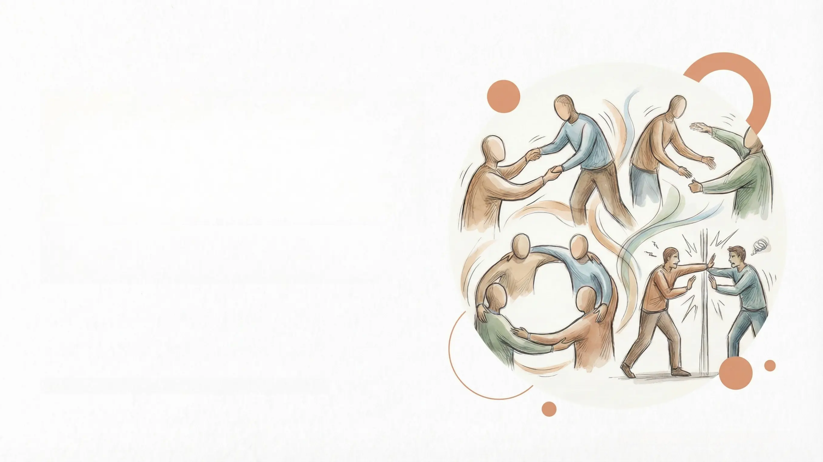
Selatol Psychology:
Prosocial and
Antisocial Behaviour
PSYCH504 - Level 5 Extended
Diploma in Psychology
Level 5 Extended Diploma in Psychology
Preparation Date: 2026-03-04

Slide 2
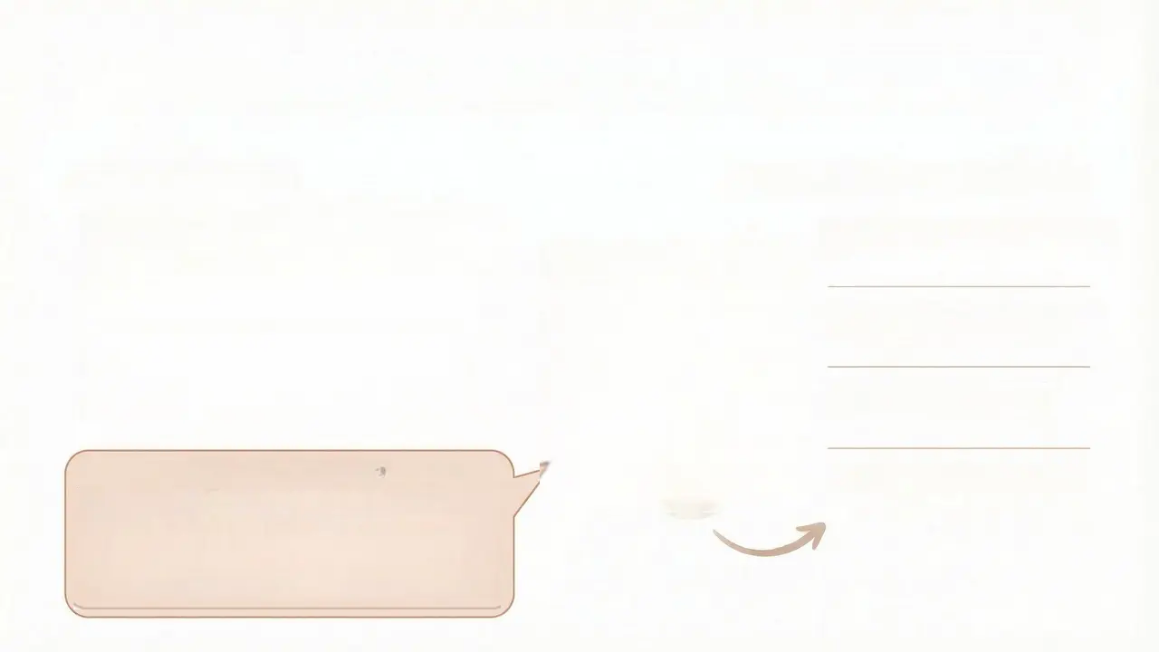





Unit Introduction & Learning Outcomes
Key Unit Objectives
Learning Outcomes (LO1–LO4)
• Understand the psychological mechanisms
behind aggression and antisocial behaviour
LO1: Understand aggression
and antisocial behaviour
• Explore the motivations behind prosocial
behaviour and altruism
LO2: Analyse the effects of
media
• Analyse the influence of media on social
behaviour
LO3: Evaluate classic
research studies
• Evaluate classic studies in social psychology
Why Study This?
LO4: Understand altruism
and bystander behaviour
Understanding the complexities of human nature
and social interactions paves the way for a more
empathetic and understanding society. Studying
these topics equips us with the tools to address
social challenges and promote positive behaviour.

Slide 3



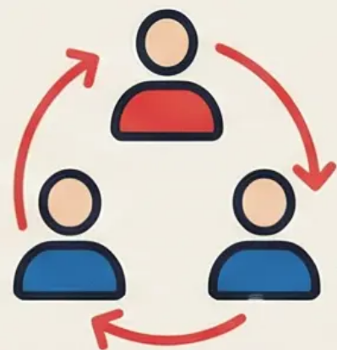
Definition of Aggression & Its Types
Psychological Definition of Aggression
Hostile Aggression
Any form of behaviour directed toward the goal of
harming or injuring another living being who is
motivated to avoid such treatment
Driven by anger and emotion
Example: Losing one's temper in an
argument and punching a wall
Core Components
Instrumental Aggression
Behaviour, not merely an
emotion
A means to achieve another goal
Intentional harm
Example: A child pushing another child
to get a toy
The victim seeks to avoid harm

Slide 4

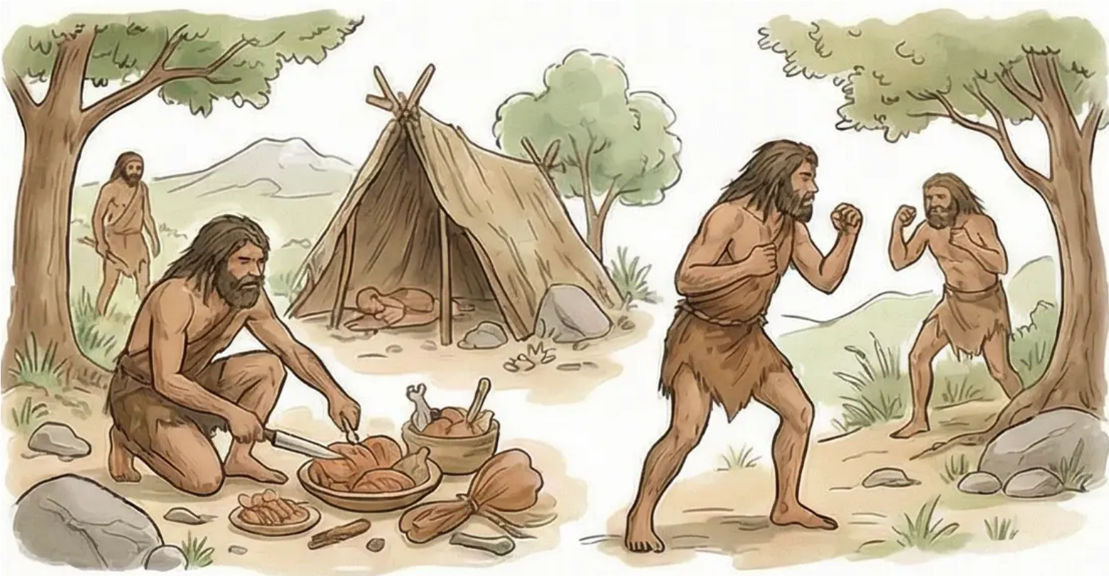
Biological & Evolutionary Perspective on Aggression
Evolutionary Functions of Aggression
• Securing resources and territory
• Establishing social dominance
• Defence against threats
• Protection of offspring and kin
Evolutionary Adaptation
Aggression is not necessarily a
negative behaviour from an
evolutionary perspective — it is an
adaptive mechanism for survival
Individuals who successfully used
aggression were more likely to pass
their genes on to future generations

Slide 5
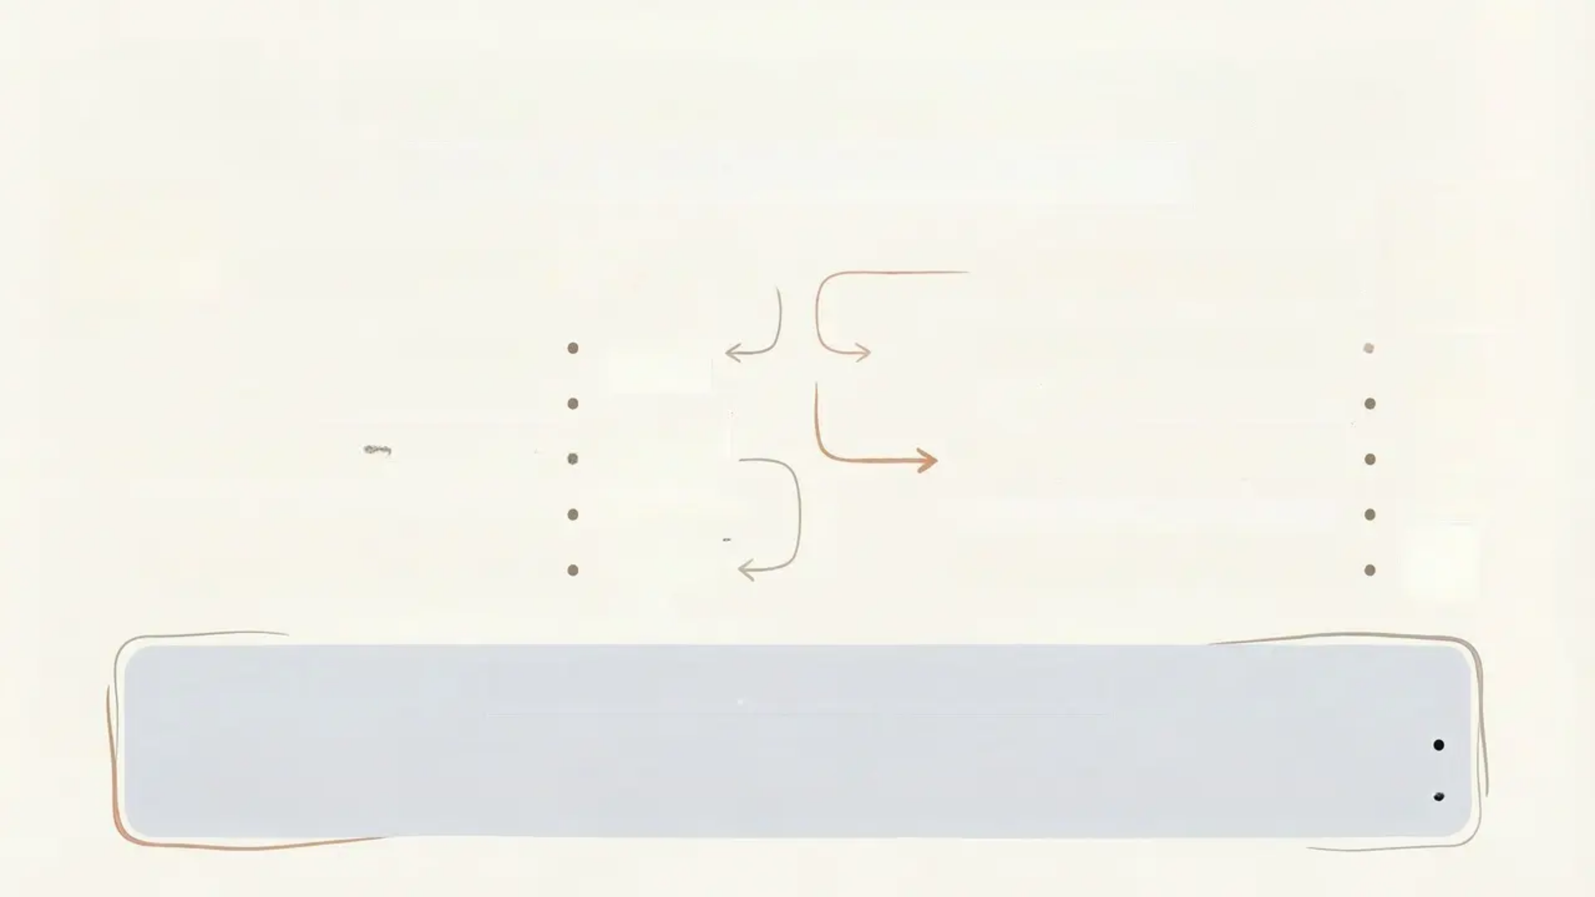
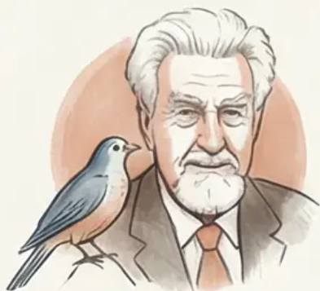
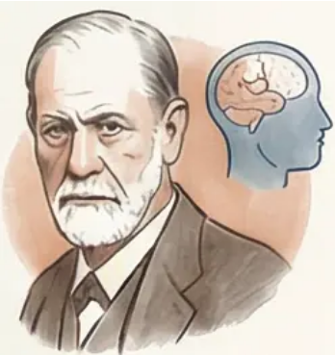
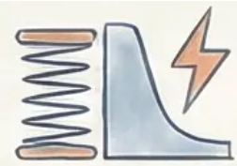
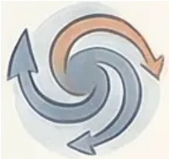
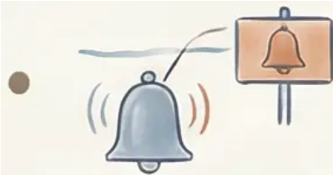
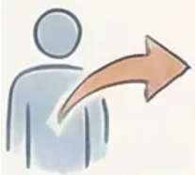
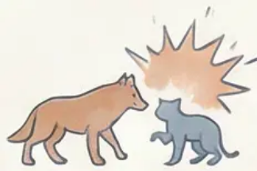

Instinct Theories: Lorenz & Freud
Comparison of Instinctual Theories of Aggression
Konrad Lorenz: The Fighting Instinct
Sigmund Freud: Thanatos
Innate instinct •
Death instinct vs. life instinct (Eros) •
Shared between humans and animals •
Drive toward self-destruction •
Aggressive energy accumulates continuously •
Redirecting destructive energy outward •
Requires release by external triggers/cues •
Aggression as a defensive mechanism for survival •
Adaptive to ensure survival of the fittest •
Internal conflict between life and death •
Scientific Critique of Instinct Theories
Lack of empirical evidence to measure "aggressive energy" •
Ignores the role of learning and social context •
Vast variation in aggression levels across individuals and cultures •
Fails to explain instrumental and calculated aggression •

Slide 6




The Frustration-Aggression Hypothesis
Original Theory (Dollard, 1939)
Berkowitz's Modified Frustration-Aggression Model
Frustration always leads to aggression •
Aggression is always the result of frustration •
Frustration = blocking of goal-directed behaviour •
Frustrating Event
(e.g., Goal Blocked)
Negative Feeling
(e.g., Anger)
Berkowitz's Modifications
Presence of
Aggressive Cues
(e.g., a weapon)
Frustration does not automatically cause aggression •
Creates a state of readiness by producing anger •
Aggression depends on cognitive interpretation •
The presence of environmental cues is important •
→
Aggressive Behaviour
Key Idea: The cognitive interpretation of the situation
determines whether frustration will lead to aggression

Slide 7





Aggressive Cue Theory & The ‘Weapons Effect’
Core Theory:
Environmental cues associated with aggression can
increase the likelihood of aggressive behaviour in
already-aroused individuals
Berkowitz's Modified
Frustration-Aggression Model
Berkowitz & LePage Study (1967):
Participants: Male university students •
Procedure: Deliberate anger arousal, then given •
opportunity to administer electric shocks
Independent Variable: Presence of weapons vs. •
neutral objects
Result: Stronger shocks administered in the •
Key Conclusion:
Weapons do not merely permit
violence – they can also trigger it

Slide 8

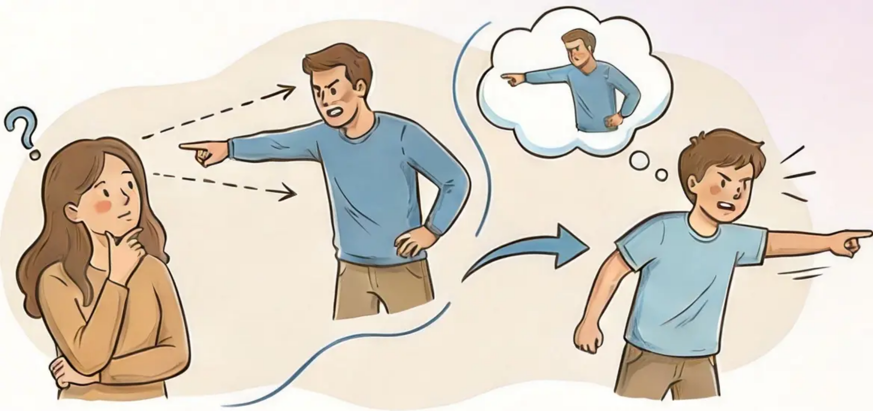



Social Learning Theory (Bandura)
Observational Learning
• Behaviour is acquired through observing others
• Social models influence the formation of behaviour
Imitation is an active cognitive process, not
mechanical
Mechanism of Acquiring
Aggressive Behaviour
Environmental Influences
• Observing the aggressive model
• Storing the behaviour in memory
• Recalling and applying the observed behaviour
• Reinforcement increases the likelihood of
repetition
• Family and School
• Media
• Peer Group
Community Role Models

Slide 9

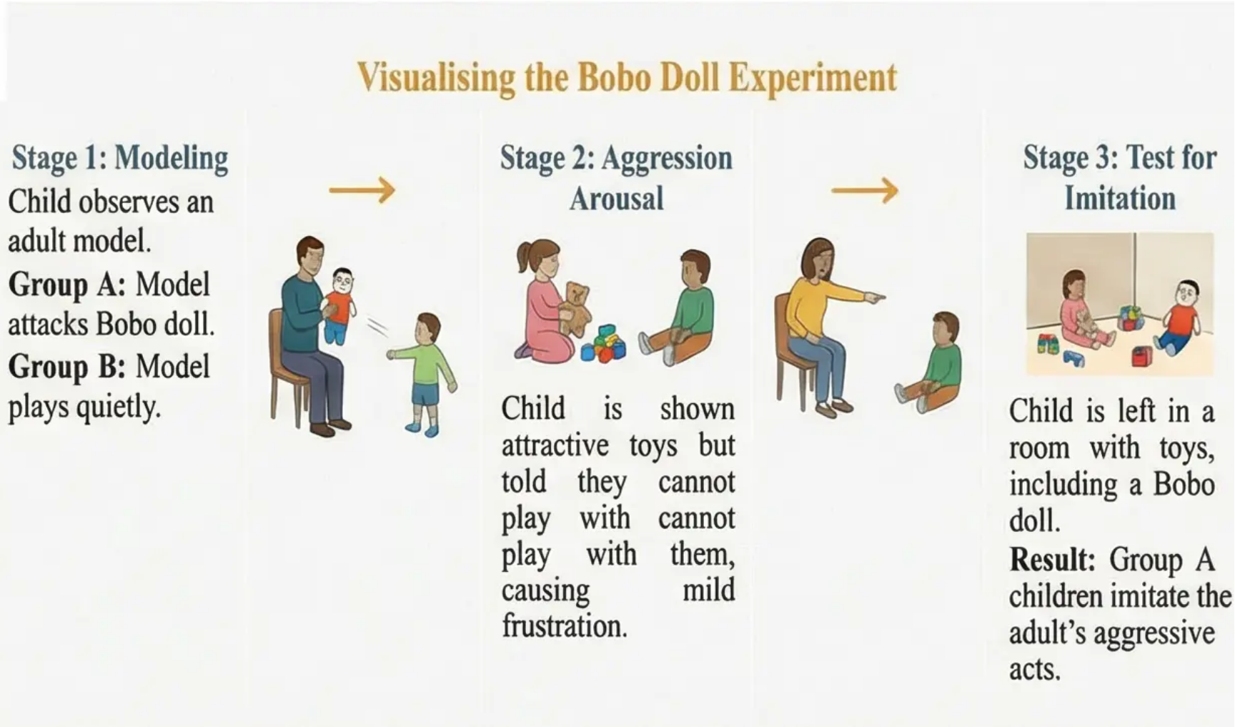
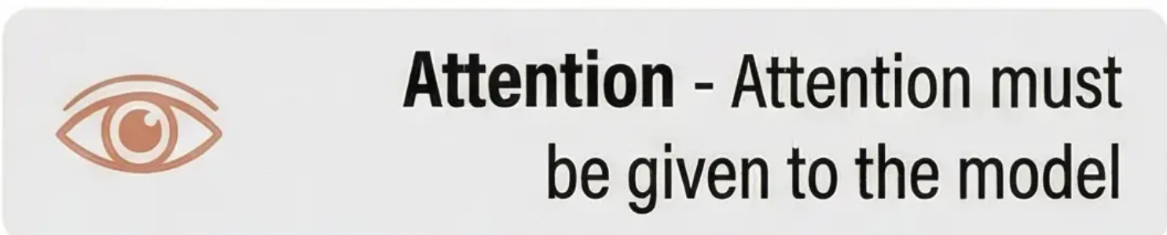
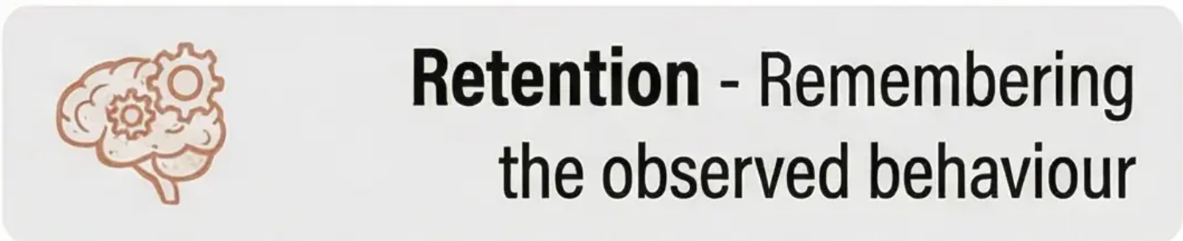
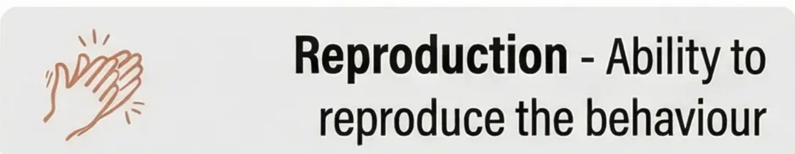
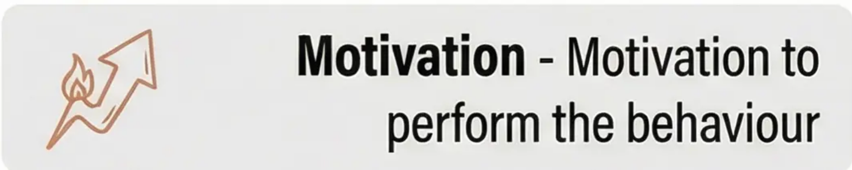
The Bobo Doll Experiment & Cognitive Processes
Results of Bandura's Famous Experiment
The Four Processes of Social Learning
Children who observed the aggressive model
displayed significantly more aggressive behaviour

Slide 10

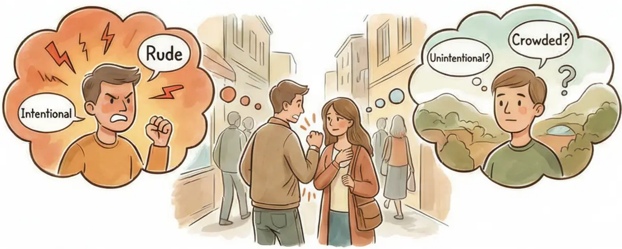
Cognitive Factors: Attribution Theory
What is Attribution?
The process of interpreting the causes
of others' behaviour and
environmental events
• Internal Attribution (Disposition)
– Attributing behaviour to the individual's
personality or intentions
– Example: “He bumped into me because
he's rude”
Impact on Aggressive Behaviour
Internal Attribution →
External Attribution →
• External Attribution (Situational)
❌ Increased anger and
aggression
✔ Reduced aggressive
response
– Attributing behaviour to environmental
factors
– Example: “He bumped into me because of
the crowd”
❌ Stronger retaliatory
response
✔ Increased understanding
and tolerance
❌ Escalation of conflict
✔ Peaceful conflict resolution

Slide 11

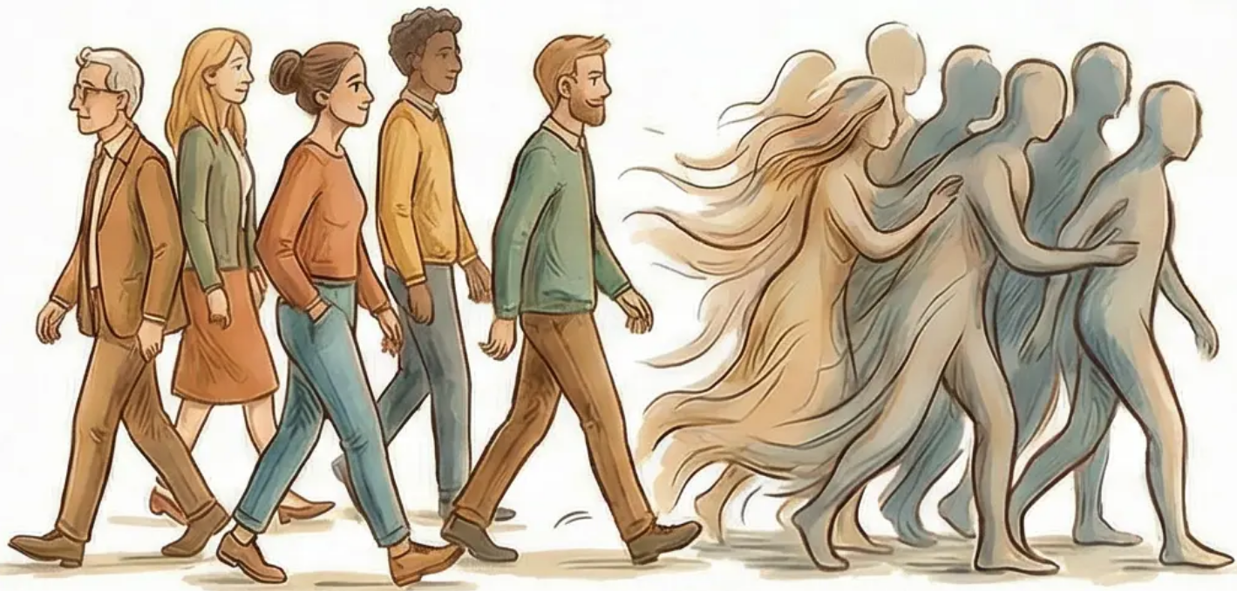
Deindividuation & Crowd Behaviour
Loss of Personal Identity in Group Environments
The Concept of Deindividuation
Contributing Factors
A psychological state characterised by loss of self-awareness •
Anonymity and disguise •
Reduced sense of personal responsibility •
Large crowds and density •
Increased likelihood of impulsive and aggressive behaviours •
Diffusion of responsibility •
Liberation from usual social norms •
High arousal and noise •
In crowds, individuals feel anonymous
and less accountable for their actions.

Slide 12

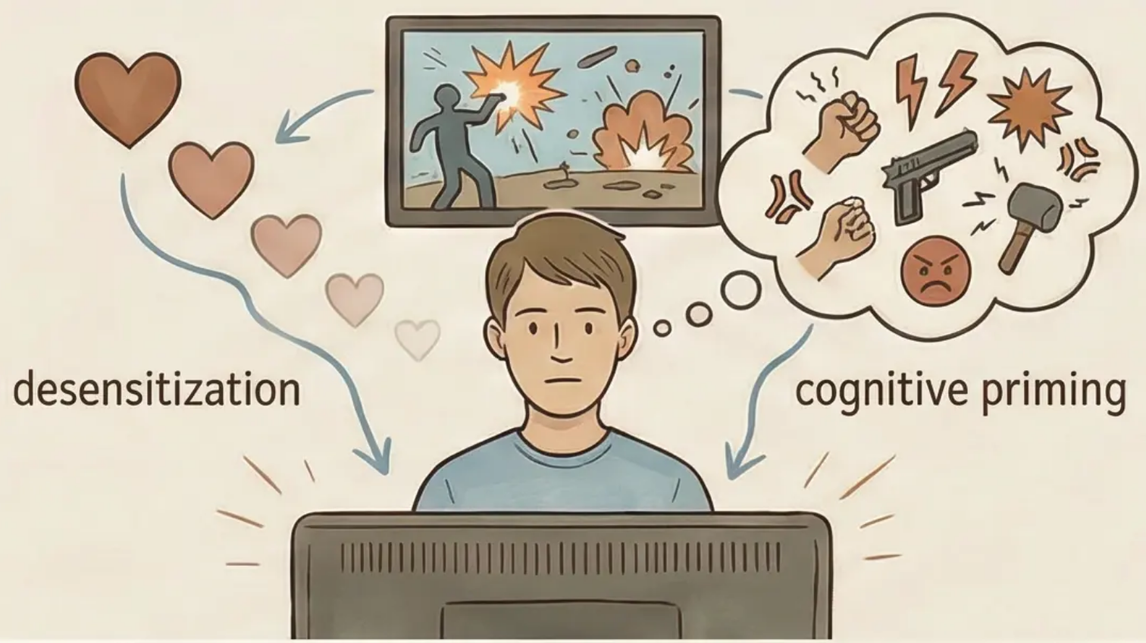
Media Influence on Aggressive Behaviour
Key Psychological Mechanisms
1. Desensitisation:
• Repeated exposure to violence reduces
emotional and physiological responses
• First time vs. hundredth time watching
violence.
2. Cognitive Priming:
• Media violence activates networks of
aggressive thoughts and feelings
• Interpreting ambiguous events in a
hostile manner.
The Causal Challenge
Does media violence cause aggression?
Hypothesis A: Media → Aggression
Hypothesis B: Aggression → Media
(exposure/preference)
Hypothesis C: A third variable affects both
3. Social Learning Theory:
• Media characters as models for aggressive
behaviour
• Vicarious reinforcement when aggression
is rewarded.

Slide 13

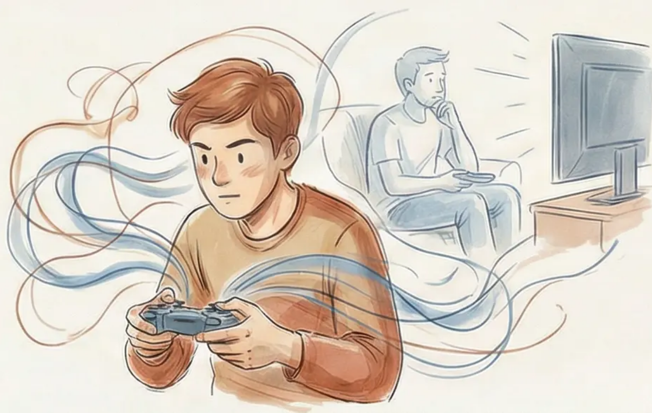
Aggression in the Digital Age & Video Games
Difference Between Traditional Media and
Interactive Games
Passive viewing (TV/films)
Active participation (video games)
Direct and immediate reinforcement
Intensive repetition of aggressive behaviours
Mechanisms of Psychological Impact
Intensive cognitive priming
Reflection Point
Automation of aggressive scripts
Does active participation in virtual violence
differ qualitatively from merely watching it?
Normalisation of violence through repetition
Built-in reward system

Slide 14


The Online Disinhibition Effect
Psychological Factors Behind Digital Aggressive Behaviour
Contributing Factors:
• Anonymity and Invisibility
– Concealment of true identity
– Absence of facial expressions and body language
– Sense of unaccountability
• Asynchronicity
– Indirect communication
– Avoiding immediate reactions
– Ability to ‘escape’ after negative behaviour
• Reduced Social Authority
– Absence of traditional status markers
– Apparent equality among participants
– Weakened social monitoring mechanisms
• Behavioural Outcomes:
– Cyberbullying and persistent harassment
– Trolling and provoking emotional responses
– Disproportionate escalation of conflicts

Slide 15

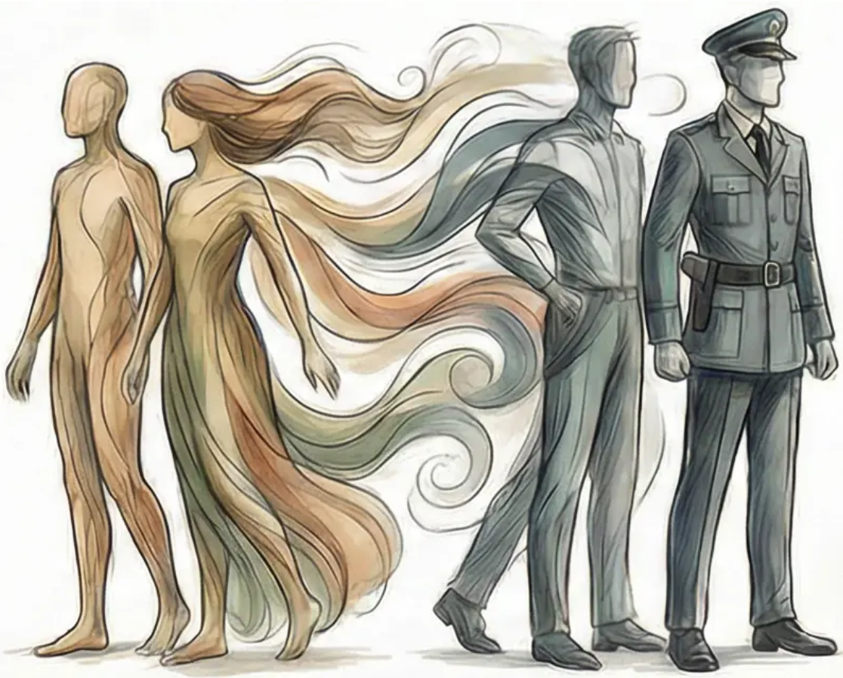
Classic Studies: The Stanford Prison Experiment
The Power of Situation in Transforming Human Behaviour
Zimbardo (1973) – Experimental Design:
Key Psychological Factors:
- 24 emotionally stable university students
- Random assignment: 'guard' or 'prisoner'
- Mock prison at Stanford University
Deindividuation
- Uniform and sunglasses
- Loss of personal identity
- Planned duration: two weeks
- Reduced sense of responsibility
Shocking Findings:
Power of Social Roles:
- The study was stopped after only 6 days
- Guards adopted sadistic behaviours
- Rapid conformity to role expectations
- Legitimisation of authoritarian behaviour
- Prisoners became passive and distressed
- Loss of personal identity
- Environmental influence on personality
Ordinary people can be transformed into perpetrators
of cruelty when placed in situations that encourage it.

Slide 16

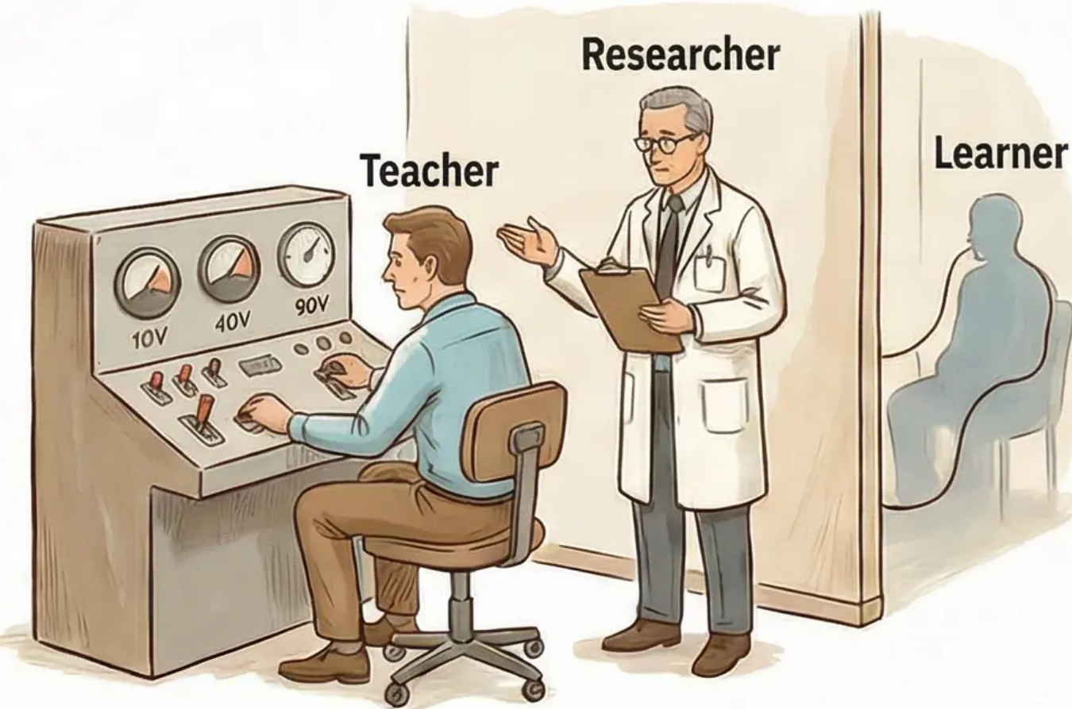
Classic Studies: Milgram’s Obedience Experiment
Experimental Setup
Participants believed they were taking part in a study •
on memory and learning
Played the role of “teacher” administering (fake) •
electric shocks for wrong answers
Shocks ranged from 15 to 450 volts •
“Authority figure” was a researcher in a lab coat (to •
confer legitimacy)
Astonishing Findings
Lessons Learned
65% of participants administered the “full shock” •
(450 volts)
The power of obedience to legitimate authority •
Ordinary people are capable of cruel acts •
The importance of social context in shaping •
behaviour
The experiment raised ethical questions about •
psychological research
Prior expectation: fewer than 1% would reach this •
level
Participants showed signs of severe distress but •
continued to comply

Slide 17

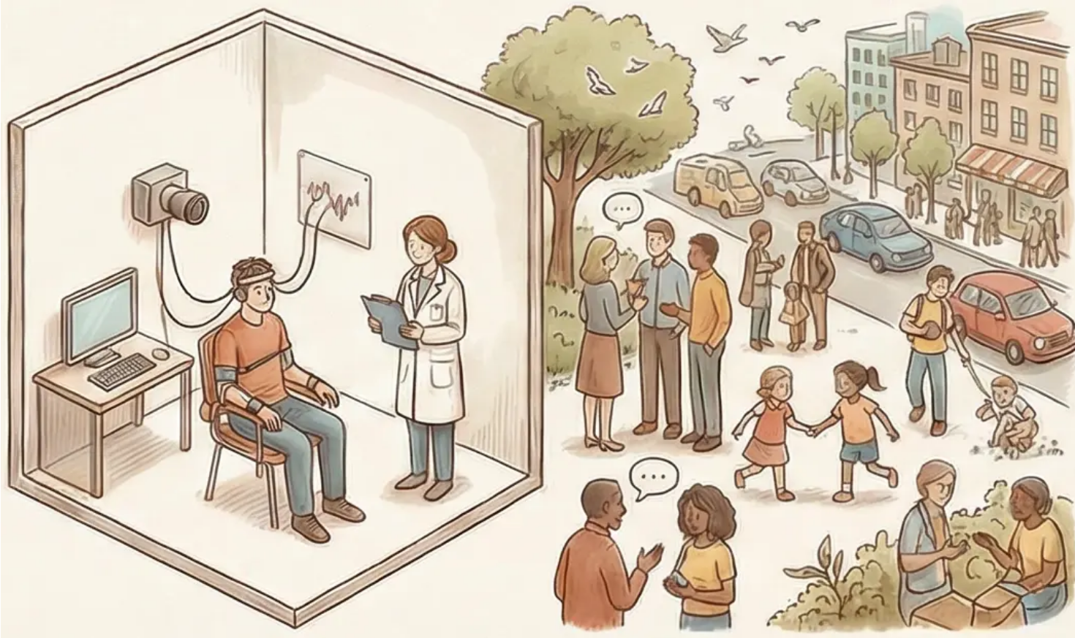
Critical Evaluation & Research Ethics
Problems of Validity and Generalisation
Key Ethical Challenges
• Ecological Validity: Do laboratories reflect real life?
Ethical Constraints: Inability to create situations of
real harm
• Demand Characteristics: The effect of participants'
expectations on behaviour
Informed Consent: Did participants understand
the nature of the experiment?
• Operationalisation: Measuring ‘aggression’ in a
laboratory setting
Right to Withdraw: Protecting participants from
psychological pressure
• Generalisation Problem: From
Bobo doll to real-world
violence
Psychological Harm: Balancing
scientific knowledge against
participant wellbeing
Do our laboratory studies
explain real human behaviour?

Slide 18


Introduction to Prosocial Behaviour & Altruism
Prosocial Behaviour
True Altruism
Any act intended to benefit
another person, regardless of
motivation
Pure helping based on empathy
without expectation of any
reward
• Helping for various reasons
• Gaining social rewards
• Avoiding feelings of guilt
• Moral duty
• Motivation: Pure empathy
• Goal: Alleviating others'
suffering
• Without expectation of reward
• Bearing personal cost
Does true altruism exist, or does all helping ultimately serve self-interest?

Slide 19

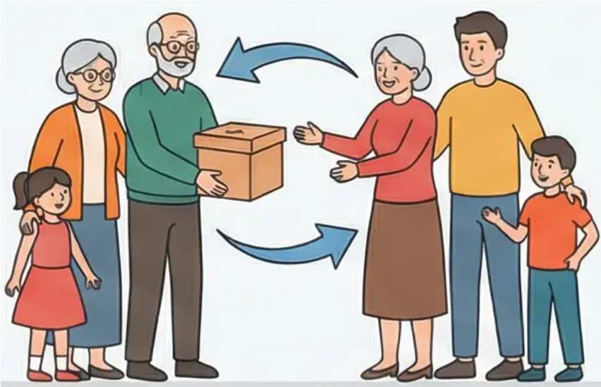

Theories of Helping: Evolution & Social Exchange
Evolutionary Perspective on Helping
Social Exchange Theory
• Kin Selection
• Minimax Principle: Maximising rewards and
minimising costs
○ Helping genetic relatives to ensure
transmission of shared genes
○ Based on the concept of the “selfish
gene”—self-interest at the genetic level
• External Rewards: Social acceptance and
praise
• Internal Rewards: Self-esteem and the
“warm glow of helping”
• Reciprocity Norm
○ The expectation that help will be returned
in the future
○ A system of mutual cooperation to
enhance survival
• Decision Equation:
Help when rewards outweigh costs

Slide 20

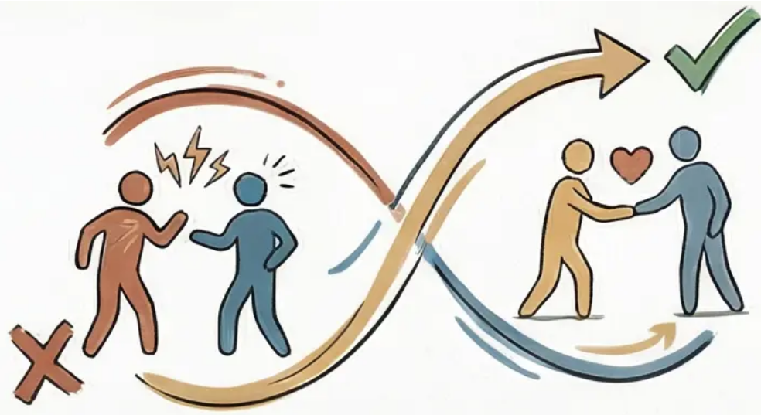
Unit Review & Assessment Requirements
Core Theories Covered
Assessment Requirements
Antisocial Behaviour:
Formative Assessment (800–900 words):
Summative Assessment (2,500–3,000 words):
Prosocial Behaviour:
Your success in this unit depends on
a deep understanding and practical
application of the theories!

