Slide 1

Contemporary
Issues and Debates in
Psychology
PSYCH506
PSYCH506 Unit | Level 5 | 20 Credits
Academic Year 2024–2025 | Department of Psychology

Slide 2

Ethical Guidelines and Professional Codes of
Conduct
Key Professional Bodies
• British Psychological Society (BPS): Founded 1901
• American Psychological Association (APA): Founded 1892
• Both play a vital role in establishing global ethical standards.
The Four Core Ethical Principles
1. Respect (Respect)
2. Competence
(Competence)
3. Responsibility
(Responsibility)
4. Integrity
(Integrity)
Valuing the dignity and
worth of all persons;
emphasis on privacy
and informed consent.
Maintaining high
standards and
continuous professional
development.
Accountability to
clients and the public;
the principle of “do no
harm.”
Honesty, accuracy,
and clarity in all
professional practice.

Slide 3

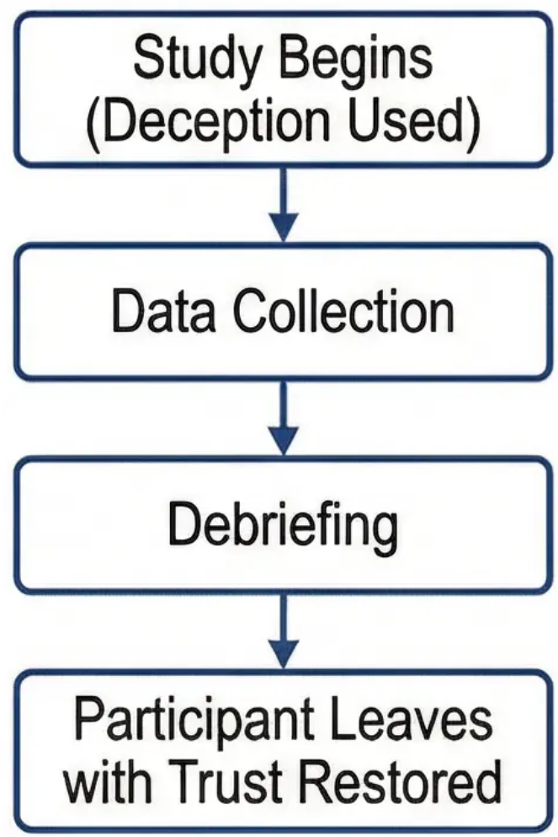
Ethics in Human Research: Consent and Deception
Informed Consent: The Ethical Foundation
The Deception & Debriefing Process
• Fully voluntary participation without coercion.
• Providing comprehensive information about the
study and its risks.
• The right to withdraw at any time without
consequences.
• Clear understanding of procedures and
potential benefits.
When Is Deception Justified?
• Significant scientific value of the research.
• No viable non-deceptive alternatives exist.
• Minimal psychological harm.
• A comprehensive debriefing plan is in place.
Debriefing is the ethical obligation that
makes justifiable deception possible.

Slide 4







Socially Sensitive Research
and the Milgram Case Study
Socially Sensitive Research:
Definition and Examples
Milgram's Study (1963): Key Points
Definition: Studies that have potential social
consequences for participants or the groups
they represent.
Aim: To understand the psychology of
obedience to authority.
Shocking Finding: 65% of participants
obeyed up to the highest shock level.
Examples: Research on intelligence and race,
sexual identity, different parenting styles.
Revelation: The terrifying power of situational
pressure on human behaviour.
The Challenge: Balancing scientific knowledge
against protection from misuse.
Key Ethical Dilemma
Does the profound insight into human nature provided by Milgram's study justify the severe
psychological distress experienced by participants?

Slide 5





Animal Research: Ethics and Debates
Justifications for Using Animals
in Psychological Research
The Core Ethical Debate
• Control of
variables
and the
experimental
environment.
The BPS Three Rs Principles
Replacement
Reduction
Refinement
Using non-
animal
alternatives
wherever
possible.
Minimising
the number
of animals
used.
Improving
procedures
to reduce
suffering.
Does potential scientific
advancement justify animal
suffering?
• Studying biological and
neurological processes.
• Understanding the
evolutionary basis of
behaviour.
• Procedures that cannot
ethically be applied to
humans.
Utilitarian
perspective
Animal rights
perspective

Slide 6





The Diverse Roles and Identity of Psychologists in Society
The Scientist-Practitioner Model: Bridging Scientific Knowledge and Field Practice
Clinical
Psychologist
Academic
Researcher
Teacher and
Trainer
Professional
Consultant
Diagnosis and
psychological treatment
Conducting scientific
studies
Teaching and
knowledge transfer
Applying psychological
principles
Hospitals and private
clinics
Universities and
research centres
Educational institutions
Corporations and courts
The Scientist-Practitioner Model: Integrating Scientific Research with Field Practice

Slide 7

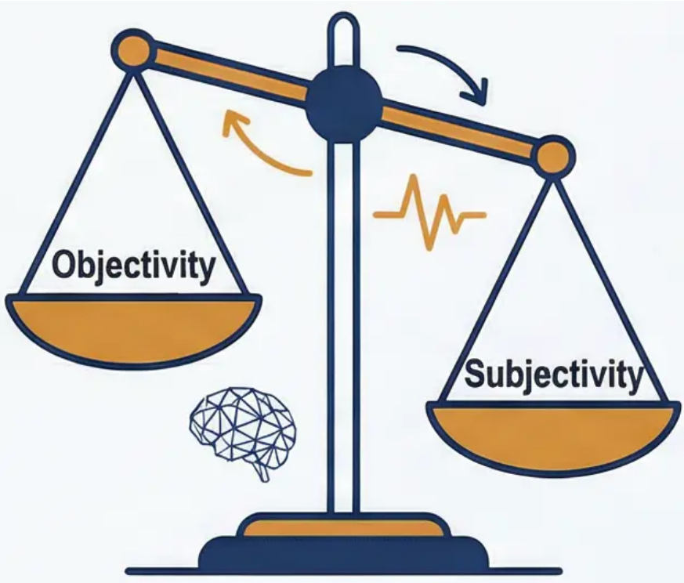
Objectivity vs. Subjectivity in Science
The Scientific Ideal:
Objectivity
The Challenge: Inevitable
Subjectivity
• The scientific method as the
foundation of neutral knowledge.
• Empiricism and objective
measurement.
• Operational definitions and
replicability.
• The pursuit of universal, bias-free
truths.
• The psychological researcher is a
human studying humans.
• The influence of personal values and
cultural experiences.
• Bias at every stage of the research
process.
• The impossibility of absolute
objectivity.
Stages of Subjectivity Infiltration:
1. Choice of research topic → Reflects the researcher's interests.
2. Design of methodology → Shaped by prior assumptions.
3. Interpretation of findings → Influenced by theoretical orientations.

Slide 8



Moral and Ethical Values in Clinical Practice
Wachtel's Critique of the ‘Neutral Therapist’ Concept
The therapist is not a machine — they are a human being carrying their own moral compass,
cultural background, and ideas about the good life.
• The Impossibility of Complete Neutrality: The therapist's values inevitably influence the therapeutic
process, whether intentional or not.
• Areas of Influence:
• Defining ‘psychological health’ and therapeutic goals.
• Choosing the therapeutic model and techniques.
• Covert reinforcement of desired behaviours.
• The Ethical Alternative:
• Self-awareness of personal values and biases.
• Transparency with clients about the therapeutic approach.
• Prioritising the client's values over the therapist's own.

Slide 9


Power Imbalances and the Social Responsibility
of Psychologists
Section 1: Power Imbalances
• The therapeutic relationship is inherently unequal.
• Sources of the psychologist's power:
• Specialist expertise and scientific knowledge.
• Professional authority and recognised qualifications.
• The client's vulnerability and need for help.
Section 2: Risks of Dual Relationships
• Definition: The simultaneous existence of a professional relationship and another type of relationship.
• Dangerous examples:
• Social relationships with clients.
• Business or financial partnerships.
• Romantic relationships (a serious ethical violation).
The Golden Rule: Avoid dual relationships wherever possible to protect the client from exploitation.
Section 3: Social Responsibility
• The broader role of psychology in society:
• Advocating for mental health policies.
• Public education and combating misinformation.
• Socially meaningful research.
• Community psychology and preventive interventions.

Slide 10




Gender Bias in Psychological Research and Theory
The Problem of ‘Androcentrism’
in Psychology
Types of Gender Bias
Alpha Bias
• Male researchers have dominated
the discipline for long periods.
• Male-only samples used in
foundational research.
• Theories formulated on the
basis of male experience and
generalised to all.
• Women's experiences and
psychological needs neglected or
marginalised.
• Exaggerating differences between the sexes.
• Presenting differences as fixed and biologically
determined.
• Reinforcing traditional gender role stereotypes.
• Example: Freud's theory of women's 'weaker moral
conscience' compared to men, treating femininity as a
deviation from the male norm.
• Minimising or ignoring differences between the sexes.
• Assuming findings derived from males automatically
apply to females.
• Ignoring women's different social and biological contexts.
• Example: Early research on the 'fight-or-flight' stress
response, conducted exclusively on male animals and
humans, ignoring the 'tend-and-befriend' response more
common in females.
Beta Bias

Slide 11

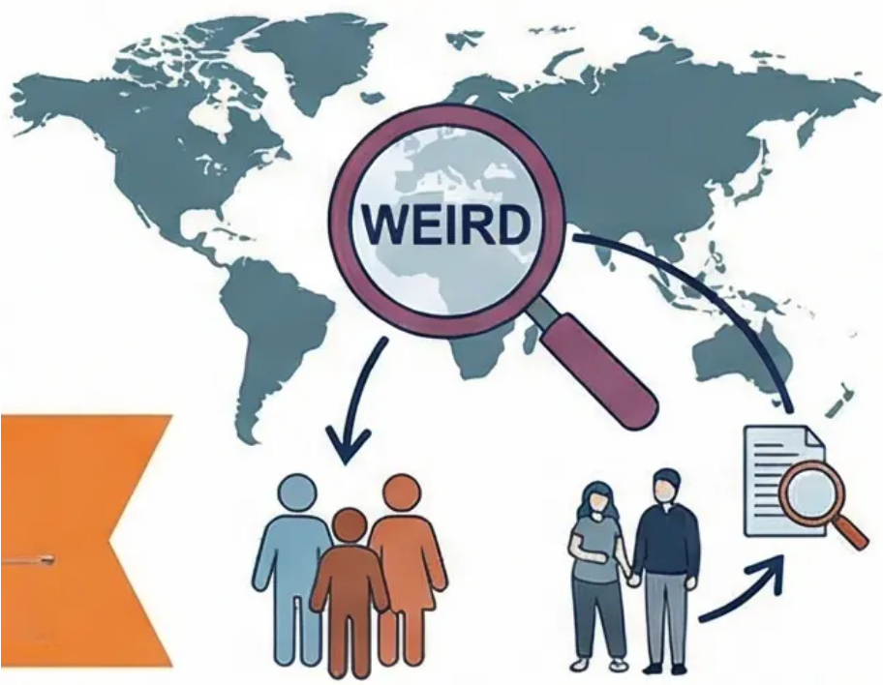







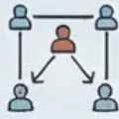
Cultural Bias and the Problem of ‘WEIRD’ Samples
Ethnocentrism
The Problem of WEIRD Samples
• Definition: The belief that
one's own culture is the
standard by which other
cultures are judged.
WEIRD stands for:
• W: Western
• E: Educated
• I: Industrialised
• R: Rich
• D: Democratic
• Example: The concept of
intelligence across
different cultures.
Key statistic: WEIRD individuals
represent less than 12% of the
world's population, yet account for
over 90% of research participants.
Comparing Research Approaches
Etic Approach (Universal)
Emic Approach (Culture-Specific)
• Seeks universal behaviours.
• Applies theories across cultures.
• Risk of ‘imposed etic’ (imposing one cultural
perspective on all).
• Example: Ainsworth's Strange Situation.
• Focuses on behaviours specific to a particular
culture.
• Understands culture on its own terms.
• Key benefit: Avoids ethnocentrism.
• Example: Indigenous concepts of mental health.

Slide 12


Researcher Bias Mechanisms and
Open Science
Problems of Research Bias
Open Science Solutions
Confirmation Bias: Seeking information
that confirms our pre-existing hypotheses.
Pre-registration: Publishing hypotheses and
the analysis plan before data collection.
Publication Bias: Journals favour positive
results over negative ones.
Data Sharing: Making raw data available
to other researchers.
The File Drawer Problem: Negative studies
remain unpublished.
Independent Replication: Re-running
studies to verify findings.
Funding Effect: Research findings tend to
favour the funding body.
Open Peer Review: Transparency in the
research evaluation process.
Open Science aims to make research
more transparent and trustworthy.

Slide 13

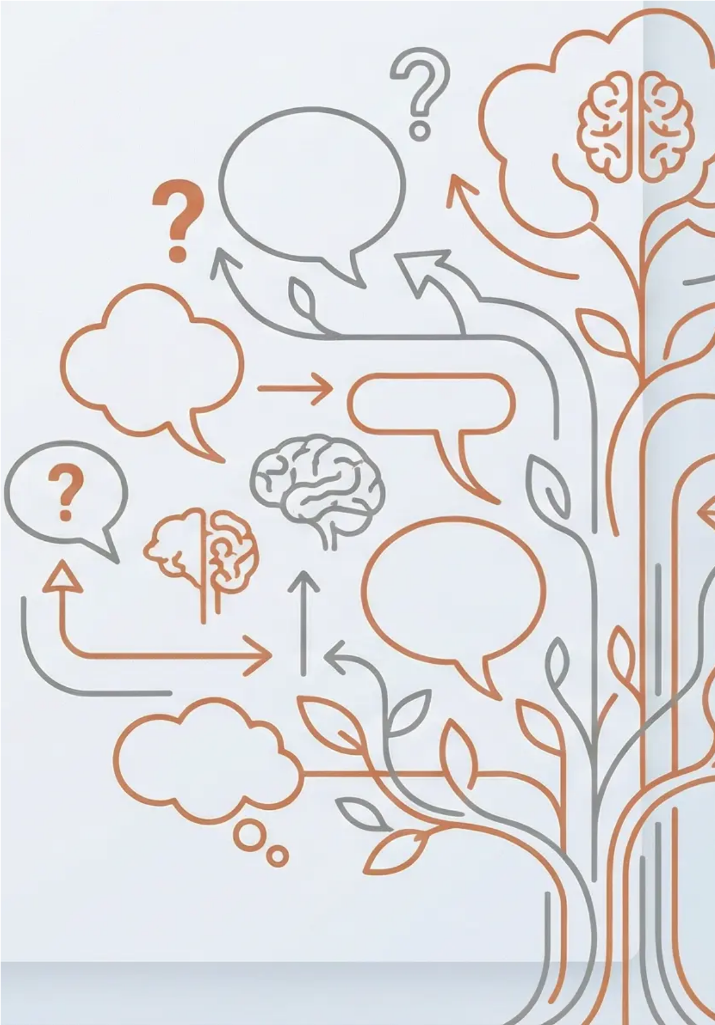
The Importance of the Great Debates in the
Development of Psiology
Debates as a Sign of
Health
How Debates Drive
Science Forward
• Ongoing discussions indicate
the vitality of the spalein field.
• They force reseuchers to develop
more nuanced and complex theories.
• Stagnant fields do not raise eew
questions or challenge their
assumptions.
• They stimulate the inovation of
new research methods to test
competing hypotheses.
• Creative tension generates new
discoftefies.
• They reveal gaps in
current knowledge
A field without debates is an intellectually stagnant field.
Lively discussions are a sign of a healthy and evolving science.

Slide 14
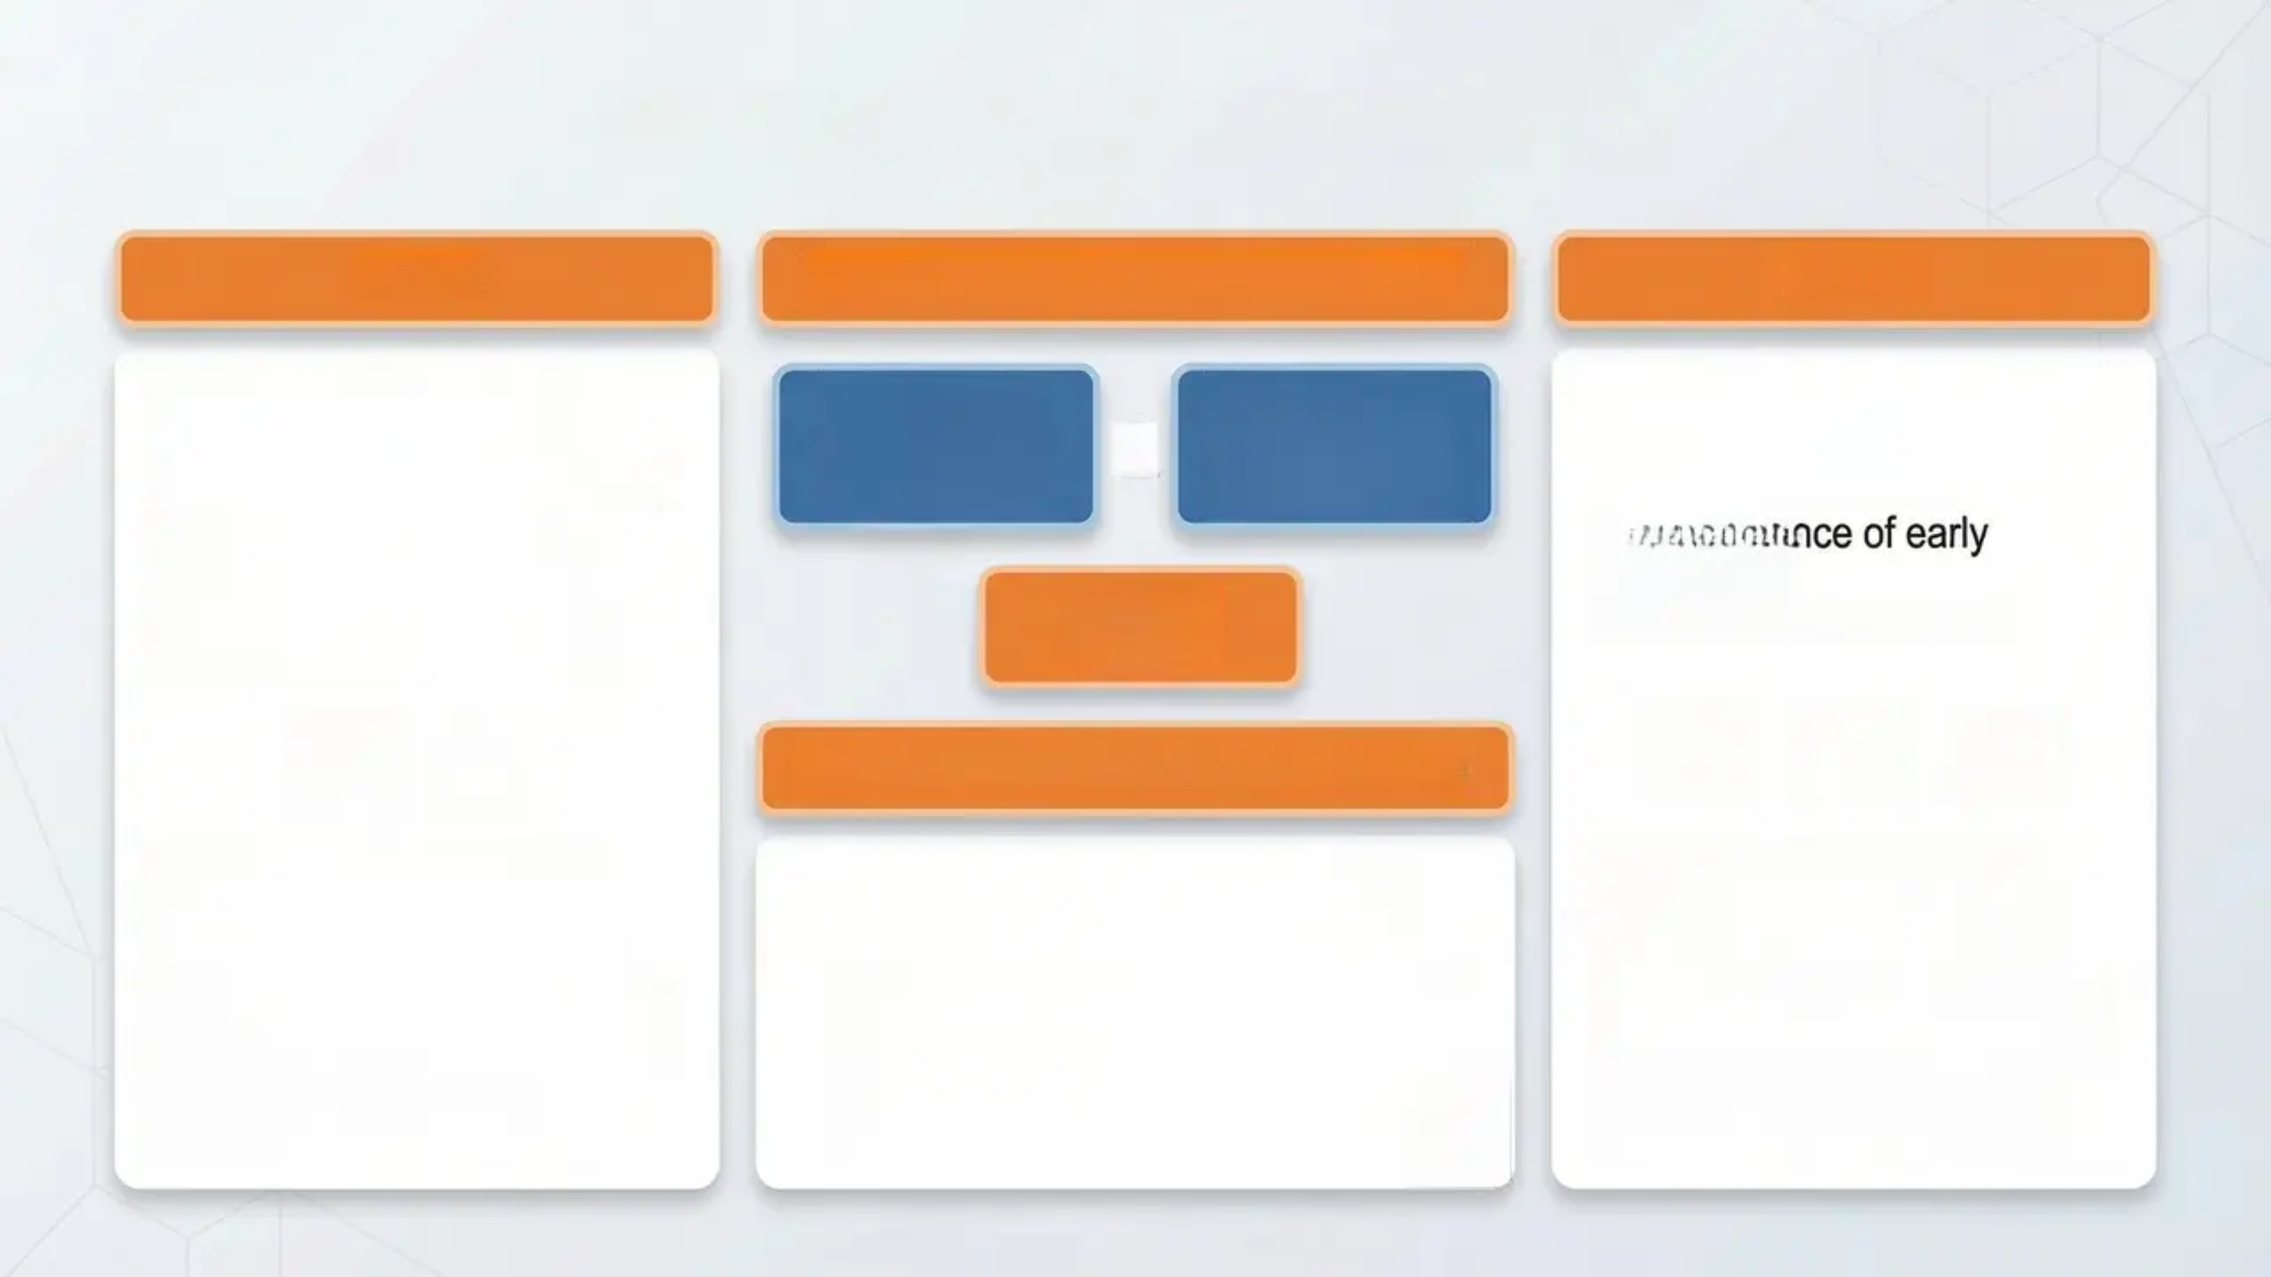









Debate 1: Nature vs. Nurture
Nature
Modern Interactionist Approach
Nurture
• Genetic and hereditary
predisposition.
• Identical and fraternal twins.
• Adoption and heritability
studies.
• The biological blueprint of
behaviour.
Genetic
Vulnerability
(Diathesis)
Environmental
Trigger
(Stress)
• Environmental and acquired
experiences.
• Social learning and culture.
• The influence of early
childhood.
• Socioeconomic factors.
Disorder
Develops
Epigenetics: The Synthetic Solution
Key Evidence for Nature:
Key Evidence for Nurture:
How the environment influences
gene expression.
• Altering the 'programming' of genes
without changing DNA.
• Transmission of environmental
effects across generations.
• Heritability of intelligence:
approximately 50%.
• Similarity of identical twins in
traits.
• Genetic predispositions to
psychological disorders.
• Brain plasticity and neural
adaptation.
• The influence of the prenatal
environment.
• The power of learning and
behavioural adaptation.

Slide 15

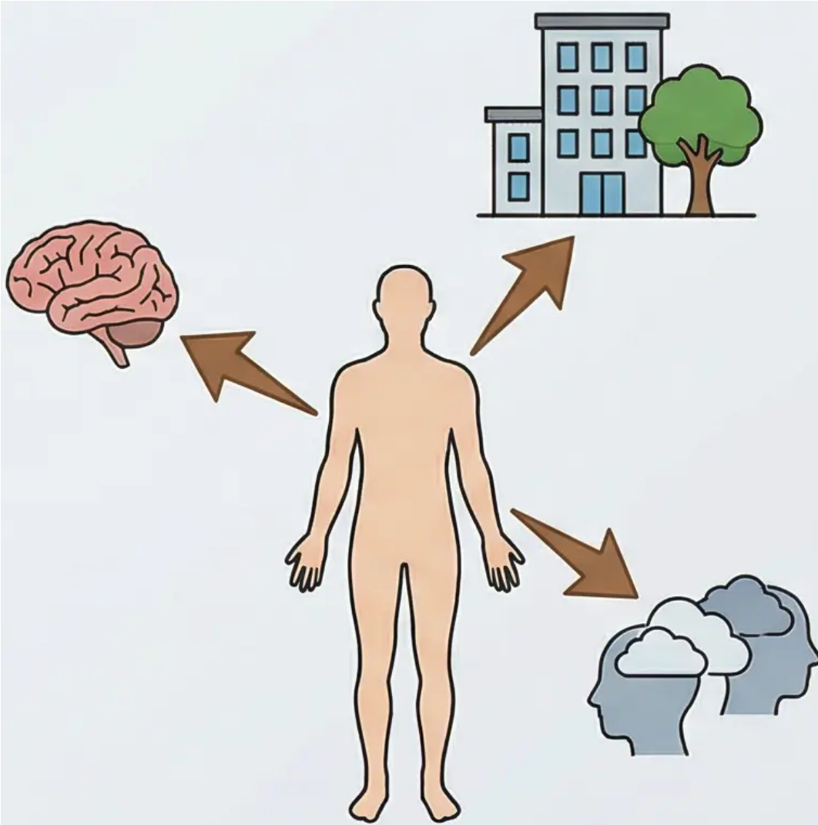
Debate 2: Free Will vs. Determinism
Free Will
Determinism
• We are free to choose our
thoughts and actions.
• We can transcend other
forces to act as we wish.
• The Humanistic Approach:
Carl Rogers and Abraham
Maslow.
• All behaviour results from prior,
predictable causes.
• Biological Determinism: Genes
and brain chemistry.
• Environmental Determinism:
Learning and reinforcement
(Skinner).
• Psychic Determinism: The
unconscious and childhood
(Freud).
Soft Determinism: Our behaviour is influenced by various factors, but we
retain a degree of freedom within these constraints.

Slide 16
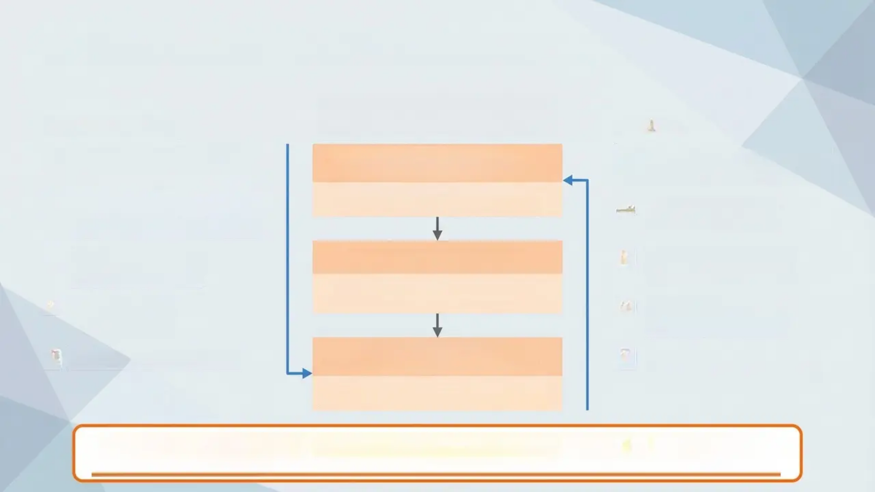








Debate 3: Reductionism vs. Holism
The Reductionist Hierarchy
in Psychology
Reductionism
Holism
Explaining behaviour through
its smallest components.
Social and Cultural Explanations
[The highest level (most holistic)]
Understanding humans as an
integrated being.
Example: Explaining behaviour through
cultural norms or social pressure.
Biological and neurological
processes.
Social and cultural
context.
Genes and
neurotransmitters.
Psychological Explanations
Complete subjective
experience.
Example: Explaining behaviour through
cognitive processes or learning history.
Basic learning
mechanisms.
Interaction between
different factors.
Biological Explanations
[The lowest level (most reductionist)]
General scientific laws.
Meaning and purpose in
life.
Example: Explaining behaviour through brain
structure, neurotransmitters, or genes.
Contemporary Challenge: How do we balance scientific analytical precision with the
richness of human experience?

